Slide 1
Contact Information
Instructor: Stephan Heinemann
SMS: +1 (250) 891-5446
Email: stephanheinemann@flyvfc.com
Bookings, Questions

Slide 2
Take-Off
Definition and Motivation
Take-Offs
  Normal, Short-Field, Soft-Field, Crosswind
  Factors

Slide 3
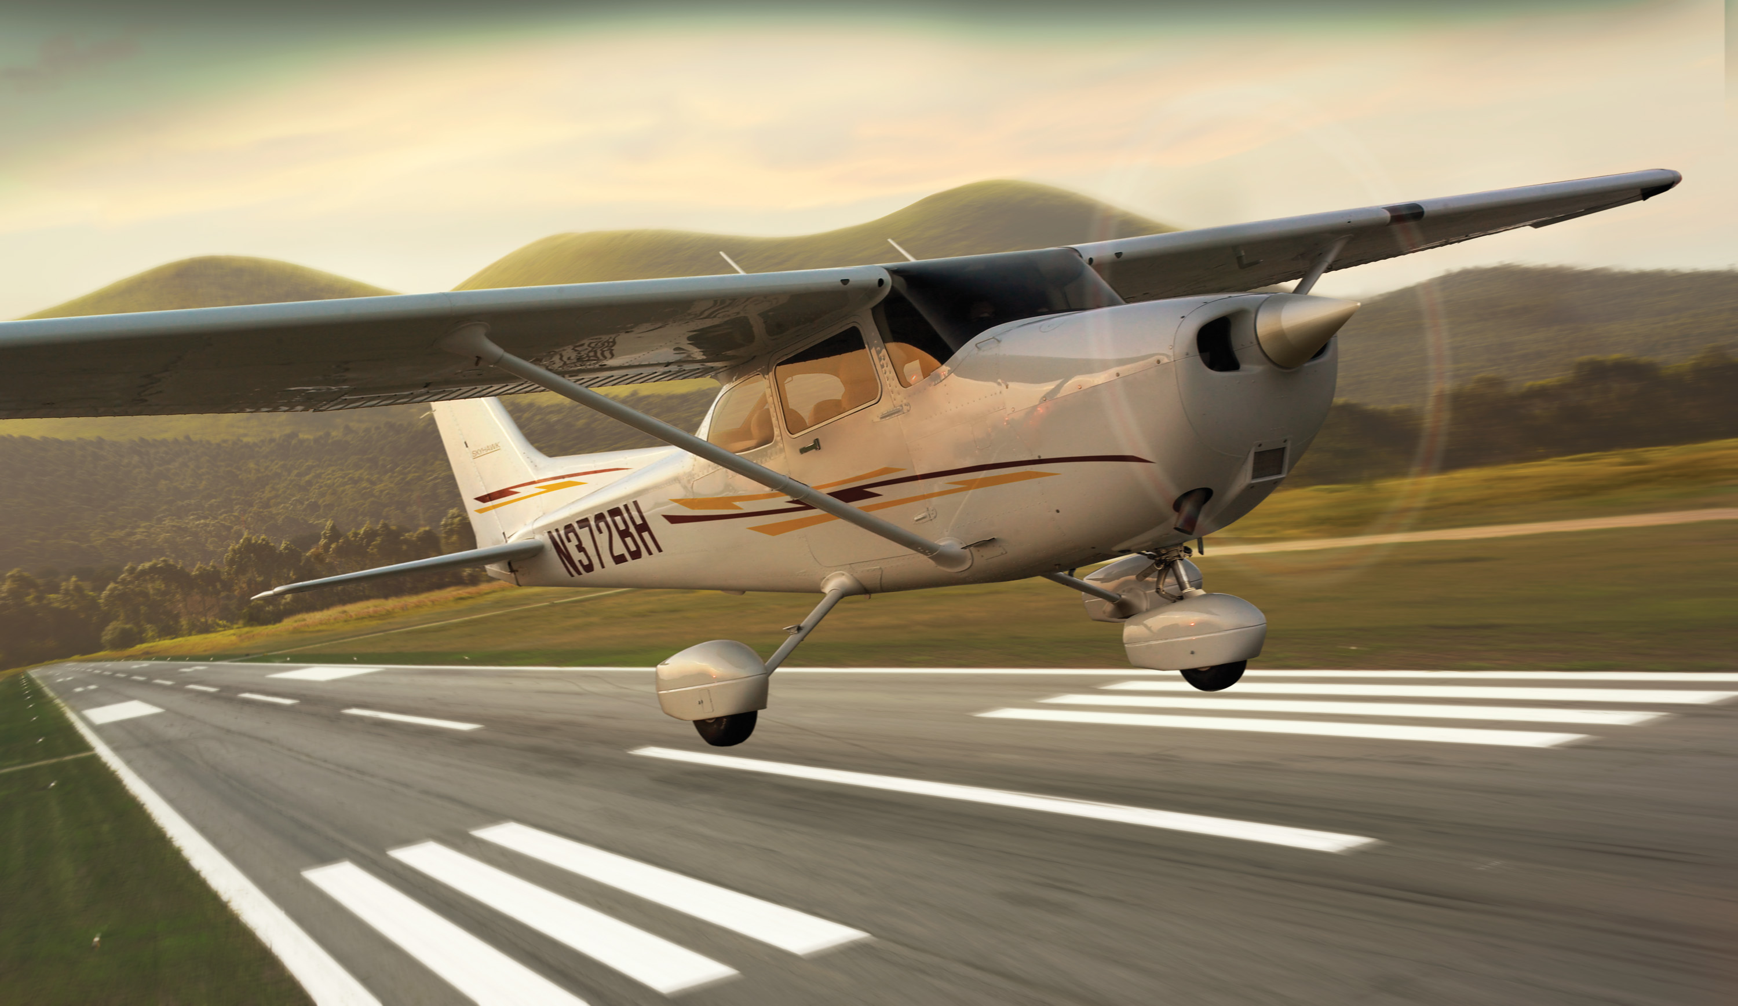
Definition and Motivation
Act of leaving a supporting surface including the immediately preceding and following acts
Leaving the ground and becoming airborne
Essential maneuver used in every single flight

Slide 4
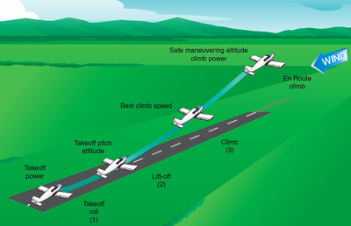
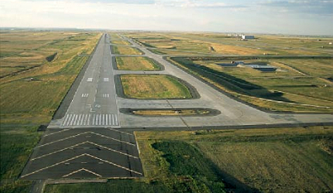
Normal Take-Off
Criteria: hard uncontaminated surface, long runway, no obstacles, low density altitude, no or steady headwind
Check environment and consult performance data in POH
Pre-take-off checks according to checklists in POH
Mixture full rich, lean for maximum RPM above 3000' DA
Passenger, departure and emergency briefings
Notes:
- low density altitude = higher air density
- align with runway centerline / centered nosewheel
- avoid brakes if possible, use rudder for directional control
- outside references (end of runway)
- rpm / airspeed check
- develop feel for the controls
- rotation speed check
- climb speed check
Abort Criteria, Decision Point, Briefings
Departure briefings not necessarily for passengers

Slide 5
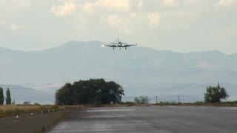
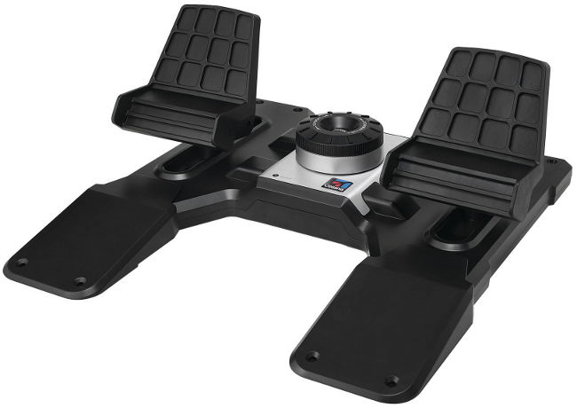
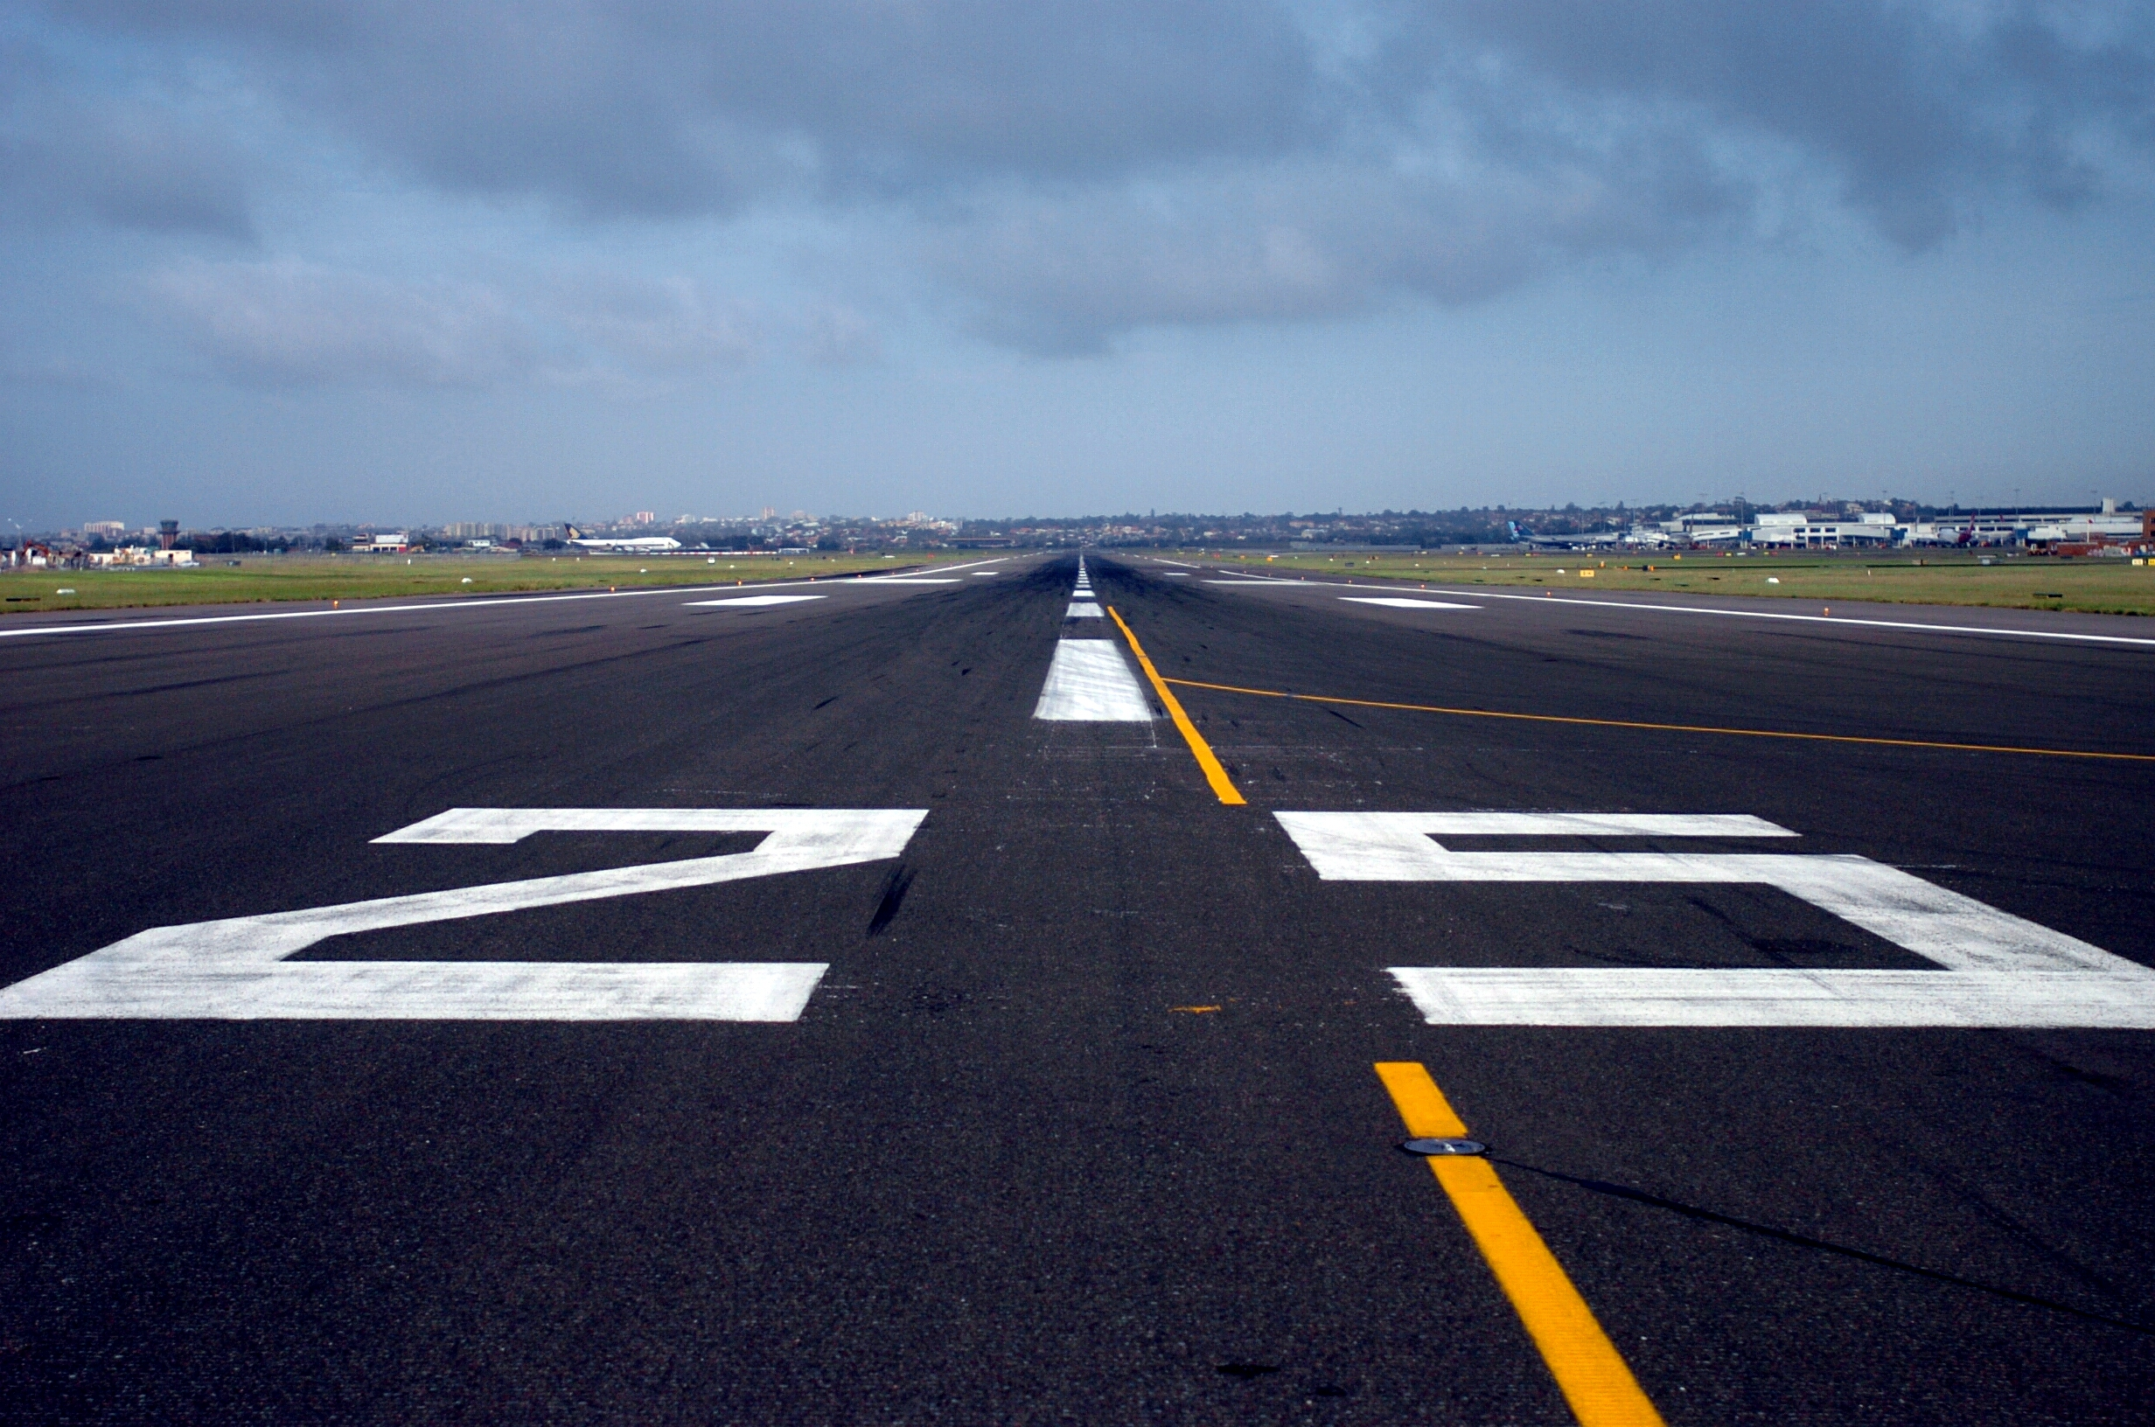
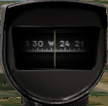
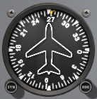
Normal Take-Off – Line Up
Check
Approach Sector
Align
Centerline
Crosscheck
Instruments
Check approach sector and callout Approach Sector Clear
Align with runway centerline using rudder and brakes
Keep nose-wheel centered and stop before take-off run
Crosscheck runway heading, magnetic compass, heading indicator
Notes:
- clearance, transponder, lights, time... (keep it simple)
- sometimes a rolling take-off might be necessary

Slide 6

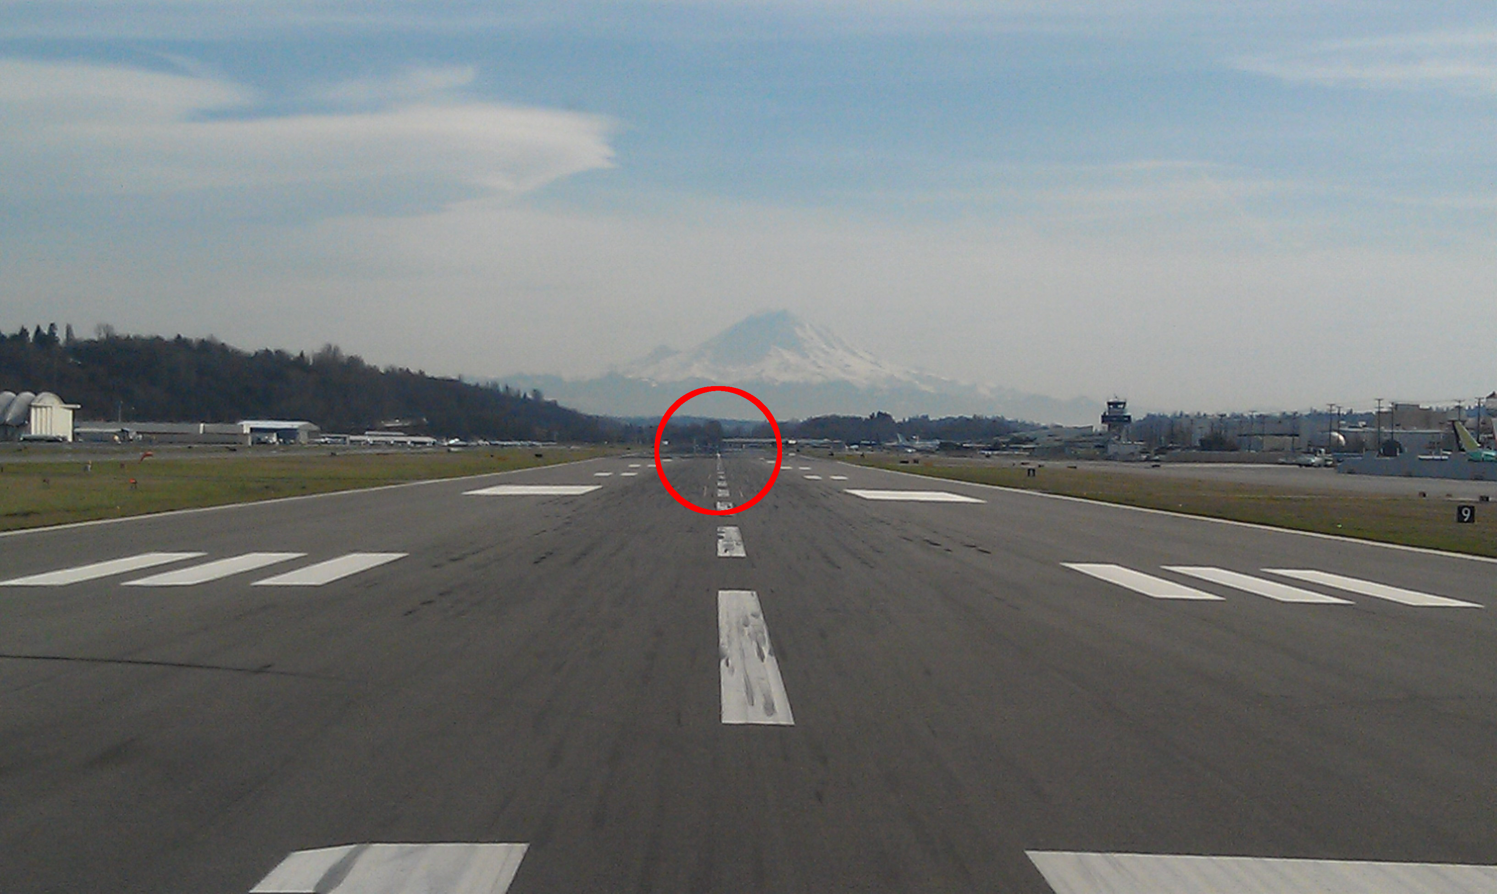

Normal Take-Off – Run
Full
Power
Keep
Straight
Runway End
Lift Off
Callout Take-Off before initiating take-off run
Smoothly apply full power keeping straight with rudder
Use runway end as reference for directional control
Check RPM/ASI and callout RPM Checked, Airspeed Alive
Continue to accelerate to lift-off speed (Vr = 55 KIAS)
Gently apply elevator back-pressure to lift off nose-wheel
Notes:
- keep ailerons and elevator neutral during initial phase
- gradually increase elevator back-pressure to lighten nose-wheel weight

Slide 7
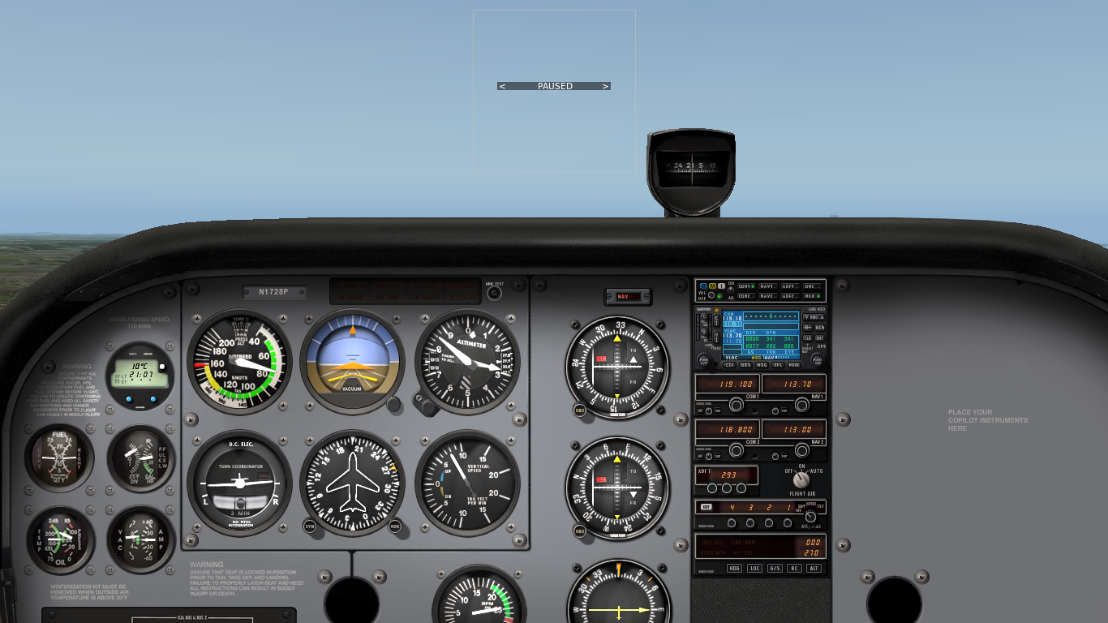
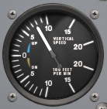
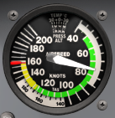
Normal Take-Off – Initial Climb
Adjust Attitude
Positive Rate
Maintain Vy
Vy..80
Control Direction
Check VSI and callout Positive Rate
Accelerate to best rate of climb airspeed (Vy = 74 KIAS)
Adjust and maintain nose-up attitude for airspeed
Trim away elevator forward-pressure as required
Maintain directional control and control yaw with rudder

Slide 8
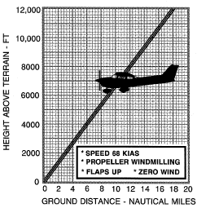
Aborted / Rejected Take-Off
Power Idle
Apply Brakes
Best Glide
Avoid Obstacles
Reasons: failures, traffic, animals, humans
During Take-Off Run: power idle, apply brakes
Immediately after Take-Off: best glide airspeed (68 KIAS), avoid obstacles
Notes:
- V1, TODA, ASDA?

Slide 9
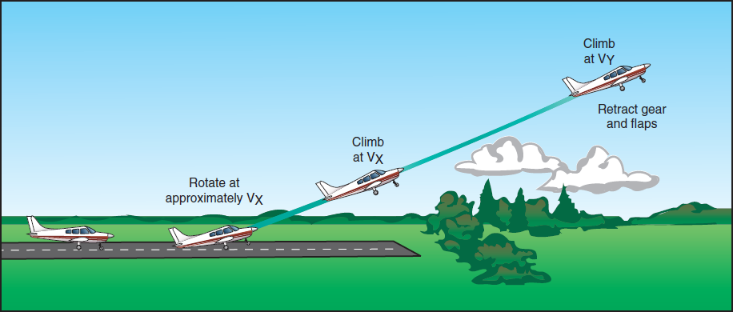
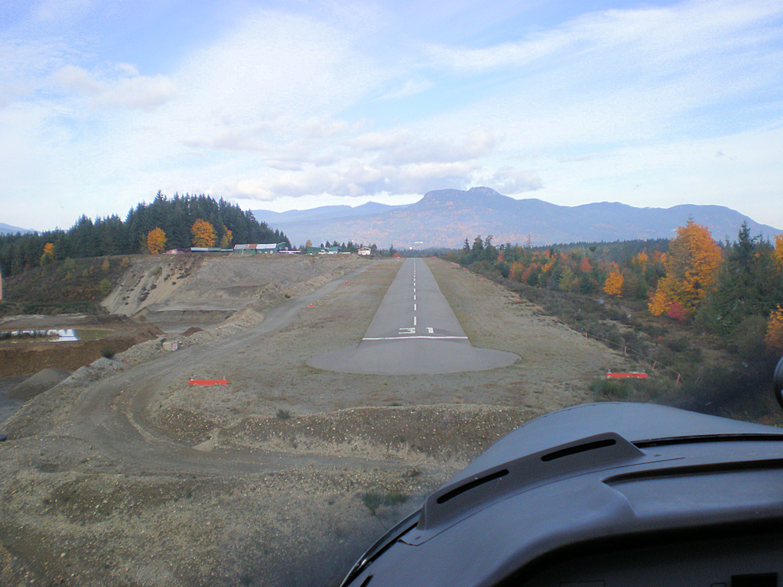
Short-Field Take-Off
Criteria: hard uncontaminated surface, short runway, obstacles, high density altitude, no or steady headwind
Check environment and consult performance data in POH
Pre-take-off checks according to checklists in POH
Mixture full rich, lean for maximum RPM above 3000' DA
Passenger, departure and emergency briefings
Notes:
- high density altitude = lower air density

Slide 10
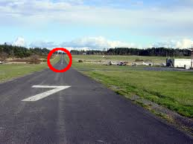
Short-Field Take-Off – Line Up
Check
Approach Sector
Align
Centerline
Crosscheck
Instruments
Check approach sector and callout Approach Sector Clear
Align with runway centerline using rudder and brakes
Keep nose-wheel centered and stop before take-off run
Crosscheck runway heading, magnetic compass, heading indicator

Slide 11

Short-Field Take-Off – Run
Flaps 10°
Hold Brakes
Full Power
Release Brakes
Set flaps 10° apply and hold brakes
Smoothly apply full power and check static RPM (2300-2400)
Callout Take-Off before initiating take-off run
Release brakes
Apply slight elevator back-pressure
Check RPM/ASI and callout RPM Checked, Airspeed Alive
Keep straight with rudder accelerating to lift-off (Vr = 44..51 KIAS)
Slight Back-Pressure
Notes:
- Vr = 44, 48, 51 KIAS depending on weight
- 2300-2400 RPM check POH

Slide 12
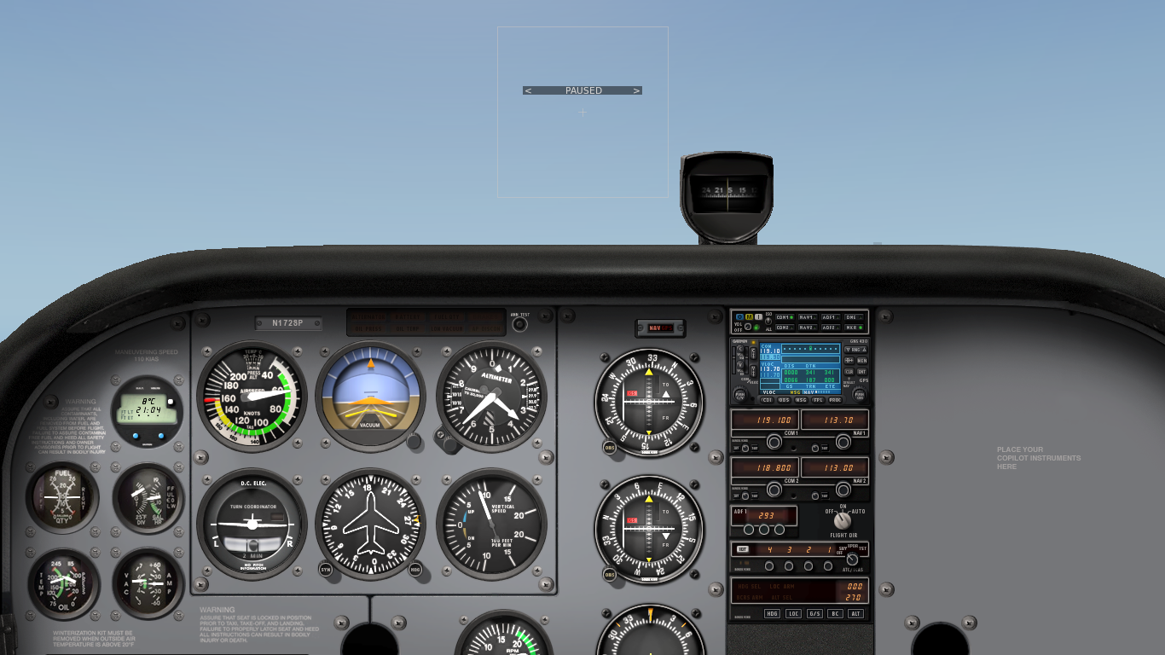
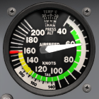
Short-Field Take-Off – Initial Climb
Adjust Attitude
Positive Rate
Maintain Vx
Vx
Clear Obstacles, Vy
Check VSI and callout Positive Rate
Accelerate to best angle of climb airspeed (Vx = 62 KIAS)
Adjust and maintain nose-up attitude for airspeed and trim
Maintain directional control and control yaw with rudder
Accelerate to best rate of climb airspeed (Vy = 74 KIAS) after obstacles cleared and trim
Retract flaps above 500' AGL in white arc
Notes:
Vc = 56 KIAS (with flaps until obstacle clearance)
Look at IAS in POH Vy decreases by 1..2 knots
Vx increases with altitude

Slide 13
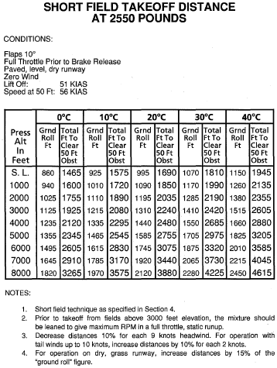
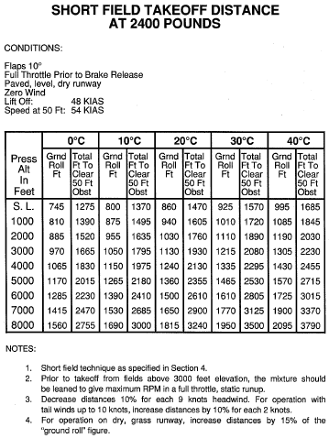
Take-Off Performance
Notes:
- 56 KIAS versus 62 KIAS clean Vx
- aim for Vx, explain if necessary

Slide 14
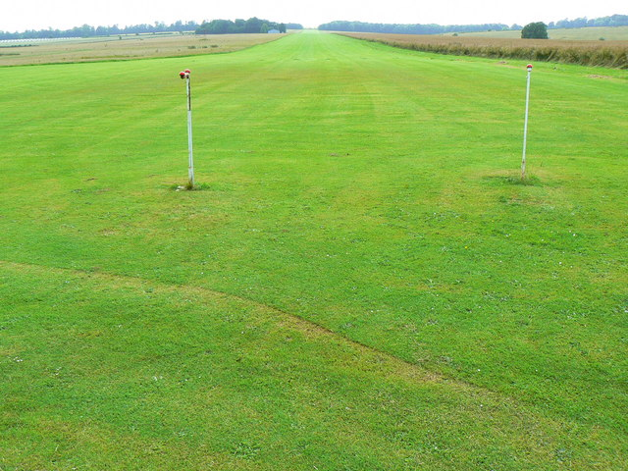
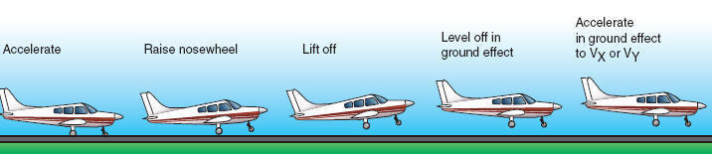
Soft-Field Take-Off
Criteria: soft, rough or contaminated surface, long runway, no obstacles, low density altitude, no or steady headwind
Check environment and consult performance data in POH
Pre-take-off checks according to checklists in POH
Mixture full rich, lean for maximum RPM above 3000' DA
Passenger, departure and emergency briefings
Notes:
Criteria, Procedure, Performance Tables
Surface, Contamination
Ground Effect

Slide 15
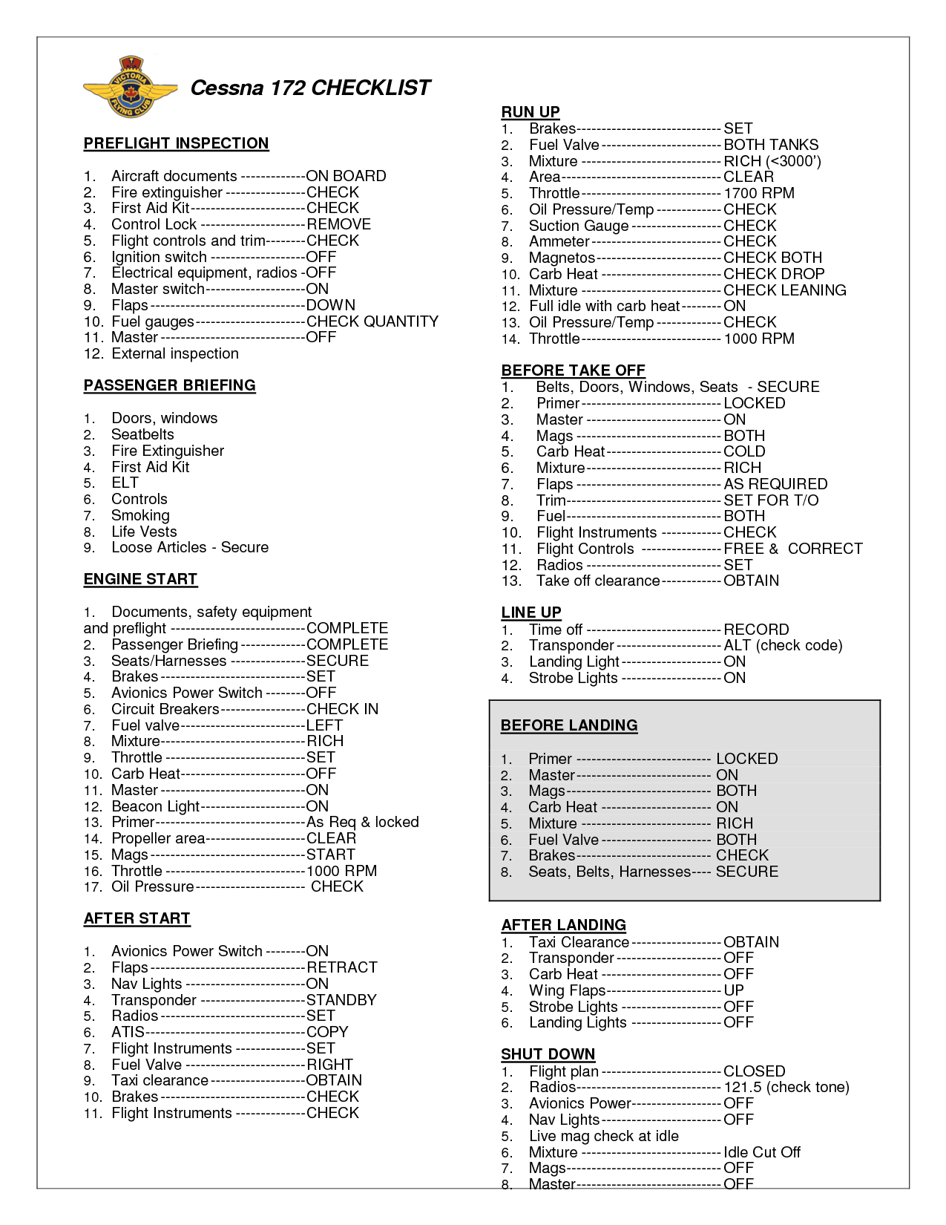


Soft-Field Pre-Take-Off
Checks
Briefings
Mixture
Flaps 10°
Complete pre-take-off checks on supporting surface
Setup aircraft for rolling take-off on soft surface
Departure and emergency briefings, mixture, flaps

Slide 16
Soft-Field Take-Off – Line Up
Relieve Nose-Wheel and Keep Rolling
Check
Approach Sector
Align
Centerline
Crosscheck
Instruments
Apply and hold elevator back-pressure to relieve nose-wheel
Check approach sector and callout Approach Sector Clear
Perform rolling take-off – do not stop after centerline alignment
Crosscheck runway heading, magnetic compass, heading indicator
Notes:
- full back-pressure at the beginning of the take-off roll, lift and keep nose-wheel off the ground
- slightly release back-pressure to improve forward visibility
- keep straight with rudder
- immediately after lift off, lower nose and stay in ground effect
- accelerate for climb (62 KIAS / 74 KIAS)

Slide 17
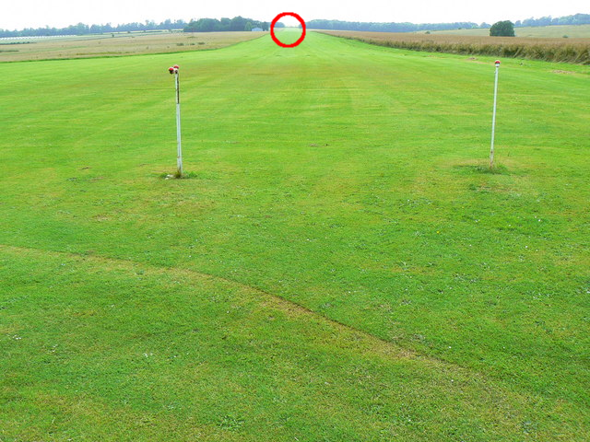
Soft-Field Take-Off – Run
Full
Power
Keep
Straight
Lift Off
Runway End
Callout Take-Off before initiating take-off run
Smoothly apply full power keeping straight with rudder
Use runway end as reference for directional control
Apply slight elevator back-pressure to raise nose-wheel
Check RPM/ASI and callout RPM Checked, Airspeed Alive
Lift off at slowest speed possible commensurate
Notes:
Accelerate in ground effect to best angle or rate of climb (Vx = 62 KIAS, Vy = 74 KIAS)
Peripheral view, nose-up attitude and visibility
(Vr = 43 KIAS) different rotation speeds

Slide 18
Soft-Field Take-Off – Initial Climb
Level-off and remain in ground effect after lift-off
Accelerate in ground effect to desired climb airspeed (Vx, Vy)
At best angle of climb (Vx = 62 KIAS) transition into climb and
Accelerate to best rate of climb (Vy = 74 KIAS)
Retract flaps in white arc when above 500' AGL

Slide 19
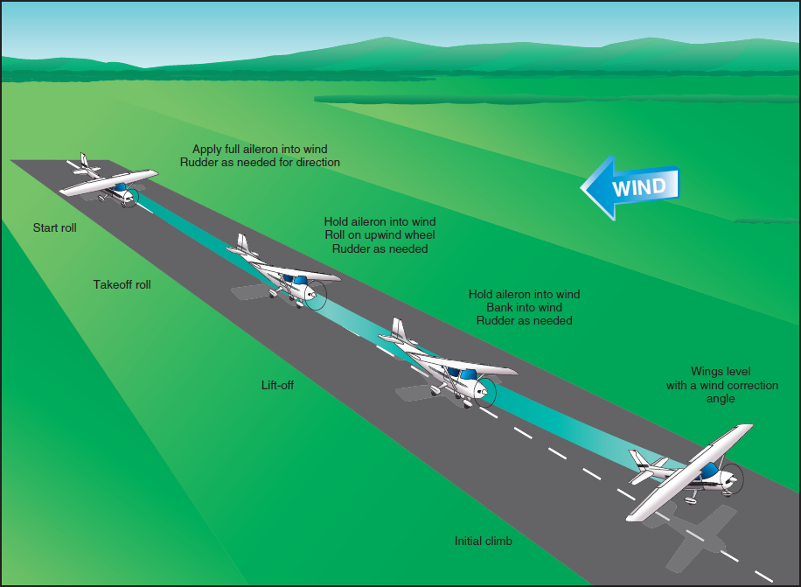
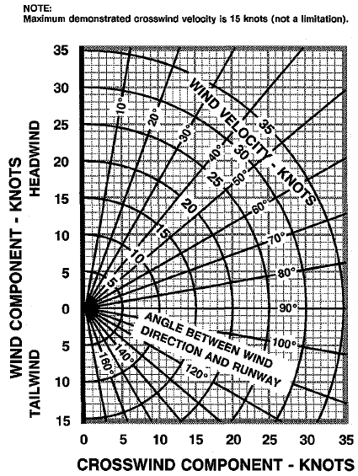
Crosswind Take-Off
Criteria: steady or gusty crosswind component (windshear)
Check environment and consult performance data in POH
Pre-take-off checks according to checklists in POH
Maximum demonstrated crosswind component 15 knots
Mixture full rich, lean for maximum RPM above 3000' DA
Passenger, departure and emergency briefings
Notes:
Criteria, Procedure, Performance Tables
Limitations, Vmxwc (20% Vs / Vs0), 15 knots
Gusts and Windshear

Slide 20
Crosswind Take-Off – Run
Full Aileron
Into Wind
Reduce Aileron,
Briskly Lift Off
Minimum
Flaps
Keep Straight
Use minimum flap setting required and hold full ailerons into the wind
Callout Take-Off before initiating take-off run
Smoothly apply full power keeping straight with rudder
Use runway end as reference for directional control
Check RPM/ASI and callout RPM Checked, Airspeed Alive
Continue to accelerate to slightly higher lift-off speed
Gradually reduce aileron input – some ailerons required at lift-off
Briskly apply elevator back-pressure to lift off
Notes:
- weather cocking
- rubber drifting
- more lift on the windward side
- positive dihidral increases lift on the windward side

Slide 21
Crosswind Take-Off – Initial Climb
Level Wings
Coordinated Turn into Wind
Check VSI and callout Positive Rate
Level wings when airborne
Perform coordinated turn into the wind (crab) maintaining desired track
Accelerate to desired climb airspeed (Vx, Vy)
Adjust and maintain nose-up attitude for airspeed and trim
Retract flaps in white arc above 500' AGL
Notes:
- maybe just slight kick of rudder required to initiate crabbing

Slide 22
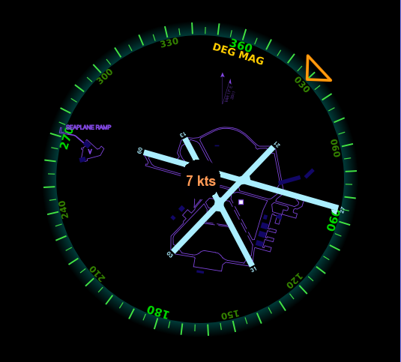
Crosswind Component

