Slide 1
Contact Information
Instructor: Stephan Heinemann
SMS: +1 (250) 891-5446
Email: stephanheinemann@flyvfc.com
Bookings, Questions

Slide 2
Pilot Navigation
Definition and Motivation
Pilot Navigation (Diversions)

Slide 3

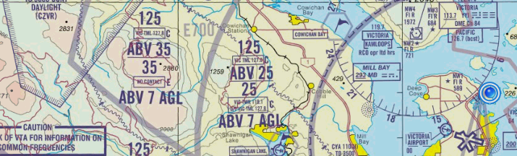
Definition and Motivation
The process or activity of accurately ascertaining one's position and planning while following a route.
Essential skill to safely and efficiently travel from departure to destination
Navigation planning establishes a level of situational awareness including potential options before the flight
Supports decision making during the flight

Slide 4
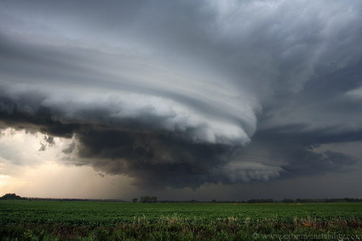
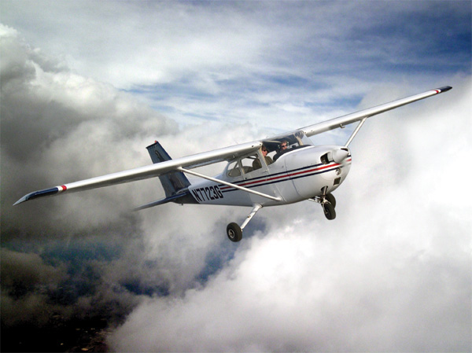
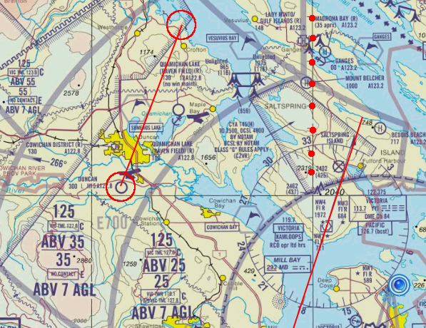
Diversions
Circle, Circle, Line, Heading, Distance, Time (Fuel)
Make a call and you'll be fine
Fuel (reserve) required and weather for alternate
Consider departure aerodrome and reciprocal track
Use physical features for visual navigation (roads, rivers)
Support with all means of navigation (GPS, VOR, NDB)
Notes:
- ccl – hdt above the pictures
- use only the following slides to explain
- 2 part separate presentations: navigation and diversions (with homework for student, prepare navigation log and perform calculations with E6B)

Slide 5
Diversions

Slide 6
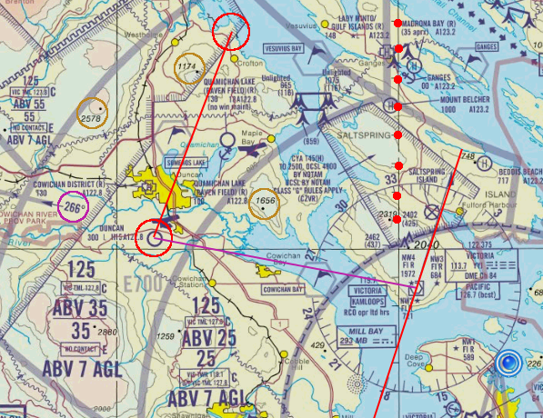
Diversions

Slide 7
E6B GS Check and ETA Update
GS Check:
  Distance in NM on the outside ring over
  Time in min/hours on the inside ring
  Read Speed in knots on the outside ring over 60
ETA / ETO Update:
  Speed in knots on the outside ring over 60
  Read Time in min/hours on the inside ring under
  Distance in NM on the outside ring

Slide 8
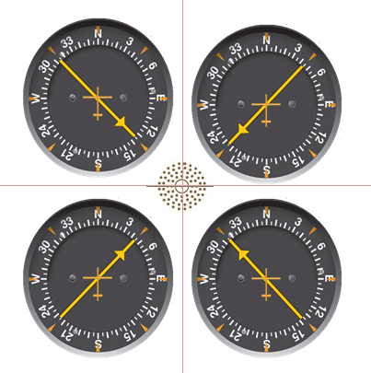
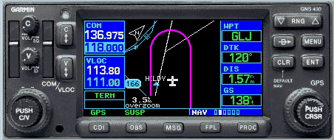
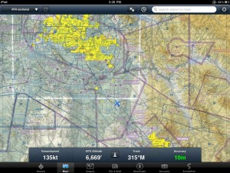
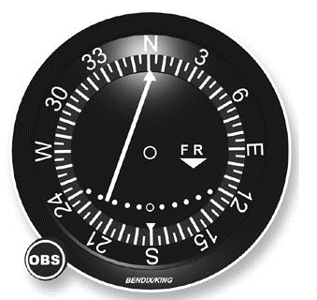
Navigational Aids
GPS – map and direct to (mounted, portable)
VOR – radial inbound or outbound, fix
NDB – bearing to station

Slide 9
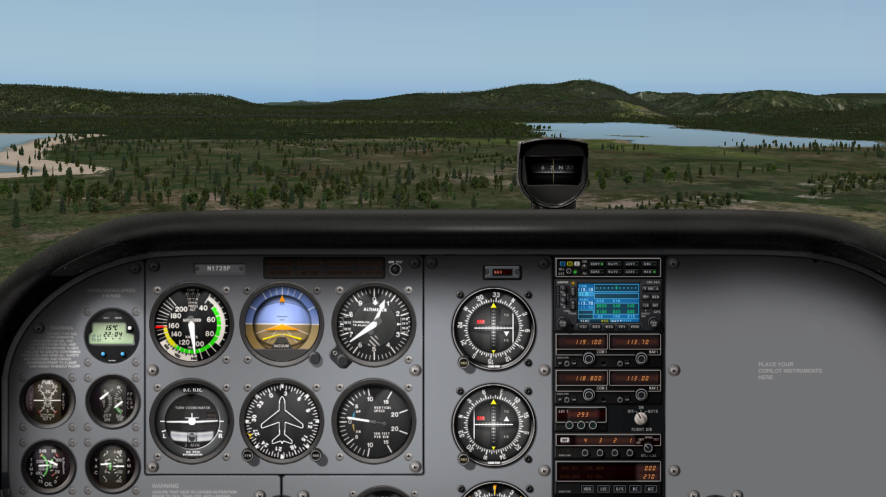
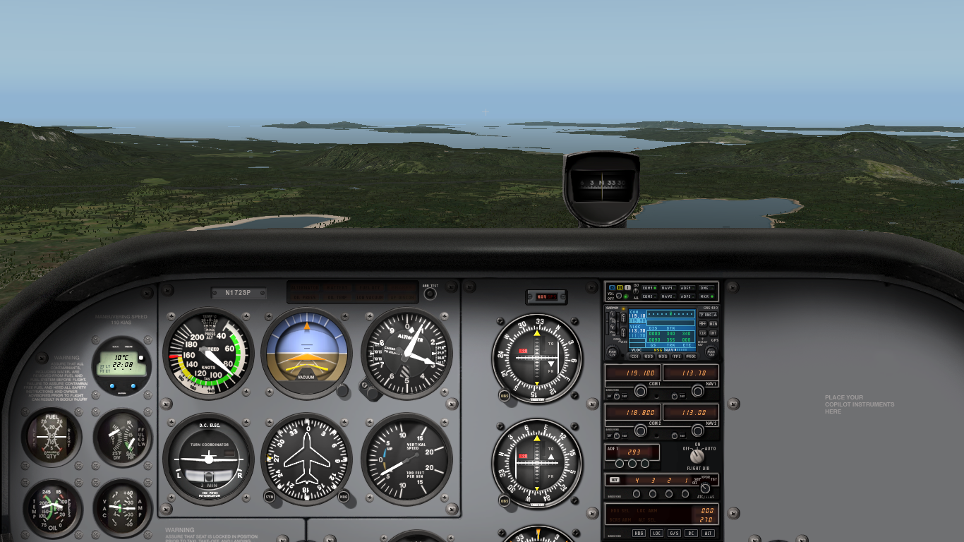
Low-Level Navigation
Restricted field of view and limited navigational cues
Requires accurate tracking and timing
Remain clear of obstacles – look outside
Use shorelines, rivers, roads, railways
Consider precautionary landing or special VFR

