Slide 1
Contact Information
Instructor: Stephan Heinemann
SMS: +1 (250) 891-5446
Email: stephanheinemann@flyvfc.com
Bookings, Questions

Slide 2
Attitudes and Movements
Definition and Motivation
Normal Aircraft Attitudes
Rotational Movements

Slide 3

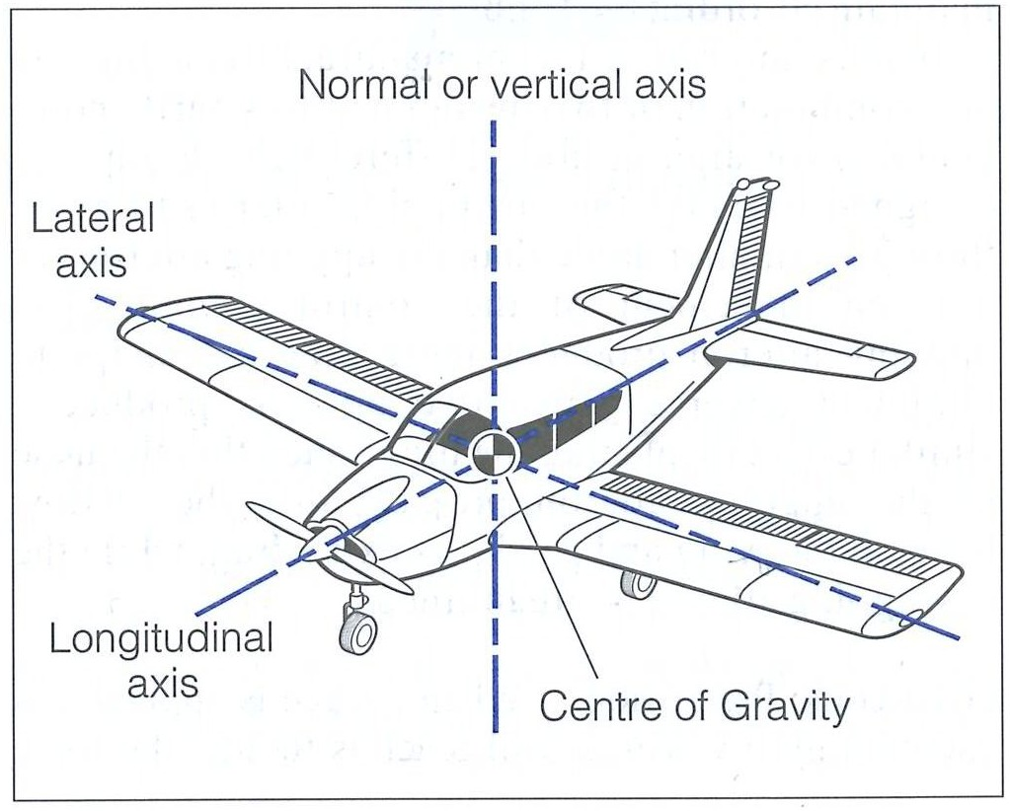
Attitudes and Movements

Slide 4

Cruise Attitude

Slide 5
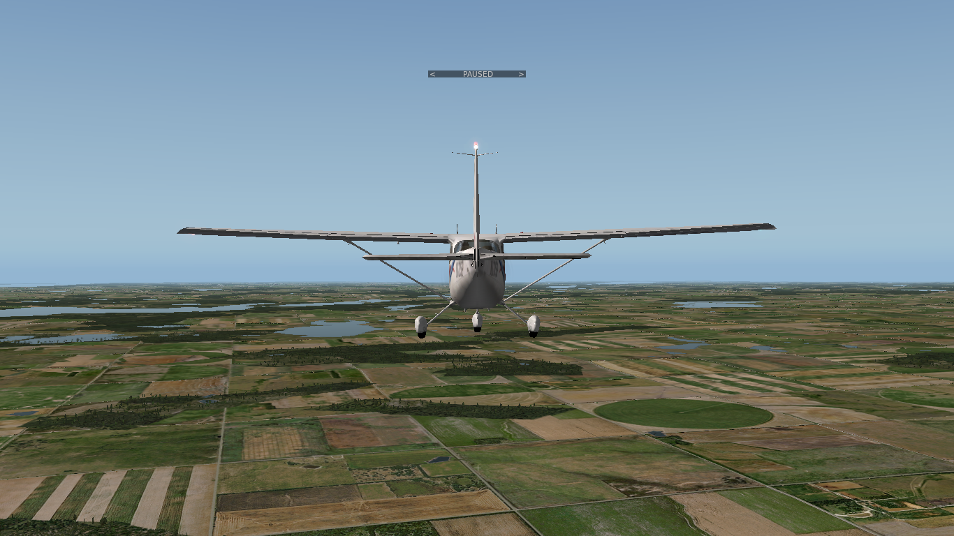
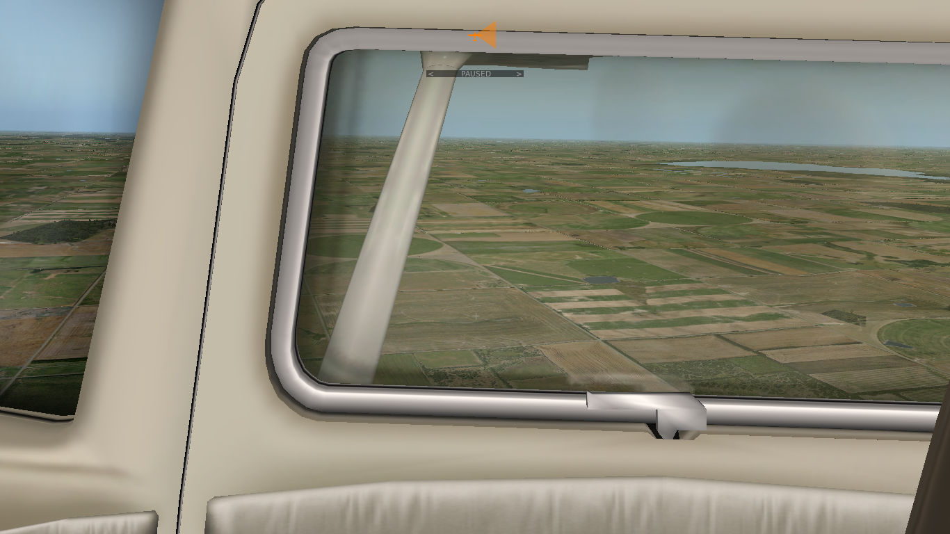
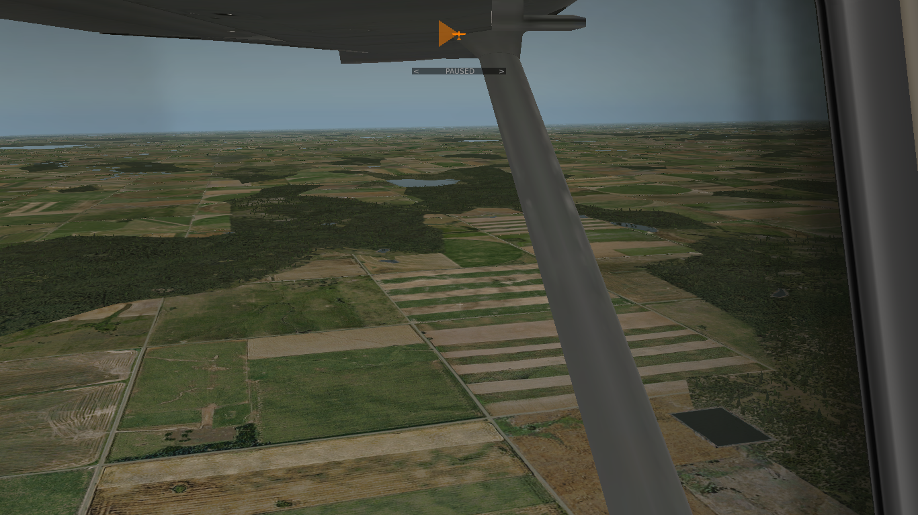
Cruise Attitude

Slide 6

Pitch Attitudes: Nose-Up Attitude
Normal Nose-Up Attitude Range to +15°
Notes:
- mention only a couple of millimeters back-movement to change attitude significantly

Slide 7
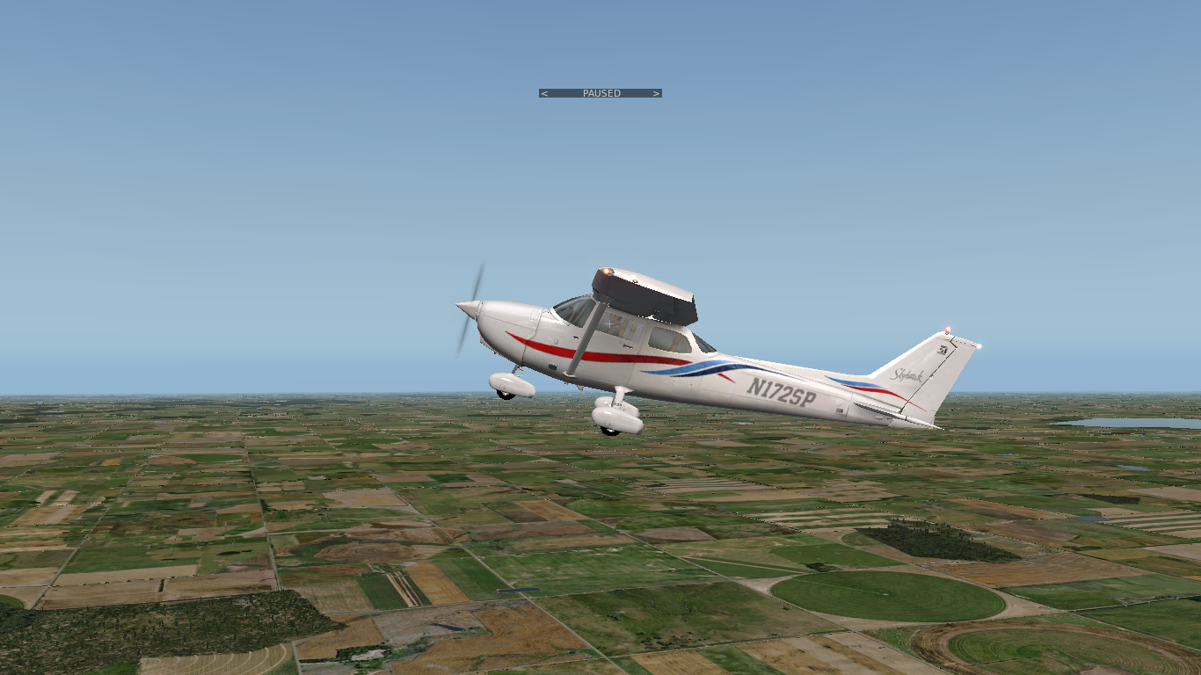
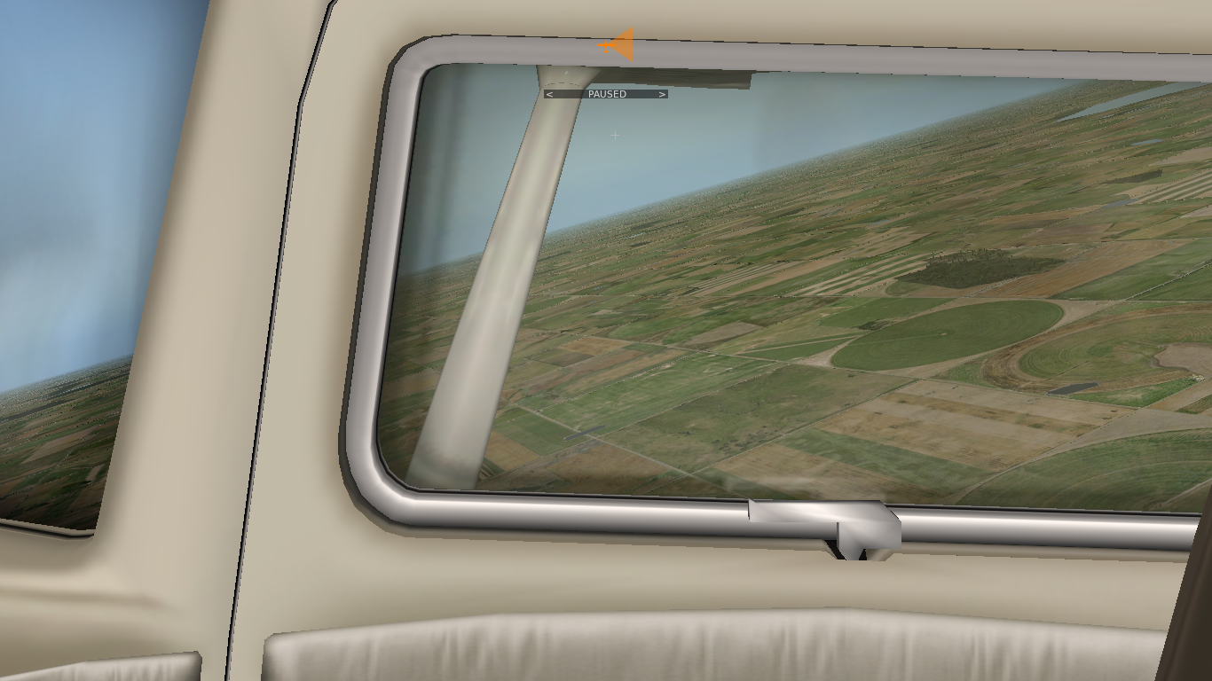

Pitch Attitudes: Nose-Up Attitude

Slide 8
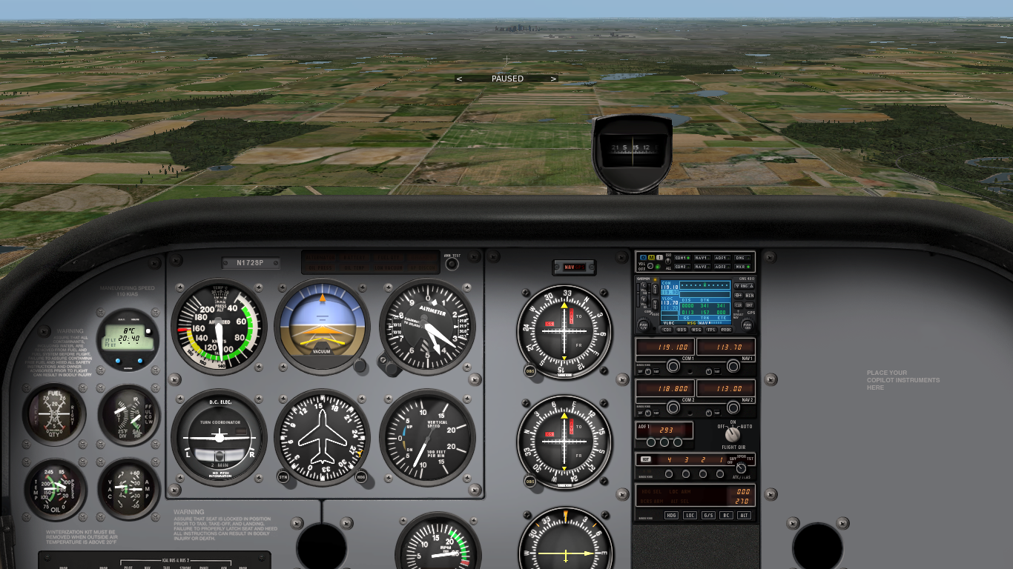
Pitch Attitudes: Nose-Down Attitude
Normal Nose-Down Attitude Range to -10°

Slide 9
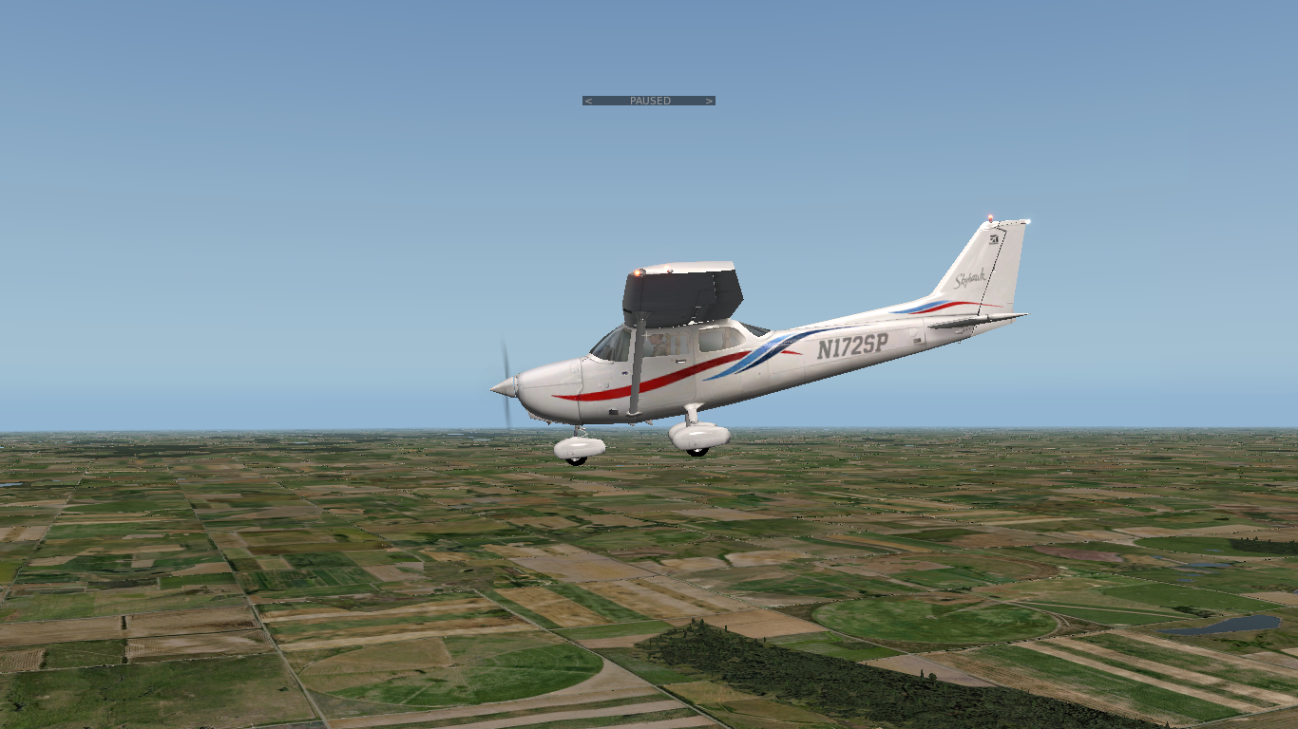
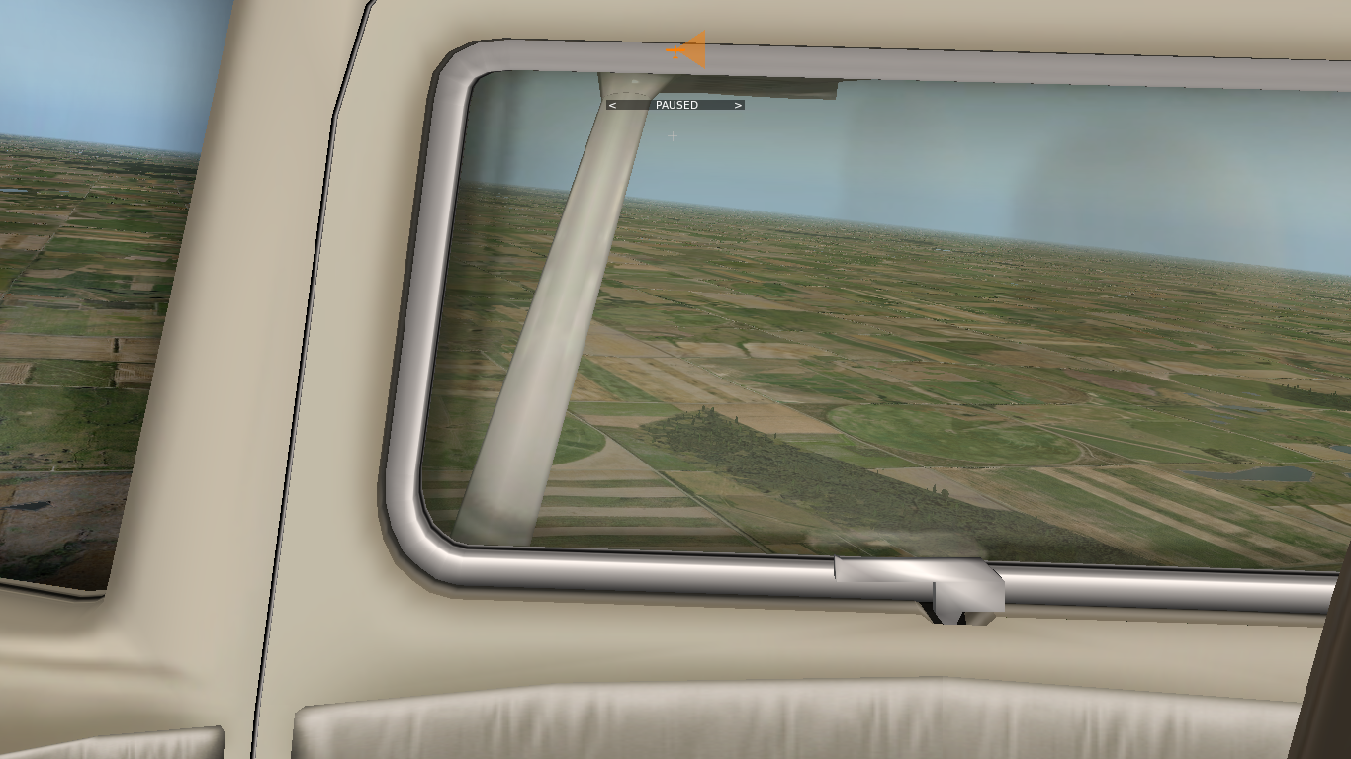

Pitch Attitudes: Nose-Down Attitude

Slide 10
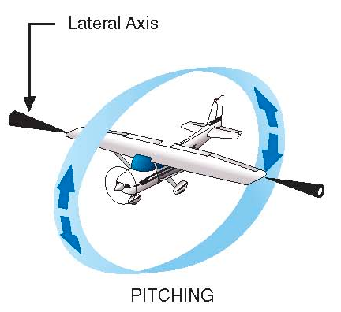


Pitching – Establishing and Recovering a Pitch Attitude
Push / Pull, Adjust Pressure
Very small movements required (millimeters)
Control pressures change gradually after establishing and holding new pitch attitude
Trim may help to relieve control pressures
Notes:
- explain howto carefully and precisely
- emphasize changing control pressures and forces required to hold attitude if power and trim remain unchanged

Slide 11

Bank Attitudes: Left-Banked Attitude
Normal Left-Banked Attitude Range to -30°

Slide 12
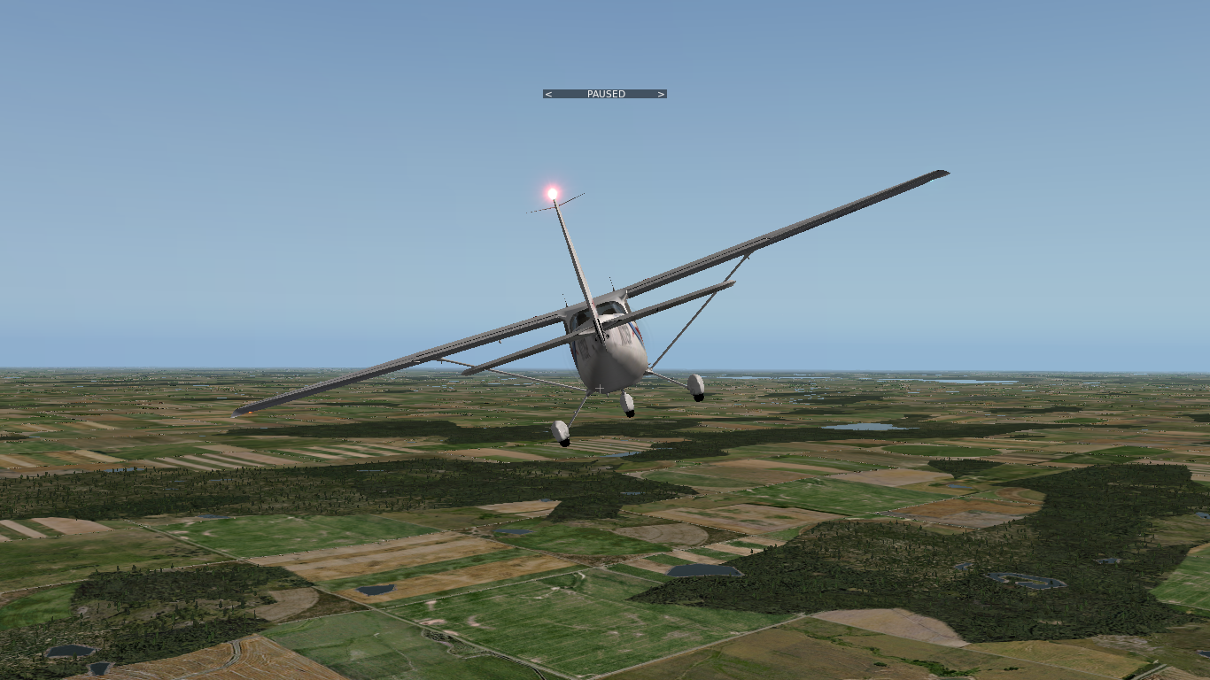
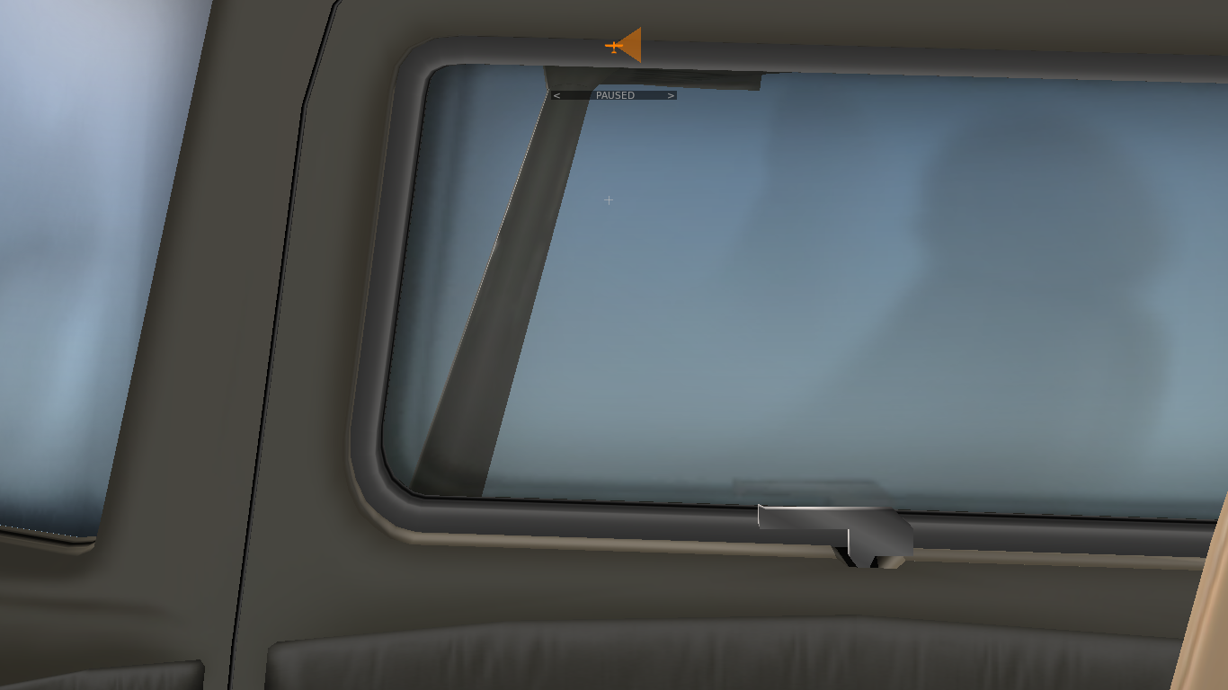
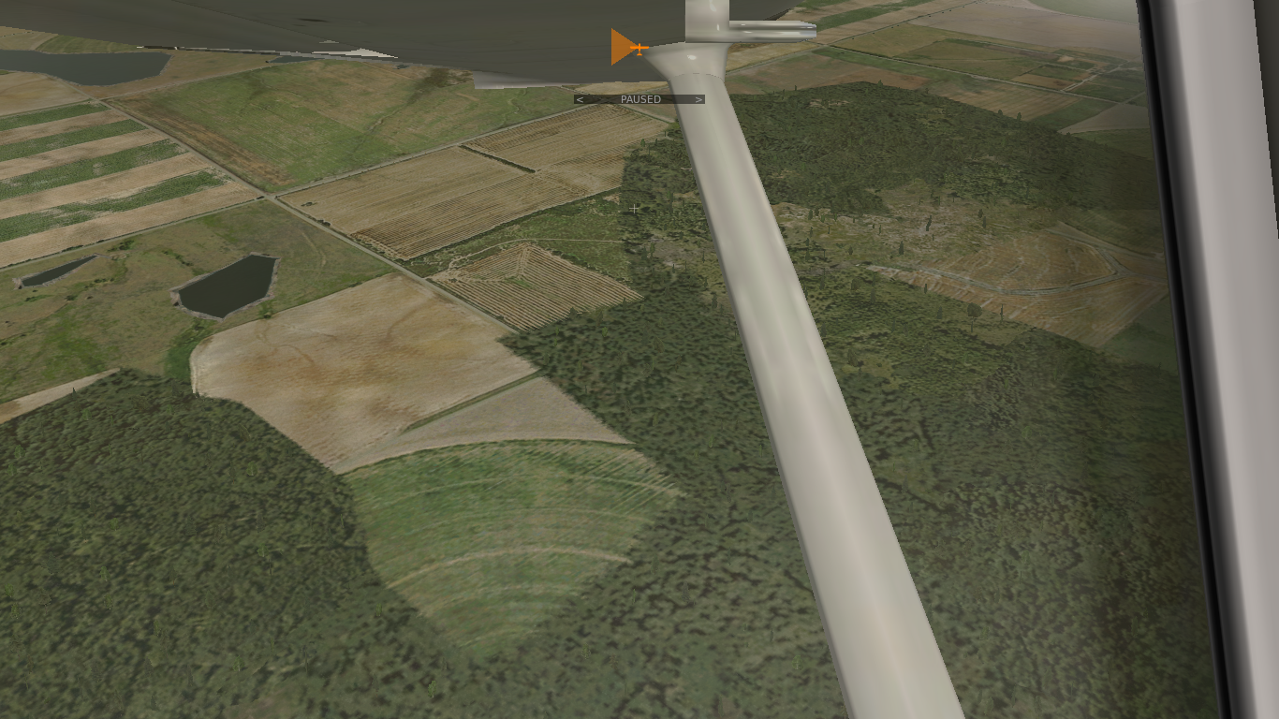
Bank Attitudes: Left-Banked Attitude

Slide 13
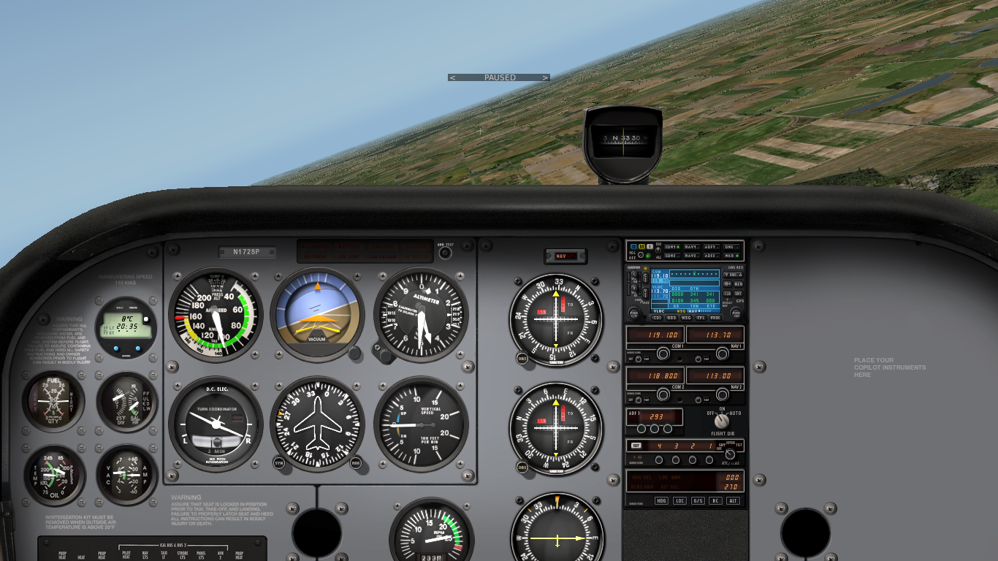
Bank Attitudes: Right-Banked Attitude
Normal Right-Banked Attitude Range to +30°

Slide 14
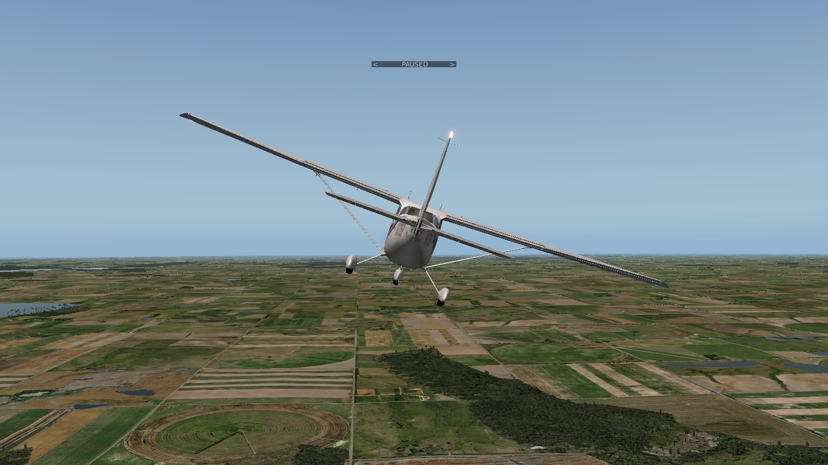
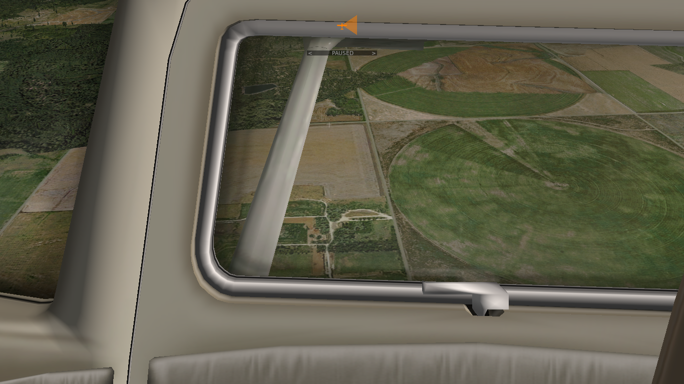
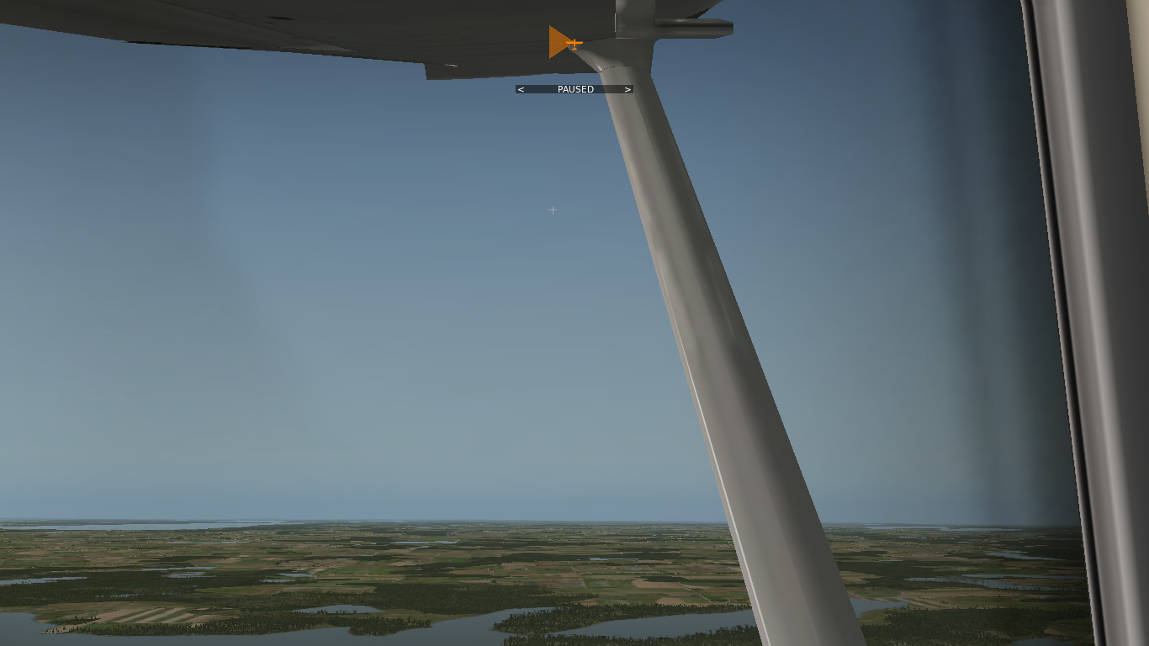
Bank Attitudes: Right-Banked Attitude

Slide 15
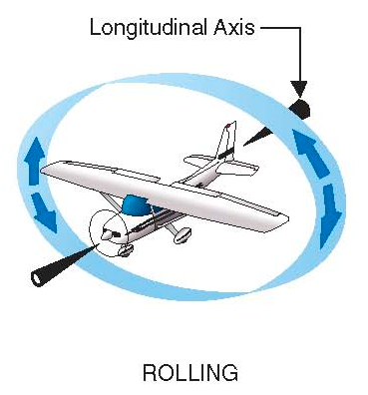
Rolling – Establishing and Recovering a Banked Attitude
Select
Neutralize
Rotation angle controls rate of roll
Select rotation angle until banked attitude is established
Neutralize yoke to maintain banked attitude
Select opposite rotation angle until cruise attitude is established
Neutralize yoke to maintain cruise attitude
Notes:
- explain howto carefully and precisely
- emphasize a continuous rotation to a selected yoke orientation for a certain rate of roll
- emphasize maintaining selected yoke orientation until banked attitude is achieved
- emphasize neutralizing yoke to maintain attitude

Slide 16


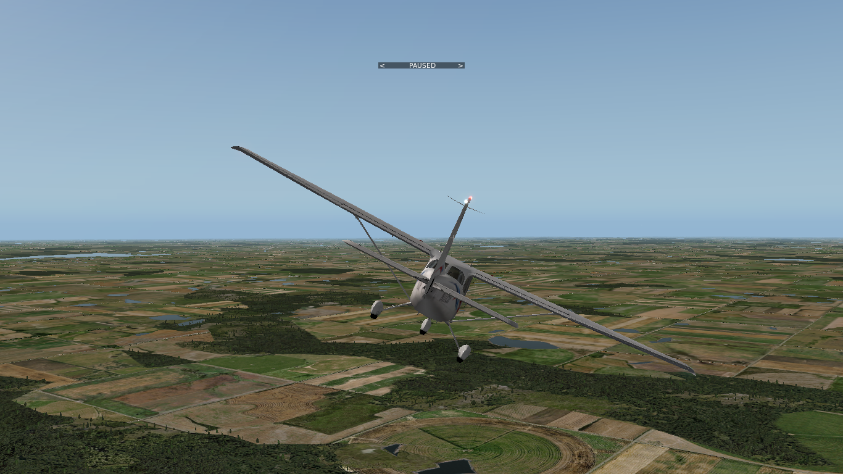
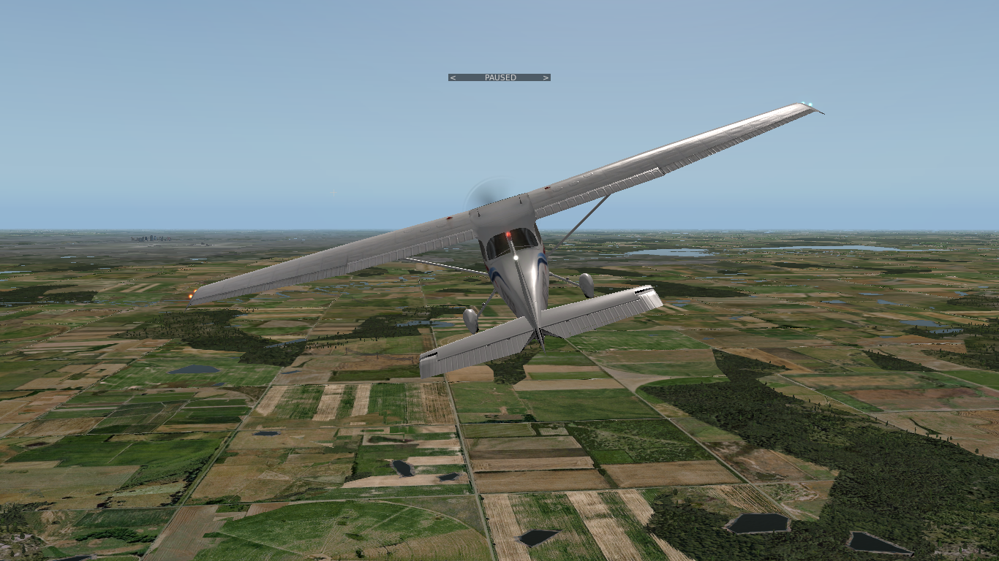
Combined Attitudes

Slide 17
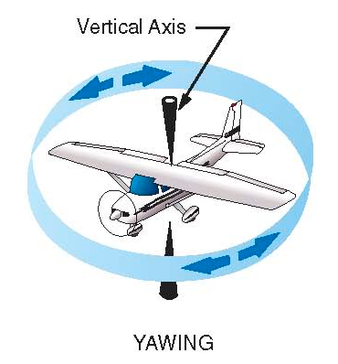


Yawing – Controlling Yaw and Coordination
Yawing is a rotational movement about the vertical (normal) axis
Yawing changes the heading of the aircraft (left, right)
Yawing is primarily controlled with the rudder pedals
Coordinated flight is desired in most situations (kick and center the ball)
Real and indicated heading change (heading indicator, turn coordinator)
Notes:
- turn coordinator indicates rate of turn (speed of yaw) and coordinated flight (radial force equals centrifugal force / overcomes inertia)
- on the ground turn coordinator indicates turn without a bank angle (skidding turn)
- turn coordinator gyros are driven electrically
- heading and attitude indicator gyros are driven pneumatically (by vacuum)

Slide 18
Straight-and-Level Flight
Definition and Motivation
Straight Flight
Level Flight

Slide 19
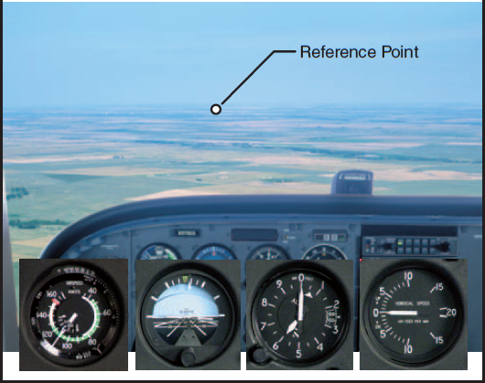
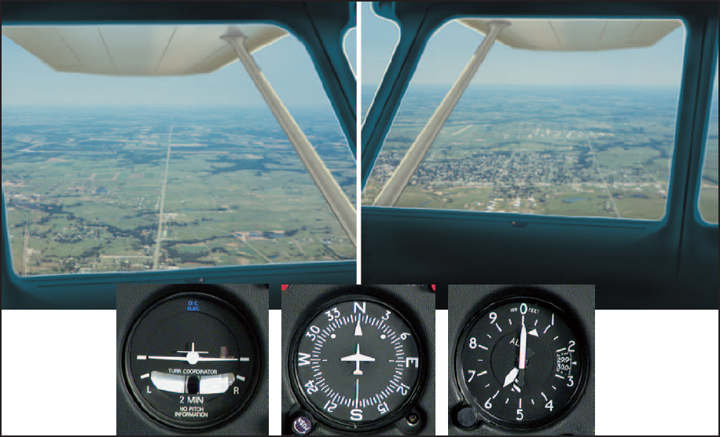
Straight Flight
Maintain constant heading (horizon and reference point)
Control roll and yaw to keep wings level in coordinated flight
Check attitude indicator (bank attitude), heading indicator and turn coordinator
Straight flight is not necessarily level flight (variable altitude)
Notes:
- Outside references first, cross-check instruments second

Slide 20
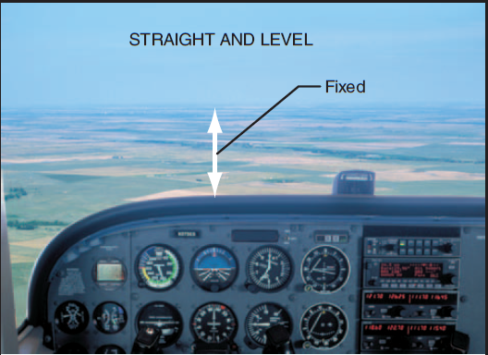

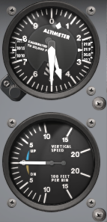
Level Flight
Maintain constant altitude (attitude and power)
Control pitch and power to maintain altitude in coordinated flight
Check attitude indicator (pitch attitude), RPM (power setting), altitude indicator and vertical speed indicator
Level flight is not necessarily straight flight (variable heading)

Slide 21
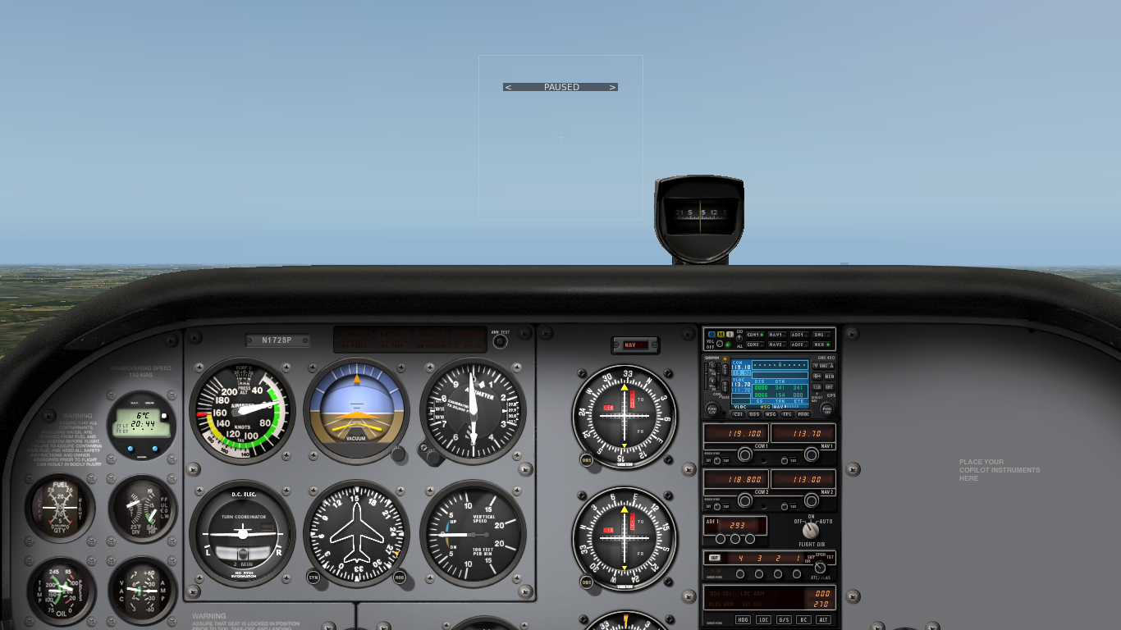
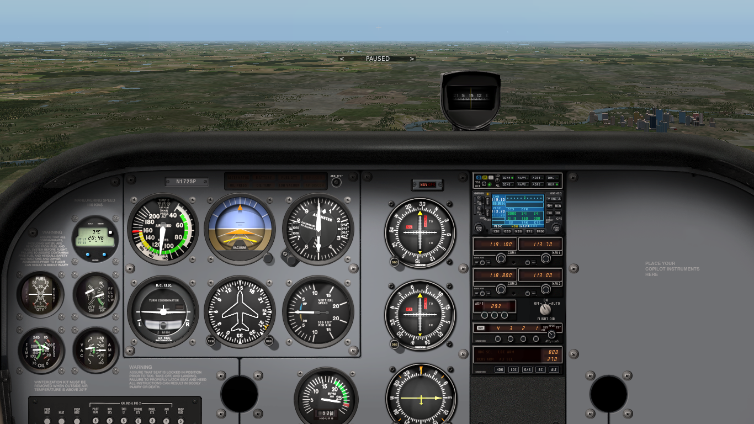
Level Flight – Attitude and Power
Attitude plus power equals performance
Less power requires more nose-up (less nose-down) attitude (and vice versa) to maintain altitude at lower constant airspeed
More power requires less nose-up (more nose-down) attitude (and vice versa) to maintain altitude at higher constant airspeed
Trim is used to compensate control forces at different settings
Notes:
Level flight can be achieved by different combinations of attitude and power

Slide 22
Straight-and-Level Flight
Maintain heading and altitude in close tolerances
Restrained use of all three flight controls
Control roll and yaw to maintain heading
Control pitch and power to maintain altitude
Maintain coordinated flight
Level flight at different power settings (airspeeds) is required for separation with other traffic
Pitch and power affect the aerodynamic and economic performance of the aircraft (range and endurance)

Slide 23
Gentle, Medium and Steep Turns
Motivation and Definition
Initiating, Maintaining and Recovering Coordinated Gentle, Medium Level and Steep Turns
Notes:
- gear and carbutettor heat are not applicable

Slide 24
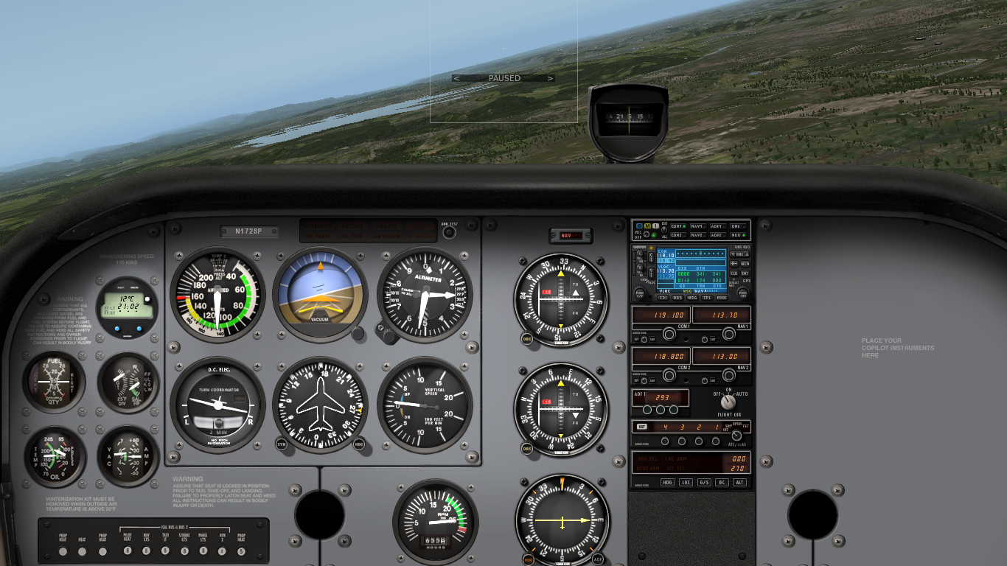
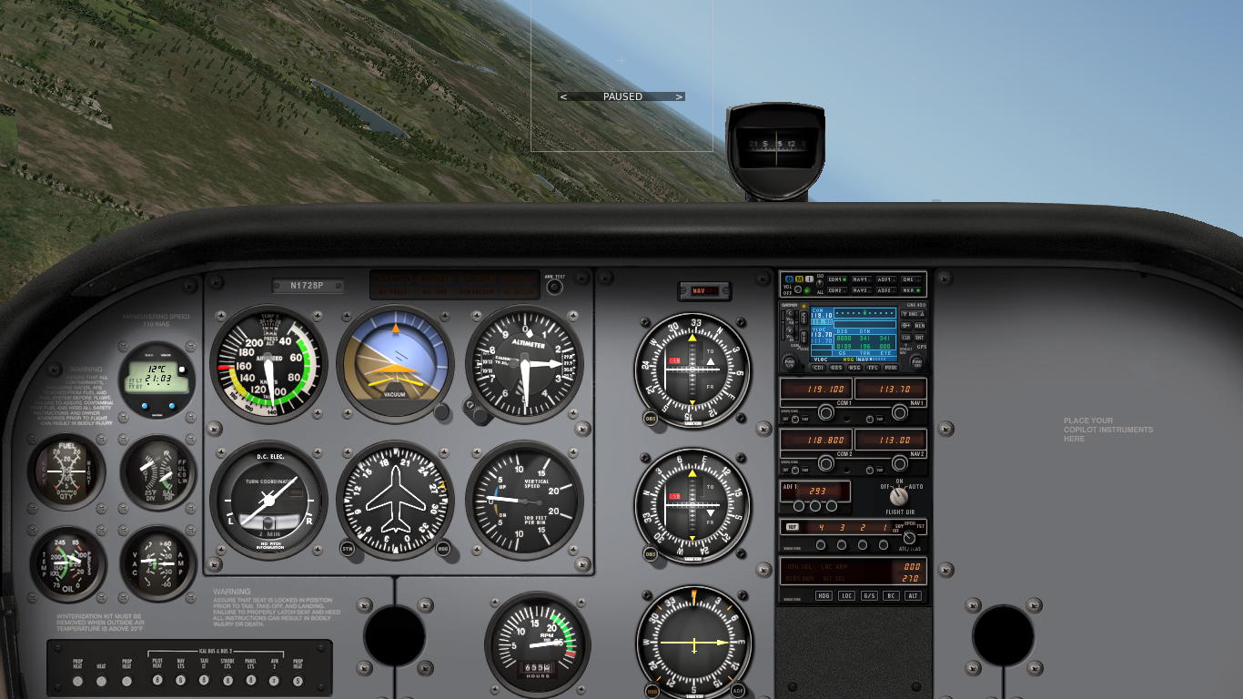
Gentle, Medium and Steep Level Turns
Gentle level turns – up to 15° bank angle
Medium level turns – 15° up to 30° bank angle
Steep level turns – beyond 30° bank angle (45°)
Heading changes maintaining a constant altitude

Slide 25
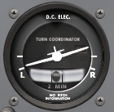
Initiating a Coordinated Level Turn
Lookout
Banked Attitude
Coordination
Perform lookout in cruise attitude before initiating a turn
Establish a banked attitude using the yoke
Apply rudder as required to remain coordinated
Center yoke after banked attitude is established
Notes:
- select appropriate yoke angle for rate of roll
- left turns require way less rudder than right turns

Slide 26
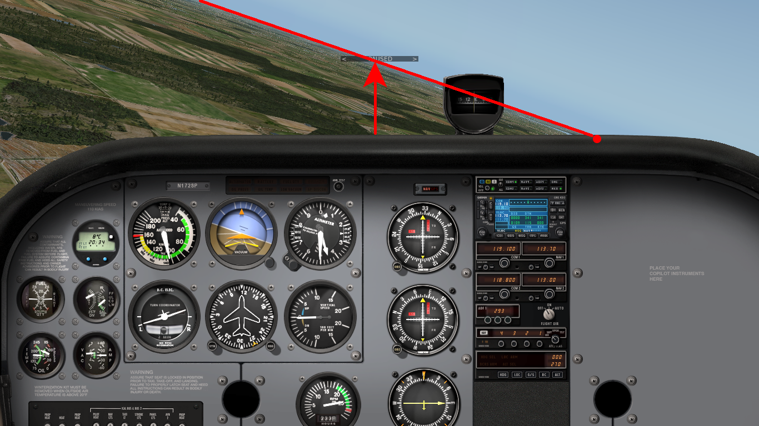

Maintaining a Coordinated Level Turn
Corrections
References
Lookout
Apply back-pressure as required to maintain pitch attitude
Apply corrections as required to maintain bank attitude
Apply rudder as required to remain coordinated
Notes:
- really focus on nose / horizon references / intersection (glare shield, rivets...)
- only crosscheck instruments for confirmation

Slide 27
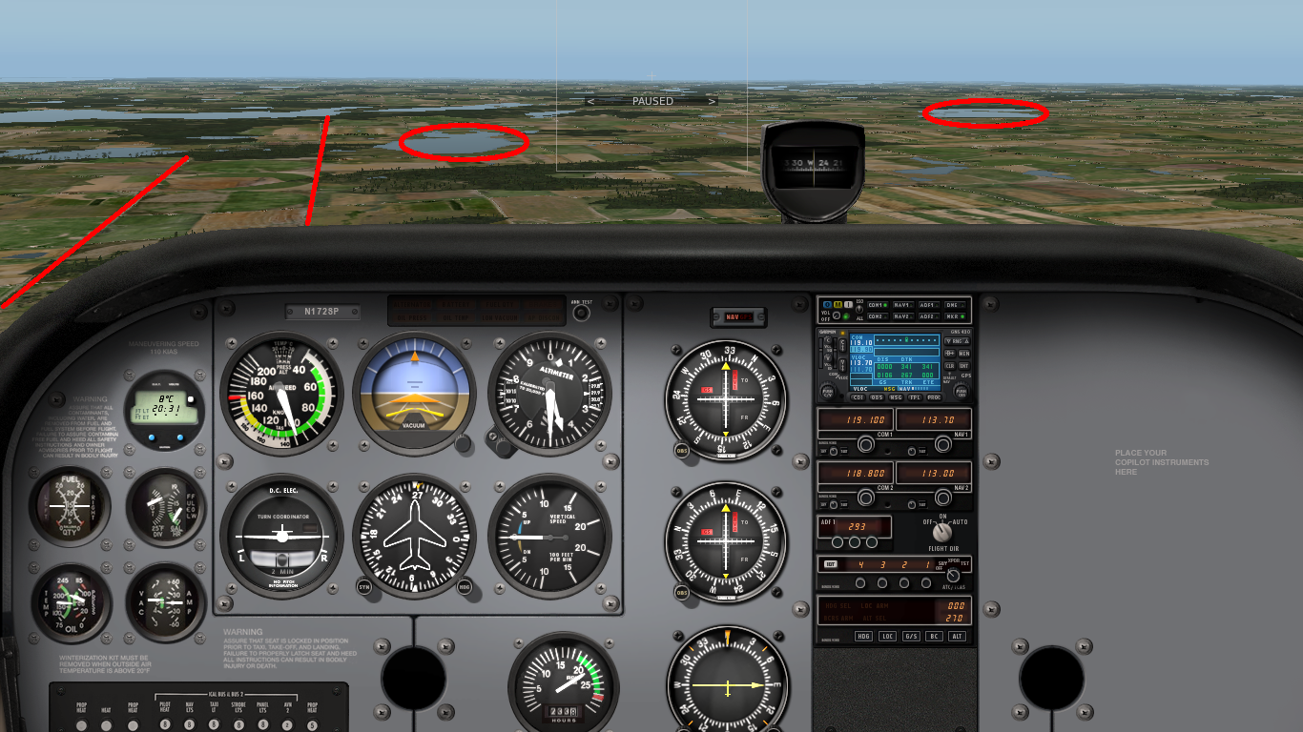
External References
References
Landmarks
Continue to lookout and observe references during turn
Horizon remains the primary attitude reference
Nose moves steadily around the horizon neither rising or falling
Landmarks can be used to establish headings

Slide 28
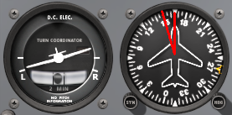
Recovering a Coordinated Level Turn
Landmarks
Anticipation
Continue to lookout observing references during recovery
Turns need to be finished anticipatory – half the bank angle
Establish cruise attitude using the yoke
Control yaw with rudder as required to remain coordinated
Adjust cruise attitude and trim

Slide 29
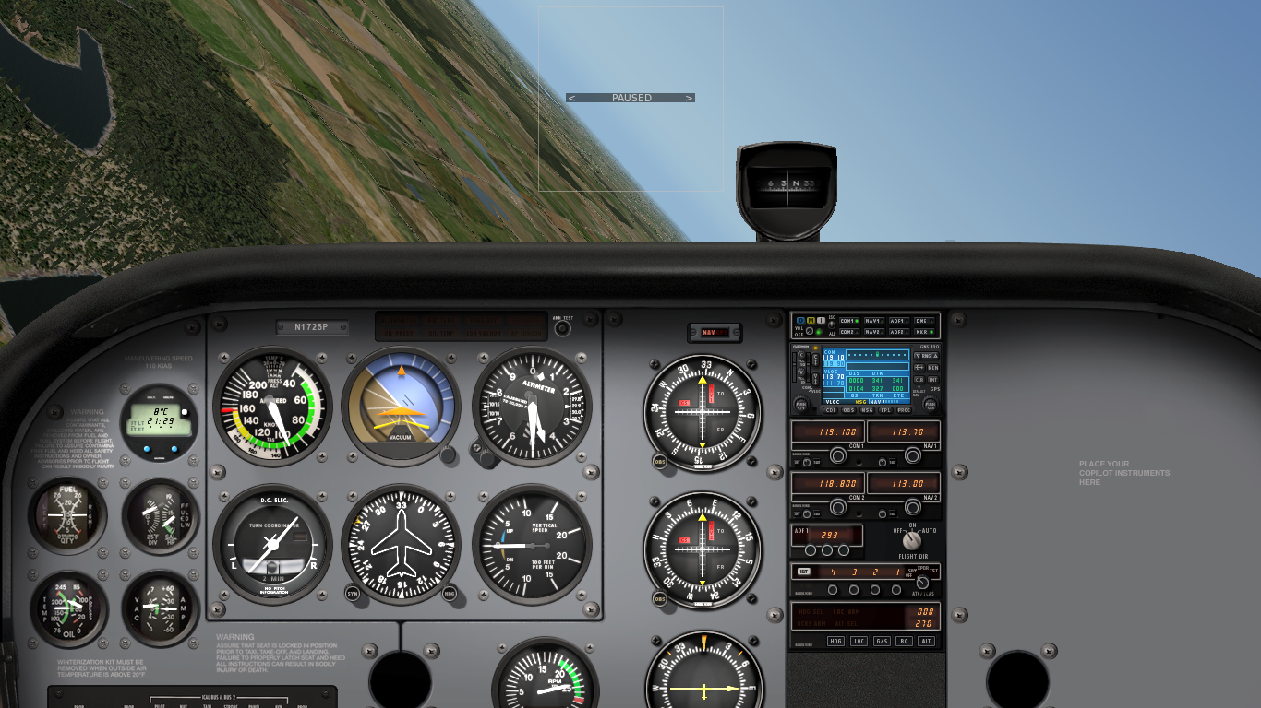
Steep Turns
45° Steep Turn
30° Medium Turn
Steep turns – beyond 30° bank angle
Evasive actions and collision avoidance
Control coordination practice
Higher load factor, stall speed and required power
Notes:
- left steep turn: almost no rudder, less back-pressure
- right steep turn: more rudder during entry, more back-pressure during turn
- additional power and yaw have a significant effect on turn characteristics
(i) use of power to maintain constant pre-selected airspeed — constant altitude;
(ii) consequences of
not
adding power — loss of airspeed;
(iii) bank and power limitations;
(iv) relationship between speed and radius of turn — minimum radius — entry
speed — use of power — use of flaps;
(v) co-ordination and technique for evasive action or collision avoidance;
(vi) attitude and speed control during steep power-off descending turns — use of flaps;
(vii) instrument indications.
NOTE: Stress attitude control to avoid spir
al entry — how to monitor instruments.

Slide 30
Performing a Steep Level Turn
Lookout all around before initiating a steep turn
Initiate steep level turn like medium level turn
Add power beyond 30° bank angle to maintain safe airspeed above increased stall speed
Correct as necessary to maintain attitude
Remain coordinated and correct overbanking
Left and right turns require different control inputs
Reduce power accordingly during recovery
Transition from left to right requires smooth control and power adjustments
Notes:
- remove HASEL definition
- remove medium level turn entry
- add power simultaneously when initiating the turn
- add power as required by bank angle to maintain airspeed (sound or RPM value)
- instructor:
left turn reference – upper right glareshield aligns with horizon, almost no left rudder or additional back-pressure
Right turn reference – right rivet row on the cowling aligns with horizon, significant right rudder and additional back-pressure

