Slide 1
Contact Information
Stephan Heinemann
SMS: +1 (250) 891-5446
Email: stephan.heinemann@hotmail.com
Bookings, Questions

Slide 2
Normal Take-Offs and Landings
Review Climbing, Descending, Slow Flight
Definition and Motivation
Normal Take-Off
  Criteria and Phases
Normal Approach and Landings
  Criteria and Phases
Circuits
Summary and Questions
Pre-Flight Briefing

Slide 3
Review Climbing
Define and state the two important reference speeds for climbing.
Where do we find the relevant performance data?
How do we maintain a selected climb airspeed given a fix power setting?
What factors affect climb performance?
How do we maintain coordinated flight during a climbing turn?

Slide 4
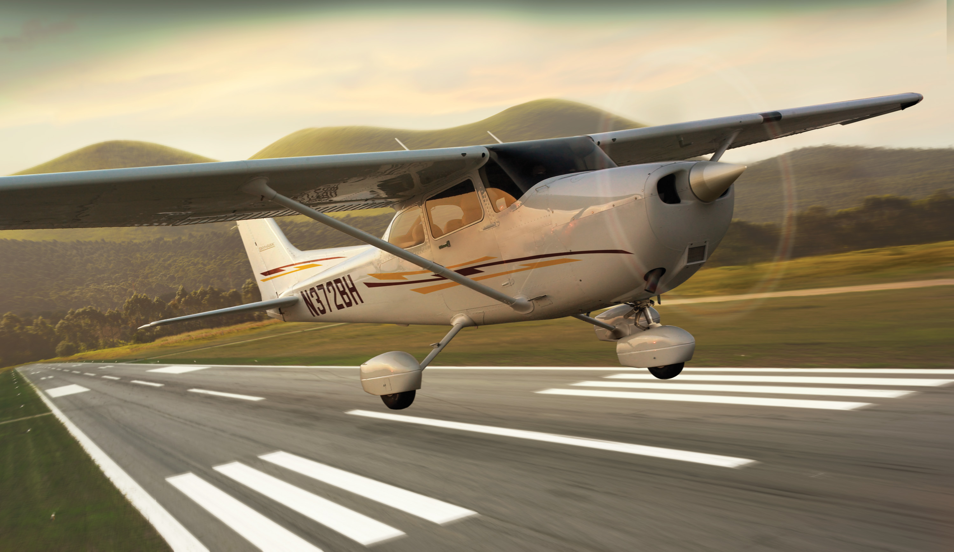
Take-Off – Definition and Motivation
Act of leaving a supporting surface including the immediately preceding and following acts
Leaving the ground and becoming airborne
Essential maneuver used in every single flight

Slide 5
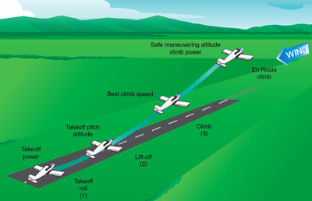
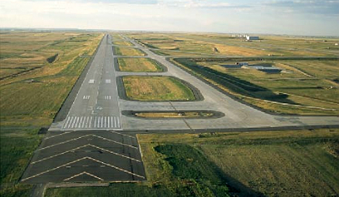
Normal Take-Off
Criteria: hard uncontaminated surface, long runway, no obstacles, low density altitude, no or steady headwind
Check environment and consult performance data in POH
Pre-take-off checks according to checklists in POH
Mixture full rich, lean for maximum RPM above 3000' DA
Passenger, departure and emergency briefings
Notes:
- low density altitude = higher air density
- align with runway centerline / centered nosewheel
- avoid brakes if possible, use rudder for directional control
- outside references (end of runway)
- rpm / airspeed check
- develop feel for the controls
- rotation speed check
- climb speed check
Abort Criteria, Decision Point, Briefings
Departure briefings not necessarily for passengers

Slide 6
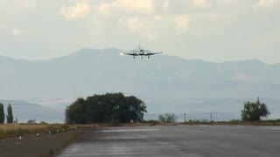
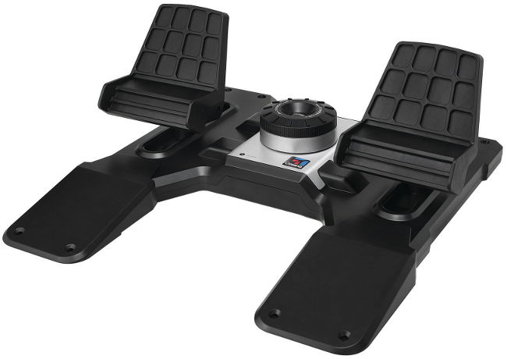
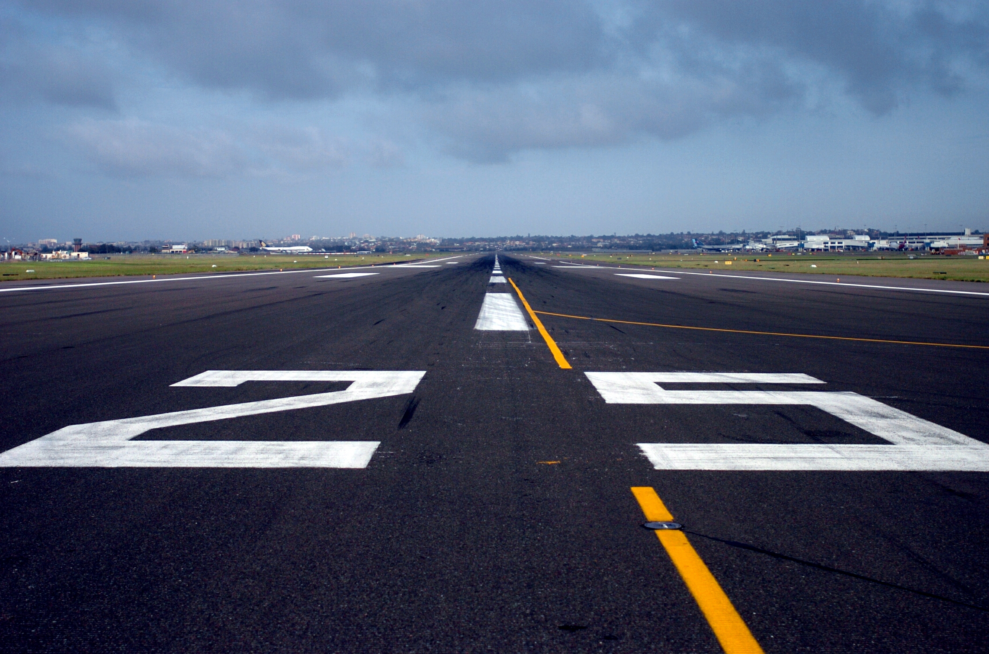
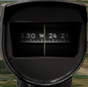
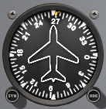
Normal Take-Off – Line Up
Check
Approach Sector
Align
Centerline
Crosscheck
Instruments
Check approach sector and callout Approach Sector Clear
Align with runway centerline using rudder and brakes
Keep nose-wheel centered and stop before take-off run
Crosscheck runway heading, magnetic compass, heading indicator
Notes:
- clearance, transponder, lights, time... (keep it simple)
- sometimes a rolling take-off might be necessary

Slide 7

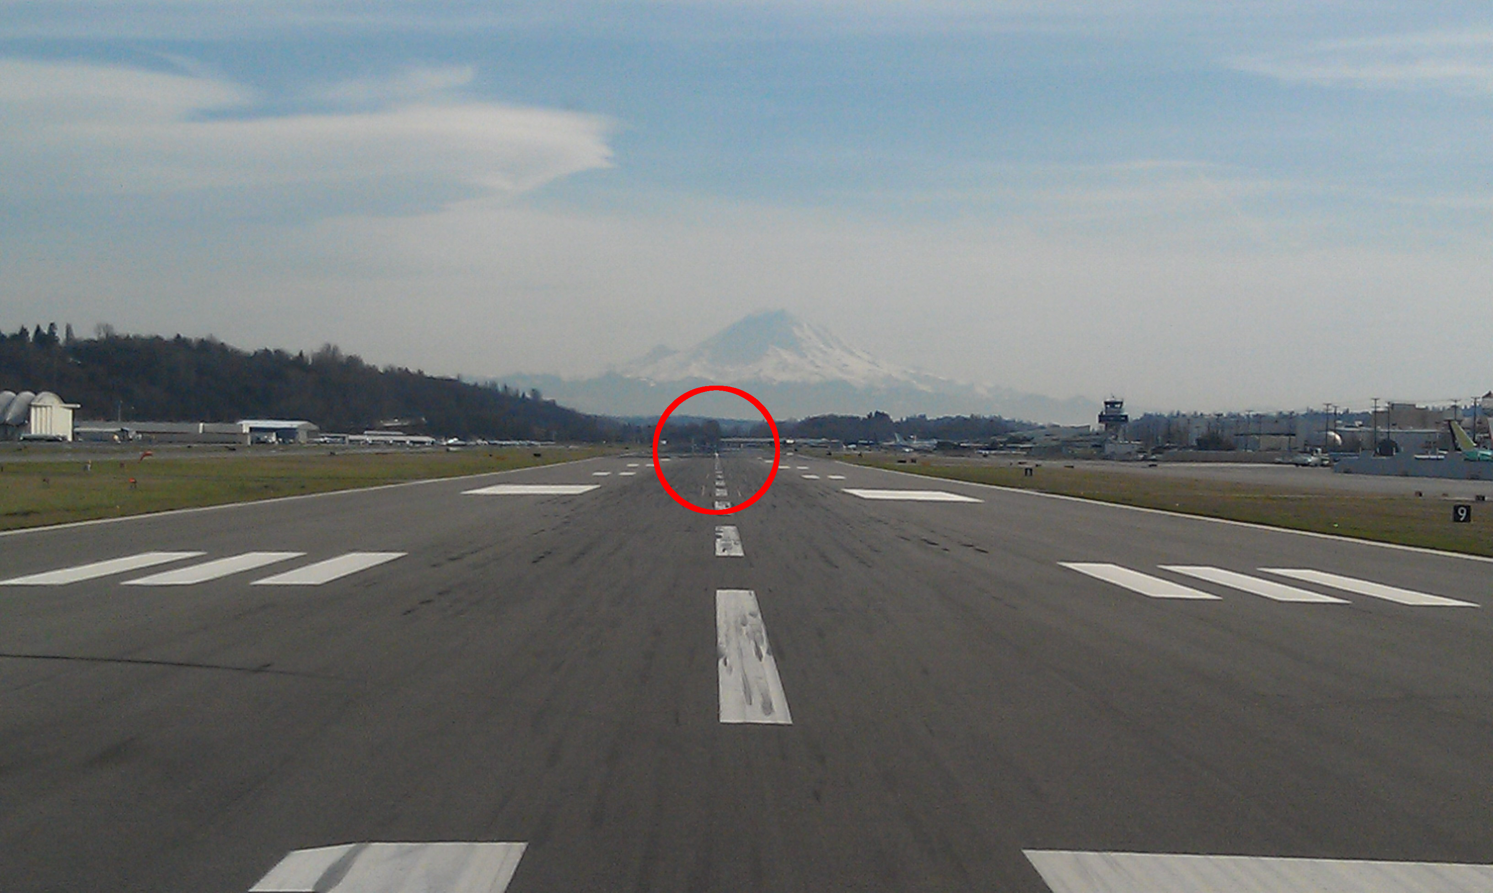

Normal Take-Off – Run
Full
Power
Keep
Straight
Runway End
Lift Off
Callout Take-Off before initiating take-off run
Smoothly apply full power keeping straight with rudder
Use runway end as reference for directional control
Check RPM/ASI and callout RPM Checked, Airspeed Alive
Continue to accelerate to lift-off speed (Vr = 55 KIAS)
Gently apply elevator back-pressure to lift off nose-wheel
Notes:
- keep ailerons and elevator neutral during initial phase
- gradually increase elevator back-pressure to lighten nose-wheel weight

Slide 8
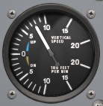
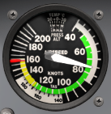
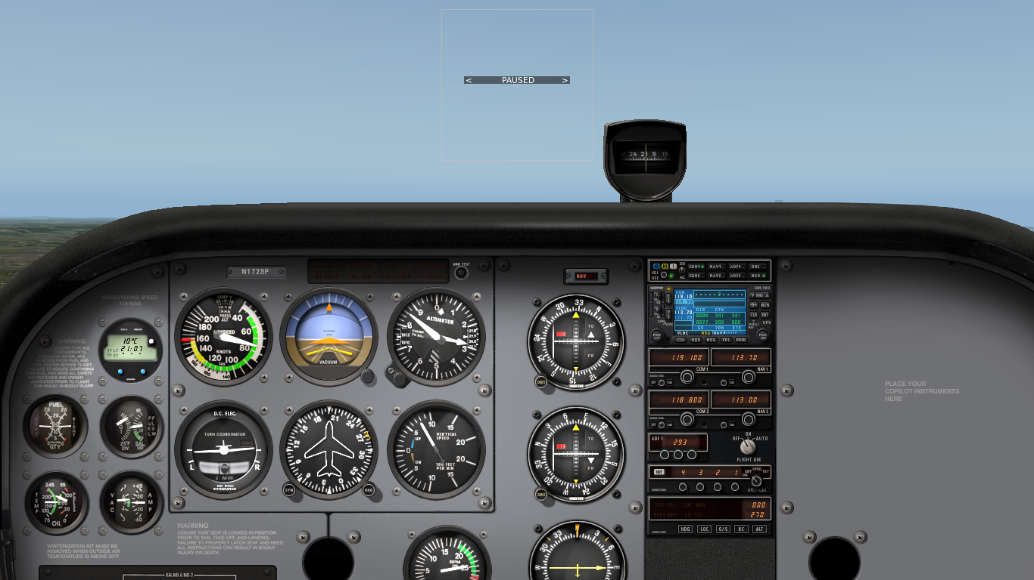
Normal Take-Off – Initial Climb
Positive Rate
Adjust Attitude
Maintain Vy
Vy
Control Direction
Check VSI and callout Positive Rate
Accelerate to best rate of climb airspeed (Vy = 74 KIAS)
Adjust and maintain nose-up attitude for airspeed
Trim away elevator forward-pressure as required
Maintain directional control and control yaw with rudder

Slide 9
Review Descending and Slow Flight
Mentally perform a power-off and power-on descent and state all observations and required actions (PAT).
Define and state the best glide airspeed.
How do we recognize that a ground reference can be reached during a descent?
What is slow flight and how do we recover from the slow flight range?
Define and state the two stall v-speeds.
Notes:
- best glide airspeed (windmilling prop) 68 KIAS
- Vs0 = 40 KCAS, Vs1 = 48 KCAS, MTOW, most forward CG, standard environment
- quicker review

Slide 10
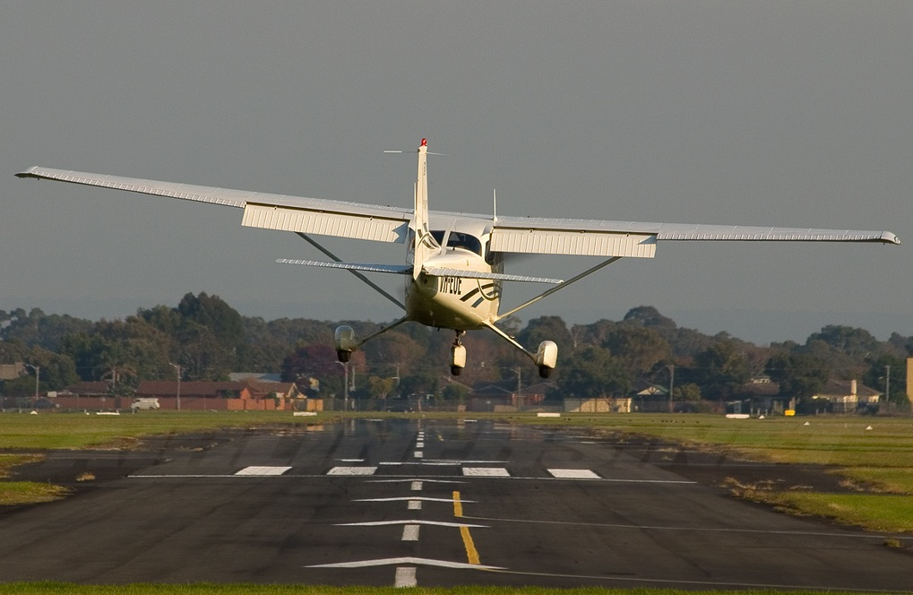
Landing – Definition and Motivation
Landing is the last part of a flight, where a flying animal, aircraft, or spacecraft returns to the ground.
Stabilized approach, flare, touchdown, ground roll
Essential maneuver used in every single flight

Slide 11
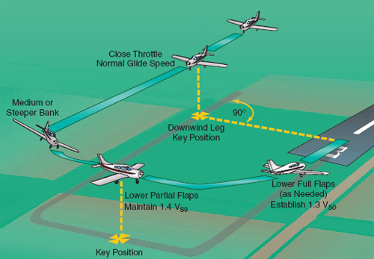
Normal Approach and Landing
Criteria: hard uncontaminated surface, long runway, no obstacles, low density altitude, no or steady headwind
Check environment and consult performance data in POH
Pre-landing checks according to checklists in POH
Passenger, arrival and emergency briefings
Notes:
- Speed and Spot, Speed or Spot, Adjust power as the third component
- low density altitude = higher air density

Slide 12


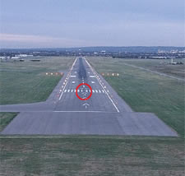

Normal Landing – Approach
Align and Descent
Perspective
Approach Speed
Align with runway and establish a stabilized descent
Aim for runway threshold to flare into landing zone
Set flaps as required (10°-20°) in white arc (below 85 KIAS)
Continuously check correct approach airspeed (65-75 KIAS)
Adjust power to maintain attitude and perspective
Notes:
- Speed and Spot!
- 1.3Vs0 KCAS * sqrt(LWT / GWT)
- Vref = 1.3 Vs, Vapp = Vref + max(20kts, GF/2)
- attitude, alignment, height
- both power-off and power-on descent
- at least 500' (152m) of straight approach
- mention stabilized approach criteria
- approach slope – perspective / runway shape
- 1500 – 1700 RPM, or power-off approach
The aircraft is on the correct flight path
Only small changes in heading/pitch are necessary to maintain the correct flight path
The airspeed is not more than VREF + 20kts indicated speed and not less than VREF
The aircraft is in the correct landing configuration
Sink rate is no greater than 1000 feet/minute; if an approach requires a sink rate greater than 1000 feet/minute a special briefing should be conducted
Power setting is appropriate for the aircraft configuration and is not below the minimum power for the approach as defined by the operating manual
All briefings and checklists have been conducted
Specific types of approach are stabilized if they also fulfil the following:
ILS approaches must be flown within one dot of the glide-slope and localizer
a Category II or III approach must be flown within the expanded localizer band
during a circling approach wings should be level on final when the aircraft reaches 300 feet above airport elevation; and,
Unique approach conditions or abnormal conditions requiring a deviation from the above elements of a stabilized approach require a special briefing.

Slide 13
Normal Landing – Flare and Touchdown
Power
Idle
Straight and Aligned
Hold Off
Runway End
Callout Landing Assured before initiating landing flare
Reduce power to idle keeping straight
Use runway end as reference for directional control
Continue to decelerate in level slow flight above runway
Gently increase elevator back-pressure to assume landing attitude gradually – slight nose-up, main-wheels first
Notes:
- 15-30' AGL (5-9m)
- increase nose-up attitude to control descent
- learn landing attitude
- diminishing control response during flare

Slide 14
Normal Landing – Ground Roll
Keep Straight
Runway End
Allow Nose Wheel to Settle
Apply Brakes
Keep straight with rudder using peripheral vision
Hold elevator back-pressure allowing nose wheel to settle
Gently apply brakes keeping straight towards runway end
Slow down to taxi speed and vacate runway
Post-Landing – clearance, flaps, transponder, lights, time
Notes:
- post landing checks

Slide 15

Circuits – Definition and Motivation
Standardized rectangular traffic circuit at aerodromes
Ordered and organized flow of traffic to avoid conflicts
Safety and traffic separation, stabilized approaches
Types: controlled and uncontrolled aerodrome circuit
Applications: portion of a circuit is flown in every single flight

Slide 16
Circuit Procedures
Climb to 500' AAE or as assigned on upwind leg
Transition to Vy and perform cockpit checks (flaps up)
Climb to 1000' AAE or as assigned on crosswind leg
Perform cockpit checks on downwind (switches)
Turn base leg at 45° or as assigned past threshold
Configure for landing on downwind and final legs
Establish stabilized approach on final leg
Maintain speed and spot with stable descent rate
Go around if necessary
Maintain lookout and separation: situational awareness
Notes:
- check positive rate
- upwind cockpit checks: climbing one – climbing two
- downwind cockpit checks: master, lights

Slide 17
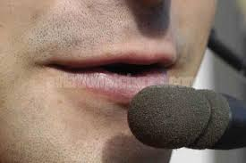
Circuit Radio Procedures and SOPs
Report entry leg
Report downwind leg (standard left or right) and intentions
Perform downwind leg midfield checks
Report final leg – check final items
Assure clearances for landings and deviations or exercises if required in the environment

Slide 18
Summary / Quiz
What are the factors affecting take-offs and landings the selection of a normal take-off and landing?
Mentally perform a normal take-off and state all observations and actions (phases).
Mentally perform a normal landing and state all observations and actions (phases).
How do flaps affect the landing performance?
How is the standard circuit organized and what procedures are associated with it?

Slide 19
Pre-Flight Briefing
Exercise
Training Area
Departure and Arrival Procedures
Weather Briefing / NOTAMs
Aircraft and Documents
Time and Fuel Requirements
Safety Considerations and Responsibilities

Slide 20

Overshoot / Go-Around
Full Power
Control Yaw
Assume Slight
Nose-Up Attitude
Flaps Up
In Stages
Reasons: balked landing, failures, traffic, animals, humans
Apply full power controlling yaw with rudder
Assume a slight nose-up attitude just above the horizon
Retract flaps to 10° and accelerate to safe climb speed
Maintain climb speed and retract flaps in white arc
Notes:
- Reasons: balked landing
- Go-around initiated from landing flare (below DH)
- low approach
- callout going around
- trim after established climb
- speed check before nose-up? Balked landing versus go-around at height

Slide 21
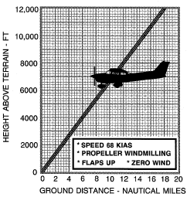
Aborted / Rejected Take-Off
Power Idle
Apply Brakes
Best Glide
Avoid Obstacles
Reasons: failures, traffic, animals, humans
During Take-Off Run: power idle, apply brakes
Immediately after Take-Off: best glide airspeed (68 KIAS), avoid obstacles
Notes:
- V1, TODA, ASDA?

Slide 22

Touch and Go
Flaps
Up
Full Power
Runway End
Keep Straight
Ensure sufficient runway length beforehand
Retract flaps completely during ground roll, trim for take-off
Apply full power and keep straight with rudder
Use runway end as reference for directional control
Perform take-off run and initial climb as required
Notes:
- let the plane slow down depending on the environment
- continue to actively control the plane during the ground roll
- do not let the nose wheel drop

Slide 23
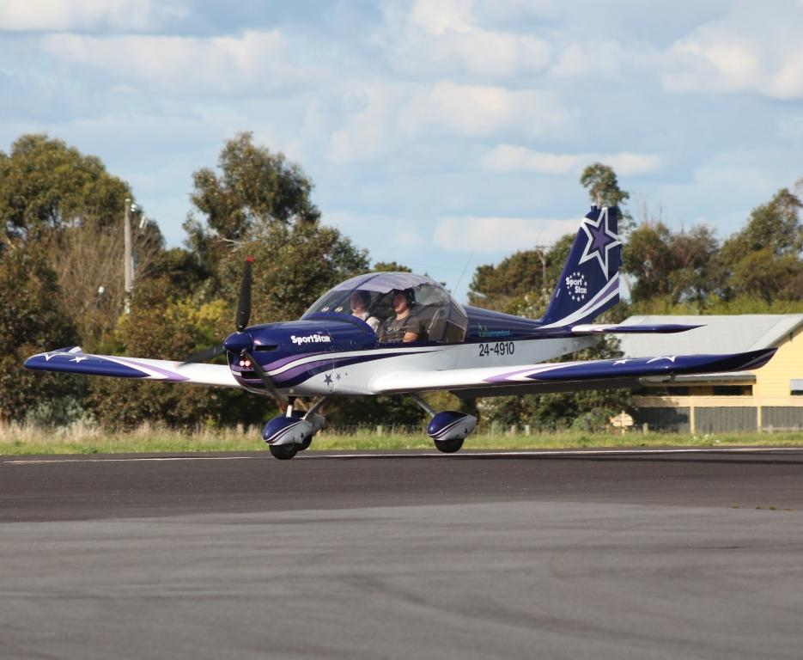
Wheelbarrowing
Higher load on the nose-wheel
Tendency to pivot about the nose wheel may result in ground loop
Before pivoting: Ease back elevator to reduce weight
After pivoting: Relax forward elevator and abort if not stopped

Slide 24
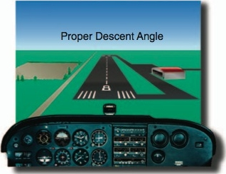
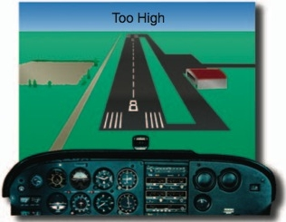
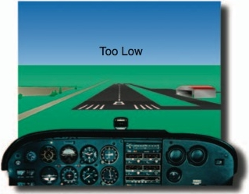
Approach Perspective
Maintain descent angle (perspective) and attitude
Control airspeed and rate of descent with power
Be aware of potential visual illusions
Notes:
- attitude plus power equals performance
- control airspeed with attitude?
- attitude has to be kept constant for a constant perspective, add power if to low, reduce power if to high
- visual illusions: runway width, illumination, terrain, precipitation, whiteout, black hole...

Slide 25
Take-Off and Landing Factors
Density (Altitude, Pressure, Temperature, Humidity)
Surface Material (Hard, Soft, Rough) and Slope
Surface Contamination (Wet, Dry, Slush, Snow, Ice)
Wind / Turbulence (Head-/Tailwind, Gusts, Windshear)
Wake Turbulence
Obstacles
Weight and Balance
Lifting Surfaces Contamination
Ground Effect, Wheelbarrowing, Weathercocking

Slide 26
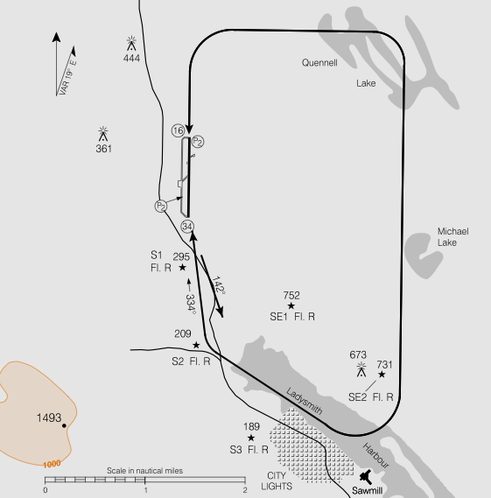
Circuit Layout
Legs: Take-Off, Crosswind, Downwind, Base, Final
Sides: Upwind and Downwind
Standard left-hand aerodrome circuit with 1000' AAE circuit height
Standard crosswind and base legs transition between 500' and 1000' AAE
Consult Canadian Flight Supplement for specific layout and procedures
Modifications due to obstacles, noise abatement and points of interest
Notes:
- points of interest may not be familiar to the pilot, point out appropriate ATC communication
- Upwind (Dead), Downwind (Active)
- focus on ground track and wind effect
- much more howto, what to do when
- downwind checks, airspeed, mixture, carburetor heat, lights, (flaps)

