Slide 1
Contact Information
Stephan Heinemann
SMS: +1 (250) 891-5446
Email: stephan.heinemann@hotmail.com
Bookings, Questions

Slide 2
Approach and Landing
Review Descending, Slow Flight and Slipping
Definition and Motivation
Approach and Landing
  Normal, Short-Field, Soft-Field, Crosswind
  Factors
Summary and Questions
Preflight Briefing

Slide 3
Review Descending and Slow Flight
Mentally perform a power-off and power-on descent and state all observations and required actions (PAT).
Define and state the best glide airspeed.
What is slow flight and how do we recover from the slow flight range?
Define and state the two stall speeds.

Slide 4
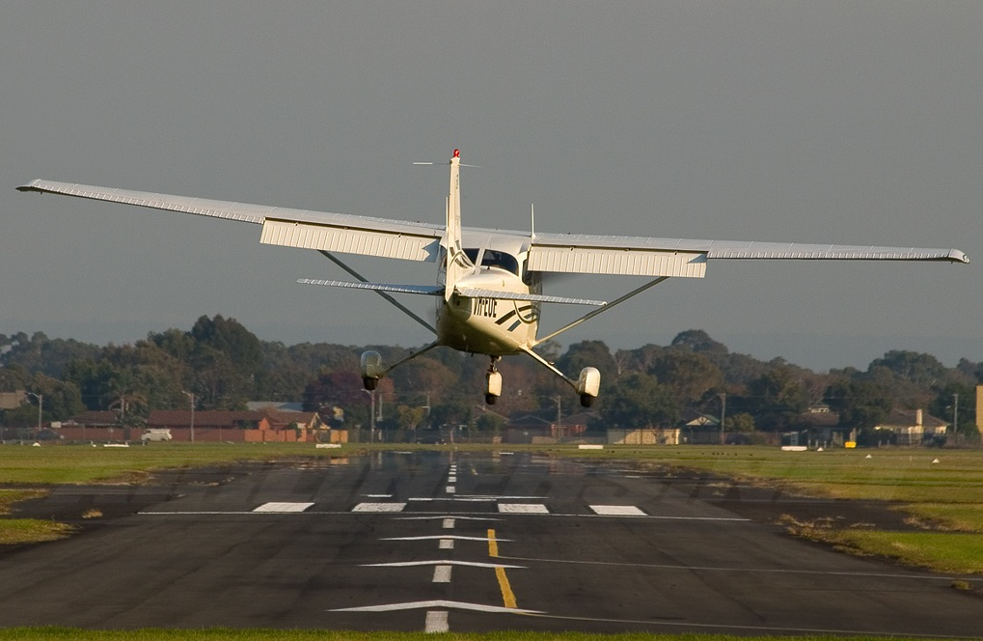
Definition and Motivation
Landing is the last part of a flight, where a flying animal, aircraft, or spacecraft returns to the ground.
Stabilized approach, flare, touchdown, ground roll
Essential maneuver used in every single flight

Slide 5
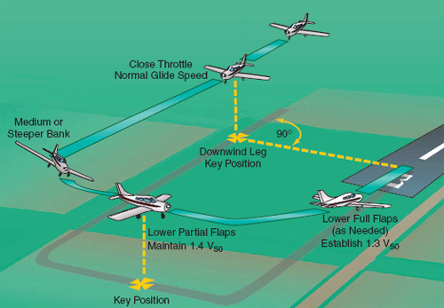
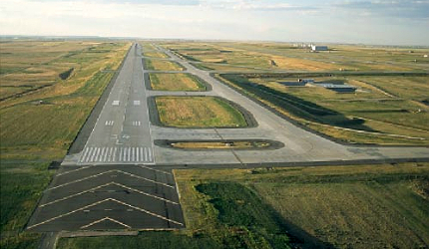
Normal Approach and Landing
Criteria: hard uncontaminated surface, long runway, no obstacles, low density altitude, no or steady headwind
Check environment and consult performance data in POH
Pre-landing checks according to checklists in POH
Passenger, arrival and emergency briefings

Slide 6




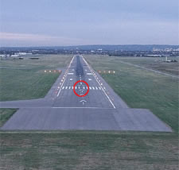

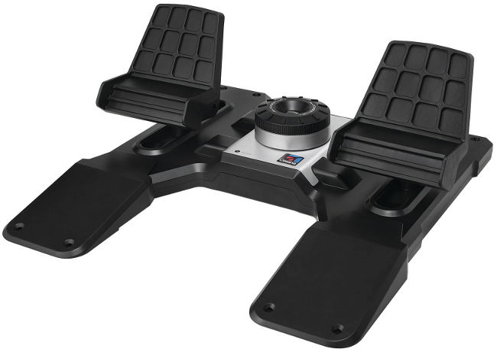
Normal Landing – Approach
Control Descent
Perspective
Approach Speed
Align with runway and establish a stabilized descent
Aim for runway threshold to flare into landing zone
Set flaps as required (10°-20°) in white arc (40-85 KIAS)
Continuously check correct approach airspeed (65-75 KIAS)
Adjust power to maintain attitude and perspective
Notes:
- attitude, alignment, height
- both power-off and power-on descent
- at least 500' (152m) of straight approach
- mention stabilized approach criteria
- approach slope – perspective / runway shape
- 1500 – 1700 RPM, or power-off approach
The aircraft is on the correct flight path
Only small changes in heading/pitch are necessary to maintain the correct flight path
The airspeed is not more than VREF + 20kts indicated speed and not less than VREF
The aircraft is in the correct landing configuration
Sink rate is no greater than 1000 feet/minute; if an approach requires a sink rate greater than 1000 feet/minute a special briefing should be conducted
Power setting is appropriate for the aircraft configuration and is not below the minimum power for the approach as defined by the operating manual
All briefings and checklists have been conducted
Specific types of approach are stabilized if they also fulfil the following:
ILS approaches must be flown within one dot of the glide-slope and localizer
a Category II or III approach must be flown within the expanded localizer band
during a circling approach wings should be level on final when the aircraft reaches 300 feet above airport elevation; and,
Unique approach conditions or abnormal conditions requiring a deviation from the above elements of a stabilized approach require a special briefing.

Slide 7
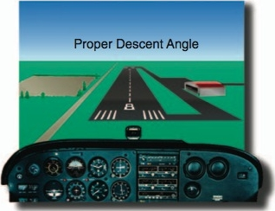
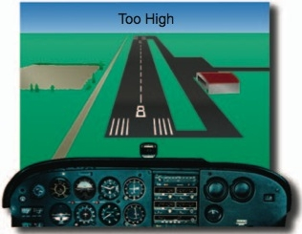
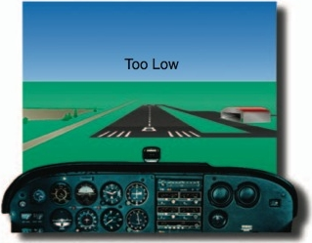
Approach Perspective
Maintain descent angle (perspective) and attitude
Control airspeed and rate of descent with power
Notes:
- attitude plus power equals performance
- control airspeed with attitude?
- attitude has to be kept constant for a constant perspective, add power if to low, reduce power if to high

Slide 8
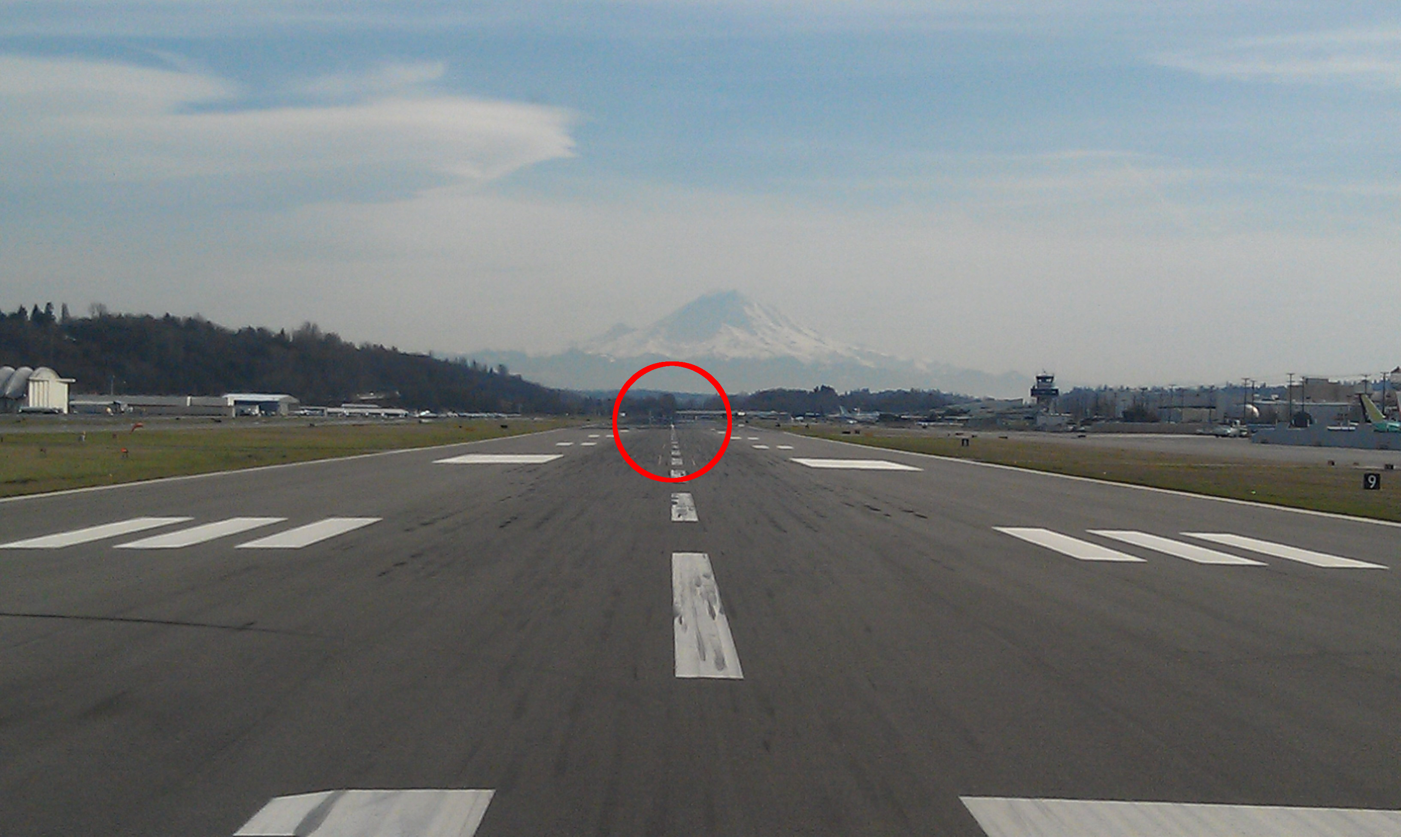
Normal Landing – Flare and Touchdown
Power
Idle
Straight and Aligned
Hold Off
Runway End
Callout Landing Assured before initiating landing flare
Reduce power to idle keeping straight
Use runway end as reference for directional control
Continue to deccelerate in level slow flight above runway
Gently increase elevator back-pressure to assume landing attitude – slight nose-up, main-wheels first
Notes:
- 15-30' AGL (5-9m)
- increase nose-up attitude to control descent
- learn landing attitude
- diminishing control response during flare

Slide 9
Normal Landing – Ground Roll
Keep Straight
Runway End
Allow Nose Wheel to Settle
Apply Brakes
Keep straight with rudder using peripheral vision
Hold elevator back-pressure allowing nose wheel to settle
Gently apply brakes keeping straight towards runway end
Slow down to taxi speed and vacate runway
Cleanup – flaps, transponder, lights, time, clearance

Slide 10

Overshoot / Go-Around
Full Power
Control Yaw
Assume Slight
Nose-Up Attitude
Flaps Up
In Stages
Reasons: balked landing, failures, traffic, animals, humans
Apply full power controlling yaw with rudder
Assume a slight nose-up attitude just above the horizon
Retract flaps to 10° and accelerate to safe climb speed
Maintain climb speed and retract flaps in white arc
Notes:
- Reasons: balked landing
- Go-around initiated from landing flare (below DH)
- low approach

Slide 11
Touch and Go
Flaps
Up
Full Power
Runway End
Keep Straight
Ensure sufficient runway length beforehand
Retract flaps completely during landing ground roll
Apply full power and keep straight with rudder
Use runway end as reference for directional control
Perform take-off run and initial climb as required

Slide 12
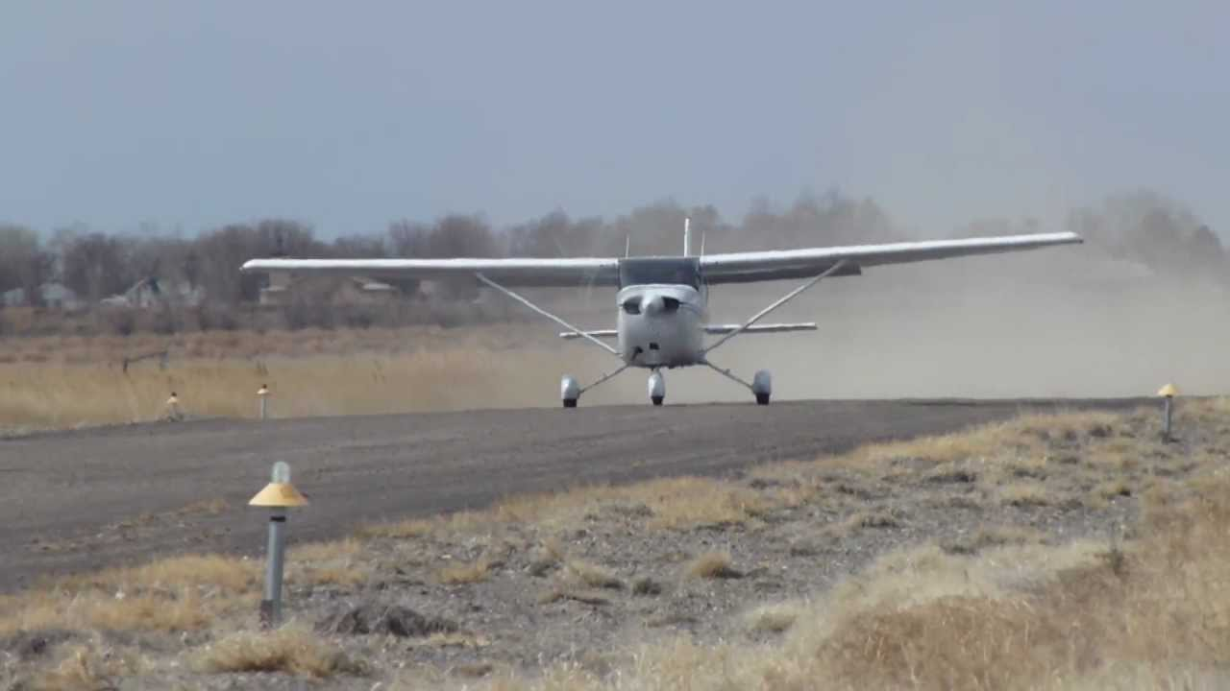
Stop and Go
Ensure sufficient runway length beforehand
Perform landing to full stop on the runway
Perform subsequent take-off from stop position

Slide 13
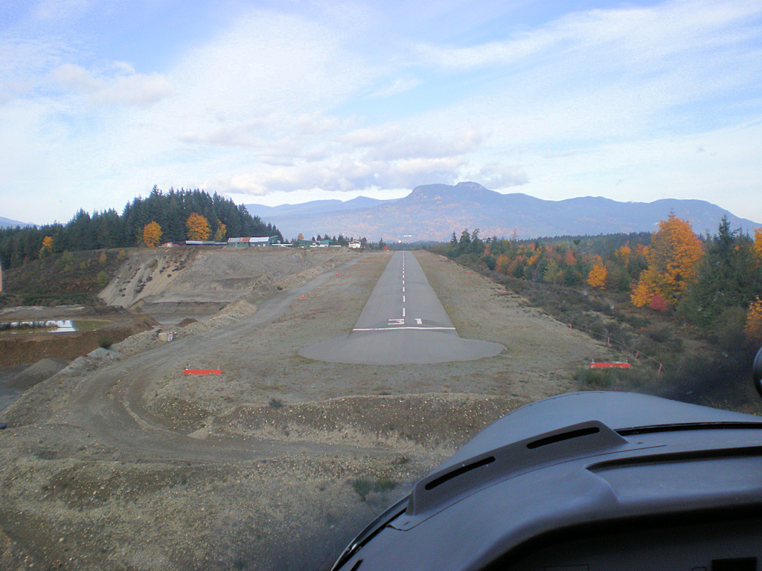
Short-Field Landing
Criteria: hard uncontaminated surface, short runway, obstacles, high density altitude, no or steady headwind
Check environment and consult performance data in POH
Pre-landing checks according to checklists in POH
Passenger, arrival and emergency briefings

Slide 14

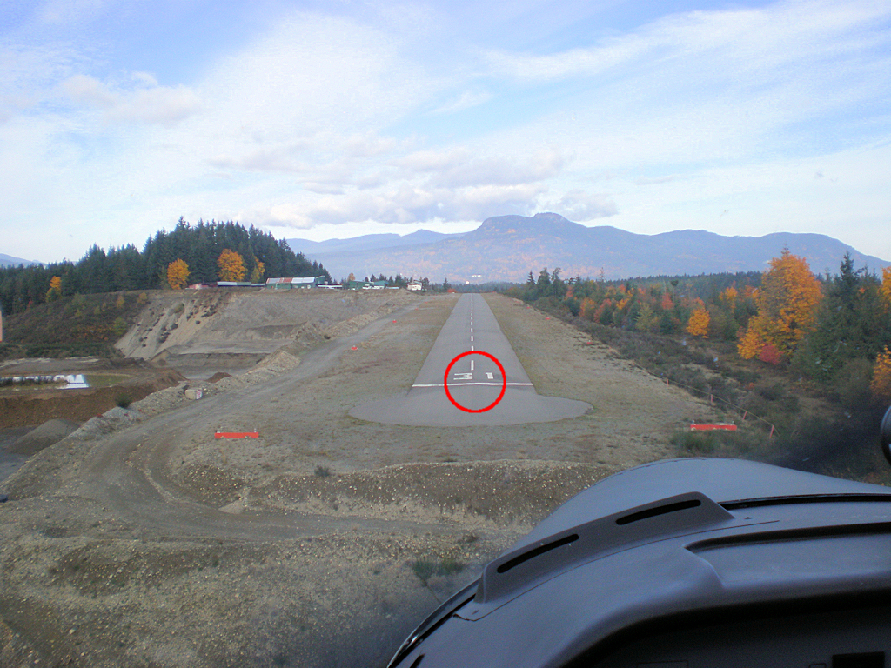
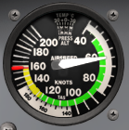
Short-Field Landing – Approach
Control Descent
Perspective
Approach Speed
Align with runway and establish a stabilized descent
Aim for runway threshold or before to flare into landing zone
Set full flaps (30°) in white arc (40-85 KIAS)
Continuously check correct approach airspeed (60 KIAS)
Adjust power to maintain attitude and perspective

Slide 15
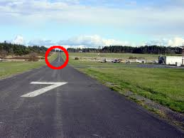
Short-Field Landing – Flare and Touchdown
Power
Idle
Straight and Aligned
Hold Off
Runway End
Callout Landing Assured before initiating landing flare
Reduce power to idle keeping straight
Use runway end as reference for directional control
Continue to deccelerate in level slow flight above runway
Gently increase elevator back-pressure to assume landing attitude – slight nose-up, main-wheels first
Notes:
- Vr = 44, 48, 51 KIAS depending on weight
- 2300-2400 RPM check POH

Slide 16
Short-Field Landing – Ground Roll
Keep Straight
Runway End
Hold Back-Pressure
Apply Brakes
Keep straight with rudder using peripheral vision
Hold elevator back-pressure allowing nose wheel to settle
Retract flaps immediately
Apply brakes firmly and increase elevator back-pressure
Keep straight and slow down to taxi speed and vacate runway
Cleanup – flaps, transponder, lights, time, clearance
Notes:
Vc = 56 KIAS (with flaps until obstacle clearance)

Slide 17
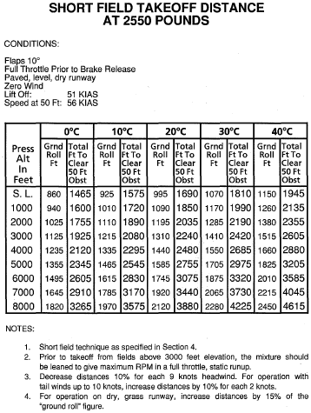
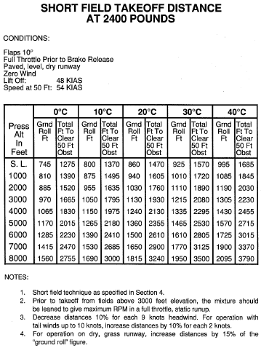
Take-Off Performance
Notes:
- 56 KIAS versus 62 KIAS clean Vx
- aim for Vx, explain if necessary

Slide 18
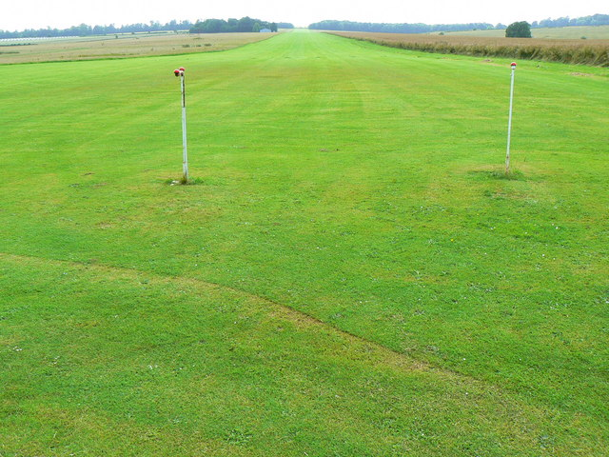
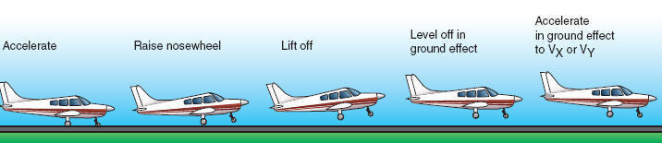
Soft-Field Take-Off
Criteria: soft, rough or contaminated surface, long runway, no obstacles, low density altitude, no or steady headwind
Check environment and consult performance data in POH
Pre-take-off checks according to checklists in POH
Mixture full rich, lean for maximum RPM above 3000' DA
Passenger, departure and emergency briefings
Notes:
Criteria, Procedure, Performance Tables
Surface, Contamination
Ground Effect

Slide 19
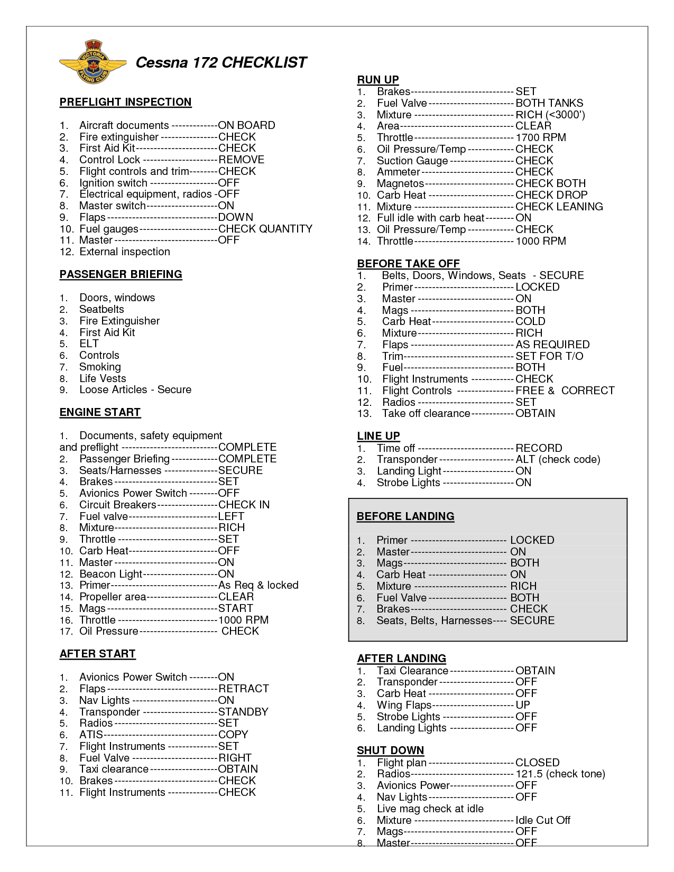


Soft-Field Pre-Take-Off
Checks
Briefings
Mixture
Flaps 10°
Complete pre-take-off checks on supporting surface
Setup aircraft for rolling take-off on soft surface
Departure and emergency briefings, mixture, flaps

Slide 20
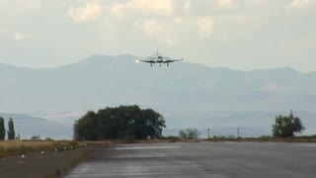
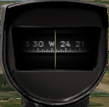
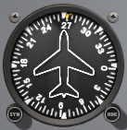
Soft-Field Take-Off Line Up
Relieve Nose-Wheel and Keep Rolling
Check
Approach Sector
Align
Centerline
Crosscheck
Instruments
Apply and hold elevator back-pressure to relieve nose-wheel
Check approach sector and callout Approach Sector Clear
Perform rolling take-off – do not stop after centerline alignment
Crosscheck runway heading, magnetic compass, heading indicator

Slide 21
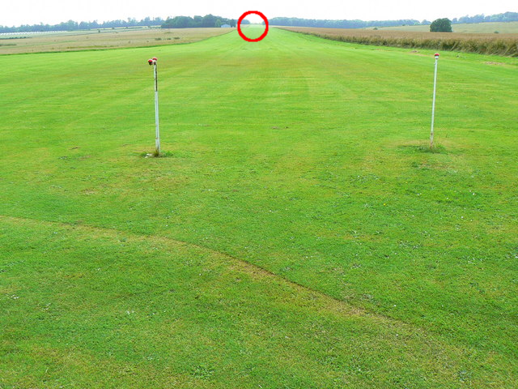
Soft-Field Take-Off Run
Full
Power
Keep
Straight
Lift Off
Runway End
Callout Take-Off before initiating take-off run
Smoothly apply full power keeping straight with rudder
Use runway end as reference for directional control
Apply slight elevator back-pressure to raise nose-wheel
Check RPM/ASI and callout RPM Checked, Airspeed Alive
Lift off at slowest speed possible commensurate
Notes:
Accelerate in ground effect to best angle or rate of climb (Vx = 62 KIAS, Vy = 74 KIAS)
Peripheral view, nose-up attitude and visibility
(Vr = 43 KIAS) different rotation speeds

Slide 22
Soft-Field Take-Off Initial Climb
Level-off and remain in ground effect after lift-off
Accelerate in ground effect to desired climb airspeed (Vx, Vy)
At best angle of climb (Vx = 62 KIAS) transition into climb and
Accelerate to best rate of climb (Vy = 74 KIAS)
Retract flaps in white arc when above 500' AGL

Slide 23
Review Slipping
Define a slip and explain the difference between a side and a forward slip and their applications.
Mentally perform a side slip and state all observations and actions.

Slide 24
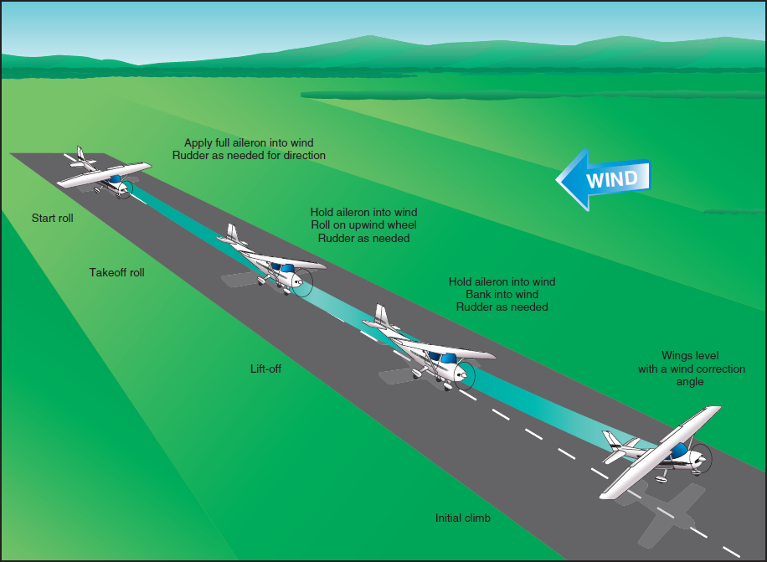
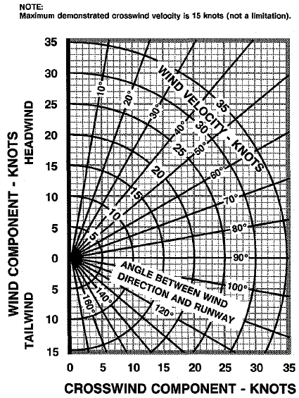
Crosswind Take-Off
Criteria: steady or gusty crosswind component (windshear)
Check environment and consult performance data in POH
Pre-take-off checks according to checklists in POH
Maximum demonstrated crosswind component 15 knots
Mixture full rich, lean for maximum RPM above 3000' DA
Passenger, departure and emergency briefings
Notes:
Criteria, Procedure, Performance Tables
Limitations, Vmxwc (20% Vs / Vs0), 15 knots
Gusts and Windshear

Slide 25
Crosswind Take-Off Run
Full Aileron
Into Wind
Reduce Aileron
Briskly Lift Off
Minimum
Flaps
Keep Straight
Use minimum flap setting required and hold full ailerons into the wind
Callout Take-Off before initiating take-off run
Smoothly apply full power keeping straight with rudder
Use runway end as reference for directional control
Check RPM/ASI and callout RPM Checked, Airspeed Alive
Continue to accelerate to slightly higher lift-off speed
Gradually reduce aileron input – some ailerons required at lift-off
Briskly apply elevator back-pressure to lift off
Notes:
- weather cocking
- rubber drifting
- more lift on the windward side
- positive dihidral increases lift on the windward side

Slide 26
Crosswind Take-Off Initial Climb
Level Wings
Coordinated Turn into Wind
Check VSI and callout Positive Rate
Level wings when airborne
Perform coordinated turn into the wind (crab) maintaining desired track
Accelerate to desired climb airspeed (Vx, Vy)
Adjust and maintain nose-up attitude for airspeed and trim
Retract flaps in white arc above 500' AGL
Notes:
- maybe just slight kick of rudder required to initiate crabbing

Slide 27
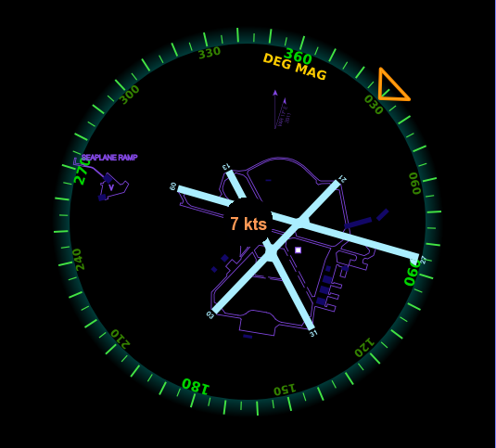
Crosswind Component

Slide 28
Take-Off Factors
Density (Altitude, Pressure, Temperature, Humidity)
Surface Material (Hard, Soft, Rough) and Slope
Surface Contamination (Wet, Dry, Slush, Snow, Ice)
Wind / Turbulence (Head-/Tailwind, Gusts, Windshear)
Wake Turbulence
Obstacles
Weight and Balance
Lifting Surfaces Contamination
Ground Effect, Wheelbarrowing, Weathercocking

Slide 29
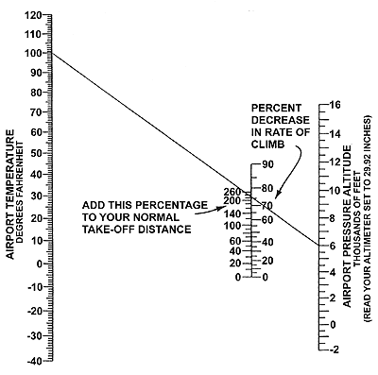
Density Altitude – Koch Chart

Slide 30
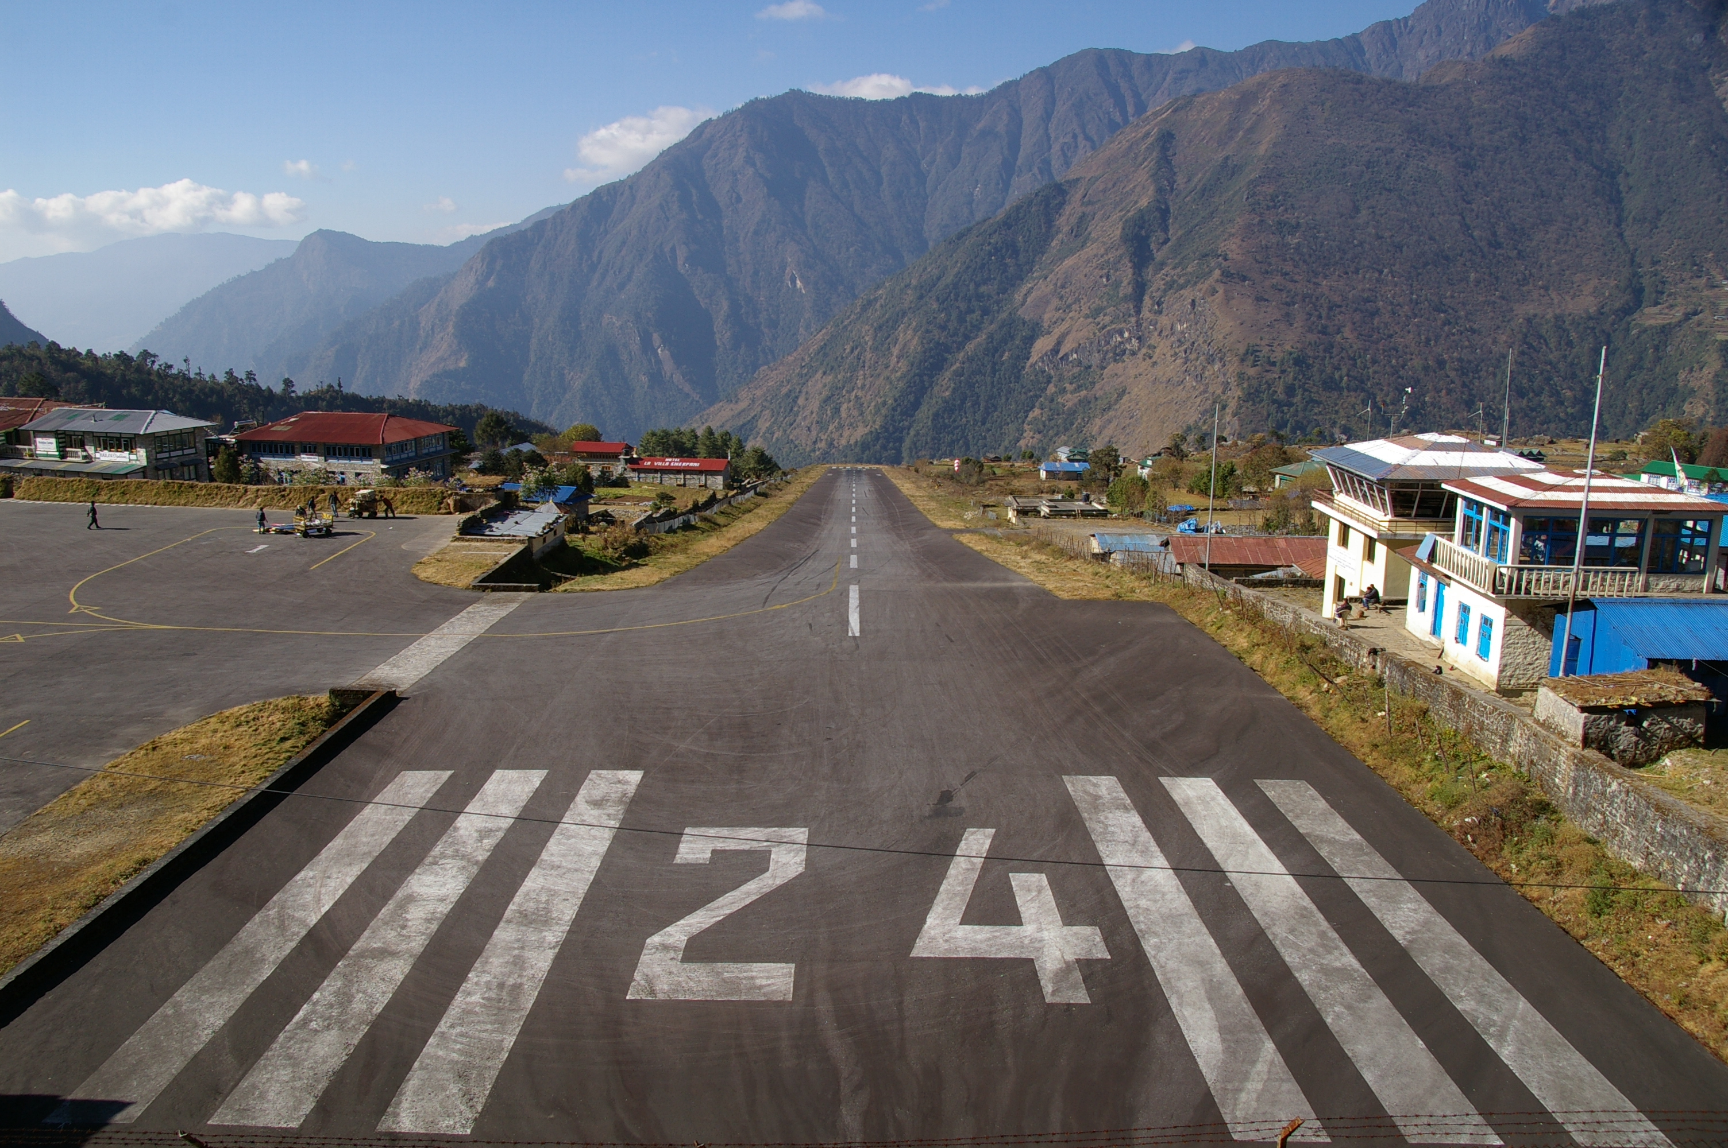
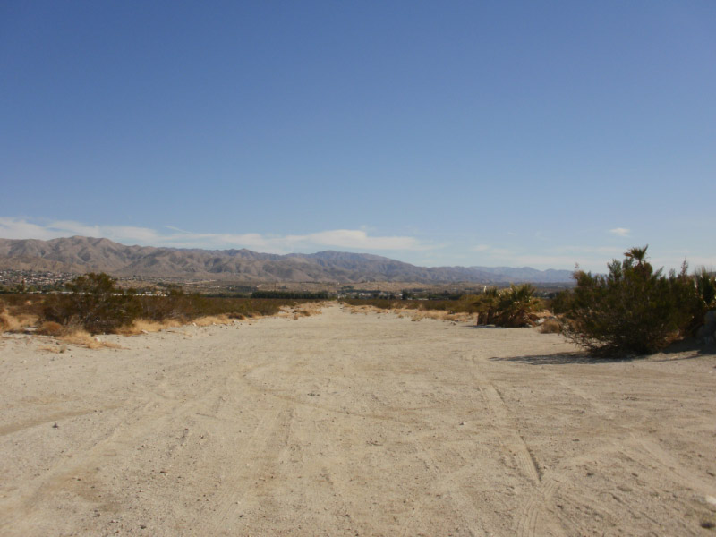
High Density Altitude Operations
Check environment and consult performance data in POH
Pre-take-off checks according to checklists in POH
Above 3000' DA lean for maximum RPM
High, hot, humid

Slide 31
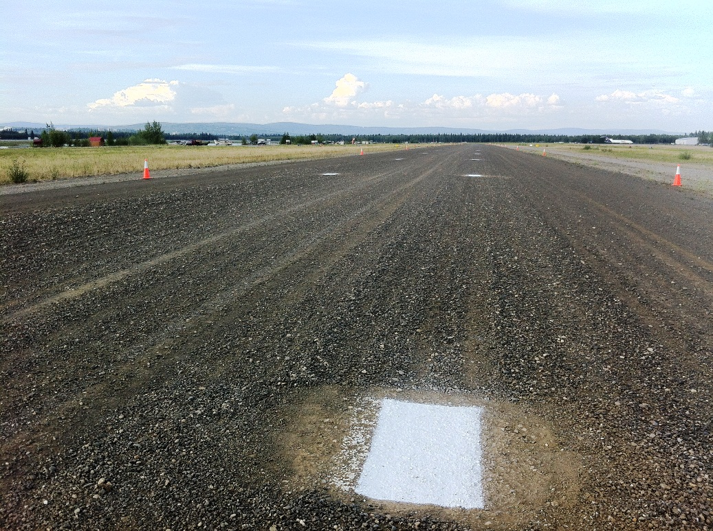
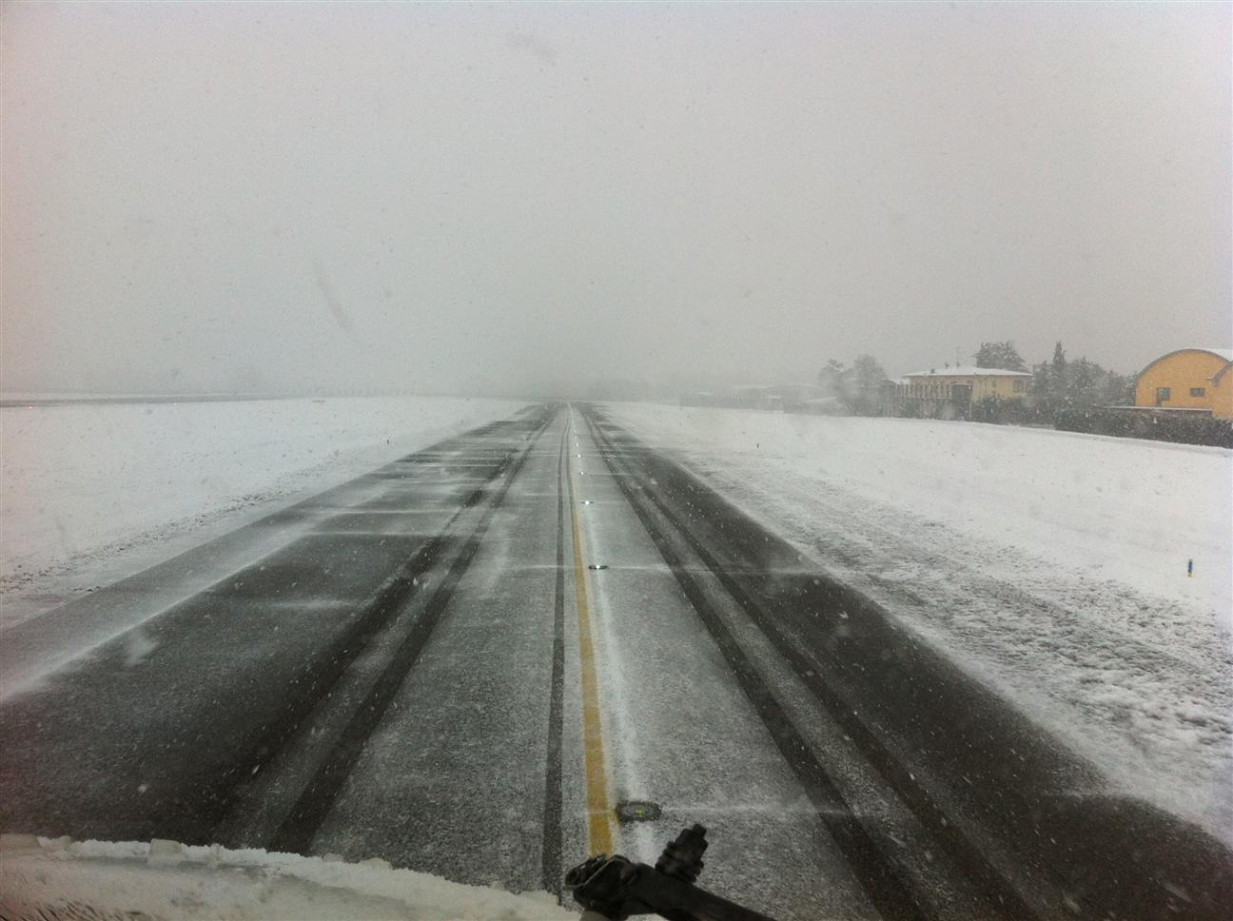
Special Take-Offs
Soft, short, high, hot, gusty, heavy, contaminated...

Slide 32
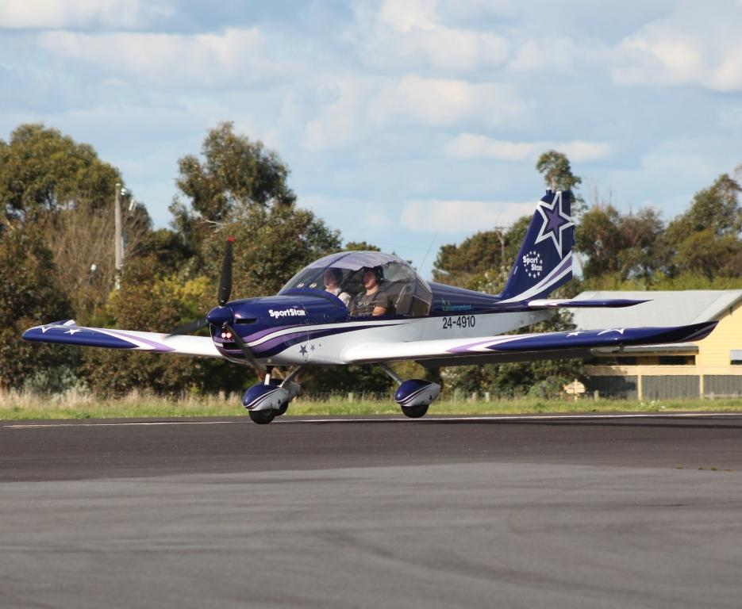
Wheelbarrowing
Higher load on the nose-wheel
Tendency to pivot about the nose wheel may result in ground loop
Before pivoting: Ease back elevator to reduce weight
After pivoting: Relax forward elevator and abort if not stopped

Slide 33
Summary / Quiz
What are the factors affecting take-offs and the selection of a take-off type?
Mentally perform a short-field take-off and state all observations and actions.
Mentally perform a soft-field take-off and state all observations and actions.
Mentally perform a crosswind take-off and state all observations and actions.

Slide 34
Pre-Flight Briefing
Exercise
Training Area
Departure and Arrival Procedures
Weather Briefing / NOTAMs
Aircraft and Documents

Slide 35
Take-Off (Ex. 16, LP. 3, 4, 14, 16, 18)
Objective
Review
Motivation
Howto
Summary / Questions
Preflight Briefing

