Slide 1
Contact Information
Stephan Heinemann
SMS: +1 (250) 891-5446
Email: stephan.heinemann@hotmail.com
Bookings, Questions

Slide 2
Slipping
Review Coordinated Flight
Definition and Motivation
Slips
Summary and Questions
Pre-Flight Briefing

Slide 3
Review Coordinated Flight
Define coordinated flight and what needs to be done to remain coordinated.
What instrument helps to remain coordinated?
Give examples of when control inputs need to be more pronounced to remain coordinated.
What would you feel during a turn with too little or too much rudder application?
Notes:
- bank attitude and rate of turn correspond, no sideways forces are felt, inclinometer ball is centered
- turn coordinator / inclinometer
- whenever an increased yawing moment results – slow flight, stall entry, climb, descents, turns
- a force to the inside of the turn due to an insufficient rate of turn

Slide 4
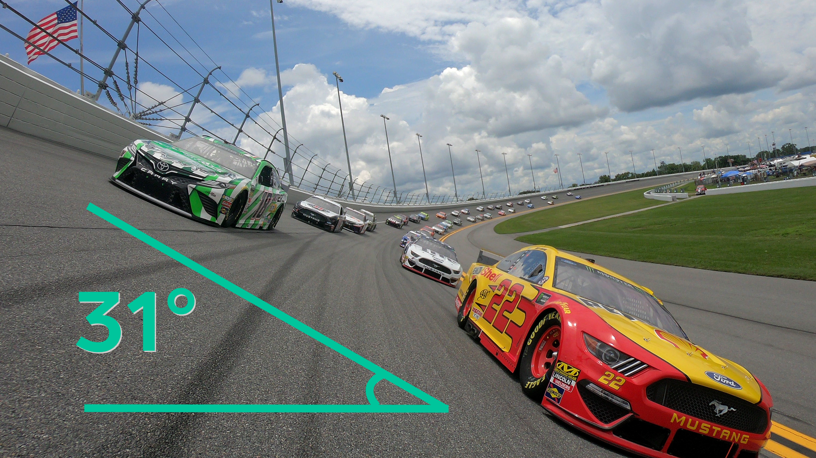
Coordinated Turns
Coordination: corresponding bank angle and rate of turn
Horizontal and vertical forces are balanced during coordinated turns
Notes:
- analyze situation at different speeds giving different rates of turns in the oval (same radius)
- standstill or slow: slip
- fast: skid
- just the right rate of turn: coordinated
- discuss forces acting on driver for each scenario

Slide 5
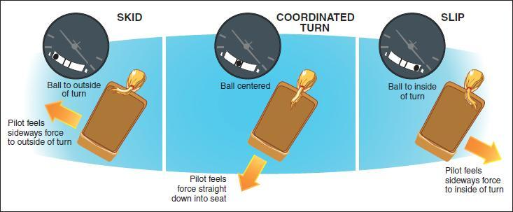
Definition and Motivation
Uncoordinated flight with insufficient rate of turn
Sideways force towards low wing while drag is increased
Types: side slip and forward slip
Applications: crosswind landings, power-off descents, emergencies
Notes:
- more inside rudder would be required to fly a coordinated turn
- no/opposite rudder creates slip
- too much inside rudder creates skid
- opposite rudder just enough to prevent turn results in a drift → side slip
- opposite rudder more than to prevent turn result in a straight flight → forward slip
- Application: wing fire emergency, iced window

Slide 6
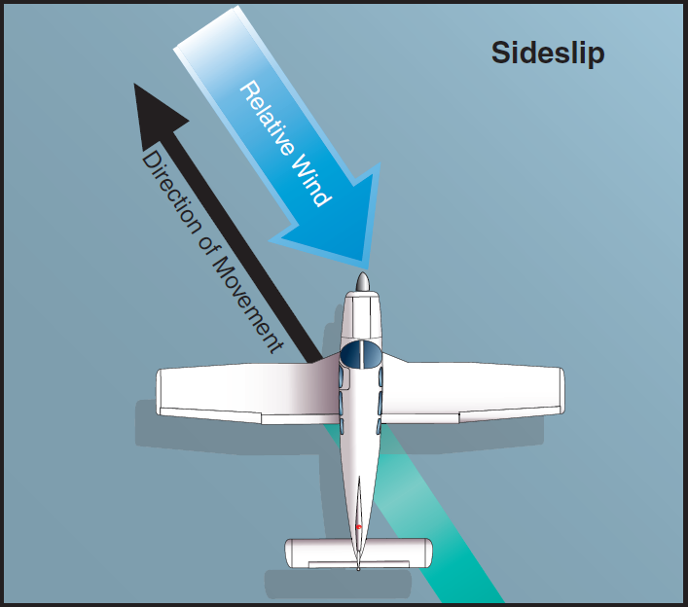
Side Slip
Longitudinal axis is parallel to original flight path
Banked attitude (wing low) into the wind to prevent sideways drift
Just enough opposite rudder to prevent turn
Aircraft would not achieve a straight track during side slip without wind
Compensates drift during crosswind landings
Notes:
- possibly find a video of a more pronounced side-slip

Slide 7

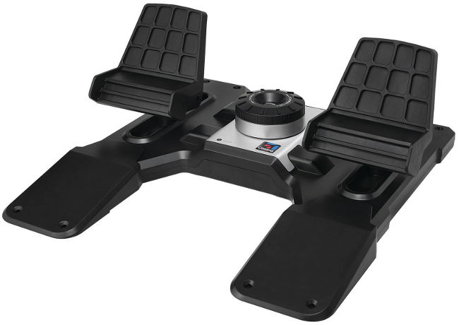
Entering a Side Slip
Maintain Pitch
Attitude
Roll into Wind
Prevent Turn
Roll one wing into the wind using ailerons while simultaneously
Apply just enough opposite rudder to prevent turn
Apply elevator as required to desired maintain pitch attitude
Adjust and balance aileron and rudder input for desired heading
Notes:
- slipping with more than 20deg flaps may cause elevator oscillations according to the POH
- opposite rudder input during a banked attitude may lead to a pitch-up moment (switched controls)
- steer like a car and keep it straight with your feet

Slide 8
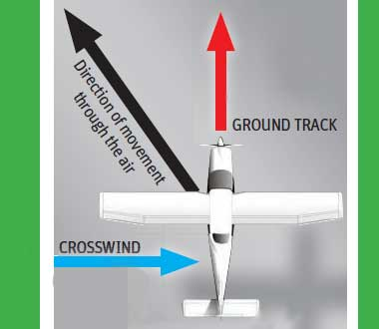
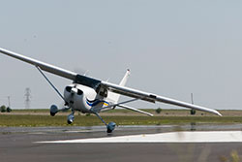
Maintaining a Side Slip
Continuously balance aileron and rudder for desired heading
Adjust balance to obtain desired track over ground
Steer like a car and keep straight with rudder
Apply as required aileron to adjust drift → track
Apply as required rudder to keep straight → heading
Use elevator to maintain desired airspeed and pitch attitude
Notes:
- simple instructions / car / sailing
More (less) aileron requires more (less) opposite rudder

Slide 9
Recovering a Side Slip
Release
Pressure
Maintain Pitch
Attitude
Roll Wings Level
Release rudder pressure while simultaneously
Roll wings level using ailerons
Adjust pitch attitude with elevator
Resume coordinated flight in landing flare or stable descent

Slide 10
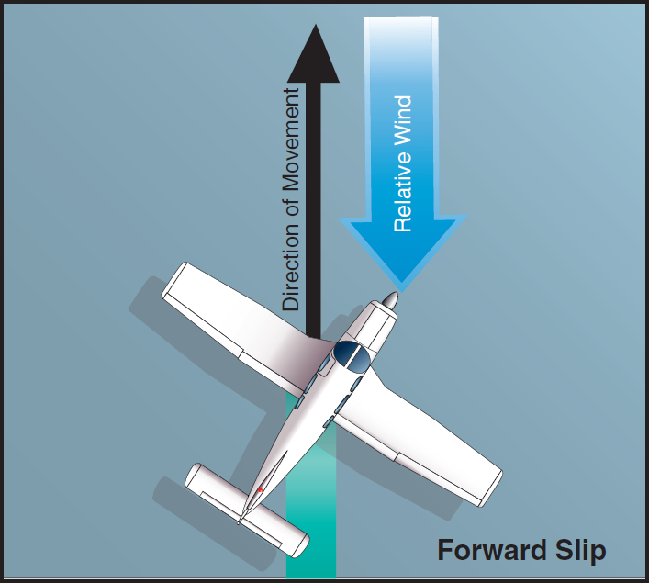
Forward Slip
Longitudinal axis is offset from original flight path
Banked attitude (wing low) into the wind to increase parasite drag
Up to full opposite rudder to control rate of descent
Aircraft is crabbing and achieves a straight track without wind
Increased rate of descent without increasing airspeed
Notes:
- forward slips are always performed with full rudder during the exercise, also always during a stable descent without flaps

Slide 11
Entering a Forward Slip
Maintain Pitch
Attitude
Roll into Wind
Control RoD
Roll one wing into the wind using ailerons while simultaneously
Apply up to full opposite rudder to control rate of descent
Apply elevator forward-pressure to maintain pitch attitude
Adjust and balance aileron and rudder input for desired track
Notes:
- forward slips are always practiced with full rudder during a stable descent
- power off

Slide 12
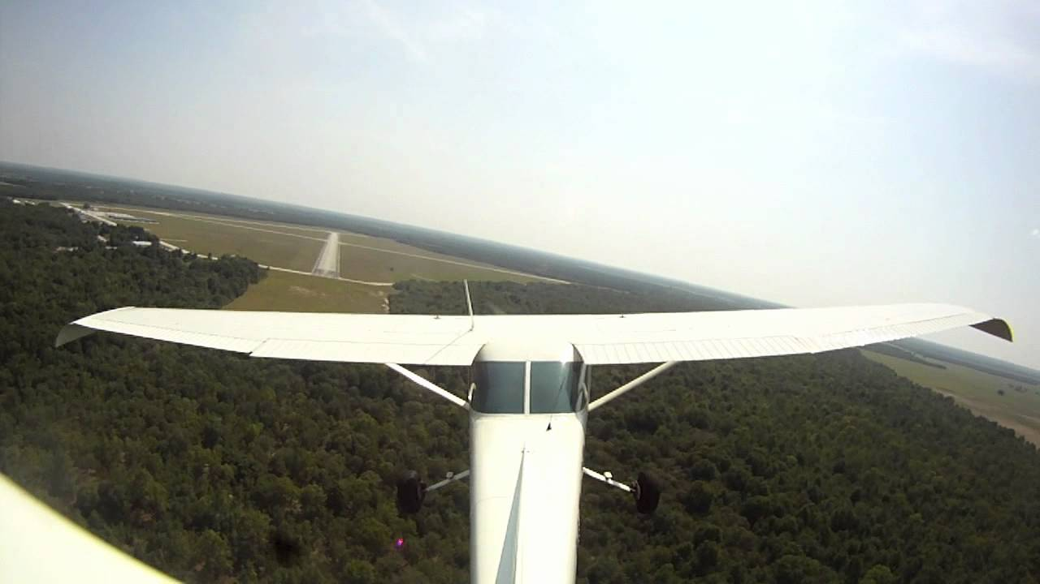
Maintaining a Forward Slip
Continuously balance aileron and rudder for desired track
More aileron and opposite rudder increases rate of descent
Less aileron and opposite rudder decreases rate of descent
Use elevator to maintain desired airspeed and pitch attitude
Notes:
More (less) aileron requires more (less) opposite rudder
Adjust balance to obtain desired rate of descent

Slide 13
Recovering a Forward Slip
Release
Pressure
Maintain Pitch
Attitude
Roll Wings Level
Release rudder pressure while simultaneously
Roll wings level using ailerons
Adjust pitch attitude with elevator
Resume coordinated flight at level or in stable descent

Slide 14
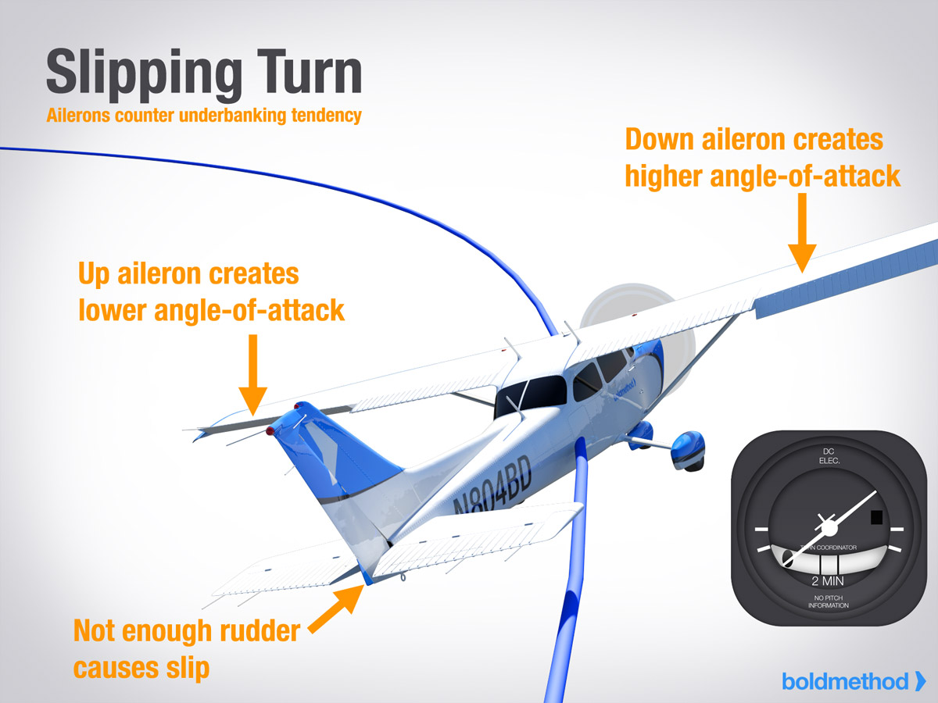
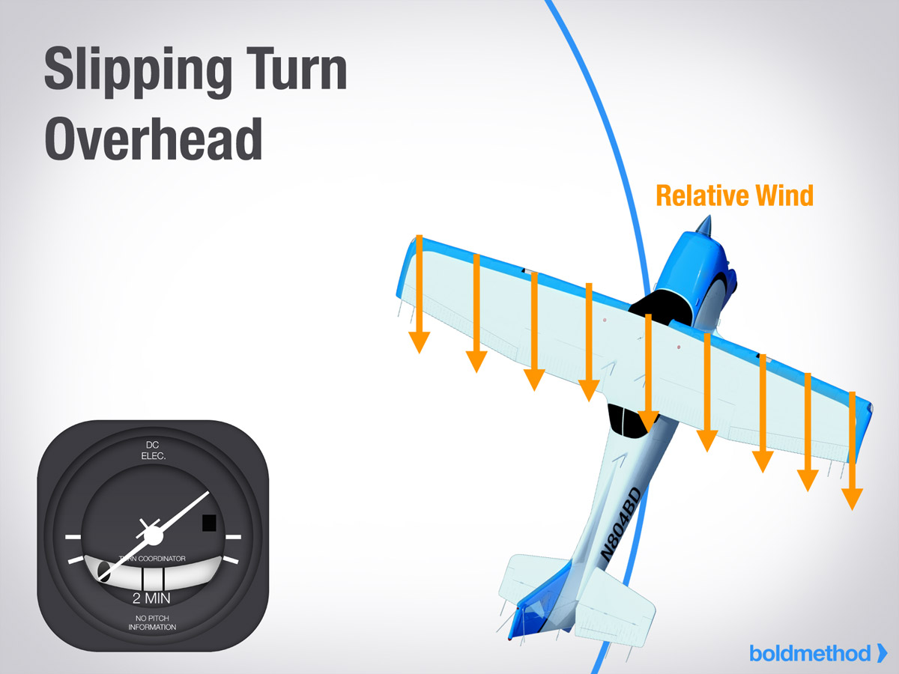
Slipping Turns
Apply rudder opposite to the turn as required
More opposite rudder decreases rate of turn
More opposite rudder increases rate of descent
Application: higher rate of descent during turn to final
Notes:
- recover between slipping turns in different directions – never skid

Slide 15

Instruments
Turn coordinator with inclinometer – slip versus skid
Airspeed indications are erroneous (position error)
Rate of descent increases during forward slips
Notes:
- check POH for airspeed (5-10 KIAS drop?)
- get page in POH
- left forward slip versus right forward slip position error, static port position

Slide 16
Safety Considerations
HASEL (except if briefed and practiced in the circuit)
Maximum 30s slip or skid duration one tank dry
With ¼ tank prolonged uncoordinated flight is prohibited when operating with left / right tank
Elevator oscillations possible with more than 20° flaps
Incorrect fuel gauges
Avoid skids at all times (accelerated outer wing)
Recover to coordinated flight before changing slip direction

Slide 17
Summary / Quiz
Define a slip and explain the difference between a side and a forward slip and their applications.
Mentally perform a side slip and state all observations and actions.
Mentally perform a forward slip and state all observations and actions.
Define a slipping turn and give an application example.

Slide 18
Pre-Flight Briefing
Exercise
Training Area
Departure and Arrival Procedures
Weather Briefing / NOTAMs
Aircraft and Documents
Time and Fuel Requirements
Safety Considerations and Responsibilities
Notes:
- maximum slip or skid duration with one tank dry: 30s
- with ¼ tank prolonged uncoordinated flight is prohibited when operating with left/right tank
- elevator oscillations with more than 20deg flaps
- fuel readings

Slide 19
Additional Materials
Additional materials for Slipping
Flight Instructor Guide – Exercise 15, Lesson Plans 7, 8

