Slide 1
Contact Information
Stephan Heinemann
SMS: +1 (250) 891-5446
Email: stephan.heinemann@hotmail.com
Bookings, Questions

Slide 2
Stalls
Definition and Motivation
Power-Off and Power-On Stalls
Stalls in Clean and Landing Configuration
Acceleration, Turning and Departure Stalls (Approach Stalls – Power-On)

Slide 3
Review Slow Flight
Attitude plus power equals performance!
Mentally enter a slow flight in landing configuration from cruise flight and state all observations and required actions.
What particular observation applies to the control inputs compared to normal cruise flight?
Mentally recover from a slow flight in landing configuration and state all observations and required actions.

Slide 4
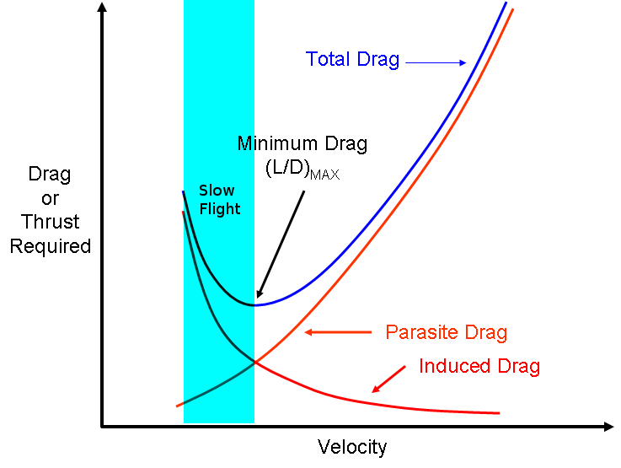
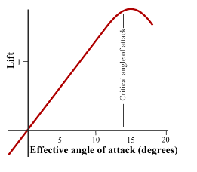
Definition and Motivation
Lower limit of the slow flight range
Any angle of attack beyond the critical angle of attack at which any further increase leads to less lift and more drag
Imminent – stall warning, bottom of arc, buffet
Fully Developed – nose or wing drop
Notes:
- Stall can happen at any attitude and airspeed

Slide 5
Safety Considerations
High nose-up attitude maneuver
Limited forward visibility
HASEL, lookout ahead and below
Maintain good lookout during maneuver
Yaw is to be controlled precisely with rudder
Remain coordinated at all times

Slide 6
Entering a Power-Off Stall
Reduce power to idle
Apply elevator back-pressure to increase nose-up attitude controlling yaw with rudder maintaining altitude
Extend flaps in stages to desired degree in white arc

Slide 7
Recovering a Power-Off Stall
Apply elevator forward pressure to lower the nose immediately
Apply full power controlling yaw with rudder to remain coordinated
Retract flaps in stages to up in white arc
Establish best rate of climb airspeed to regain altitude
Establish cruise attitude and accelerate to cruise airspeed
Reduce power to cruise power setting and finally trim
Notes:
- Break the stall first (lower nose), then apply power
- Establish best rate of climb airspeed first during recovery

Slide 8
Entering a Power-On Stall
Reduce power to low power setting (1500 RPM)
Apply elevator back-pressure to increase nose-up attitude controlling yaw with rudder maintaining altitude
Extend flaps in stages to desired degree in white arc

Slide 9
Recovering a Power-On Stall
Apply elevator forward pressure to lower the nose immediately
Apply full power controlling yaw with rudder to remain coordinated
Retract flaps in stages to up in white arc
Establish best rate of climb airspeed to regain altitude
Establish cruise attitude and accelerate to cruise airspeed
Reduce power to cruise power setting and finally trim
Notes:
- Lower stall speed due to power and slipstream
- Higher nose-up attitude
- More yaw to be controlled
- Less effective ailerons
- More sudden and abrupt nose (wing) drop

Slide 10
Power-On verus Power-Off Stall
Slightly lower stall speed and higher pitch attitude
Directional control and coordination more difficult
Ailerons are even less effective
More rudder and elevator effectiveness (slipstream)
More steep and rapid attitude change

Slide 11
Imminent and Fully Developed Stalls
Stall recovery in normal flight operations should be performed as early as possible – during the imminent stall
Recover at the first indication of stall warning, bottom of arc or buffet
Fully developed stalls are practiced to develop proficiency in recognition and recovery only

Slide 12
Accelerated Stall
High load factors and abrupt elevator back-pressure may lead to a stall at any airspeed and attitude
An incorrect stall recovery may lead to a secondary stall
Notes:
- high load factors can be introduced by gusts

Slide 13
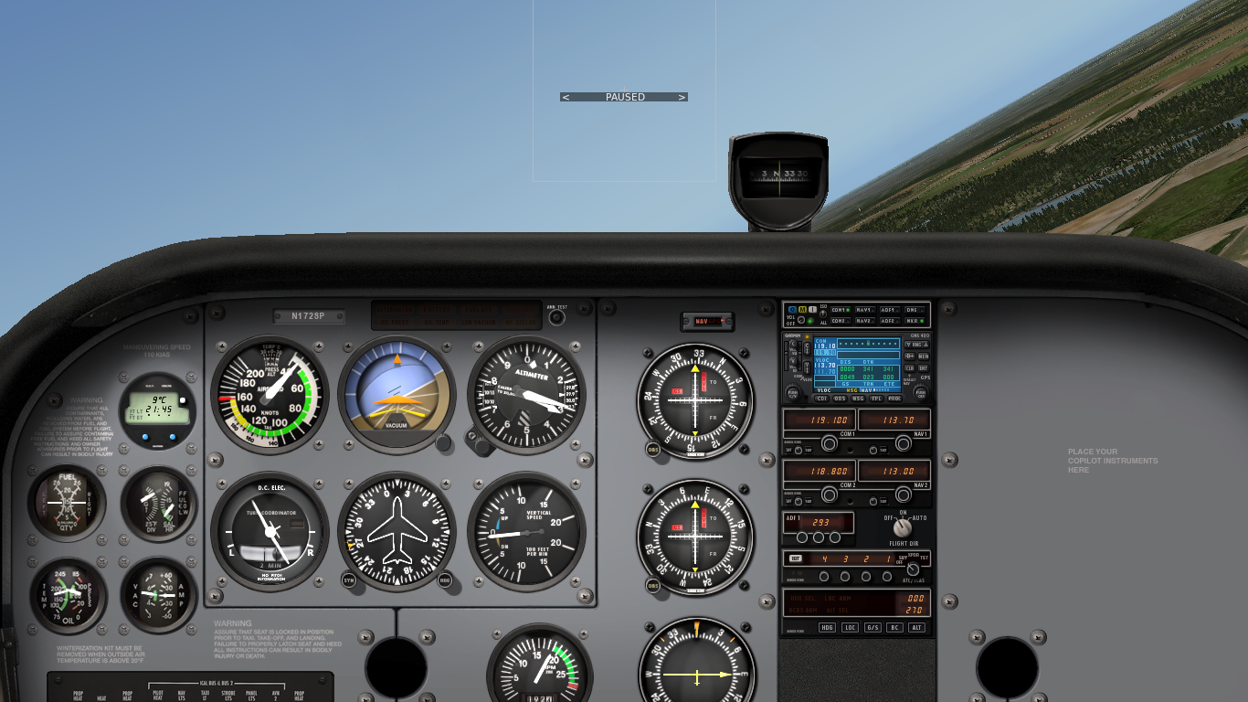
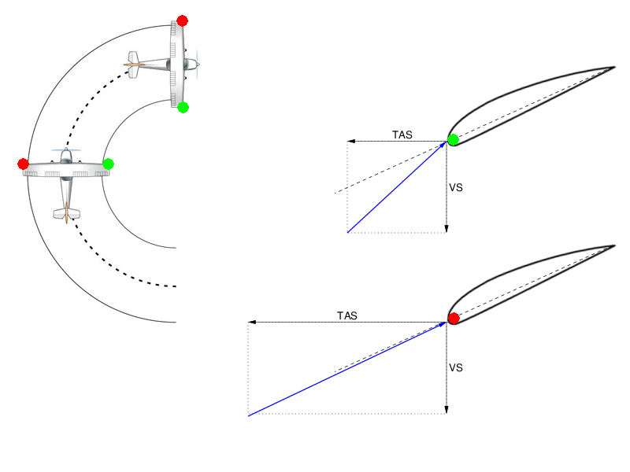
Approach / Turning Stall
Establish a power-off descending turn
Increase bank attitude with high rate of turn
Inner wing may stall first and drop
Release elevator back-pressure lowering nose, apply opposite rudder and ease out of dive applying power
Notes:
- Descending Turn: low airspeed, low rate of descent
- Recovery: lower nose, wings level, ease out of dive

Slide 14
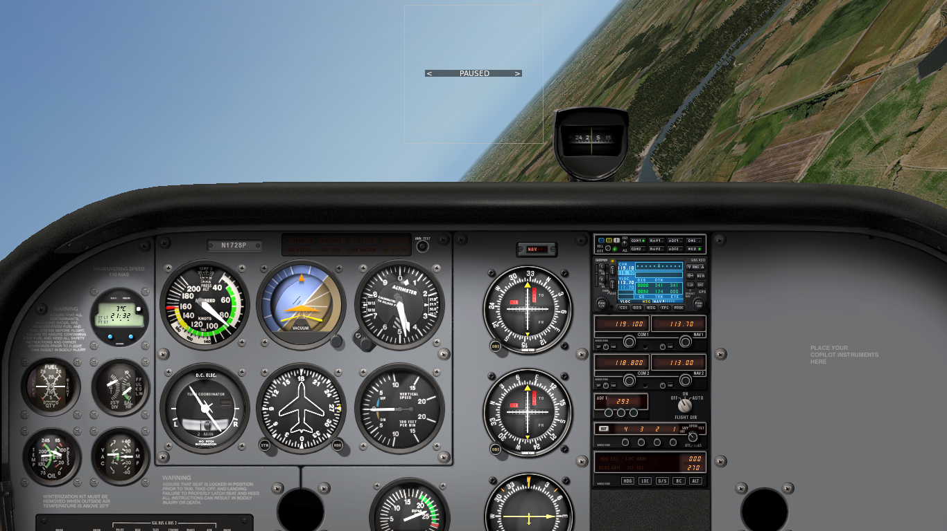
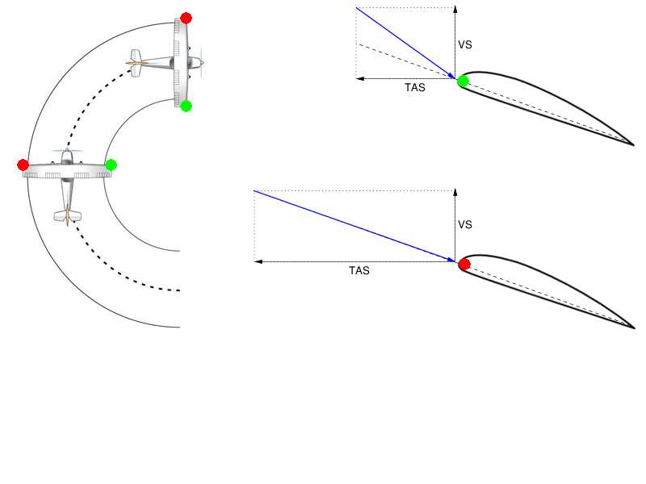
Departure / Turning Stall
Establish a power-on climbing turn
Increase nose-up attitude while turning
Outer wing may stall first and drop – opposite to the turn
Release elevator back-pressure lowering the nose, reduce power, apply opposite rudder and ease out of dive applying power
Notes:
- Climbing Turn: full power, low airspeed, high pitch attitude
- Recovery: lower nose, wings level, ease out of dive

Slide 15
Summary / Quiz
Define a stall and describe the indications of a stall.
What airspeed or attitude is required to produce a stall?
Mentally enter and recover a clean power-off stall from cruise flight and state all observations and required actions.
Mentally enter and recover a power-on stall with flaps from cruise flight and state all observations and required actions.
Mentally enter and recover a departure stall and state all observations and required actions.

Slide 16
Pre-Flight Briefing
Exercise
Training Area
Departure and Arrival Procedures
Weather Briefing / NOTAMs
Aircraft and Documents

