Slide 1
Contact Information
Stephan Heinemann
SMS: +1 (250) 891-5446
Email: stephan.heinemann@hotmail.com
Bookings, Questions

Slide 2
Aerodrome Traffic Circuit
Review Slow Flight and Take-Off
Definition and Motivation
Aerodrome Traffic Circuit
Summary and Questions
Preflight Briefing

Slide 3
Review Slow Flight and Take-Off
Mentally perform a recovery from slow flight and state all observations and required actions.
What actions have to be completed before initiating a take-off?
Describe the take-off phases line-up, run and initial climb.
What are the criteria for a normal take-off?
Mentally perform a normal take-off and state all observations and actions.
What causes wake-turbulence and how does it affect your take-off?
Notes:
- much shorter review

Slide 4

Definition and Motivation
Standardized rectangular traffic circuit at aerodromes
Ordered and organized flow of traffic to avoid conflicts
Safety and traffic separation, stabilized approaches
Types: controlled and uncontrolled aerodrome circuit
Applications: portion of a circuit is flown in every single flight

Slide 5
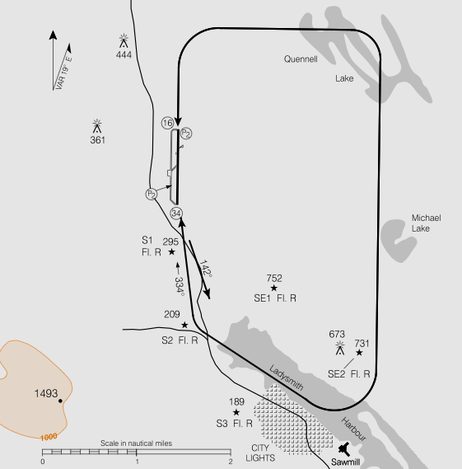
Circuit Layout
Legs: Take-Off, Crosswind, Downwind, Base, Final
Sides: Upwind and Downwind
Standard left-hand aerodrome circuit with 1000' AAE circuit height
Standard crosswind and base legs transition between 500' and 1000' AAE
Consult Canadian Flight Supplement for specific layout and procedures
Modifications due to obstacles, noise abatement and points of interest
Notes:
- points of interest may not be familiar to the pilot, point out appropriate ATC communication
- Upwind (Dead), Downwind (Active)
- much more howto, what to do when

Slide 6
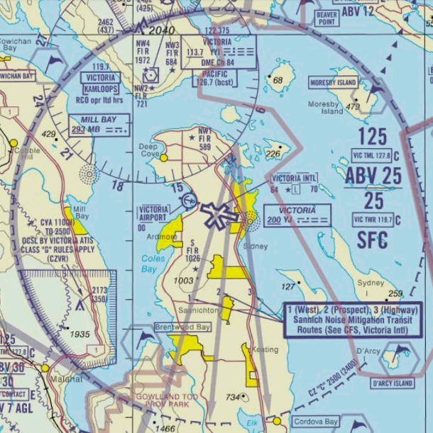
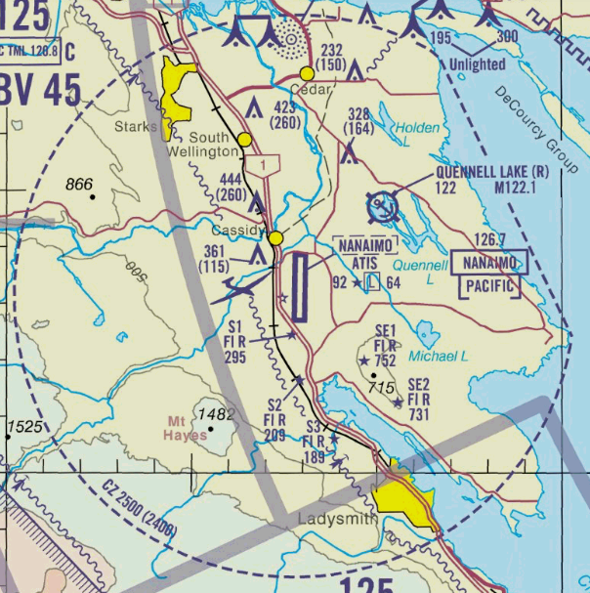
Controlled Airports
Control zones with traffic patterns to join circuit
Standard control zone extends 5 NM radius up to 3000' AGL
Airspace requirements: weather minima, communication, clearances, equipment

Slide 7
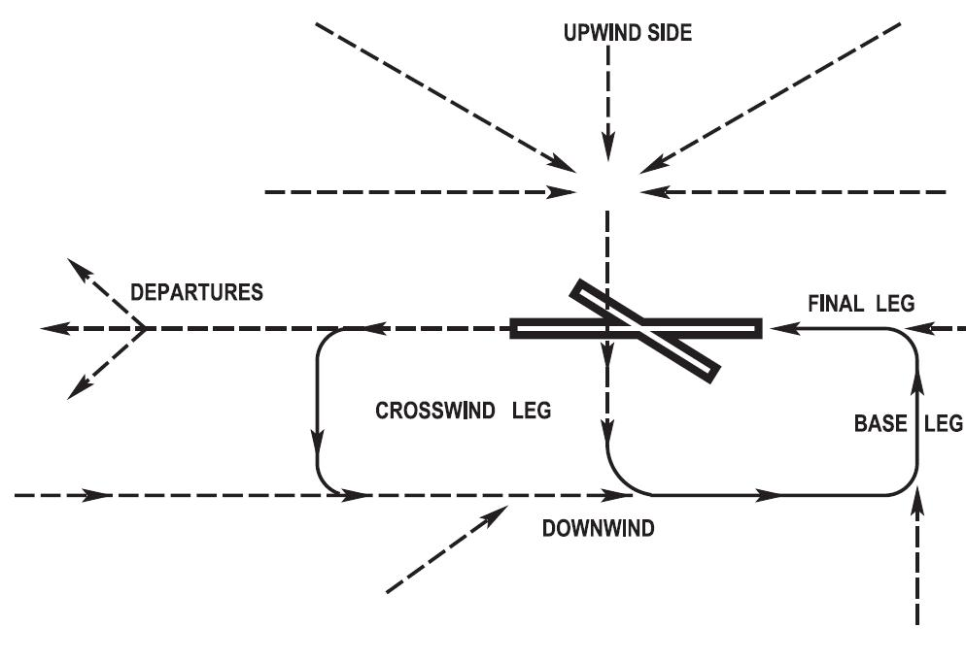
Controlled Airports Procedures
Concrete procedures are described in the CFS
Instructions are to be followed on towered airports
Advisories help decision making on non-towered airports
Maintain constant lookout, separation and order

Slide 8
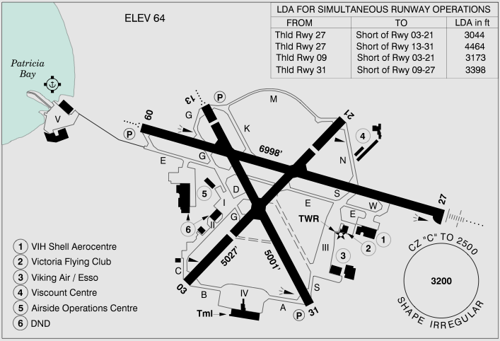
Towered Airports (CYYJ)

Slide 9
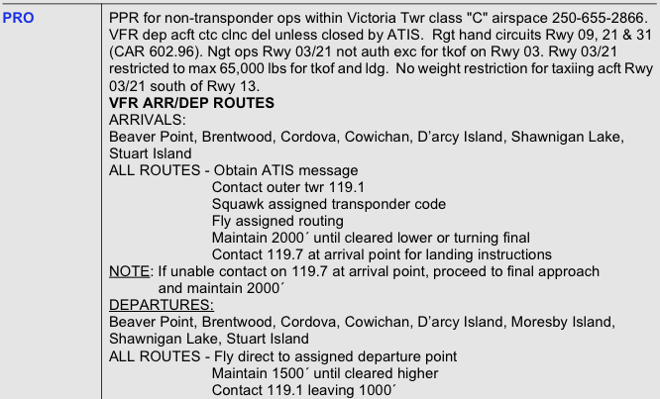
Towerd Airports (CYYJ)

Slide 10
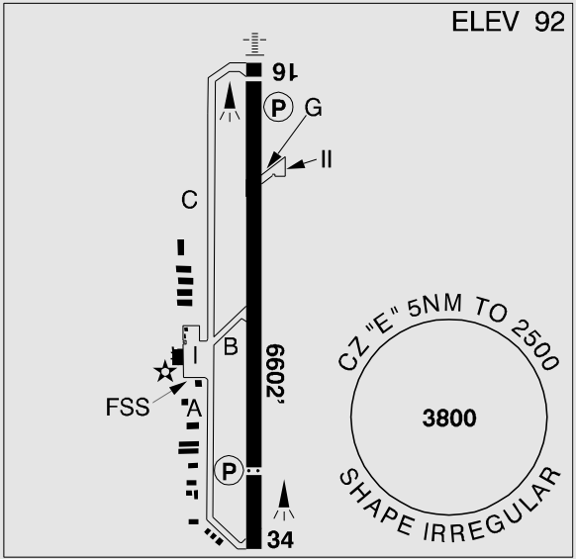
Non-Towered Airports / MF (CYCD)
Notes:
- published night procedures only (used during day time)

Slide 11
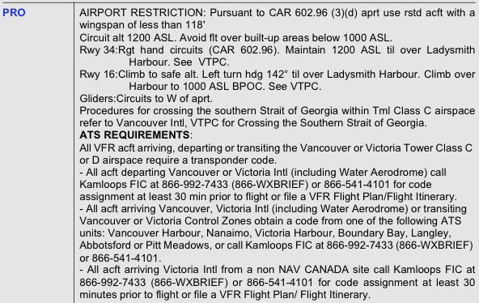
Non-Towered Airports / MF (CYCD)

Slide 12
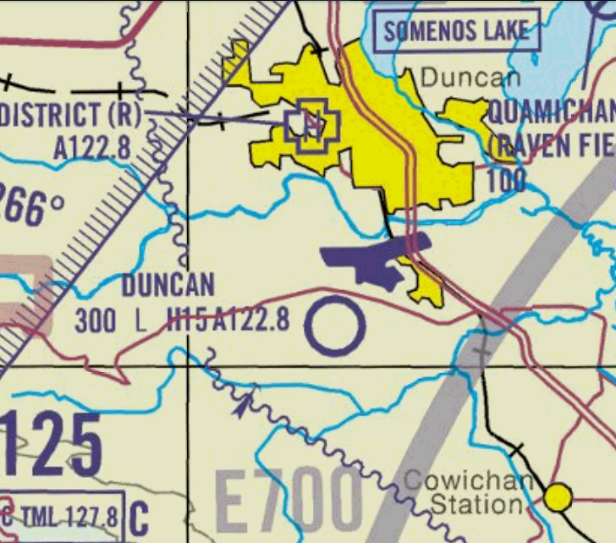
Uncontrolled Aerodromes
Located in uncontrolled airspace (G)
Airspace does not require radio contact, clearances or special equipment

Slide 13
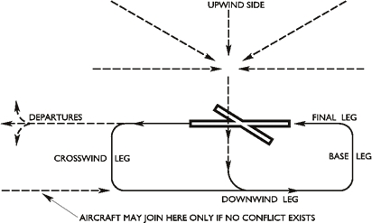
Uncontrolled Aerodromes Procedures
Concrete procedures are described in the CFS
Advise other aircraft of your position and intentions
Be aware of and lookout for potential NORDO traffic
Maintain constant lookout, separation and order

Slide 14
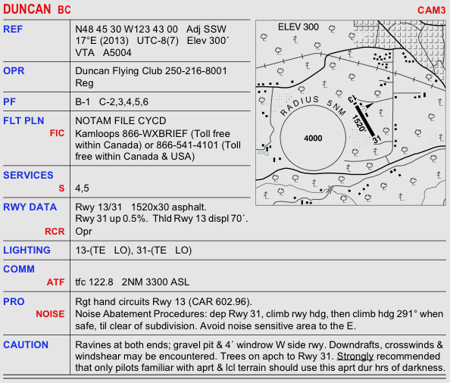
Uncontrolled Aerodromes / ATF (CAM3)

Slide 15
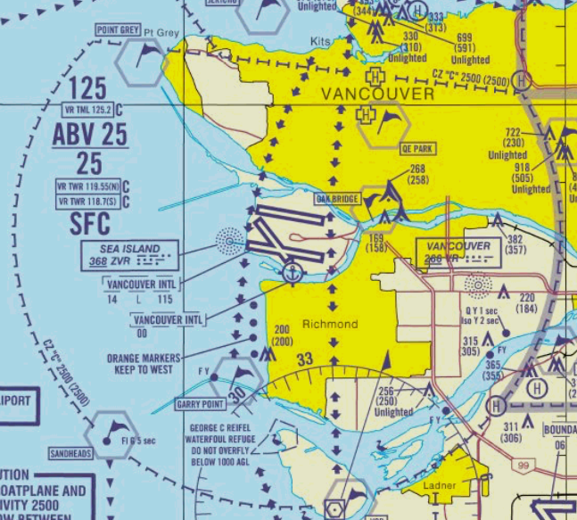
Crossing Control Zones
Crossing requirements depend on airspace structure
Radio contact, transponder, clearance, routing
Refer to Terminal Chart and CFS procedures

Slide 16
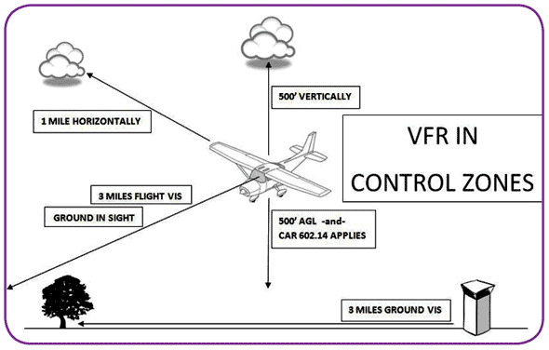
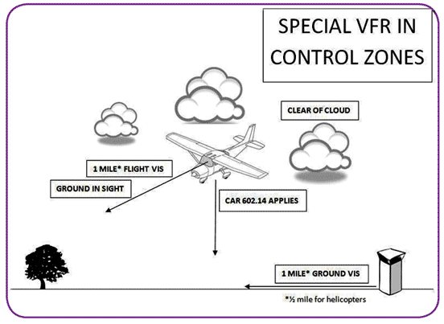
Special VFR
Allows to enter a control zone in IMC under VFR
Special VFR has to be requested by the pilot
Special VFR can be denied due to IFR traffic

Slide 17
Summary / Quiz
What are the two main types of circuits and how do they differ?
Describe the standard circuit with respect to legs, sides, directions and heights.
Where do you find what particular circuit and procedure applies to an aerodrome?
Assume you want to join the Nanaimo traffic circuit approaching from Victoria. The ATIS informs you that the weather is VFR and the active runway is 34. Mentally perform the procedure and state all observations and required actions.

Slide 18
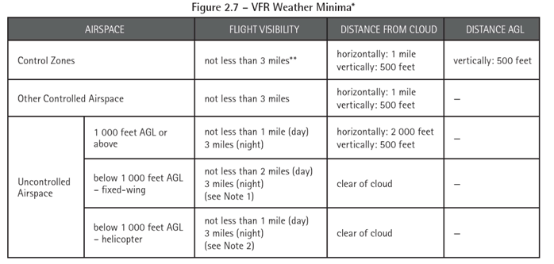
VFR Minima

Slide 19
Pre-Flight Briefing
Exercise
Training Area
Departure and Arrival Procedures
Weather Briefing / NOTAMs
Aircraft and Documents

Slide 20
The Circuit (Ex. 17, LP. 3-10, 20)
Objective
Review
Motivation
Howto
Summary / Questions
Preflight Briefing

Slide 21
Terminal and Transition Airspace

