Slide 1
Contact Information
Stephan Heinemann
SMS: +1 (250) 891-5446
Email: stephan.heinemann@hotmail.com
Bookings, Questions

Slide 2
Forced Landing
Review Descent, Approach and Landing
Definition and Motivation
Forced Landing
Summary and Questions
Pre-Flight Briefing

Slide 3
Review Descent, Approach and Landing
Mentally perform a power-off descent and state all observations and required actions.
What is the best glide airspeed and where do we find it?
How do we visually determine our glide distance?
What types of landing can we perform?
Mentally perform a soft-field landing and state all observations and required actions.
Notes:
- remove soft-field landing question

Slide 4
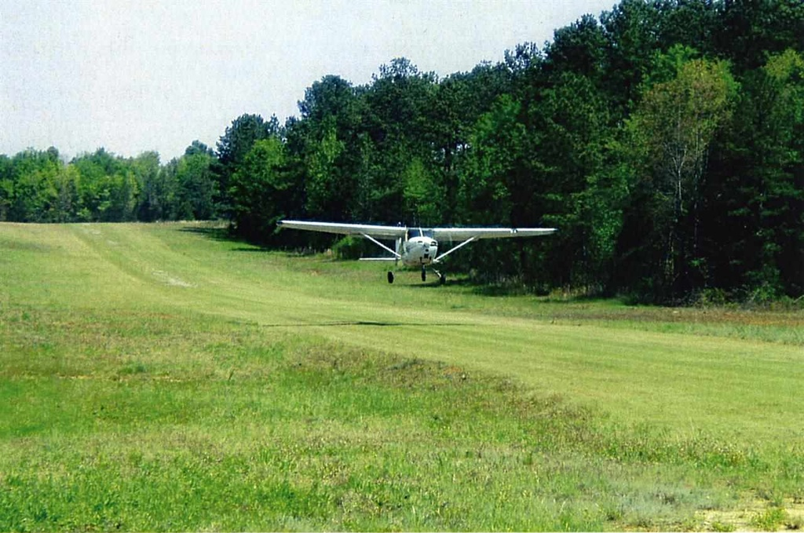
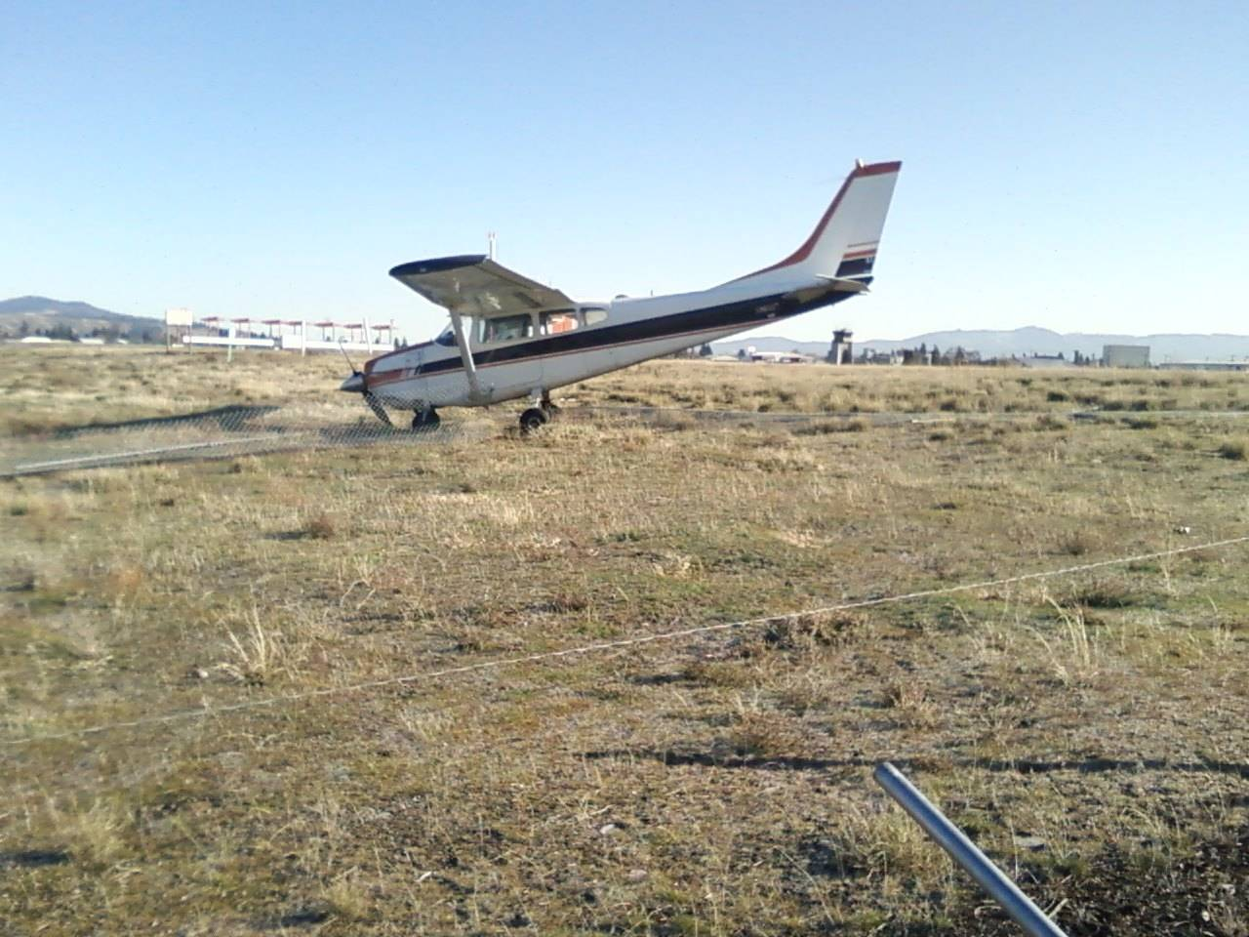
Definition and Motivation
Unplanned landing due to failure or other emergency
Aviate, Navigate, Communicate, Manage
Continue to fly the airplane has highest priority
Situations: engine failure (mechanical, oil supply, fuel supply – contamination, air supply – icing, blockage)

Slide 5
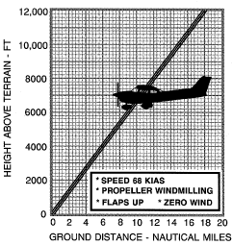
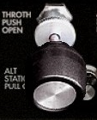

Engine Failure During Take-Off
Power Idle
Apply Brakes
Best Glide
Avoid Obstacles
During Take-Off Run: power idle, apply brakes
Immediately after Take-Off: best glide airspeed (68 KIAS), avoid obstacles
Notes:
- V1, TODA, ASDA?
- if time permits: Fuel Valve Off, Mixture Off, Ignition Off, Master Off
- attitude versus 68 KIAS (focus on attitude)

Slide 6
Engine Failure at Low Altitude
Establish best glide (68 KIAS) and trim
Select and head towards suitable field
Seats, Seatbelts, Cockpit Hazards
Fuel Valve - Off, Mixture - Off, Ignition - Off
Mayday, Squawk 7700, ELT On
Flaps as required
Master - Off, Doors – Unlatch
MEMORIZE THIS PROCEDURE!
Notes:
- focus more on attitude → establish glide speed attitude
- key words at the beginning
- brace, brace, brace vs. seats, seatbelts, hazards
- below 500, above 500, above 1000

Slide 7
Engine Failure at Safe Altitude
Establish best glide (68 KIAS) and trim
Select and head towards suitable field
Cause check (Fuel Valve, Fuel Selector, Mixture, Throttle, Engine Instruments, Fuel Pump, Magnetos, Primer)
Attempt restart
If restart not successful, continue with low altitude procedures
MEMORIZE THIS PROCEDURE!
Notes:
- Carburettor heat if equipped
- Alternate air door automatically opens due to suction
- Causes: Mechanical, Fuel, Oil, Icing
- Safe Altitude: 2000' AGL?
- primer versus fuel injected engine (remove primer)
- cause check order POH

Slide 8



Restart Procedure
Fuel Valve – On
Fuel Selector – Both
Mixture – Full Rich
Fuel Pump – On
Ignition – Start
Fuel Pump – Off (Consider On)

Slide 9
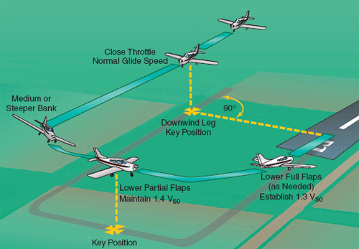
Engine Failure in Circuit
Perform power-off landing if at circuit altitude
Manage energy / airspeed and plan for each leg to final
Consider altitude, rate of descent and wind
Inform ATC (request clearance beforehand if practicing)
Notes:
- focus on key position and where it is
- 45° left wing perspective
- 1 ½ NM back on final at 1000' AGL
- figure of eights, visual estimate
- explain radius of action
- remove v-speeds

Slide 10
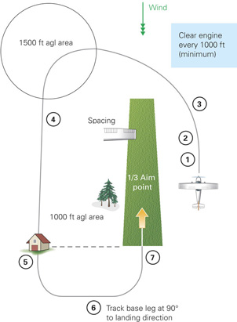
Forced Landing Approach
Establish key points
Organize legs
Consider altitude, rate of descent and wind
Approach slightly high and attempt to land in first third of the selected field
Use flaps and slipping to increase rate of descent
Notes:
- head directly to key point instead of circuit

Slide 11
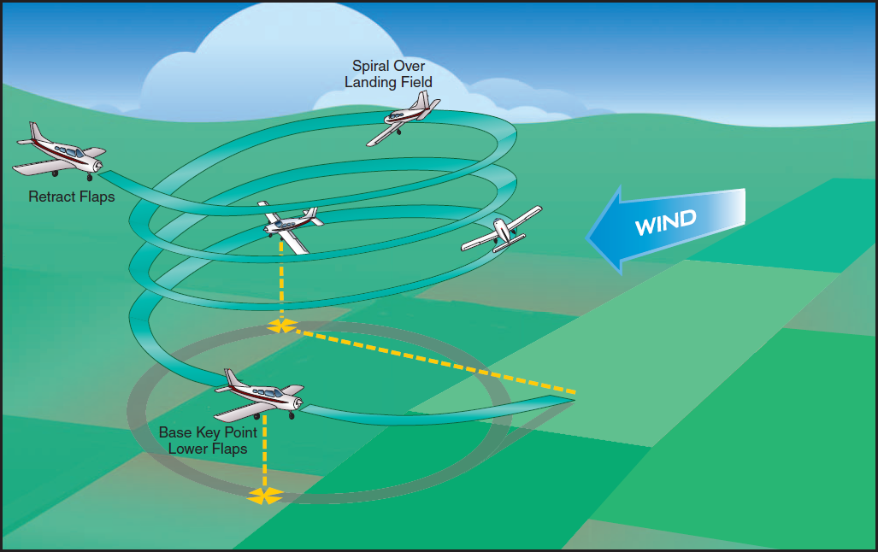
360° Forced Landing Pattern
Proceed to selected key point at altitude – high key
Descend to lower altitude circling – low key
Initiate final approach from low key point
Notes:
- remove spiral, try to get original FTM pictures

Slide 12
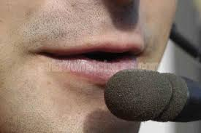
Distress Communication
Current frequency or 121.5
Mayday, Mayday, Mayday
3 x Callsign
Position, Altitude
Problem
Intentions
Callsign
Squawk 7700, ELT On
Notes:
- can be abbreviated, more important to make the field

Slide 13
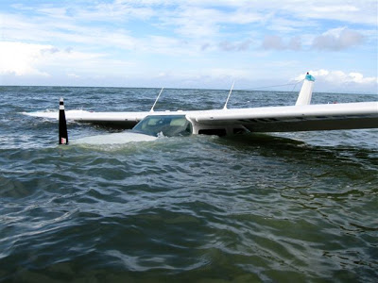
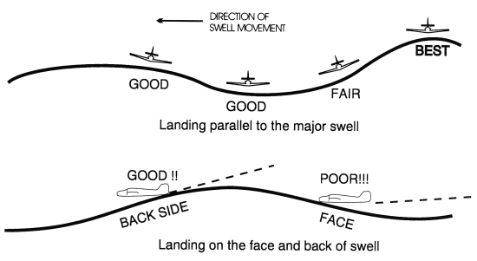
Hills, Mountains, Forest, Water
Hills / Mountains: land uphill
Forest: assume tree tops as landing surface
Roads (traffic, power lines, obstructions)
Water: ditching and evacuation – swell, wind

Slide 14
Safety Considerations
Remain clear of obstacles
Clear engine every 1000'
Go around at 500' AGL (1000' over civilization)
Notes:
- 500' AGL minimum?
- 1000' AGL VFC

Slide 15
Summary / Quiz
What situations may lead to a forced landing?
How does altitude affect the type of forced landing?
Mentally perform a forced landing from a safe altitude within farmland countryside.
Simulate a Mayday call reporting an engine failure and state your intentions.
What other means of communication are available in an emergency?
Notes:
- mentally perform is probably to much
- maybe aviate, communicate, …
- maybe the first one or two steps...

Slide 16
Pre-Flight Briefing
Exercise
Training Area
Departure and Arrival Procedures
Weather Briefing / NOTAMs
Aircraft and Documents
Time and Fuel Requirements
Safety Considerations and Responsibilities

Slide 17
Forced Landing (Ex. 22, LP. 24)
Objective
Review
Motivation
Howto
Summary / Questions
Preflight Briefing

