Slide 1
Contact Information
Stephan Heinemann
SMS: +1 (250) 891-5446
Email: stephan.heinemann@hotmail.com
Bookings, Questions

Slide 2
Spins
Review Stalls
Definition and Motivation
Spinning and Factors
Summary and Questions
Pre-Flight Briefing

Slide 3
Review Stalls
What are the signs of an imminent stall?
Define a wing drop stall and give examples of situations when it may occur.
Mentally perform a departure / turning stall entry and recovery and state all observations and required actions.
Notes:
- Review: wing drop stalls entry and recovery
Mentally perform an approach / turning stall entry and recovery and state all observations and required actions.

Slide 4
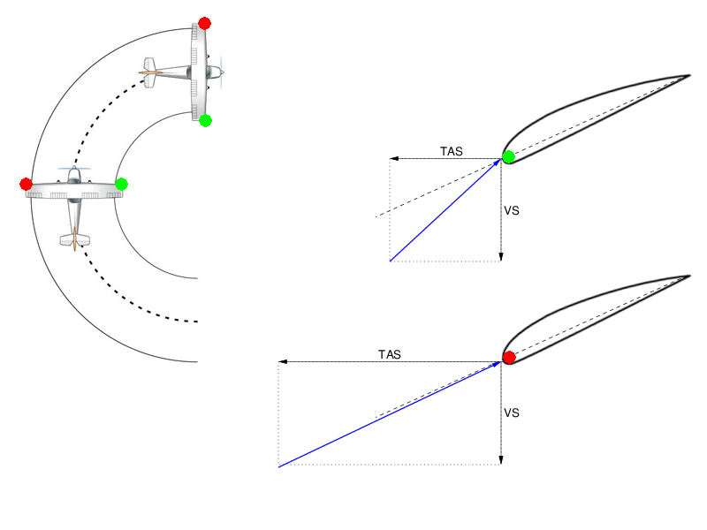
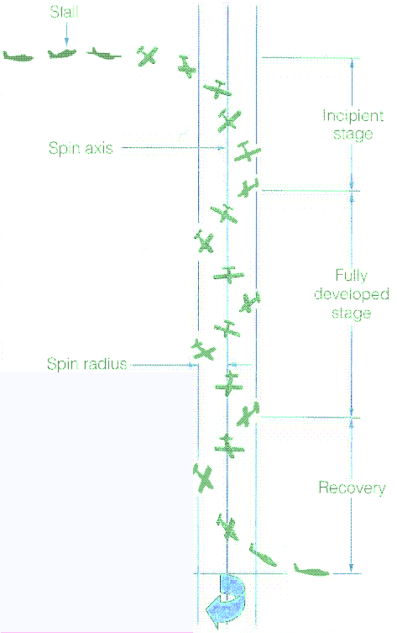
Definition and Motivation
Stall aggrevated by yaw
Inner wing has higher angle of attack and drag
No applications – recognition and recovery
Incipient – initial transition into stable rotation
Fully Developed – stable rotation and airspeed
Notes:
Inner wing remains with higher angle of attack
High drag limits the increase in airspeed
Spins can occur at any attitude and airspeed as with a stall

Slide 5
Safety Considerations
High nose-up / nose-down attitude maneuver
Spin can occur at any attitude and airspeed
AFM – utility category is required
HASEL, lookout ahead and below
Significant loss of altitude
Recovery above 2000' AGL

Slide 6


Spin Entry
Enter Imminent Stall
Full Aft Elevator
Full Left Rudder
Reduce power to low power setting (1500 RPM)
Apply elevator back-pressure to increase nose-up attitude controlling yaw with rudder maintaining altitude
During the imminent stall simultaneously apply and hold full elevator back-pressure and full left-rudder
Notes:
- full left-rudder to use the yaw advantage
- enter spin at bottom of green arc for reference (stall warning will come on too early)

Slide 7
Spin Entry
Enter Imminent Stall
Full Aft Elevator
Full Rudder
Reduce power to idle
Apply elevator back-pressure to increase nose-up attitude controlling yaw with rudder maintaining altitude
During the imminent stall simultaneously apply and hold full elevator back-pressure and full rudder
Notes:
- no power during right-hand spins to reduce left-hand yaw

Slide 8

Spin Recovery
Power
Idle
Full Opposite
Rudder
Release
Back-Pressure
Ease Out
Reduce power to idle and keep ailerons neutral
Apply full opposite rudder (opposite spin direction) and release elevator back-pressure until turn stops
Ease out of dive and increase power to regain altitude
Establish cruise attitude, set cruise power and trim
Notes:
- release back-pressure versus positively forward, briscly forward (CoG as a factor)
- TODO: neutralize

Slide 9
Spin Recovery – Factors
Incipient versus fully developed spin
Power
Flaps
Weight and Balance
Altitude
Notes:
- more recovery time during fully developed stage
- more power induces more yaw which aggrevates the stall, more power during the spin leads to less nose down, more altitude loss during recovery
- flaps create a higher camber leading to a flatter spin, reduces elevator effectiveness (deflected airflow), potential structural damage → retract flaps
- more weight increases the load factor and more inertia → flatter spin, more difficult recovery
- forward CoG increases stability (more difficult entry, flatter spin (inertia), easier recovery)
- rearward CoG decreases stability (easier entry, flatter spin (inertia), more difficult recovery)
- high altitude → less dense air, more difficult recovery
- include how factors change spin characteristics into slides

Slide 10
Incipient versus Fully Developed Spin

Slide 11

Instruments
Turn coordinator may help to determine direction of spin
Airspeed should not increase significantly
High airspeed (acceleration) could indicate a spiral dive
Rate of descent should be stable – constant altitude loss
Notes:
- Instruments for recovery

Slide 12
Summary / Quiz
Define spinning and explain the difference between incipient and fully developed spin.
Mentally perform a spin entry and recovery and state all observations and required actions.
Why can ailerons not be used for the recovery of a spin?
What situation can potentially lead to an inadvertent spin at low altitude?

Slide 13
Pre-Flight Briefing
Exercise
Training Area
Departure and Arrival Procedures
Weather Briefing / NOTAMs
Aircraft and Documents
Time and Fuel Requirements

Slide 14
Spins (Ex. 13, LP. 6)
Objective
Review
Motivation
Howto
Summary / Questions
Preflight Briefing

