Slide 1
Accessibility in bitesize
Notes:
Hi, my name is Stéphanie
and I’m a service designer living in Scotland

Slide 2
What is Accessibility?
Notes:
This video is an introduction to accessibility

Slide 3
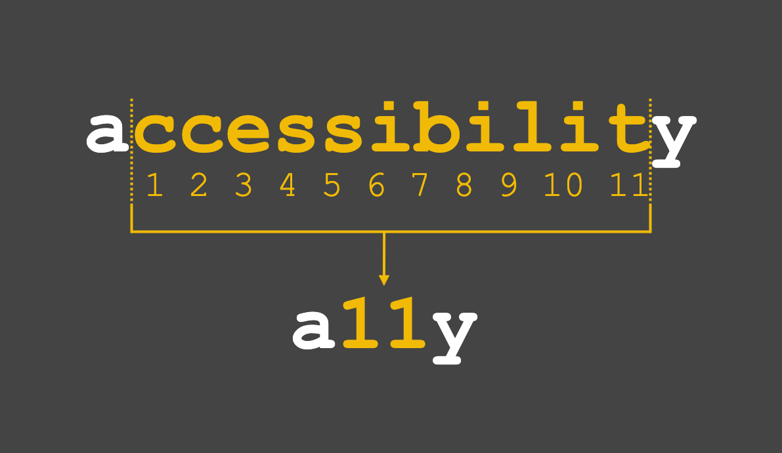
Notes:
You might have seen the hashtag a - eleven - y on social media
it is a short version of the word short accessibility,
you take the first and last letters
and instead of writing the eleven letters in between,
you just write 11

Slide 4
What is Accessibility?
In the UK, 1 in 5 people are disabled

Slide 5

What is Accessibility?
In the UK, 1 in 5 people are disabled
vision
Notes:
it can affect their vision

Slide 6

What is Accessibility?
In the UK, 1 in 5 people are disabled
vision hearing
Notes:
their hearing

Slide 7

What is Accessibility?
In the UK, 1 in 5 people are disabled
vision hearing speech
Notes:
their speech

Slide 8

What is Accessibility?
In the UK, 1 in 5 people are disabled
vision hearing speech physical
Notes:
it can be a physical disability

Slide 9

What is Accessibility?
In the UK, 1 in 5 people are disabled
vision hearing speech physical cognitive
Notes:
or it can be cognitive disability
this means it affects their memory,
or how they process things and think

Slide 10
What is Accessibility?
In the UK, 1 in 5 people are disabled
vision hearing speech physical cognitive
Or a mix of them
Notes:
or it can be a mix of them
in fact it’s quite frequent that people have more than one disability

Slide 11
What is Accessibility?
In the UK, 1 in 5 people are disabled
vision hearing speech physical cognitive
Or a mix of them … and it’s not always visible to others

Slide 12
Accessibility means that
you don’t put barriers for them
to access the same things as others
Notes:
whether it’s online (in that case we talked about digital accessibility)
or in a physical space,
or when they use a device or an object

Slide 13
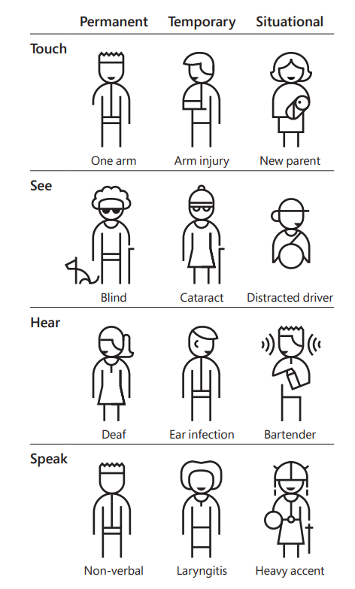
Accessibility is not just for disabled people: Permanent – Temporary - Situational
Diagram from the Microsoft Inclusive Design toolkit
Notes:
Quite often, when we speak about disability, we think of permanent and visible disability
but you can be injured and be temporary affected the same way as a person who is permanently disabled
or a situation can make you experienced a similar issue
This diagram from Microsoft is a good illustration of this

Slide 14
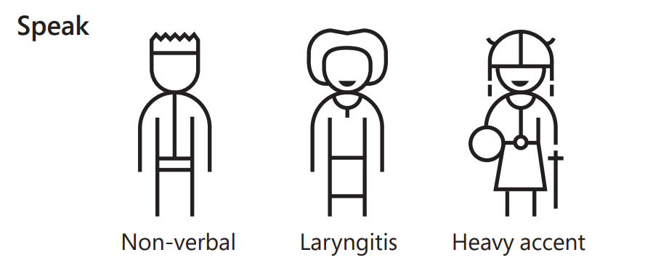
For example
Notes:
a person can be permanently non verbal for various reasons and this will be a barrier when you use a voice recognition system, like Alexa for example
But you will be affected just the same if you have a laryngitis
This is also something that someone with a strong accent - like me! - could struggle with

Slide 15
It can and it will affect everyone at some point in life

Slide 16
General advice
There is no perfect solution which works for everyone, always plan alternatives and ask people what they need, do not assume

Slide 17
General advice
There is no perfect solution which works for everyone, always plan alternatives and ask people what they need, do not assume
Learn about accessibility and best practice
Notes:
quite often it’s not that hard to do the right thing

Slide 18
General advice
There is no perfect solution which works for everyone, always plan alternatives and ask people what they need, do not assume
Learn about accessibility and best practice
If you’re on twitter or LinkedIn, follow disabled people or accessibility advocates
Notes:
that way you hear directly from them about things you might never have realised otherwise

Slide 19
Some simple things you can do

Slide 20
Share your slides at the start of the meeting
Notes:
or when you are presenting,
sharing a link to your slides allow people to see them on their own device, change the colours, zoom or do whatever makes it easier for them to read them.
They can follow on their own rhythm and go back if they missed something

Slide 21
Share your slides at the start of the meeting
Don’t use all caps for headings or long texts
Notes:
When you write in capitals, you lose the shape of the word and make it harder to read for everyone, and for dyslexic people in particular.
In some cases,
screen readers might think it’s an acronym and start reading it letter by letter.

Slide 22
Share your slides at the start of the meeting
Don’t use all caps for headings or long texts
Avoid italic or unusual fonts
Notes:
harder to read too for dyslexic people and everyone else

Slide 23
Share your slides at the start of the meeting
Don’t use all caps for headings or long texts
Avoid italic or unusual fonts
Make sure your colour contrasts are good enough
Notes:
this is between your background and your text
this will help people with low vision in particular

Slide 24
Share your slides at the start of the meeting
Don’t use all caps for headings or long texts
Avoid italic or unusual fonts
Make sure your colour contrasts are good enough
And don’t rely on colour only
Notes:
colour blind people don’t see the difference between some colours as well as others

Slide 25
Do you want to learn more?
Notes:
join a meet up group about accessibility
follow disabled people on Twitter or LinkedIn and learn from them
You don’t need to become an expert, but do make a start

Slide 26
Thank you!

