Slide 1
Accessibility in bitesize
Notes:
Hi, my name is Stéphanie
and I’m a service designer living in Scotland

Slide 2
Social Media
Notes:
this short video is about making your social media posts accessible

Slide 3
To reach your audience, you need to make sure everyone can access your posts
Notes:
So here are a few advice for you

Slide 4
Use plain English

Slide 5
Avoid jargon and use clear, simple language

Slide 6
Avoid jargon and use clear, simple language
If you’re creating a longer post on platforms like Facebook or LinkedIn,
use line breaks to break up your text

Slide 7
Alt text = Alternative text
Notes:
This is a text that is read by a screen reader when there is an image in your post – You need to provide that text to describe that image

Slide 8

Notes:
For example, for this image you could have

Slide 9
alt = “2 cute kittens in a paper bag”

Slide 10
All pictures should have an Alt text
so people with screen readers don’t miss any information
If you can’t add a proper alt text,
just describe it within your post in [square brackets]
Notes:
like on Yammer or Slack
A good way to know what to say for your alt text is to think of how you would describe it to someone over the phone.
Best to keep them short and to keep to the level of details needed to make your point.

Slide 11
Capitalise hashtags

Slide 12
#thisishardtoread

Slide 13
#thisishardtoread
#ThisIsEasierToRead
Notes:
Well at least I hope it is for you,
but if you use a screen reader than it’s definitely easier
because the screen reader will say the word separately in that case

Slide 14
#thisishardtoread
#ThisIsEasierToRead
#ThisIsHowtoFormatAnAccessibleHashtag

Slide 15
#thisishardertoread
#ThisIsEasierToRead
#ThisIsHowtoFormatAnAccessibleHashtag
#a11y
Notes:
Do you know this one?

Slide 16
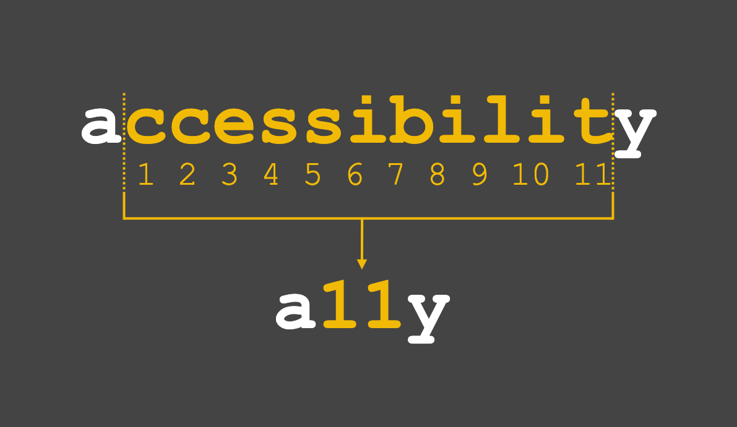
Notes:
You might have seen the hashtag a - eleven - y on social media
it is a short version of the word accessibility,
you take the first and last letters
and instead of writing the eleven letters in between,
you just write 11

Slide 17
Add captions

Slide 18
Make sure people can understand your video, even if they can’t hear

Slide 19
Make sure people can understand your video, even if they can’t hear
If there is no sound, say it,
so people who can’t hear
don’t think they are missing out
Notes:
Auto generated caption is better than nothing but not ideal, quite often they are lots of mistakes in it

Slide 20
Emoji

Slide 21

= smiley face emoji
Notes:
You can use emoji, but beware that screen readers will read them. So don’t use too many of them.
For this one, you would hear= smiley face emoji

Slide 22
= smiley face emoji
Only use them in addition to written text, not instead

Slide 23
= smiley face emoji
Only use them in addition to written text, not instead
Best to use them at the end

Slide 24
Hashtags and mentions at the end

Slide 25
# and @ are said aloud by screen readers
Notes:
The hash key of your hashtags and the at of your name mentions are said aloud by screen readers,

Slide 26
# and @ are said aloud by screen readers
Add them after the text
Notes:
so it’s best to add them after the text
instead of within the text

Slide 27
# and @ are said aloud by screen readers
Add them after the text
It will make it easier to understand
Notes:
It will make it easier to understand

Slide 28
Avoid writing in capital letters

Slide 29
You lose the shape of the word,
so it’s harder to read
Notes:
Some people rely on the ‘shape’ of a word to read more efficiently. Using all caps means words lose their shape, and sometimes screen readers read the words letter by letter.

Slide 30
You lose the shape of the word,
so it’s harder to read
…and it can be interpreted as shouting

Slide 31
Do you want to learn more?
Notes:
join a meet up group about accessibility
follow disabled people on Twitter or LinkedIn and learn from them
You don’t need to become an expert, but do make a start

Slide 32
Thank you!

