Slide 1
Accessibility in bitesize
Notes:
Hi, my name is Stéphanie
and I’m a service designer living in Scotland

Slide 2
Not everyone uses a mouse!
Notes:
this short video is about people using assistive technologies

Slide 3
People might use websites in a way you did not expect

Slide 4
A dyslexic person might use a screen reader even though they can see

Slide 5
A dyslexic person might use a screen reader even though they can see
Someone with a motor impairment might be using a switch or their voice to interact, instead of a keyboard, or a mouse

Slide 6
A dyslexic person might use a screen reader even though they can see
Someone with a motor impairment might be using a switch or their voice to interact, instead of a keyboard, or a mouse
A person with low vision might be zooming to see or use a large mouse pointer

Slide 7
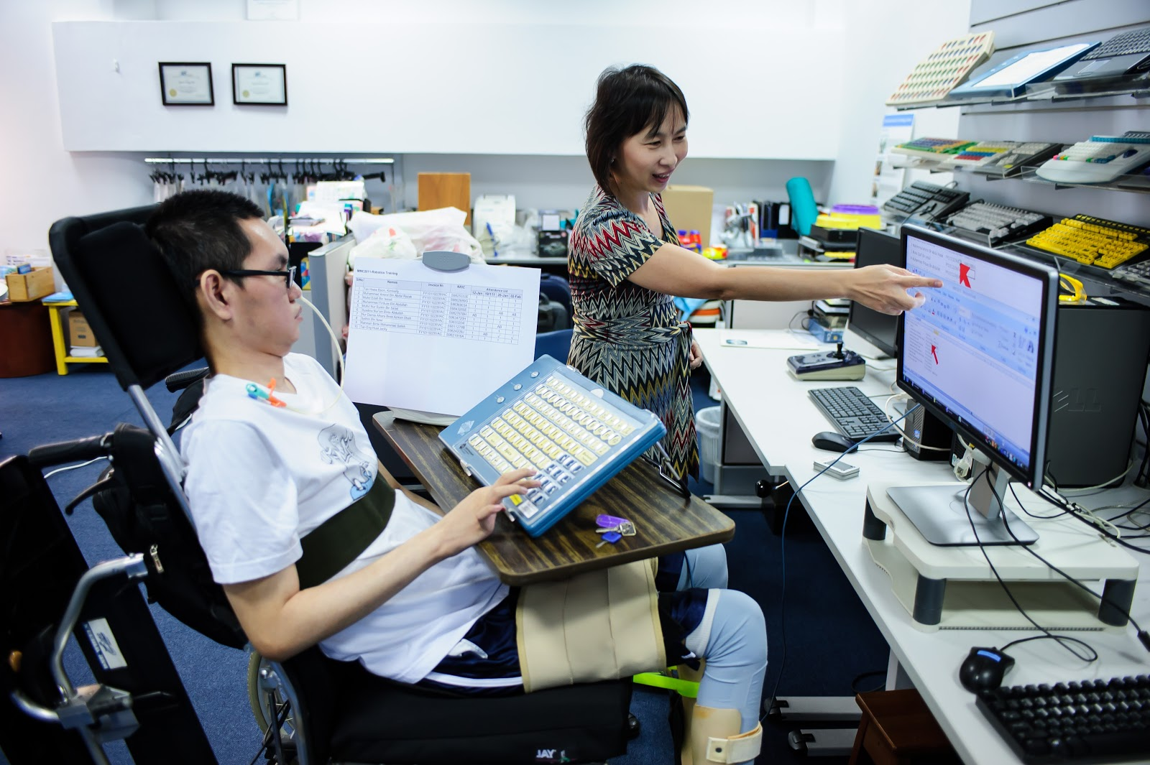
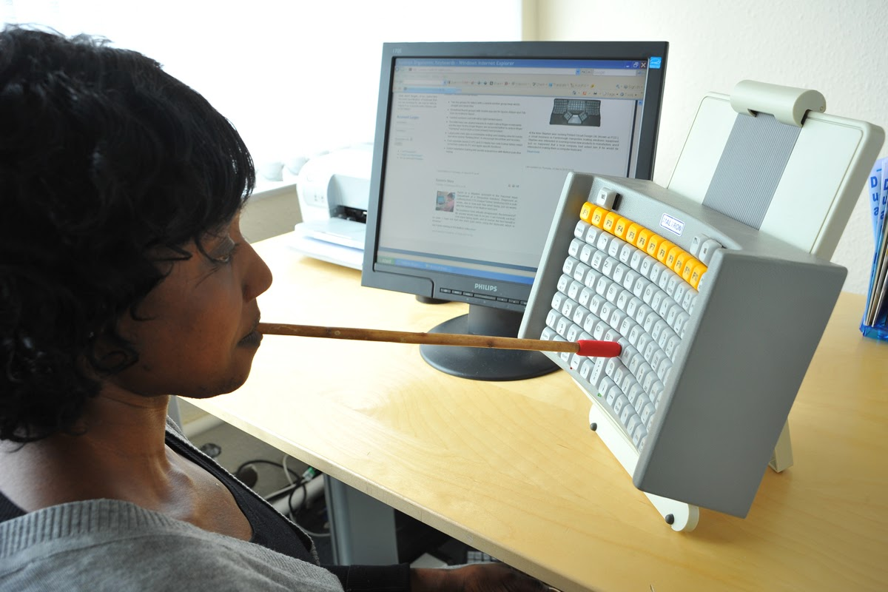


Notes:
Here you can see a few examples with:
a woman using a mouth stick to use a keyboard,
a man holding a switch which is a tool to help you navigate a website or an app
someone using a Braille keyboard
and a keyboard for people with a low vision
Photos from these websites: https://shaylanassistivetechnology.weebly.com/computer-access-supports.html
https://www.ergocanada.com/detailed_specification_pages/maltron_keyboards_mouth_head_stick_keyboard.html
http://www.designhub.it/smartdesign/2017/09/24/design-assistive-technology-equipments-auxiliary-performance-everyday-life-activities-elderly-disabled-people-socially-institutionalised_majorthesis_gruppo04/
https://www.24a11y.com/2018/i-used-a-switch-control-for-a-day/
https://www.worthingtonlibraries.org/sites/default/files/styles/teaser_standard/public/images/promotions/Assistive%20Technologies.jpg?h=4915d655&itok=Ic-yV5zf

Slide 8
So what happen when you can’t use a mouse?

Slide 9
Try yourself!
Notes:
Well you can try yourself!

Slide 10
Try yourself!
Don’t use your mouse and instead:
Use the Tab key to move forward
Shift and the tab key to move back

Slide 11
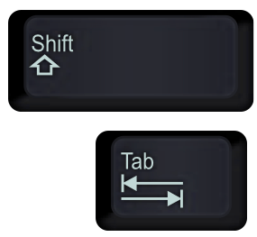
Try yourself!
Don’t use your mouse and instead:
Use the Tab key to move forward
Shift and the tab key to move back
Notes:
if you’re not too sure, this is how these keys look like on most keyboards

Slide 12
Try yourself!
Don’t use your mouse and instead:
Use the Tab key to move forward
Shift and the tab key to move back
Can you still navigate and use the website?

Slide 13
When you need to zoom to see

Slide 14
Try yourself!

Slide 15
Try yourself!
To zoom in:
use the ctlr and + keys,
To zoom out:
ctlr and -
Notes:
or you can use the settings of your browser

Slide 16
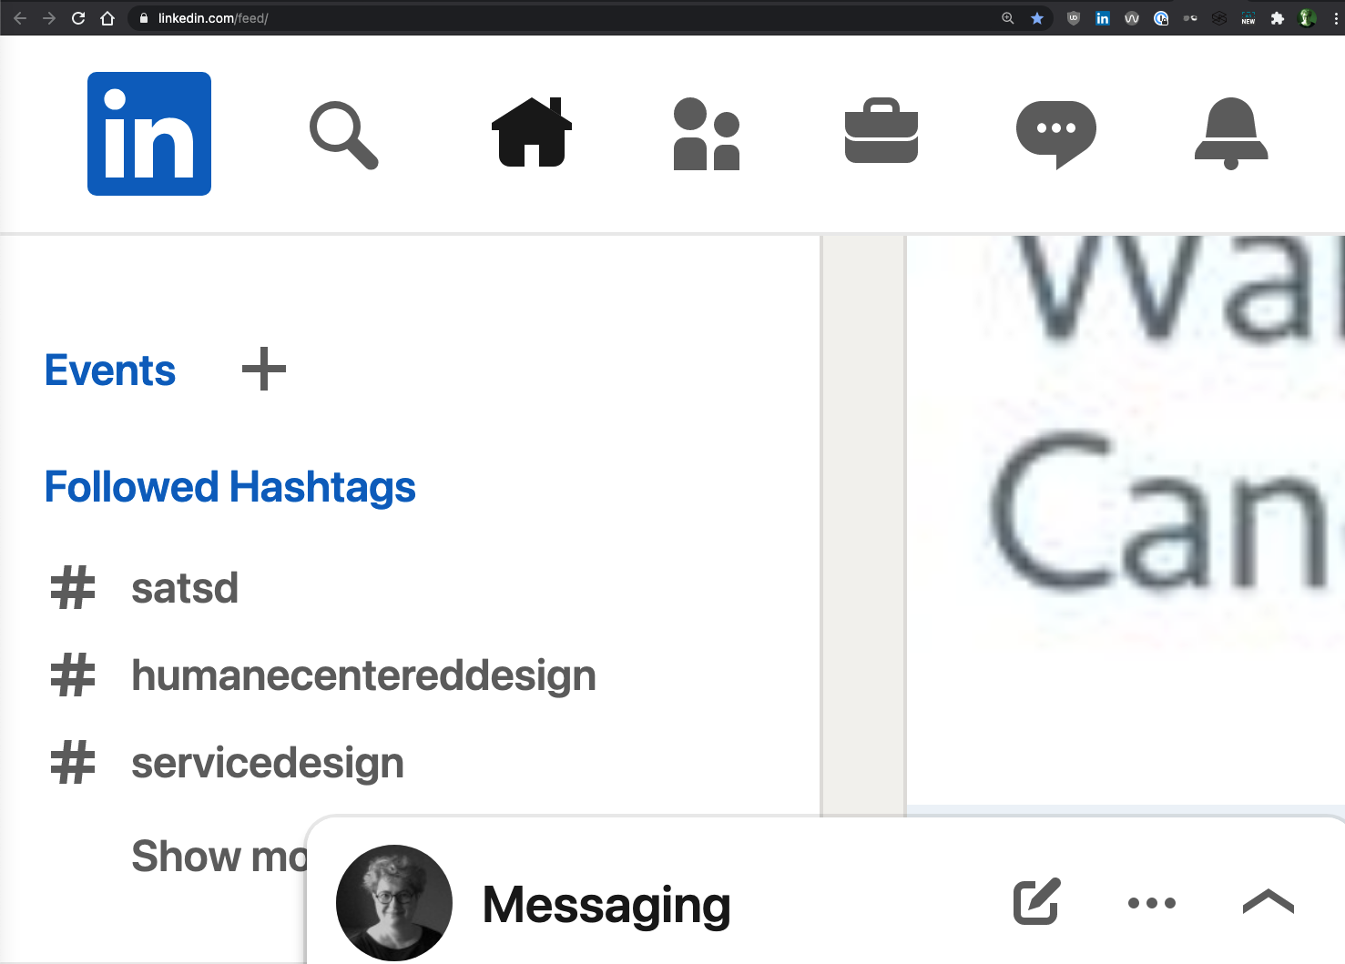
Try yourself!
Zoom in up to 400%
To zoom in:
use the ctlr and + keys,
To zoom out:
ctlr and -
Notes:
This is LinkedIn when you Zoom at 400%

Slide 17
Try yourself!
Zoom in up to 400%
To zoom in:
use the ctlr and + keys,
To zoom out:
ctlr and -
Can you still navigate and use the website?
Notes:
Try posting or reading something

Slide 18
The best way to understand it,
is not to try yourself for 10min,
Notes:
But remember!

Slide 19
The best way to understand it,
is not to try yourself for 10min, but to speak with someone who experience this every day

Slide 20
If you create websites
always do at least these 2 tests:

Slide 21
If you create websites
always do at least these 2 tests:
test with keyboard only

Slide 22
If you create websites
always do at least these 2 tests:
test with keyboard only
zoom at 400%

Slide 23
Do you want to learn more?
Notes:
join a meet up group about accessibility
follow disabled people on Twitter or LinkedIn and learn from them
You don’t need to become an expert, but do make a start

Slide 24
Thank you!

