Slide 1
Accessibility in bitesize
Notes:
Hi, my name is Stéphanie
and I’m a service designer living in Scotland

Slide 2
Colour blindness
Notes:
This video is about colour blindness

Slide 3
1 in 12 men (8%) 1 in 200 women In the UK, this about 3 million people
Notes:
Colour blindness affects …
https://www.nhs.uk/conditions/colour-vision-deficiency/

Slide 4
What is colour blindness?

Slide 5
Most people still see colours

Slide 6
Most people still see colours … but they see them differently

Slide 7
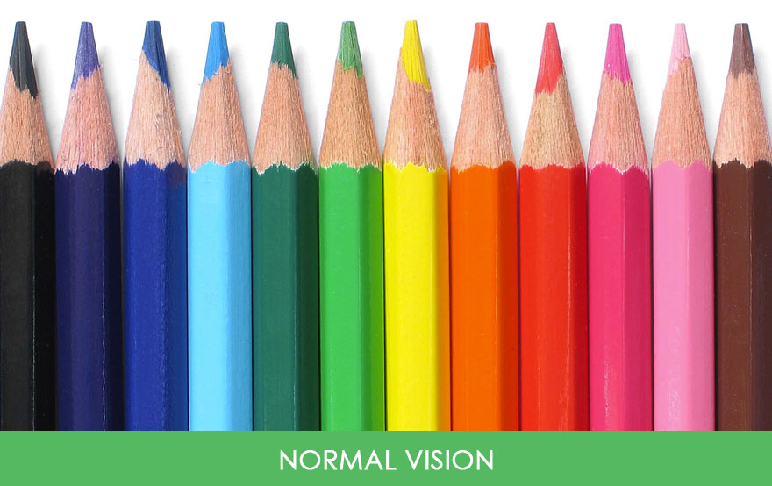
What does it look like?

Slide 8

What does it look like?
Reduced sensitivity to green
Notes:
this is how the colours look like when you have a reduced sensitivity to green

Slide 9

What does it look like?
Reduced sensitivity to blue
Notes:
or to blue

Slide 10
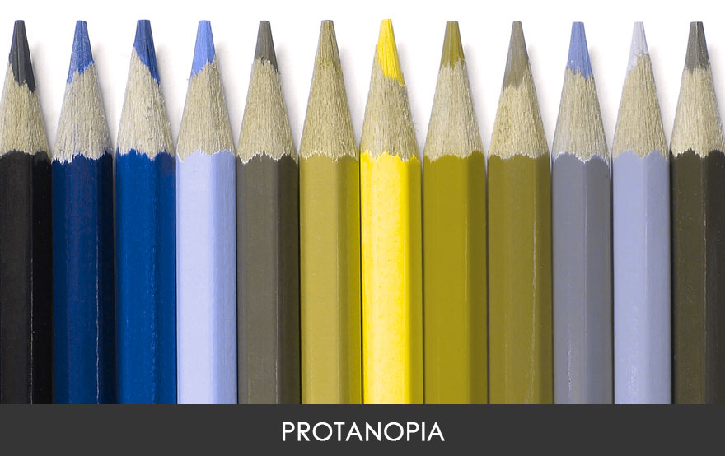
What does it look like?
Reduced sensitivity to red

Slide 11
What should you do?

Slide 12
What should you do?
Use strong colour contrast
Notes:
This is for text, button and other elements

Slide 13
What should you do?
Use strong colour contrast
Avoiding relying on colour alone to convey meaning

Slide 14
Using the RAG system Red, Amber, Green
Notes:
I’m going to take an example, the RAG system

Slide 15
It is used in a lot of documents
Notes:
either in diagrams as dots for example
or to colour code a spreadsheet
This can be hard for a colour blind person

Slide 16
High
Adding text is better,
but it needs to be contrasted enough
Medium
Low
Notes:
which is not the case here

Slide 17
High
This is more contrasted
Medium
Low
Notes:
I’ve used bold and white text now for the darker colours

Slide 18



You can use symbols instead of text

Slide 19
A colour gradient can work too
Notes:
this means using the same colour but going from dark to light,
Using gradient works well for maps

Slide 20
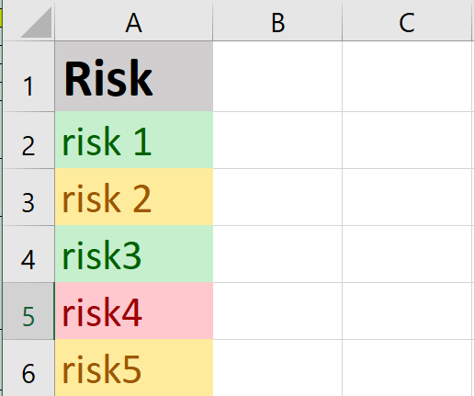
Using RAG in a spreadsheet?
Don’t rely on colour only!
Notes:
If you are using this to colour code a spreadsheet, don’t rely on colour only!

Slide 21
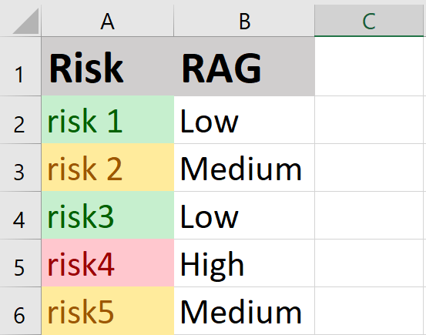
Using RAG in a spreadsheet?
Add an extra column

Slide 22
Do you want to learn more?
Notes:
join a meet up group about accessibility
follow disabled people on Twitter or LinkedIn and learn from them
You don’t need to become an expert, but do make a start

Slide 23
Thank you!

