Slide 1

23 March
10:30am
Designing for users with dyscalculia or low numeracy
2023
Notes:
Hello everyone!
Thank you for joining us today for our talk about designing for users with dyscalculia or low numeracy.
This talk is being recorded. It will be available afterwards with the other talks from Services Week.

Slide 2
Services
Week
20 Mar
24 Mar
2023
➔

Slide 3
Hello everybody
Notes:
My name is Rachel Malic, I’m a content designer at HMRC.
I joined HMRC from a charity called National Numeracy. When I started working on government services was astounded at how little advice and support there for government designers on how to present numbers clearly. There was no mention of dyscalculia anywhere.
So I last year at Servies week I gave a talk about it. Some of you might have been there. Since then, I’ve been on an incredible journey with two incredible people who I’m presenting with today, and we’re going to share some help for you.
Introduce Jane…
Intro Laura…

Slide 4
“I have dyscalculia so I need to check the numbers I enter at least twice. This makes me feel nervous on your website.”
Notes:
First off. How does dyscalculia affect our users?
At HMRC we have something called the operational listening tool. This is a database of all the comments and feedback which people leave on HMRC webpages.
We found comments like this. Talking about problems entering numbers. This is a big deal because we ask people to enter numbers a lot in our services. Some are really long references, or amounts of money which would have stressful implications if you entered it wrong, and we know these are challenging.

Slide 5
“I am dyscalculic, so figures and number calculations are challenging. I have just about come to terms with dealing with HMRC through the internet and have all my codes filed carefully and readily to hand. I dread yet another layer of 'security' being added.”
Notes:
This one talks about entering codes. We ask people to do that to log in to government services and this can be very challenging.
So we know from just a quick look at these survey comments that it is affecting people. And it’s likely to be affecting a lot more than we realise as often it goes undiagnosed so don’t explicitly mention it.
Now Laura and Jane are going to say a bit more about this and what we’ve been working on.

Slide 6
Living with dyscalculia
Low confidence with numbers gets in the way

Slide 7
What is dyscalculia?
Dyscalculia (dis - cal - coo - lia) is a specific and persistent difficulty in understanding numbers. People with dyscalculia have:
poor sense of numbers, number estimation and telling the time
low mental arithmetic skills
high level of maths anxiety
difficulties with working memory (remembering items on a shopping list, phone numbers, game scores)
Many adults are unaware they have dyscalculia, but know that they ‘struggle with numbers’.

Slide 8
Dyscalculia is under diagnosed
About 1 in 20 people have dyscalculia in the UK. As a comparison, about 1 in 10 to 20 people have dyslexia.
Low numeracy affects half of the working-age adults in the UK. That’s nearly 17 million people.
1 in 5 people say they would avoid jobs that involve frequent use of numbers.
A Financial Conduct Authority 2020 survey found that people who had fallen into debt felt it might have been avoided if they had understood their options better.

Slide 9
Living with dyscalculia
Barrier for accessing further education, jobs
Overpaying for shopping and not spotting mistakes
Being late and missing appointments
Missing trains, busses and even flights
Confusing units of measurement
Avoiding using cash at all costs
Distances
Keeping count
Accessing online service
Embarrassment, anxiousness about numbers, getting ‘found out’
Notes:
My dyscalculia has informed some major life choices.
I left high school without a qualification in Maths, so that limited and dictated my University options and then ultimately, my career pathway. Courses and jobs that didn’t even involve maths - still asked for math qualifications, as if this is a measure of intelligence or competence.
And dyscalculia continues to impact my life every single day.
If I’m overcharged, or even if there’s a clear mistake on a bill, I never spot it.
Many people with dyscalculia are late or miss appointment because of problems with understanding or reading time. I’m paranoid about it, so I am always arriving far too early, or obsessively looking at the date, or time of an appointment ‘to double check’
Travel can be stressful, especially when things like gate numbers are announced in airports or trains are cancelled and platform numbers change quickly, I mis-read these really easily.
Units of measurement are hard to understand – I once bought a picture online for my Mum that was 100cm by 100cm and was shocked at the size of it when it arrived – 100cm = 1m luckily her wall was big enough.
I avoid using cash if possible. I used to have a constant dread I wouldn’t be able to work out change so now I use my bank card for everything.
Distances make little sense – that Sat Nav in my car telling me to turn left in 300 yards? I have no clue how long 300 yards is, so I don’t know which left it means.
Keeping numbers in my head is impossible. They seem to either mix up, or slowly fade and disappear so I lose count really easily. My meditation app, Tai Chi and Pilates classes all involve keeping count in my head – so I just give up, and keep going until someone says ‘stop’
Even getting onto services can be a problem. For example, to pay for my son’s school trip via an online service. To sign up, you had no choice but to pass a reCAPTCHA test. You’ve probably seen the ‘Select the photos with buses in them’ one for example. But schools being schools, they thought it would be cute to use mathematical sums. Further insult, they called it a ‘simple equation’.
It’s not simple for someone with Dyscalculia, it’s an actual barrier to access.
I asked my kids if they could help me. And with exactly no questions and no fuss – my 9 year old got me on to the service in 2 seconds flat.
Until very recently, I thought my problems with understanding and using numbers was my fault. I’ve felt stupid, embarrassed and ashamed about it all of my life.
I’ve hidden my struggles by avoiding situations, finding work arounds, making extra effort in time or mental effort, being constantly wary of being found out – and quite frankly it’s exhausting.
Hopefully being open about how numbers affect someone with dyscalculia and raising awareness about it, will help others know they are not alone, and it’s not their fault.

Slide 10
Dyscalculia poster
Designing for users with dyscalculia or low numeracy
Notes:
Jane
In March last year, Laura and I both went to a UK Government Digital Service talk by Rachel Malic about ‘Taking a plain numbers approach to service design’. She described what Dyscalculia was and the symptoms – and it was like they were describing us both exactly!.
Laura and I decided get in touch with Rachel. As it happens we’re all content designers working in the UK government – myself in DWP Digital and Laura and Rachel in HMRC.
We realized we were in a unique position to help potentially millions of people with the services we help design. So we decided to work together to raise awareness and to provide design guidance for making digital services accessible.
We researched the symptoms of Dyscalculia and how that impacted somebody understanding numbers. We then worked out what the most common issues were, and how design could help improve understanding.
We reached out and worked with the Dyscalculia Network, created a focus group and consulted with National Numeracy and the Plain Numbers organisation.
And after months of research, collaboration and iteration we created our poster.

Slide 11

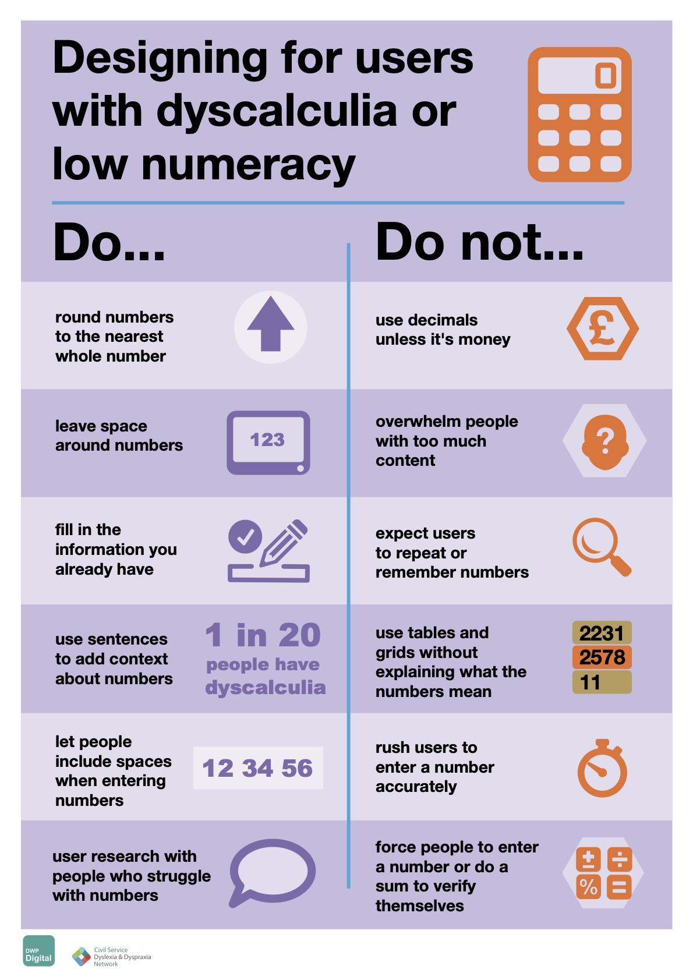
Dyscalculia poster
Raise awareness of dyscalculia
Make services accessible to people with dyscalculia
Provide general guidance rather than being overly prescriptive
Provide evidence for people who want to make design changes
Hosted on the DWP accessibility manual in HTML and PDF
Notes:
Jane
And this is it. It’s available for anyone to download and use from the DWP Accessibility Manual.
If it’s not possible for people to follow all of our guidance when designing using numbers, we want them to do as many of them as possible – it will help.
Design to be inclusive and everyone benefits
We launched our poster at the end of November, when we published a blog about our work on the GOV.UK website.

Slide 12
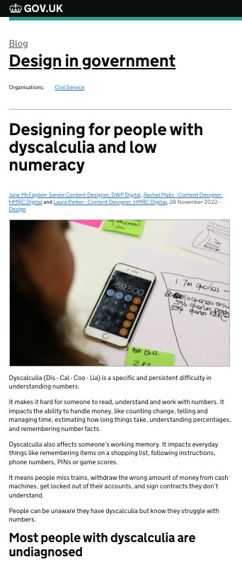
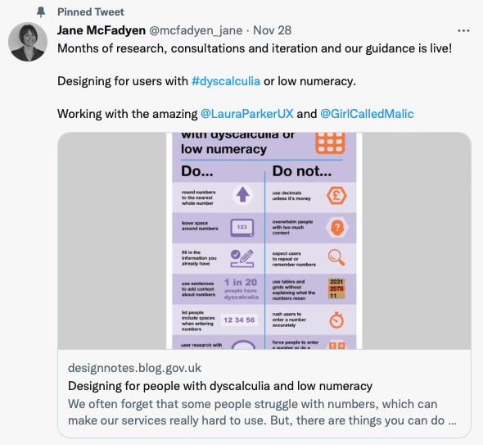
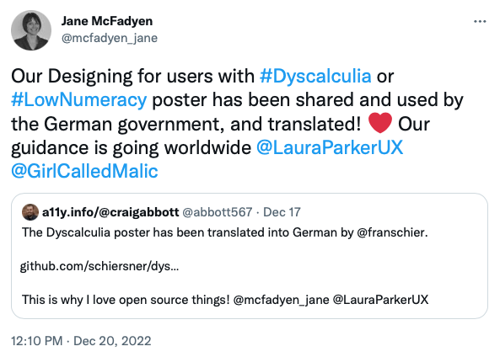
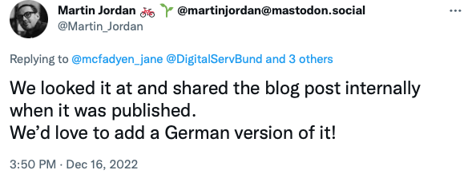
Notes:
Jane
And our blog went viral - It was the most viewed post on Design in GOV in 2022, and our work has since been discussed on podcasts, shared world-wide and even translated!
Martin Jordan, the Head of Design for Government Digital Services in Germany, got in touch and used our poster for their accessibility training. He then worked with us to translate the guidance into German, which was just launched in January.
And the new Centre for Digital Public Services for the Welsh government, used our guidance to help train their new digital teams.
We’ve been contacted by MP working groups asking about consultations.
I’ve delivered talks throughout DWP and cross government, while Laura and Rachel have done the same from HMRC.
I’ve recorded a couple of YouTube video’s for National Numeracy talking about my struggle with numbers.
And Laura has written blogs for the Dyscalculia Network and presented to the BBC and NHS digital teams.

Slide 13

“
“
Brilliant to see this. I think it's the first guidance I've seen, which is helpful to dyscalculia. Great to raise awareness about neurodiversity in general too.
I have always struggled with numbers. Most of the time, I just can’t get my head around them and manual calculations are a massive struggle.
“
I'm working on digital accessibility at an accountancy firm and needed exactly this!
“
I have dyscalculia and this is the first design advice I have ever seen on it. And I'd say it's bang on.
“
Love this. I'm one of the one in twenty. I struggle with all the do not's.
Notes:
Jane
Since our poster was launched, the response has been amazing.
I’ve shared just a few of the hundreds of positive comments here.
It’s fair to say we’ve been overwhelmed that our work has made such an impact. And perhaps most importantly, we’ve had so much validating feedback from other people living with dyscalculia.
This kind of reaction not only shows the need for this design guidance, it demonstrates it can really make a difference for people.

Slide 14
There is a financial crisis.
People with dyscalculia are disproportionately affected.
Notes:
There is a financial crisis going on at the moment. Some research has shown that people with dyscalculia and low numeracy are more affected.
This is 1 in 20 people. That works out as 5 percent of the UK population, which is several million people.
These people might be using government services to find out about benefits, pensions, taxes, and other information.
We have a duty to be looking at this.

Slide 15
Are we doing enough to present numbers clearly for everyone?
Notes:
Are we doing enough?
Are we funding any research on this?
Do user researchers have enough support to recruit participants with dyscalculia or low numeracy?
Are there any design leaders or accessibility leaders commissioning projects to looking at design patterns through the lens of someone with dyscalculia?
Not that I know of.
All the work we’re showing you today is being done by the three of us in our spare time.
If we want to make numbers clearer for everybody, and meet our legal requirement under WCAG, then we need funding and time to do it properly.
That is our call to you today if you’re a design leader. Please help us if you can. We will work hard with the funding you give us, it could inform design patterns not only in the UK but around the world.
Meanwhile. If you’re a designer or researcher we are now going to run through some tips that will help you.

Slide 16
Providing a service
Ways to improve your service for people who struggle with numbers
Notes:
Meanwhile. If you’re a designer or researcher here are some tips that will help you meanwhile.

Slide 17
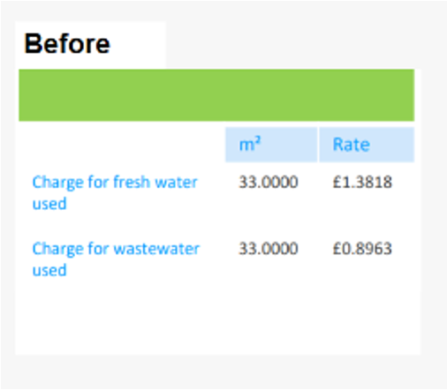
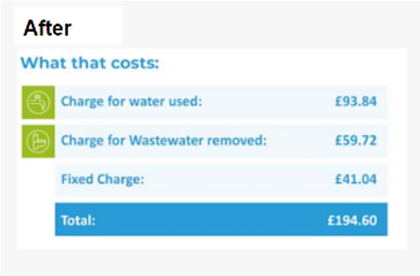
Round numbers to the nearest whole number
Simplifying the numbers by rounding them to the nearest whole number, helps reduce the effort it takes for someone to understand your content.
If your content displays numbers as an exact amount in money, then using decimals to show pounds and pence is OK.
Example from a utility bill from the Plain Numbers report.

Slide 18
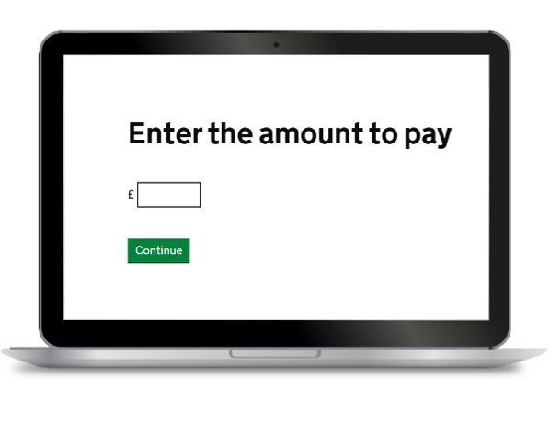
Leave space around numbers
Research shows that it’s easier for people to understand content when there are fewer digits on the page.

Slide 19
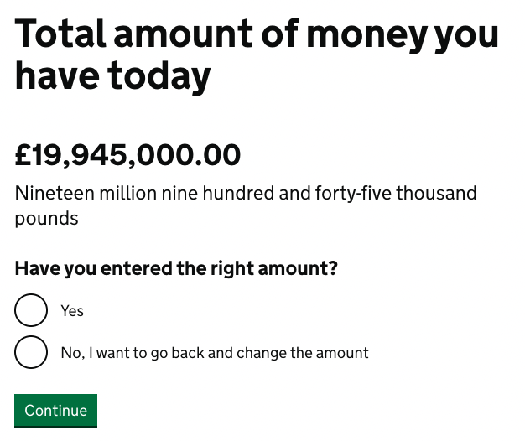
Fill in the information you already have
Do not expect people to remember or repeat numbers.
Many people with dyscalculia have issues with working memory, so remembering numbers is difficult. Let technology work for users, especially if you keep information in a system somewhere.

Slide 20
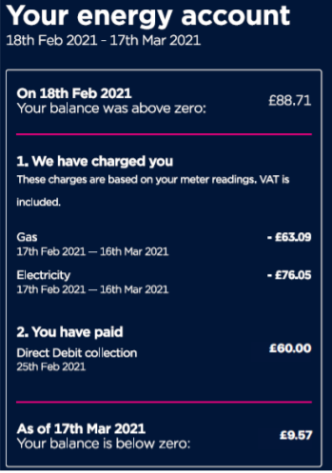
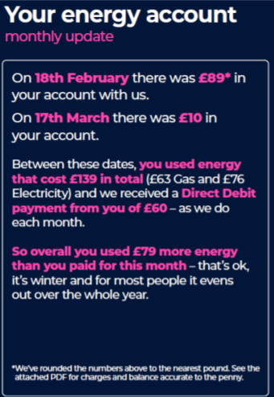
Use sentences to add context about numbers
Only use tables or grids if you explain what the numbers mean.
When numbers are presented in sentences, people find it easier to understand utility bills and payment plans. Adding context helps to make the meaning clearer.
Example from Plain Numbers report.

Slide 21
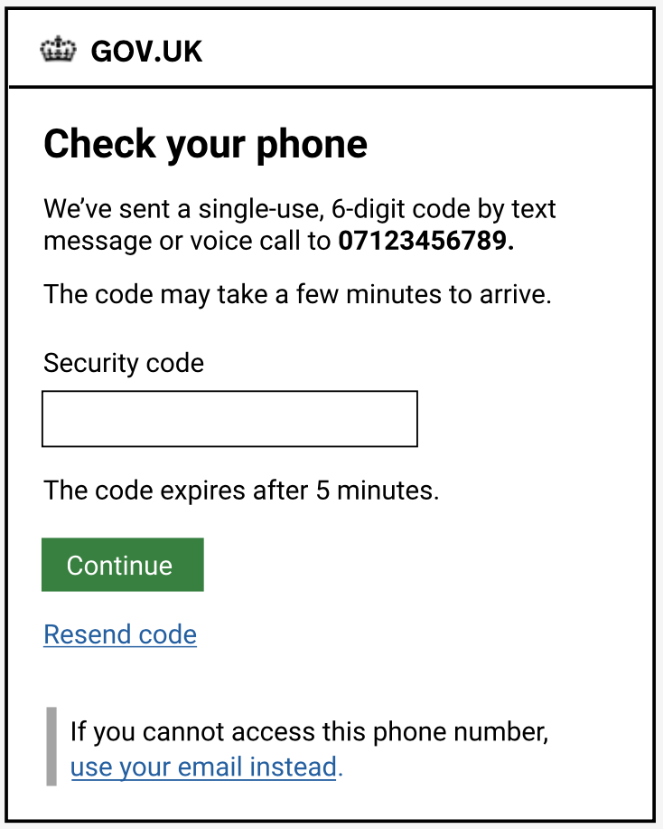
Do not rush people to enter numbers
Forcing people to do sums to verify identity is likely to exclude them. Instead, tell people about a different way to complete the task which doesn’t involve entering numbers, like using face recognition.
Avoid setting time limits because people might make more attempts to enter numbers accurately.

Slide 22
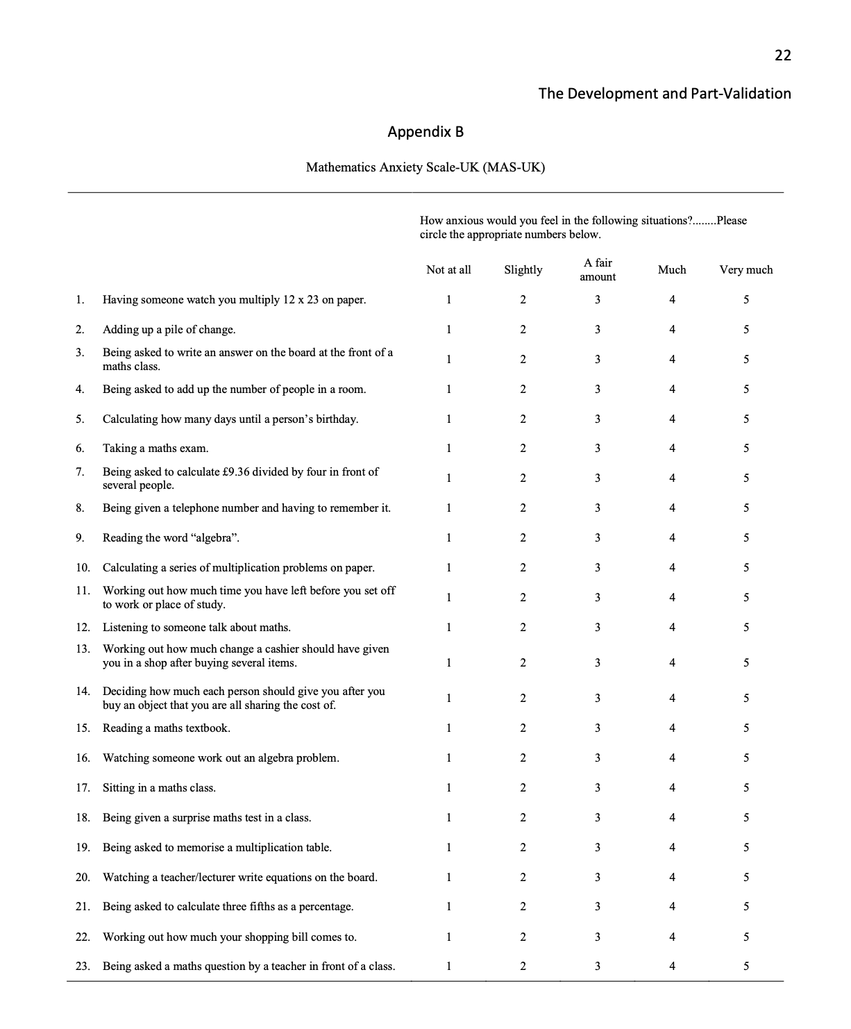
Research with people who struggle with numbers
Include people with dyscalculia when researching and testing your product or service but don’t ask for their help for free.
Some people know they struggle with numbers but don’t know they have dyscalculia. Use professor Tom Hunt’s maths anxiety opening discussion questions.

Slide 23
Check out these links
What is dyscalculia?
Dyscalculia poster
Plain Numbers report
The difference between dyslexia and dyscalculia
The Dyscalculia Network
Follow us on Twitter:
@mcfadyen_jane
@LauraParkerUX
@GirlCalledMalic

