Slide 1
Bridging the gap between communities and City hall
Ayesha Hameed,
Head of Community Engagement, Greater London Authority

Slide 2
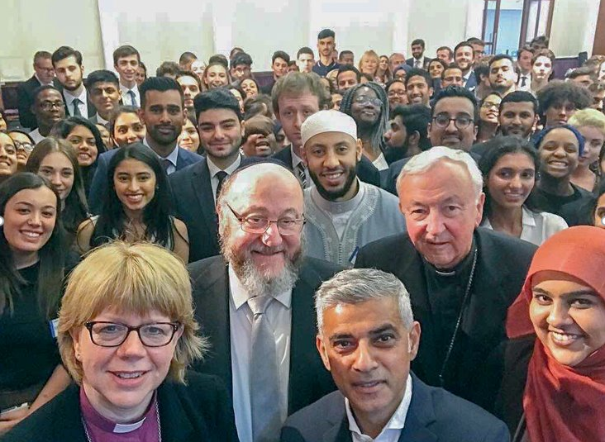
London
8.1 million people
300 languages spoken
70% identify with a faith/religion
32 boroughs inc. City of London
Major incidents in last 5 years:
Grenfell Tower tragedy
Rise in serious youth violence
COVID19
Cost of living crisis
Climate emergency

Slide 3



HOW WE GET THERE
improving community led insight
SHIFTING INTERNAL AND EXTERNAL SYSTEMS
STRENGTHENING RELATIONSHIPS AND CAPACITY
Community Insights Hub for London
Civic Strength Index for London
Embedding peer/community led research into the GLA’s policy process
Profiling best practice internally and externally
Creation of the London Engagement Collaborative
Developing tools, resources and guidance to help mainstream good practice e.g. remuneration guidance
Civic Futures leaders fellowship – currently in year 3
Funding for equity-led orgs
Public Health Briefings during and after the pandemic

Slide 4
ENGAGEMENT VALUES
Open honest and trusting
Inclusive and diverse
Collaborative
Respect and power
Responsive
We value open honest conversations, with transparency about opportunities and barriers. In turn we also trust partners to work with us through complexity.
We centre the importance of diverse voices and perspectives, and actively design processes that remove barriers to participation and focus on the needs of diverse groups.
We recognise that challenges facing London are complex, and seek to work in partnership wherever possible to achieve sustainable solutions.
We respect the contribution of all groups and perspectives and address inequalities in resource and power.
We are active in responding to the needs of communities, and always share the impact of engagement back with partners.
Notes:
Engagement values and top tips
1. Take an asset-based approach
When engaging with community groups it can be easy to start in a well-intended place which maps their deficits, needs and problems. I have learnt to adopt an assets-based approach to community engagement. I seek to mobilise communities individuals, associations, connections and institutions.
2. Be ok with the unknown
When we work with communities I’ve learnt it’s easier to go in and be open to the possibility that we won’t have a clear answer. That allows more space for genuine collaboration. And to be honest that we are engaging with communities to fill the gaps in our knowledge.
3. Be curious and find the 2% of truth in everything
Use curiosity as the antidote to judgement. Understand why your stakeholder thinks in a certain way and explore their thought process. If you encounter conflict, try to find the 2% of truth in everything and use this as common ground to explore ways forward, rather than allowing a disagreement to escalate.
4. The ‘little things’ matter
It’s so important not to underestimate the power of the ‘little things’ in developing close connections to communities, like providing venue space or event platforms for communities to share their stories, attending community events or helping make introductions and connections. By making the process of navigating the GLA easier, community groups tend to feel more confident in our ambition to engage meaningfully with them which in turn leads to greater trust and stronger relationships in the long-term.
5. Embrace the discomfort
Two questions we ask ourselves when carrying out engagement are:
Who is not here?
What are the limits of our own abilities?
The answers to these questions often take us out of our comfort zone and towards confronting gaps in our knowledge and our networks. We tend to rely on quantifiable answers and think tank research, but community engagement surfaces equally important qualitative data and voices. Step away from the absolutes and embrace the discomfort of the unknown, it will help us get things right the first time.
6. Valuing community contribution
We are used to paying consultants for their time and expertise and we set our budgets accordingly, all too often the same consideration is not given for community or Civil Society expertise. Giving the impression that their time is not valued. Consider how you reward and recognise involvement whether it’s by paying travel expenses, payment for people’s time and/or publicly acknowledging their role
7. There are many tools in your toolbox
Some classic tools that have been used in City Hall to carry out engagement are consultation responses, roundtables and stakeholder advisory boards. The community engagement team are developing alternative methods such as peer led research, social media, book discussions, video messages and podcasts. These methods help us reach and engage with some seldom heard groups, resulting in us learning much more about London’s different communities.
8. Be honest about what is ‘up for grabs’ – and what isn’t
We use terms like ‘co-design’ and ‘community-led’ all the time, but too often this is without having properly thought through what those terms mean in practice. Meaningful co-design means being truly willing to develop your policy and process in partnership with the community, and ultimately concede some control. The reality may fall some way short of this. If all you’re able to offer is consultation (very different to co-design) that’s fine! By being honest and transparent about exactly what we’re asking of communities and what might change as a result, the community will have far greater respect for a process that they can trust, where their impact is clear, even if limited.

Slide 5
Case studies
Working with underrepresented communities

Slide 6
CASE STUDY 1: Citizen Led Engagement Programme
In 2017, the GLA piloted a new way of collecting community-led insight, via a peer research model to address limited or no engagement with communities whose voice and influence over public policy had been historically underrepresented.
Worked with 17 small, grassroots organisations between 2017-2020
Grant funding and wrap-around support.
Focused on engaging communities who were furthest removed from policy making spaces – based on data we had on participation.
‘What will the Mayor do about it?’ to ‘What can we do about it together?’
Notes:
Evaluations:
Mayor-of-London-Citizen-Led-Report.pdf (thesocialchangeagency.org)
Evaluating the Greater London Authority’s Citizen-Led Engagement Programme – The Social Change Agency

Slide 7
CASE STUDY 2: COMMUNITY CONVERSATIONS Model
London Recovery Programme – funded engagement activity to prioritise what GLA and partners should focus on to get London back on its feet
Festival of Ideas – funded events across London to help us reimagine what strong communities look like
3. Adult Education Budget - £300m
Devolved funding to Greater London Authority for adult education
Multiple routes to participating in deciding what the funding prioritises for communities
Community Conversations – a model trailed and tested
Focus groups with local adult education providers
Talk London platform engagement [digital]
Notes:
Links provided for more info in the slide.

Slide 8
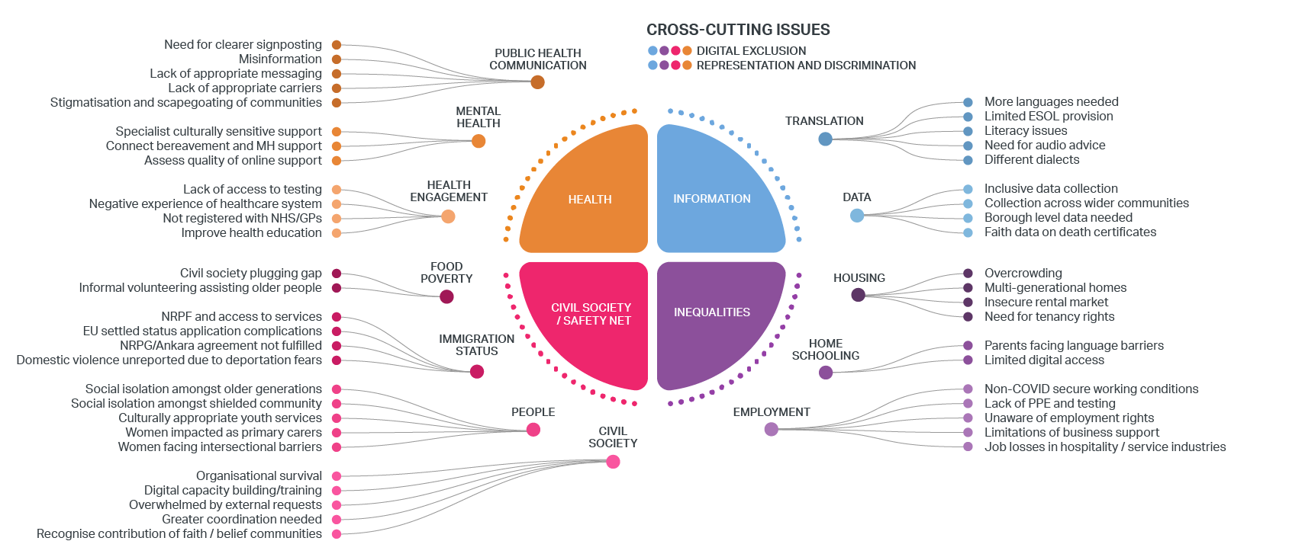
CASE STUDY 3: MAP OF COMMUNITY INSIGHTS
Notes:
Map of Community Views – London Datastore

Slide 9
“We must never lose sight of the fact that the GLA exists to serve London’s communities. It is our job to make sure not only that the collective voice of Londoners is heard, but that it is instrumental in shaping public policy for the betterment of everyone in our city. Representation, collaboration, equality and inclusion must always be at the heart of our approach to engagement. Everything [at the gla] must be in partnership with Londoners, rooted in the daily reality and lived experiences of our communities because this is the only way we can truly help to improve Londoners’ quality of life and tackle the barriers, challenges and problems they face. This approach is also the only way that we as partners can possibly enhance Londoners’ welfare and wellbeing, enable our city to flourish and thrive, and ensure that London is an even better place to live and work after this pandemic than it was before.”
“
”
Sadiq Khan, Mayor of London

Slide 10
THANK YOU
Ayesha Hameed
ayesha.hameed@london.gov.uk
www.london.gov.uk

