Slide 1
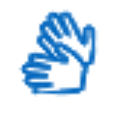
British Sign Language
Insights and content creation

Slide 2
Slides prepared by:
Ewan Ferguson – Senior Content Designer, Scotland’s Census 2021 ewan.Ferguson@gov.scot
Frankie McLean – BSL Policy Officer, Scottish Government frankie.mclean@gov.scot

Slide 3
Frankie McLean
BSL Policy Officer
SG Equality Unit

Slide 4
What is British Sign Language (BSL)?
British Sign Language is a visual means of communicating using gestures, facial expression, and body language
it is the indigenous signed language of the UK
signed languages are often a first and preferred language for people who are deaf
British Sign Language (Scotland) Act 2015 aimed at promoting access in and usage of BSL
Notes:
British Sign Language the indigenous signed language of the United Kingdom. A common misconception is that sign language is all about hand gestures but BSL users also use facial expressions and body language to communicate.
Most people are probably aware of British Sign Language but may not know that it is officially recognised as a minority language in the UK. In Scotland this is through the 2015 British Sign Language (Scotland) Act. This puts it on an equal standing with English and Gaelic. But while providing services in Gaelic has a lot of cultural importance, providing services in BSL is vital in terms of giving citizens access to services.

Slide 5
What is British Sign Language (BSL)?
the number of people in Scotland whose first or preferred language is BSL was estimated by the Scottish Government to be around 6,000
2011 census recorded almost 13,000 people using BSL at home
BSL is part of a global family of signed languages
for example: American Sign Language, Langue des Signes Francaise, Lengua de Signos Espanola
Notes:
The number of people in Scotland with BSL as a first or preferred language is estimated at 6,000, with the 2011 census recording almost 13,000 people using BSL at home. It’s not uncommon for people who are deaf to have hearing children, who often learn BSL as a first language before English.
BSL is part of a global family of signed languages, with many countries having their own versions, with their own name.

Slide 6
Comparing English with BSL
English | British Sign Language
Civil Partnership | Two-people-together-legal
Take into account | Think about
Civil servant | Government worker
Multi storey | Tall building
Apple of your eye | Favourite
Bend over backwards | Try (hard)
Notes:
Some aspects of English don’t translate directly to BSL. Here or some examples of how some English phrases may be translated to BSL. Often in BSL, a similar sign can be used to represent different meanings, depending on the context and the facial expression being used by the signer. While English may seem to have more variety in terms of words and phrases, BSL is a much more nuanced language.

Slide 7
British Sign Language Plans
six year planning cycle
Scottish Government committed to publishing a National Plan every six years, with a progress report mid-way
this involves agencies and other public bodies producing their own BSL plans
Notes:
Under the BSL act, the Scottish Government is committed to producing and publishing a national BSL plan every six years, and reporting on progress mid-way between each plan. The plan sets out how the SG is going to promote access to and use of BSL. Public bodies and agencies are also required to produce their own BSL plan to set-out how they will support the national plan.

Slide 8
BSL National Plan 2017-2023
https://www.gov.scot/publications/british-sign-language-bsl-national-plan-2017-2023/
70 actions
10 ambitions:
public services
family support, early learning and childcare
school education
post-school education
training, work and social security
health, mental health and wellbeing
transport
culture and the arts
justice
democracy
Notes:
The national plan has 70 actions and 10 ambitions that touch on many aspect of life in Scotland.

Slide 9
Current challenges
Incidental information
Education
Access to opportunities
Cultural norms
Priorities
Attitudes
Dominance – “majority rules”

Slide 10
What can be done?
Short-term view vs long-term view
Plain, simple English
Audio => visual
Increase profile
Language is for everyone
Less is more
Consider presentation of information – if deaf/BSL-speakers benefit, majority should benefit

Slide 11
Ewan Ferguson
Senior Content Designer
Scotland’s Census

Slide 12
BSL and the census
Approx. 100 BSL videos covering census questionnaire and guidance
challenges around user research and testing
direct engagement with select group of BSL users
Notes:
For the census, we are delivering about 100 BSL videos, covering two different completion routes – online and paper – as well as some website content.
Wee bit of a disclaimer: The advice and tips that are in these slides come from work to create BSL videos for Scotland’s Census 2022 and were taken directly from feedback from BSL users as part of this process. At time of writing – September 2020 – this work is still ongoing. These discussions were with a limited group of BSL users, all fluent in English. This means that their preferences may not represent the wider BSL audience, who may not have the same level of English. So with that in mind, take all of this with a pinch of salt. Some desk research was undertaken without much success and this seems to be an area crying out for a bit more research and testing.

Slide 13
Help us improve
let us know about any work you are doing in this area
can you confirm, adjust or radically challenge the approach presented here?
get in touch- we will update this resource and give you due credit!
Notes:
In the spirit of the last slide, we’d love to hear from anybody who is also working with BSL content and can share their experiences and what they have learned. Perhaps you have received similar feedback or maybe you have come to different conclusions. What we want is to provide some sound, user-focussed advice to help with design of BSL content. Please get in touch!

Slide 14
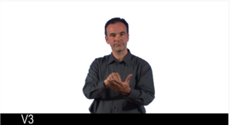
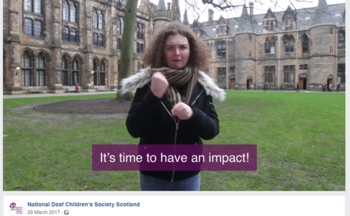

What is BSL content?
Notes:
For the purposes of these slides, BSL content is videos of people using sign language. This could be to translate English content for BSL users – either a translation of a web page or offline content, such as a policy or consultation document. Some websites may also produce parts of their content exclusively in BSL. You can translate BSL content in different styles – some videos may be purely BSL and some may involve a BSL interpreter translating English audio.

Slide 15
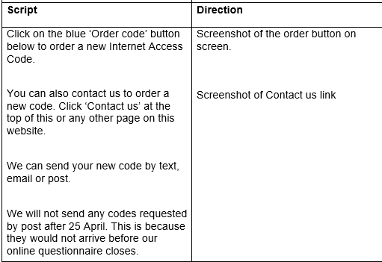
What is BSL content?
Notes:
For content designers, this can mean turning a web page or a document into a script to be filmed. This is not simply a case of copying and pasting your English content into an autocue. The structure of your BSL content may differ from your English content, depending on the purpose of the page and what users need to do with it. More on this later.

Slide 16
Things to remember as a content designer
BSL is a full and proper language using the full body and space
BSL is a first language for the majority of users - you must not assume that a BSL user can or cannot read or write English fluently
BSL is visual and not everything translates easily from English
much of this advice is true for video production and accessibility more generally
Notes:
Before you start thinking about BSL content, it’s important to understand some key facts about the nature of BSL and how it differs to English. To reiterate, BSL is not just about hand gestures – it involves facial expressions and body movement.
To a lot of BSL users, it is their first language, the language they have learned from birth before English. Because of this, you can’t assume that a BSL user will have a high level or understanding of written English. For many, English is a second language. For others, understanding of English can be very limited. Equally, though, you shouldn’t assume a BSL user doesn’t understand English.
Most important is to recognise that BSL is a language totally separate from English. It is not simply a signed version of English but has its own unique characteristics. Words, sentences, grammar and punctuation are structured differently to English. This means that a lot of English phrases and terminology may not have direct BSL translations.
In terms of BSL content, it’s important to remember that a lot of good practice and accessibility that applies to any video production is the same for BSL videos.

Slide 17
Co-design
co-design of BSL content is really important
much harder to iterate a video than a written piece of content or a graphic
plan the user journey to ensure you are maximising your resource on the essential parts of the service
Notes:
Co-design is always important. But with BSL content co-designing right from the beginning is crucial. When designing English content, you have the luxury of prototyping internally first, then testing a few options and iterating later on as you test with users.
Often this means updating a word document or CMS page, maybe getting a bit of graphic design re-done. Because of the nature of BSL content – video – however, it may be much harder to iterate once you have committed something to film.
So working with BSL users from an early stage to get your concept right and test your scripts before they are filmed is really important.
This is, of course, the same for any video content.
The other aspect to consider is that you may not have the budget and resource to fully translate your website or service. While this isn’t ideal, it’s unfortunately a reality. It’s really important to work with your BSL users to understand the key journeys and interactions that are absolutely essential to be offered in BSL.

Slide 18
Top tips
Make a visual connection with your page
Quick access to Calls to Action
Make use of text and numbers on screen
Make it prominent
Notes:
We will now go through some tips for creating your BSL content. Again, these are based on feedback and discussions with SOME BSL users but not in any way formal research and testing. A lot of these are also equally applicable to content design and video production of any kind.

Slide 19
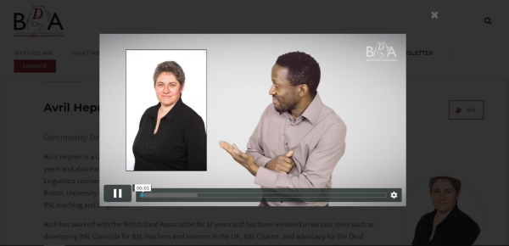
Make a visual connection with your page
Notes:
When the BSL presenter is signing about a particular part of your content, BSL users told us that it can help to offer visual prompts to the viewer to help them understand where or what on the page they are referring to.
In the example on this slide, the video is using a picture of the person being signed about. This mirrors the picture on the page and helps the BSL user understand this is the person the video is about.
It may seem obvious to most users with good English that a video on a page about Avril Hepner is about Avril Hepner. But if you don’t understand English, this kind of prompt can be really useful.
Other useful ways you could use visual prompts is when referring to links or lists. If you have a long list of links, for example, it can be tricky for a BSL signer to sign these all out. This is especially true if you are presenting them as URLs.
BSL users told us that we should simply show a screenshot of the links and explain what they are. By making the visual connection, the BSL user can find what you are referring to on the page.

Slide 20
Make a visual connection with your page
Script | Direction
British Sign Language users can make use of the Contact Scotland free video relay service. Click the Contact Scotland-BSL link in the text on this page to use this service. | Screenshot of link on page
Notes:
Example of how a link may look like in a script. Interestingly, I couldn’t find an example of this but it was something the BSL users we consulted wanted.

Slide 21
Quick access to Calls to Action
help your BSL user get to what they want as soon as possible
front load calls to action
describe them and show them on screen
Notes:
There has been lots of research around how users view and scan web pages – such as scanning in the F shape and being drawn to visual elements before they absorb much written content (check out www.nngroup.com for more on this).
This is no different for BSL users and your BSL videos should facilitate the user getting to the task or call to action as quickly as a non-BSL user can.

Slide 22
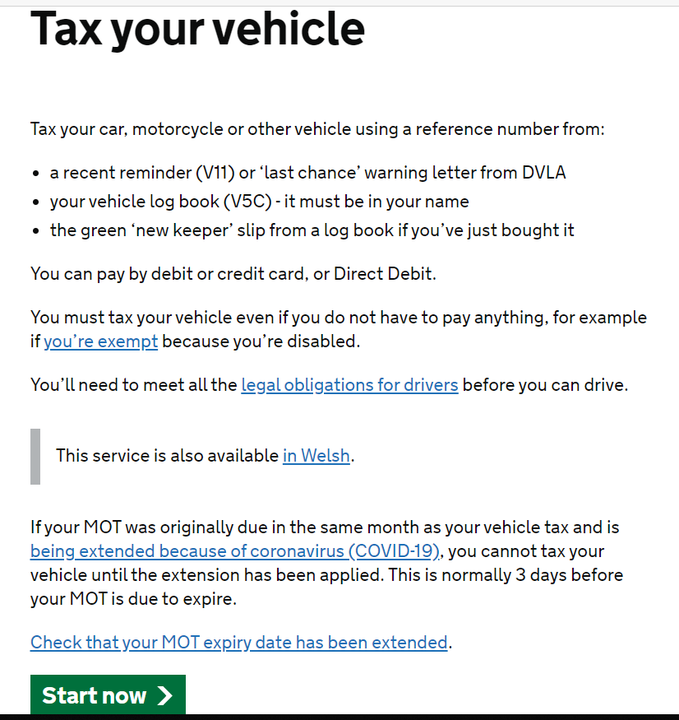
Quick access to Calls to Action
Notes:
This page from gov.uk has a nice big call to action button at the bottom and some text above that users SHOULD read. But how many people read it in detail before clicking ‘Start now’? How many skim and then go straight to ‘Start now’? (This isn’t a critique of gov.uk - the page was no doubt refined very nicely through testing).
If you have a good level of English, there is a fair chance the first thing you will notice when you arrive on the page is the big green button and the second thing is that it says ‘Start now’. This gives you the option to use it straight away if you wanted to. You can probably review the text and move on fairly quickly too.
But if you are a BSL user who doesn’t have a good level of English, it may not be evident what the button does. It would hold you up if you had to watch a whole translation of the page just to find out that the green button at the bottom is what you want (or do not want).

Slide 23
Quick access to calls to action
Script | Direction
To get started and tax your vehicle, click the start now button on the page. Tax your car, motorcycle or other vehicle using a reference number from: a recent V11 reminder or ‘last chance’ warning letter from DVLA Your V5C vehicle log book - it must be in your name the green ‘new keeper’ slip from a log book if you’ve just bought it You can pay by debit or credit card, or Direct Debit… You must tax your vehicle even if you do not have to pay anything, for example if you’re exempt because you’re disabled. To check to see if you are exempt, click this link on the page… | Show the ‘start now’ button on page Show the ‘you’re exempt’ link on page
Notes:
So a BSL script for this page may work better if it is presented like this. BSL users told us that for pages like this, the description of the call to action and what it does should be right at the start of the page. Be careful about using colours to describe page elements as your user may be colour blind.
Presenting it like this means a BSL user has the option of going straight to it. If they want to know the guidance as well, they have the option to keep watching to find out the rest of the page content.
Notice also, the visual of the ‘you’re exempt’ hyperlink. Making a visual connection to how the link looks on the page can help the BSL user locate it.

Slide 24
Make use of text and numbers on screen
long urls and phone numbers may not translate well into sign language
displaying these on screen may be easier for BSL users to understand and copy or use
if you can make links clickable, even better
Notes:
Signed languages are rich and have a varied vocabulary. But when it comes to long URLs and telephone numbers, they cannot be translated. In BSL, they have to be fingerspelt or enumerated letter by letter or number by number. This is difficult to watch and pick up. They are not elements that are translatable – they are what they are, to be typed or input as they are.
BSL users told us that showing URLs and phone numbers on screen is more user friendly. If you are able to make URLs clickable in your video, even better.

Slide 25
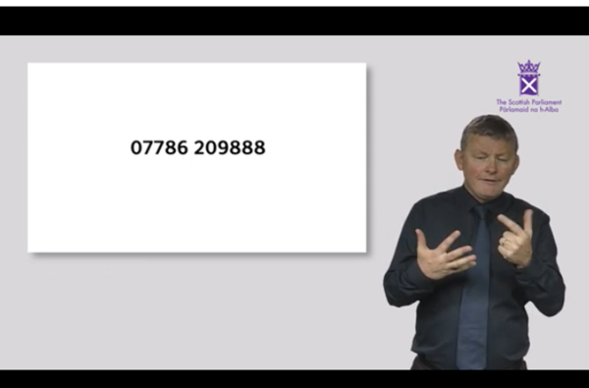
Make use of text and numbers on screen

Slide 26
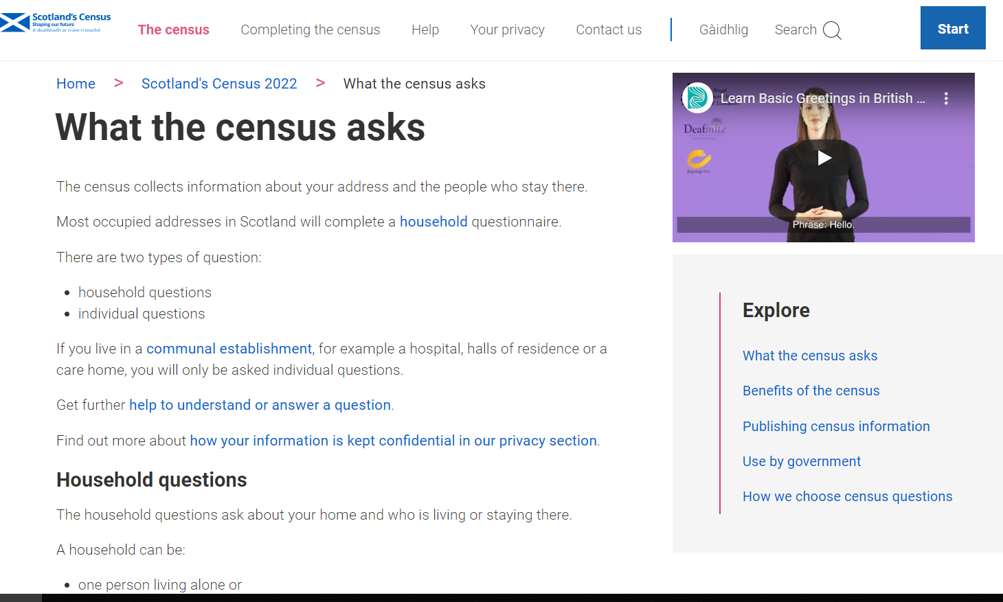
Make it prominent
BSL content should be as easy for users to access as English content
placing BSL videos in a prominent place on your page means users don’t have to search for it
users shouldn’t have to leave the page to view a video
signpost your content
Notes:
Placing your videos in a clear and prominent place reduces the cognitive load on your BSL users as they don’t have to scroll and hunt for content they need. The key point here is equality – the BSL content should not dominate the page at the expense of the English content but neither should it be lost among the English content. This is why designing your page templates with BSL content in mind is a smart thing to do.
BSL users told us that BSL content should be placed high up on the page and ideally in the same place on every page with BSL content. Because we hadn’t thought about this when we designed the website, we had to go back and retro-fit.
A less-frequent issues these days but still one we have heard feedback on is that of BSL users having to click through to another page (or website!) to view a BSL translation. This is obviously really bad UX, regardless of the video’s purpose.
Something else that BSL users told us could make their experience much easier is if you signpost any BSL content. You could have a dedicated page that lists all of the BSL content or, if you get your design right, you can mark up your menus with the BSL hands symbol against any page with BSL content.

Slide 27
Examples and more info
https://www.gov.scot/publications/british-sign-language-bsl-national-plan-2017-2023/
https://www.parliament.scot/help/109625.aspx
https://bda.org.uk/
https://www.childline.org.uk/info-advice/bullying-abuse-safety/deaf-zone/bsl-videos/
https://www.facebook.com/NDCSScotland/videos/1810916879232999/
https://www.facebook.com/NDCSScotland/videos/1819338888390798/

