Slide 1
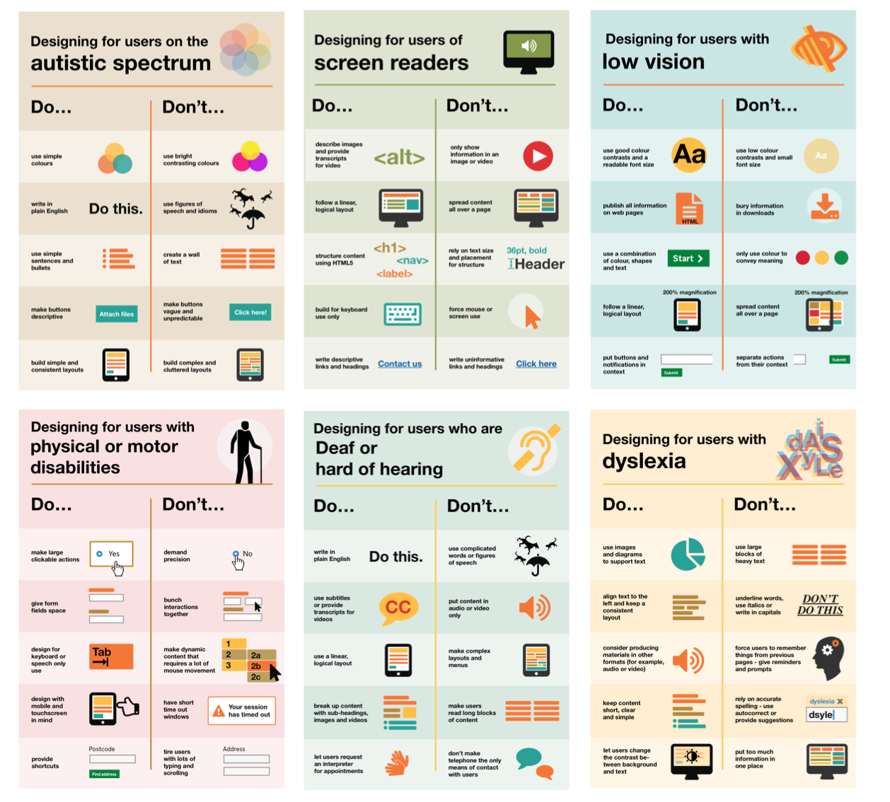
Do’s and Don’ts of accessibility posters
Home Office
Guidelines & best design practices for making services accessible in government.
Meant to be general guidance as opposed to being overly prescriptive.
6 posters in the series that cater to users from these areas: low vision, D/deaf and hard of hearing, dyslexia, motor disabilities, users on the autistic spectrum and users of screen readers.
https://accessibility.blog.gov.uk/2016/09/02/dos-and-donts-on-designing-for-accessibility/

Slide 2
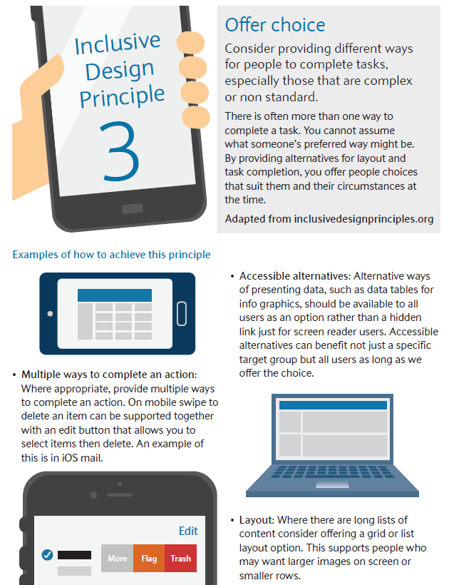
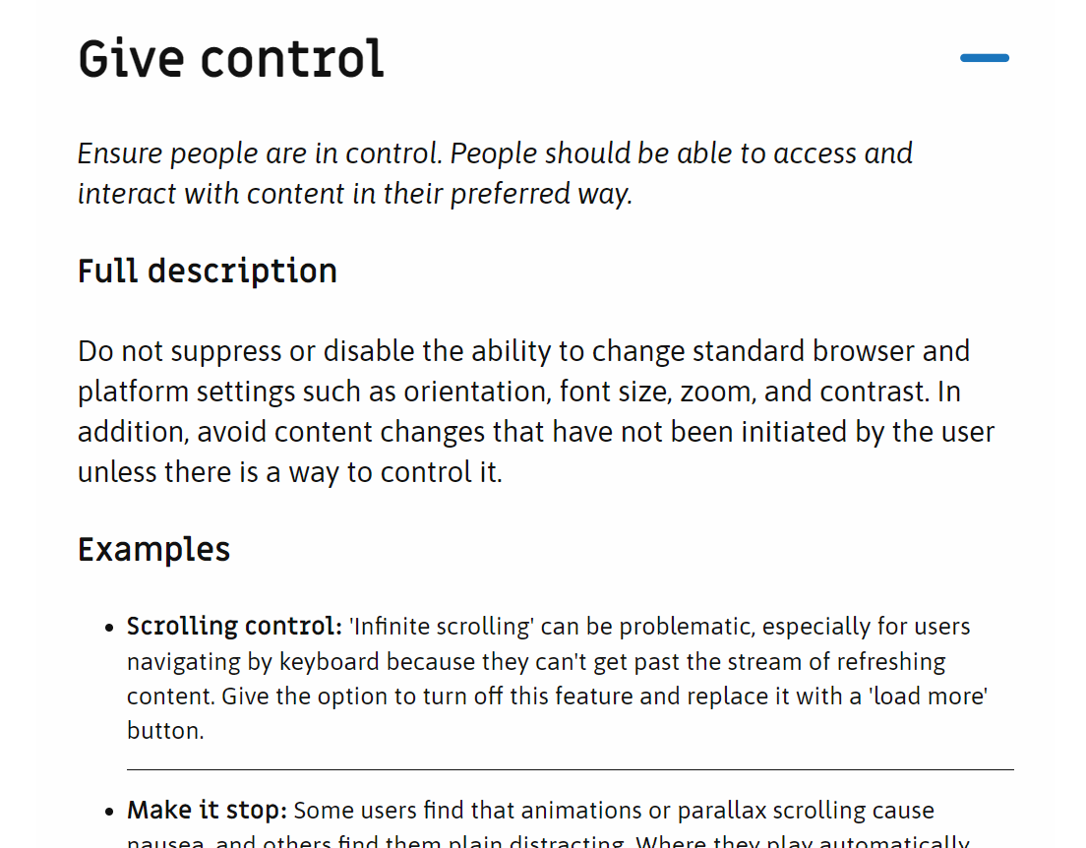
Inclusive Design Principles
Barclays
Also available as an expandable checklist on:
https://inclusivedesignprinciples.org/
https://bighack.org/wp-content/uploads/2019/11/BigHack_Barclays_Inclusive-Design-Principles-booklet.pdf

Slide 3
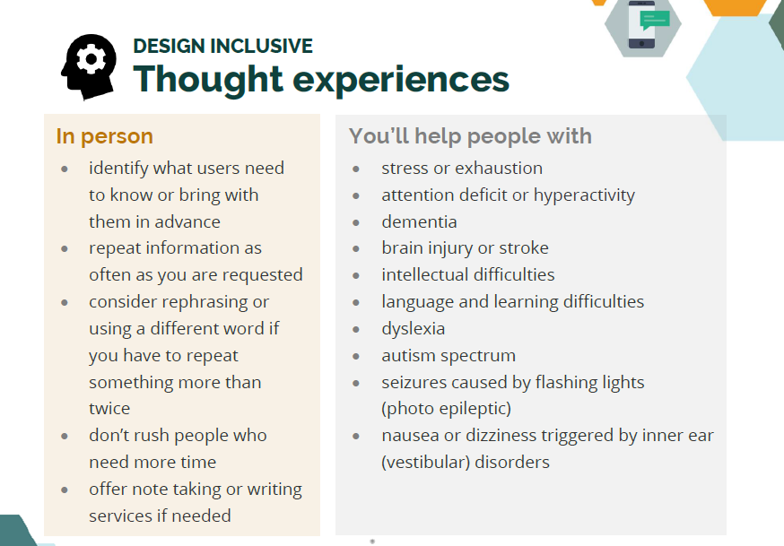
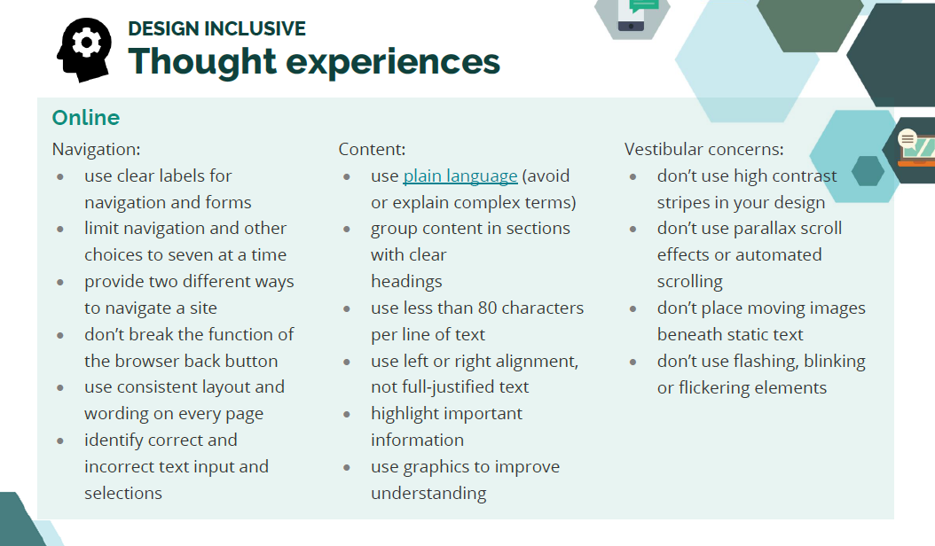
Inclusive Design Cards
Ontario Government
https://www.ontario.ca/page/inclusive-design-toolkit
https://github.com/ongov/Inclusive-Design-Toolkit/blob/master/Inclusive%20Design%20Cards%201.1.1.pdf

Slide 4
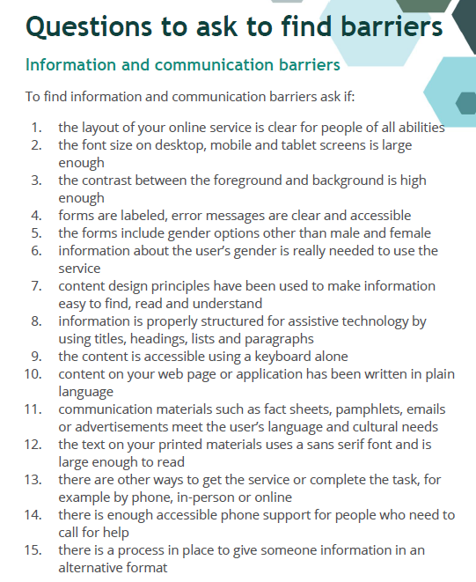
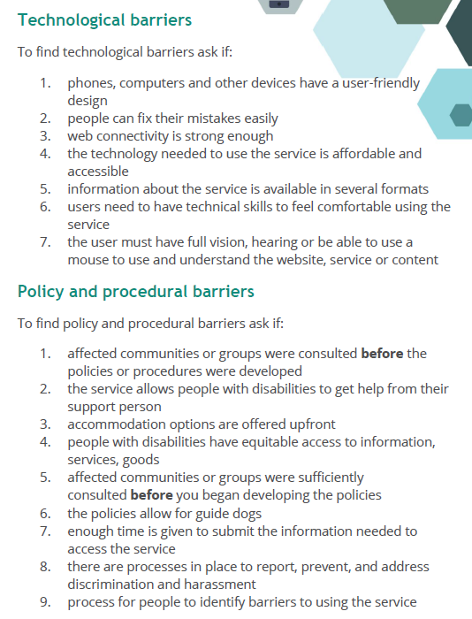
Questions to ask to find barriers in your service
Ontario government
Information and communicational barriers, Technological Barriers, Policy and Procedural barriers, Attitudinal Barriers, Physical barriers….
https://github.com/ongov/Inclusive-Design-Toolkit
Notes:
https://www.ontario.ca/page/inclusive-design-toolkit

Slide 5
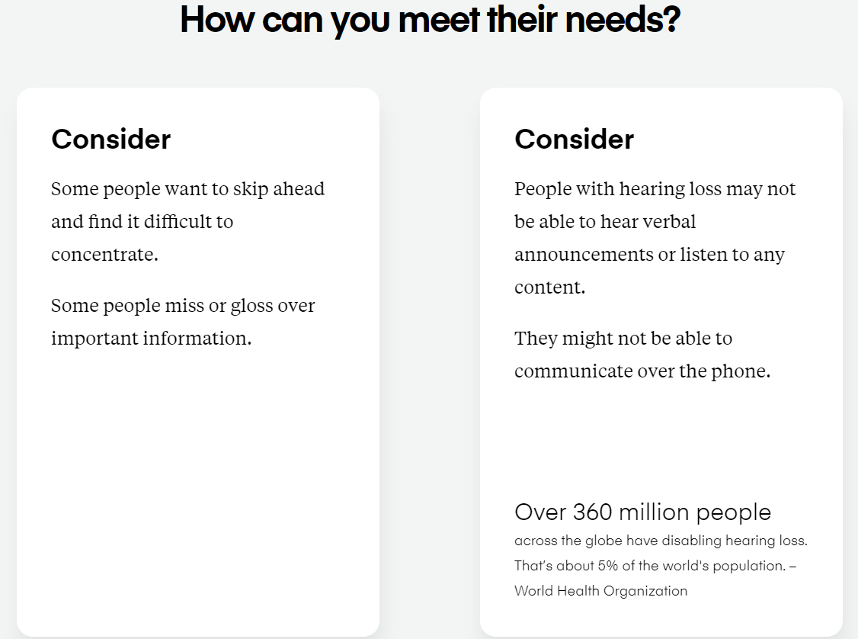
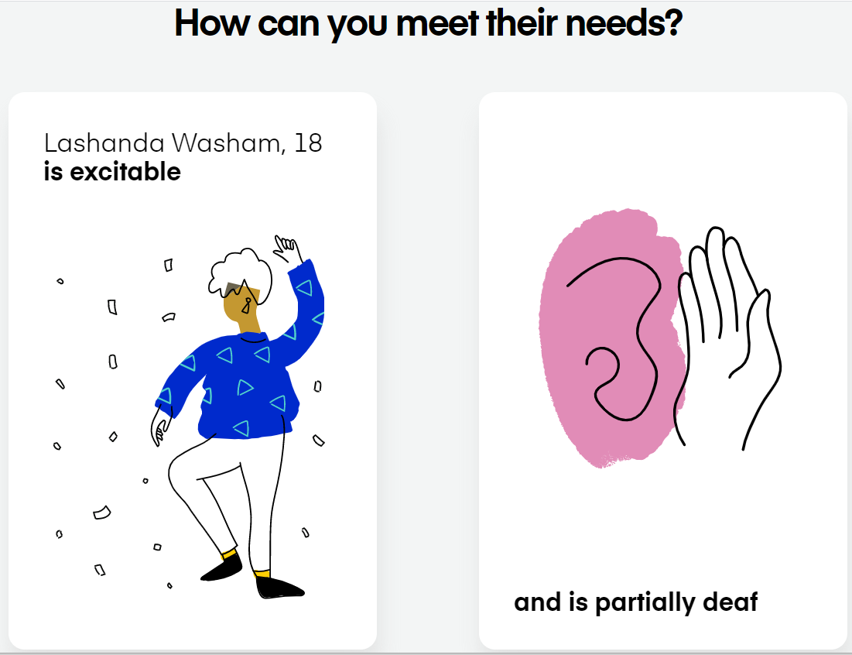
Cards for Humanity
Idean
Set of digital cards that can be shuffled in infinite varieties.
To get teams thinking about the combinations of inclusion needs that people have.
They are designed not to replace User Research but to establish principles of inclusive and accessible design from the offset, which can be improved through user research and testing.
http://www.inclusivedesigntoolkit.com/processreview/processreview.html

Slide 6
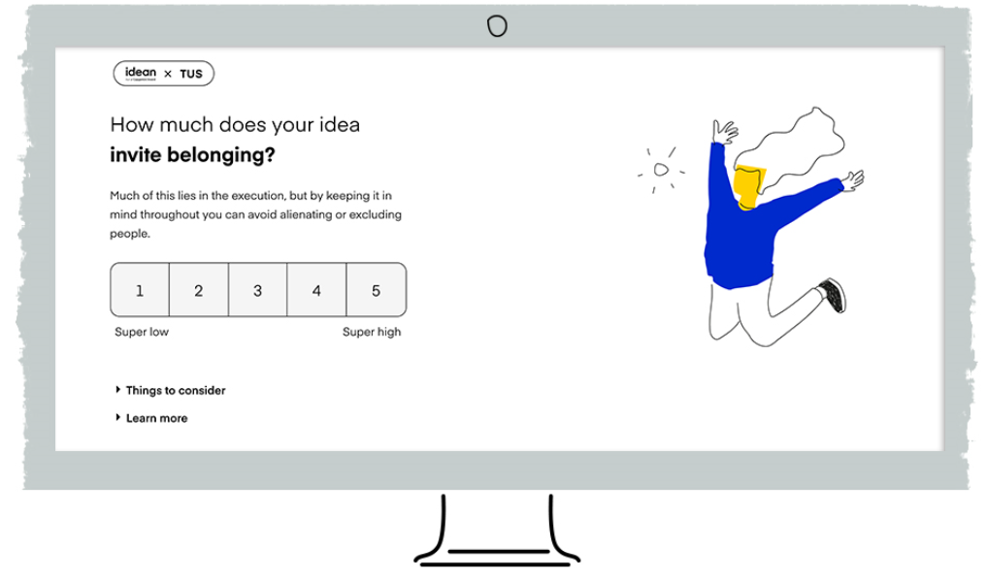
The Universal Score
Idean
An inclusive evaluation tool that poses a set of questions to help evaluate ideas against a more inclusive criteria.
For example:
Will this idea promote mental wellbeing?
Does this idea invite belonging?
Does this idea support physical needs?
Does this idea accommodate cognitive differences?

Slide 7
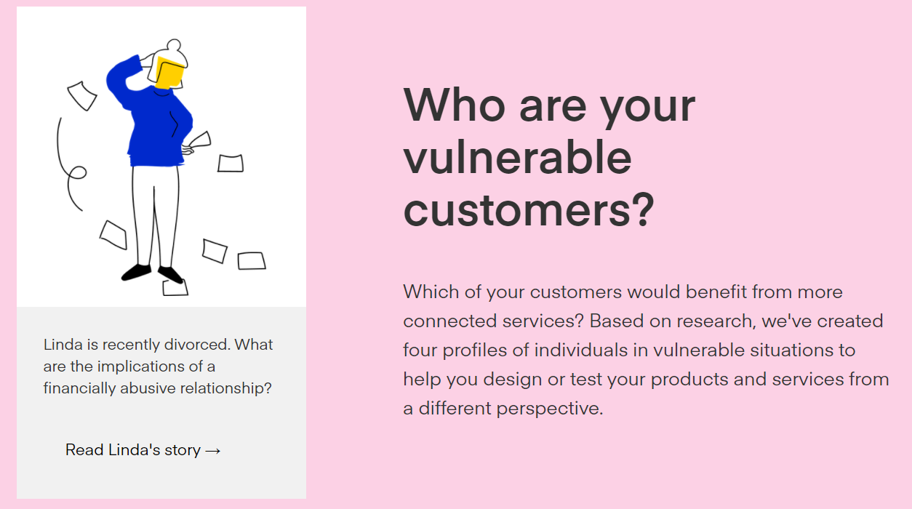
Vulnerability Profiles
Idean
A set of evidence based profiles paired with questions for teams to reflect on to asses the impact of their services on people who may experience vulnerability
https://vulnerability.idean.com/starting-point-connect-services
https://vulnerability.idean.com/profile-amy-spiralling-debt

Slide 8
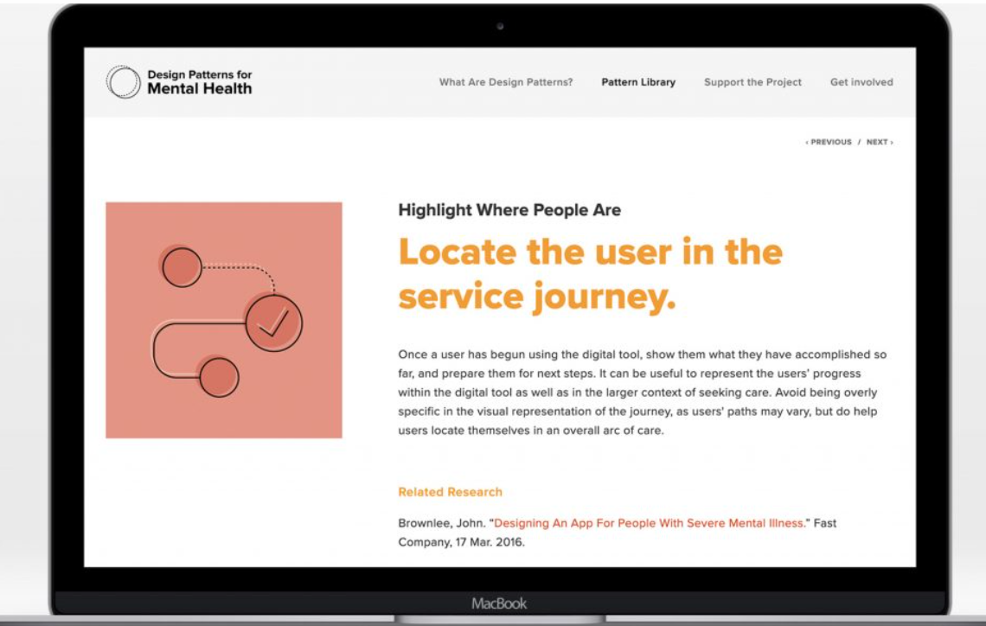
Design Patterns for Mental Health
Snook
https://www.designpatternsformentalhealth.org/pattern-library/immediate-support

Slide 9
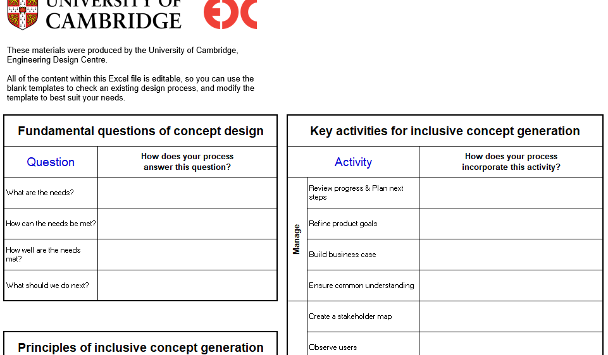
Inclusive Design concept Checklist
University of Cambridge
http://www.inclusivedesigntoolkit.com/
http://www.inclusivedesigntoolkit.com/processreview/processreview.html

Slide 10
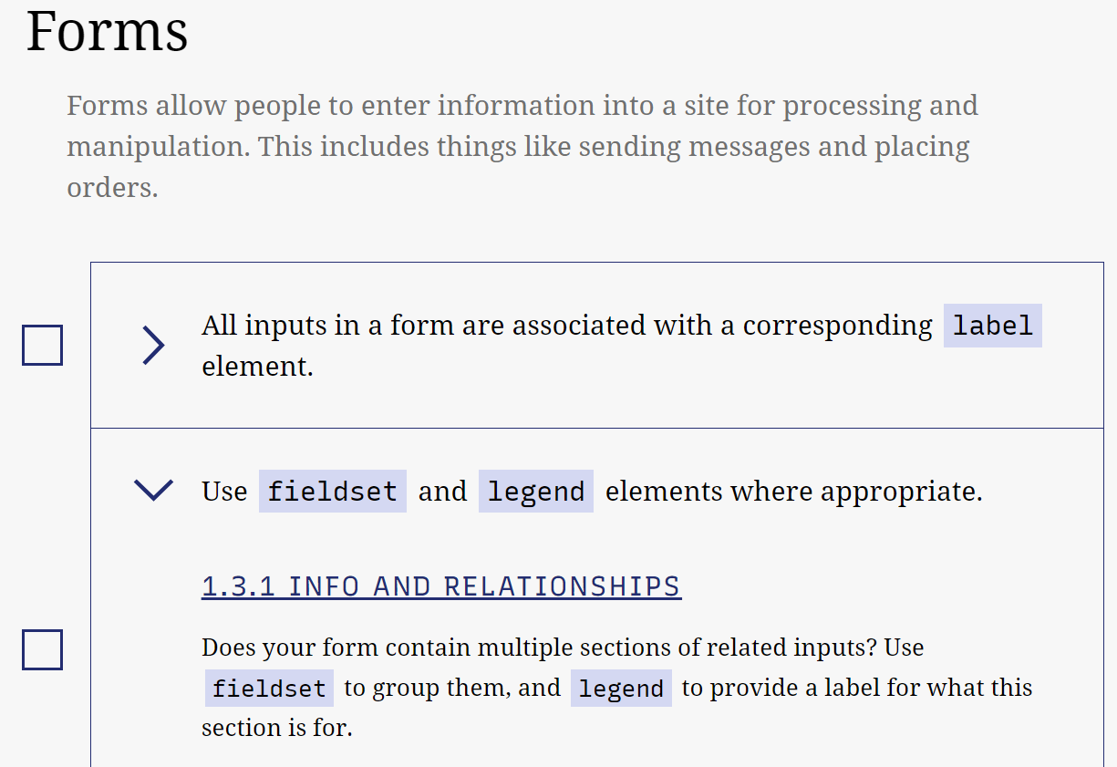
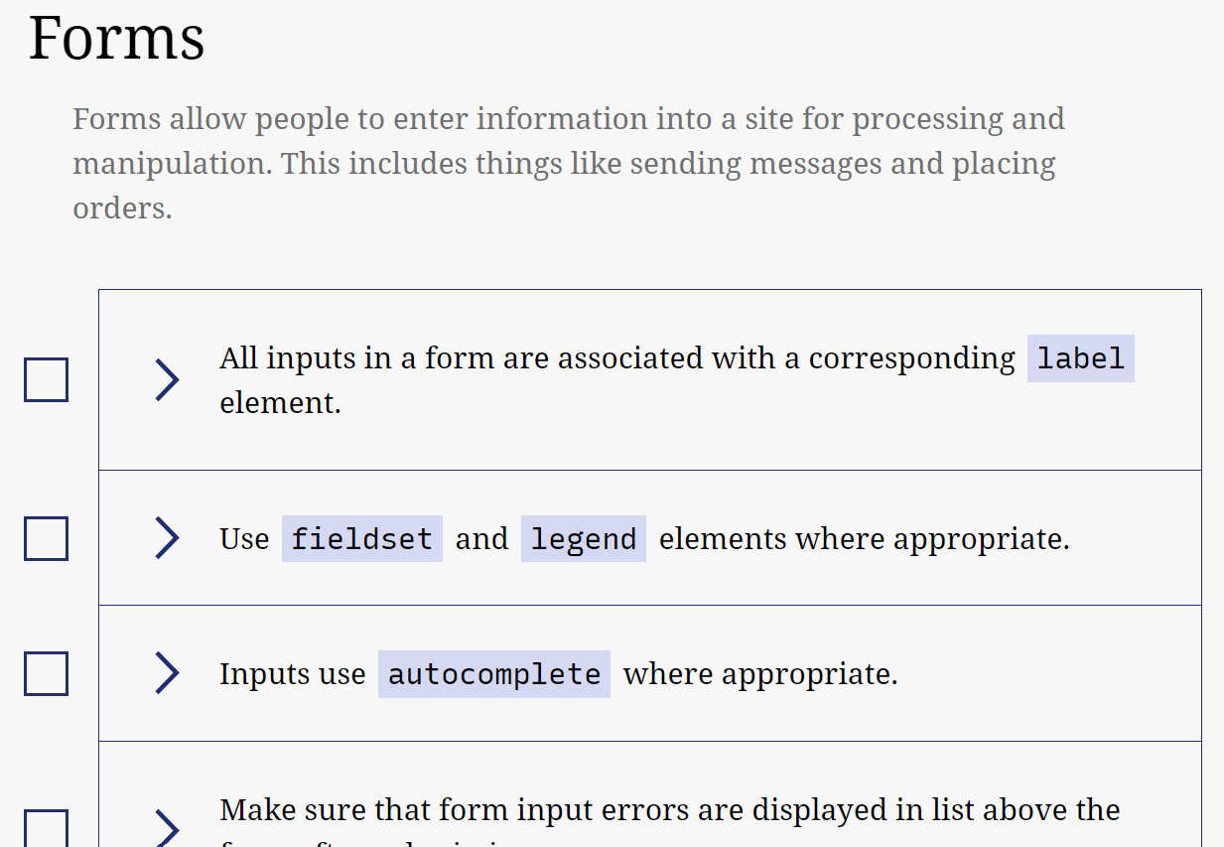
Accessibility Checklist
A11Y
https://www.a11yproject.com/checklist/

Slide 11
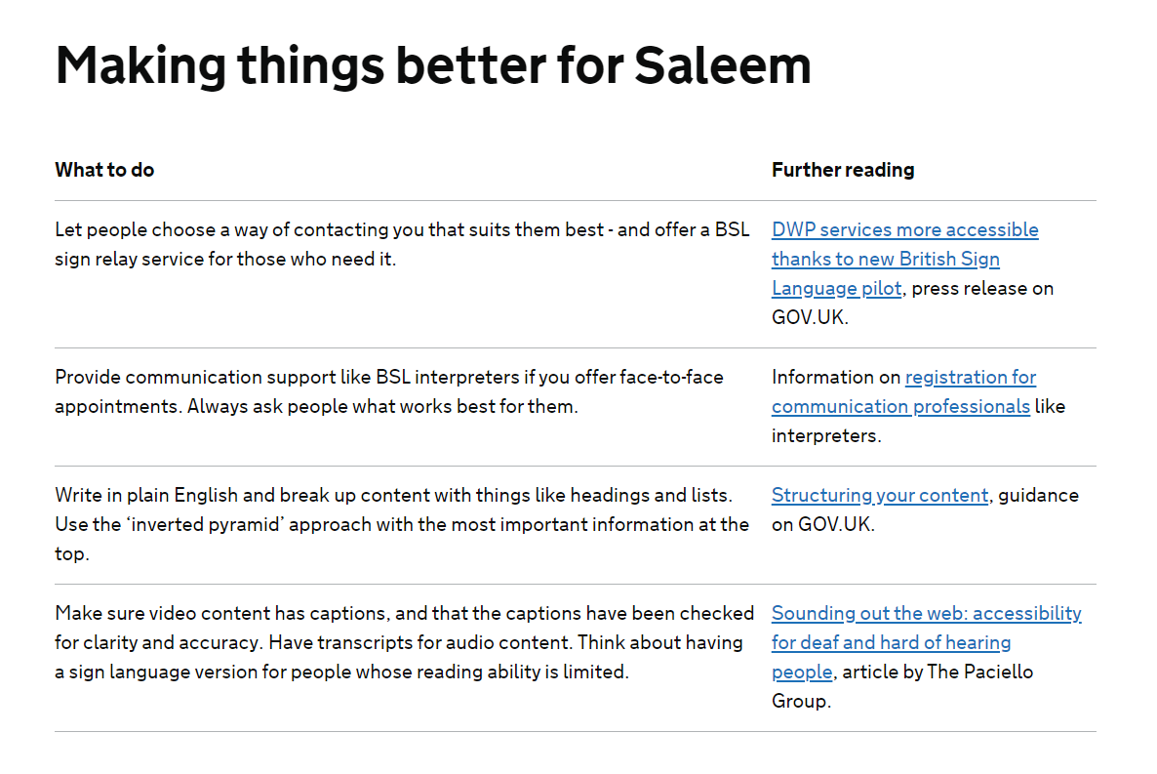
Accessibility Personas
GDS
….
https://www.gov.uk/government/publications/understanding-disabilities-and-impairments-user-profiles/saleem-profoundly-deaf-user

Slide 12
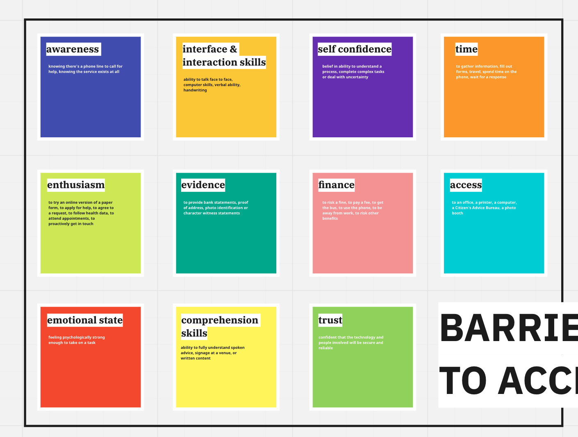
Barriers To Access Cards
NHS
In progress at NHS Scotland.
Currently adding what they know about each barrier from desk research (quantitative + qual) – Equalities team.
Design team is collecting known ways to decrease barriers through design interventions over time.
No Link

Slide 13
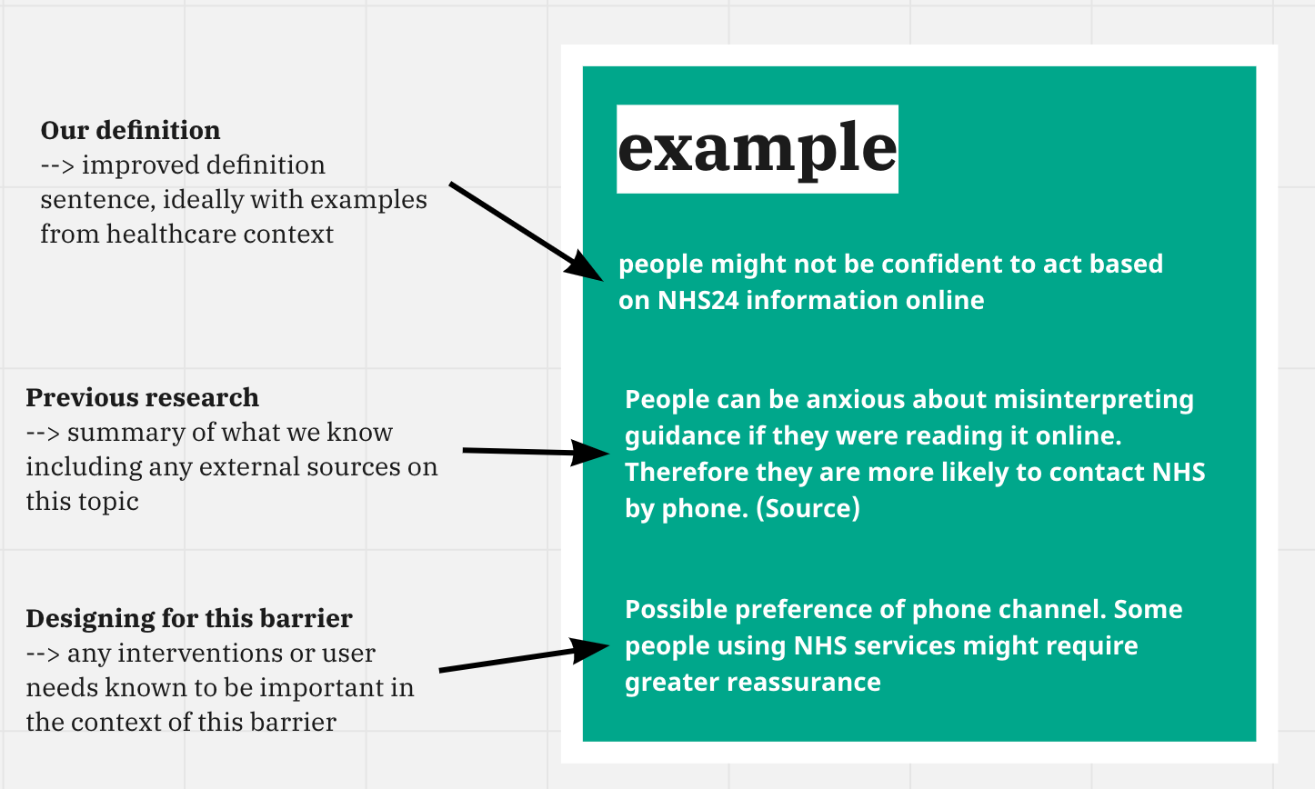
Barriers To Access Cards
NHS

Slide 14
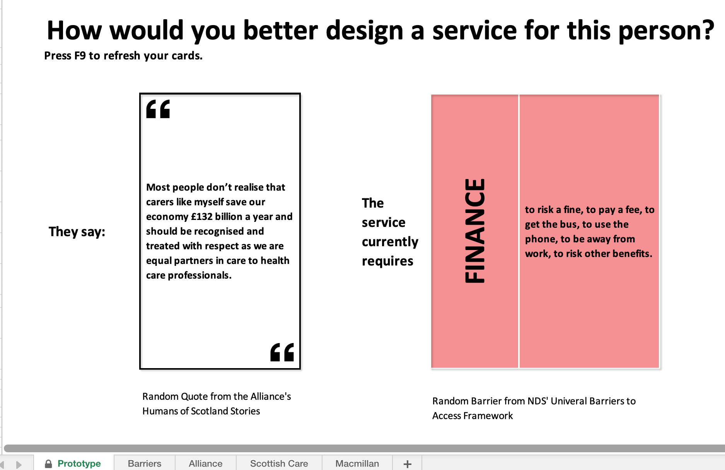
Barriers To Access Cards
NHS

Slide 15
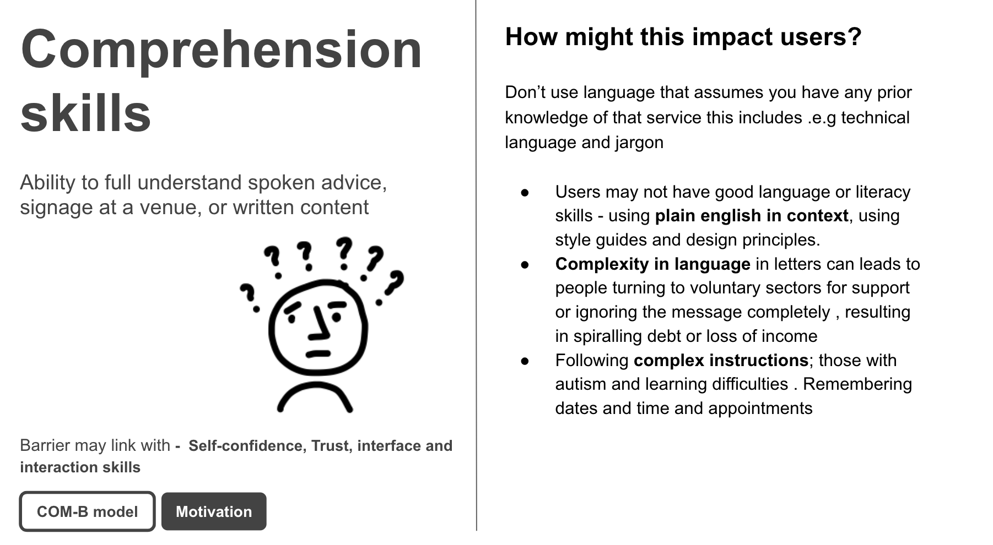
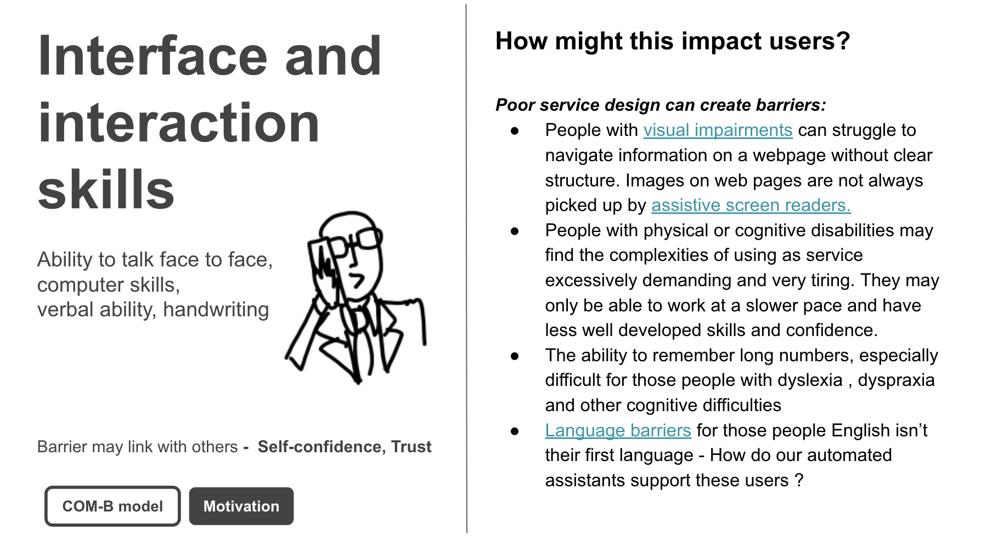
Universal Barriers Cards
GDS
Shows barrier, impact on user, and the design implications of this.
Show how other models and frameworks of inclusion (e.g. POUR, COM-B, WCAG, Assisted digital requirements)
Shows how barriers inter-relate, illustrating how working to the barriers might not be as complex as it first appears. Solving one part of a problem also helps solve another.
Notes:
Show how other models and frameworks of inclusion (e.g. POUR, COM-B, WCAG, Assisted digital requirements) to enable design teams to consolidate and collaborate around the single all-encompassing universal barriers and make better progress around inclusion.
The list of 11 barriers can be overwhelming, but we know that not only can researching with one user give insight into multiple barriers, but working to improve one part of a journey can improve things across multiple barriers. So...
**We should** come up with a way to show how the barriers inter-relate
**So that** we can show how working to the barriers might not be as complex as it first appears
**This will** help bring stakeholders along with the inclusive design process.

