Slide 1
Office of the Chief Designer
Notes:
10:30 – 11:30

Slide 2
But, ‘design’… isn’t that just making things look nice?
Notes:
Within the OCD, we have been promoting the SAtSD – a way in which we can start to applying design-thinking within the complex public sector landscape.

Slide 3
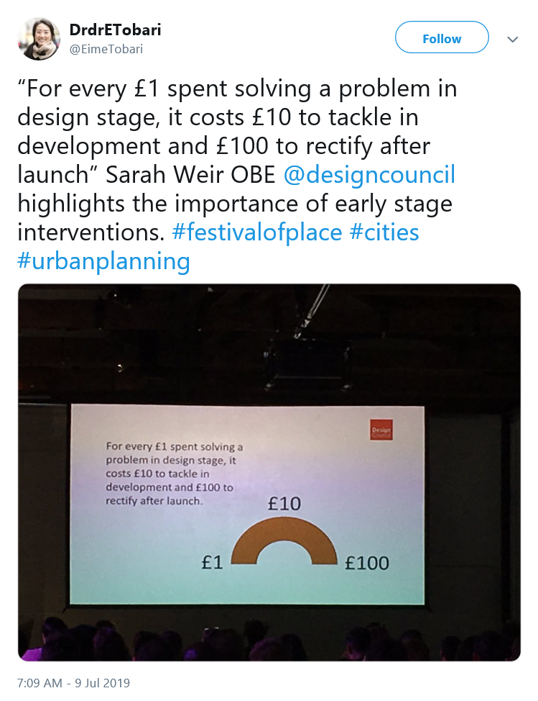
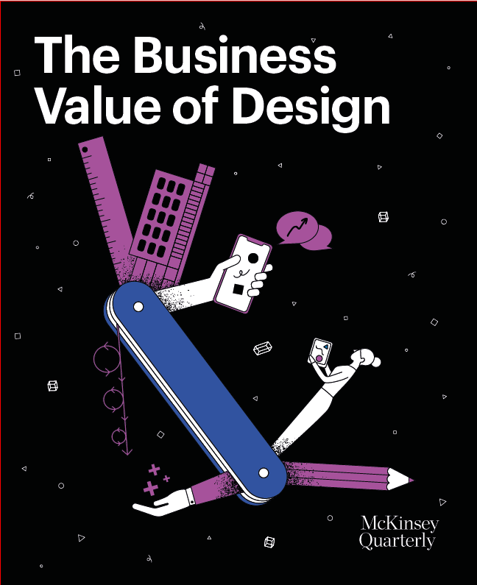
Notes:
We use this principle – taken from the 1-10-100 rule, a quality management concept - to illustrate the importance of early stage interventions and the cost of correcting issues in the delivery rather than design phase (1/2)
A real-life example where it can cost more to put flaws right in delivery rather than design phase,an error on $1000 knife edge seal on an Airbus airplane engine can cost $50M to fix https://www.flightglobal.com/news/articles/fixing-faulty-gtf-seal-to-cost-50-million-pw-446840/
(2/2)

Slide 4
So, how does a person experience services in the public sector?
Notes:
Within the OCD, we have been promoting the SAtSD – a way in which we can start to applying design-thinking within the complex public sector landscape.

Slide 5
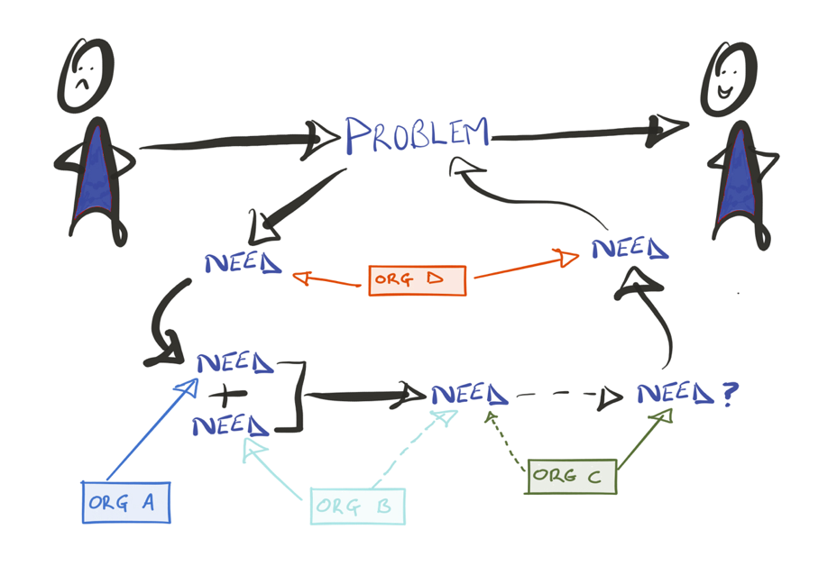
We expect people to know how to navigate the system, when we’ve created it to work as separate pieces…
Notes:
Myself and Alex will introduce the programme.

Slide 6
… so even when we do our part really well, the system will likely still fail the person.
Notes:
Myself and Alex will introduce the programme.

Slide 7
Why? Because the current landscape has…
No standard methods or tools
It’s organisation led, not service user led
Uneven capacity and capability

Slide 8
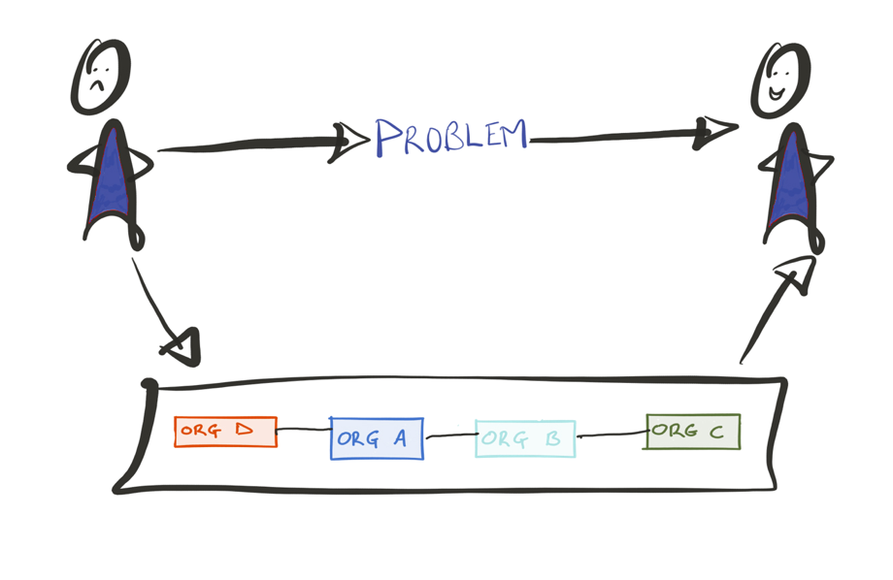
So, how might we design our services around people, and not around how public sector is organised?

Slide 9
We believe that service design is everyone’s business.
Notes:
Within the OCD, we have been promoting the SAtSD – a way in which we can start to applying design-thinking within the complex public sector landscape.

Slide 10
The Scottish Approach to Service Design describes design as a way of exploring the problem space openly, collaboratively and with users, before a solution or service is decided.
https://resources.mygov.scot/alpha/designing-services/
Notes:
A way of working that should be present at the very heart of government policy, bringing otherwise disparate parts of the public sector around a common goal.
To explore problems that remove organisational or sectoral boundaries.

Slide 11
Empowering and supporting the people of Scotland to actively participate in the definition, design and delivery of their public services.
https://resources.mygov.scot/alpha/designing-services/
Notes:
A way of working that should be present at the very heart of government policy, bringing otherwise disparate parts of the public sector around a common goal.
To explore problems that remove organisational or sectoral boundaries.

Slide 12
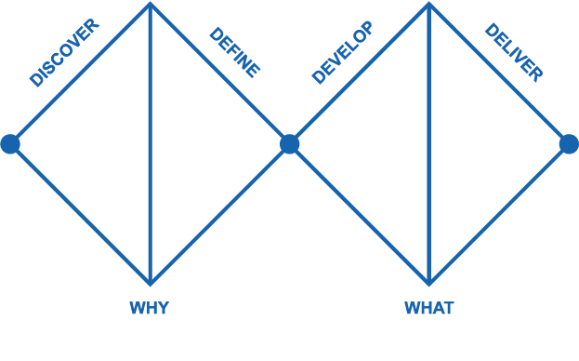
What is the Double Diamond?
DESIGNING THE RIGHT THING
DESIGNING THE THING RIGHT
Notes:
It’s about designing the right thing, to make sure we’re designing the thing right – and so this first WHY section is where we’re at today.

Slide 13
We need to accept our solution to someone else’s problem is unlikely to be the right answer.
Notes:
Design fails if we jump into solving the problem too quickly
Whatever we are doing
Need to think about problem
Understand the landscape
Before we start solutionising
Examples of failure – Invisible women

Slide 14
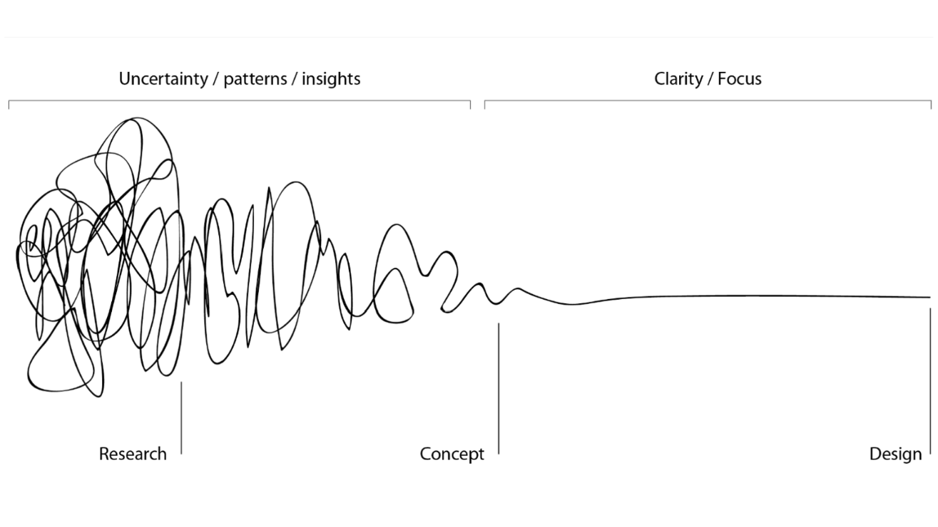
This is messy! We need to learn to be comfortable with being uncomfortable!
Notes:
It’s not an easy process.
This is how this entire process will look – it’s about delving to gather and understand insights before understanding what you can design.
The next few days might feel like this too! That is ok!

Slide 15
SAtSD Principles:

Slide 16
This is not about tech.
It’s about improving services and rethinking the way we provide them based on the perspective of the user.
https://resources.mygov.scot/alpha/designing-services/

Slide 17

How might we reach and involve those who are seldom heard, so we work with them to design solutions?
Invisible Women by Caroline Criado Perez
Notes:
An example of what happens if you don’t get the right people in the room from the start
Who:
-
Challenge:
Most women in low-income countries still cook using the three-stone stove, which gives off incredibly toxic fumes.
The typical cooking fire produces about 400 cigarettes’ worth of smoke an hour, and prolonged exposure is associated with respiratory infections, eye damage, heart and lung disease, and lung cancer. In the developing world, health problems from smoke inhalation are a significant cause of death in both children under five and women.
Process:
Multiple design teams tried to solve this problem by designing multiple stoves but none of the design teams spoke to the women.
So they came up with solutions that did not work, a stove which needed larger fire wood – it was the role of the men in the culture to collect larger wood and they didn’t want to spend time doing this, so the stoves were never used. Another team designed a stove that increased the cooking time of the food, so the stoves were never used.
Outcome:
The designers blamed the women for not using their designs, saying they didn’t understand them and needed to be education. But the truth here is that the designers did not understand the women, their lives or needs.

Slide 18
How might we use prototyping ideas to ensure that the service works for people receiving and delivering it?
Designing for public Services, by IDEO, Design for Europe and Nesta pg 65
Notes:
Who: Whittington Hospital, Design Council, architectural co-design experts Studio TILT, common ground
Challenge:
Whittington Hospital is one of the UK’s busiest, and its in house pharmacy knew that collecting a prescription at the hospital was not a pleasant experience for patients. They entered the pharmacy often feeling unwell and anxious — and these feelings were exacerbated by long waiting times and a lack of communication. Previous efforts to improve the situation, such as user questionnaires, had resulted in poor levels of patient participation and provided no clear insights.
Process:
They decided to take a co-design approach and work with patient, staff and management groups to collaboratively create a space. Together, through workshops, they came up with new ways for how the space could work and created cardboard models to try out their ideas. Next, these ideas were tested in the actual pharmacy at half scale. This gave both the workshop attendees and other visitors the opportunity to experience the changes and give feedback.
Outcomes:
queue of patients at the registration area has been shortened,
prescription tracking has been introduced and
new areas for confidential consultations have been created.
The work has measurably improved the patient experience,
boosting staff morale
increasing sales at the pharmacy.
Courtesy - https://www.nesta.org.uk/sites/default/files/nesta_ideo_guide_jan2017.pdf

Slide 19
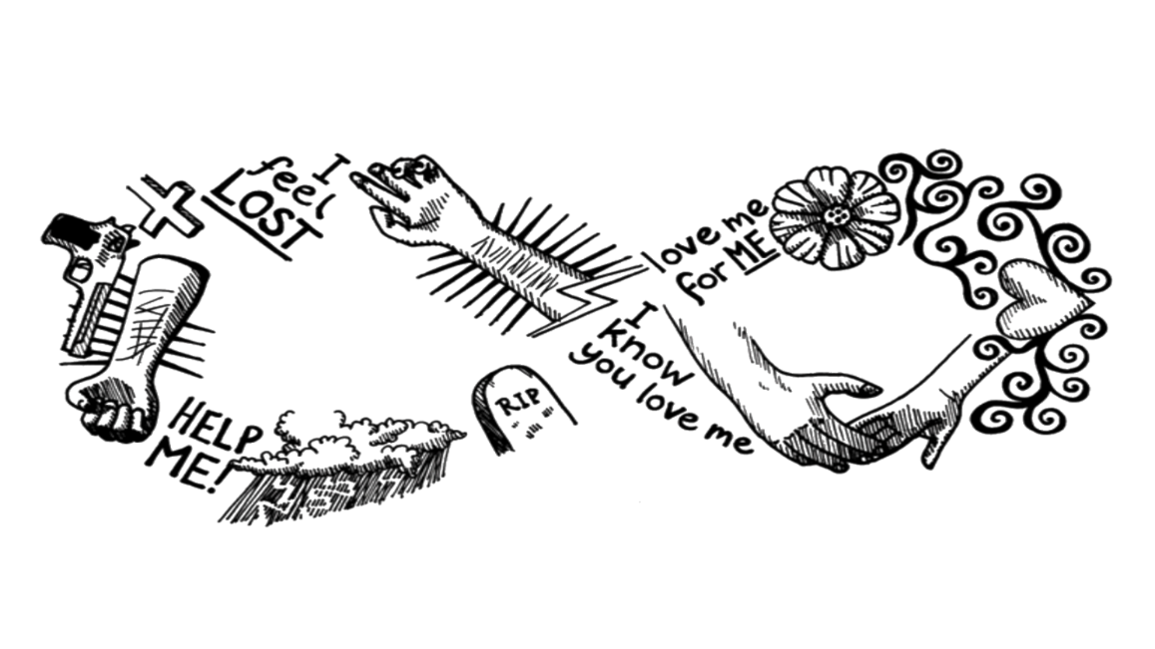
How might we ensure we get all the right people in the room from (as close to) the start as possible?
Shared at Service Design in Government 2016
Illustration by illustrationetc.co.uk
Notes:
An example of what happens if you don’t get the right people in the room from the start
Who:
NHS mental health centre
Project with Katherine Garzonis
Didn’t get buy-in – did all the work but nothing happened at the end.
Challenge:
In summer 2015 we asked service users how we could improve their local NHS mental health center. Through a series of workshops, we worked with people from a range of treatment and diagnostic backgrounds to help solve particular challenges.
However, during that time we realised they weren’t just answering our questions, they were designing their own mental health pathway.
Process:
Why didn’t it work:
Co-design – missed out the client manages, budget holders, therapies
“not co-design without everyone”
Outcome:
Leaflets – NHS about to make leaflets
More workshops
Highlights the need to Get everyone in the room from the start:
Leadership = creating persuasive ideas
Help transform ideas into actionable ideas

Slide 20
We believe that service design is everyone’s business.
Notes:
Within the OCD, we have been promoting the SAtSD – a way in which we can start to applying design-thinking within the complex public sector landscape.

Slide 21
Discuss with the person next to you:
How might we reach and involve those who are seldom heard, so we work with them to design solutions?
How might we use prototyping ideas to ensure that the service works for people receiving and delivering it?
How might we ensure we get all the right people in the room from (as close to) the start as possible?
https://resources.mygov.scot/alpha/designing-services/

Slide 22
Thank you
Alex Clarke
Senior Service Designer
ihub: Alexandra.clarke2@nhs.net
Office of the Chief Designer: alex.clarke@gov.scot
or design@gov.scot
Notes:
Thank you for taking part in the discussion!
Stay in touch.

