Slide 1

Put on your own oxygen mask before helping others
Service Design in Government
Anne Dhir
She/her
@brightkaos
Notes:
Looking after the mental wellbeing of design teams.

Slide 2
Why this talk?
Notes:
The importance of discussing mental health at work isn’t yet obvious: “we just got on with it” “we design games”

Slide 3
Mental health problems in the UK workforce cost employers almost
£35 billion a year
£10.6 bn in sickness absence
£21.2 bn in reduced productivity at work, or ‘presenteeism’
£3.1 billion in replacing staff who leave their jobs because of their mental health
(Parsonage and Saini 2017)
Anne Dhir | @brightkaos
Notes:
If “It’s the right thing to do isn’t motivation enough”, here are some figures that might convince you that it’s in your organisation’s interest to address mental health at work.

Slide 4
84% of employees have experienced physical, psychological, or behavioural symptoms of poor mental health where work was a contributing factor
(Deloitte Centre for Health Solutions, 2017)
Anne Dhir | @brightkaos

Slide 5
Trial and errors

Slide 6
Understand triggers

Slide 7


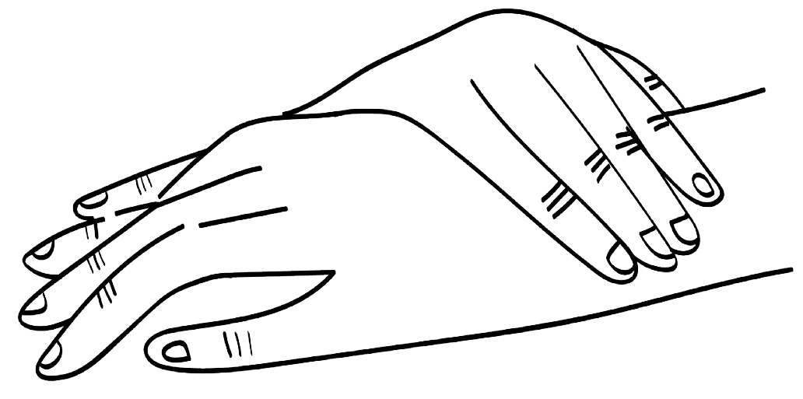
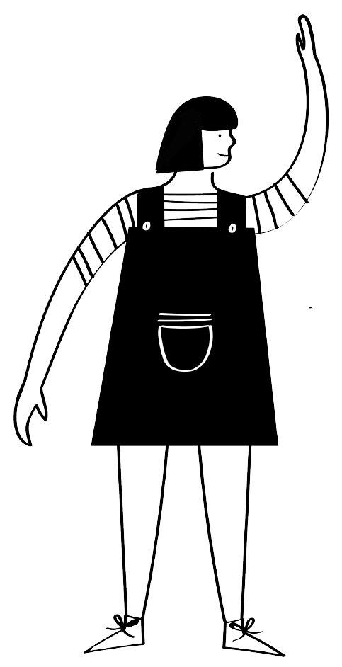

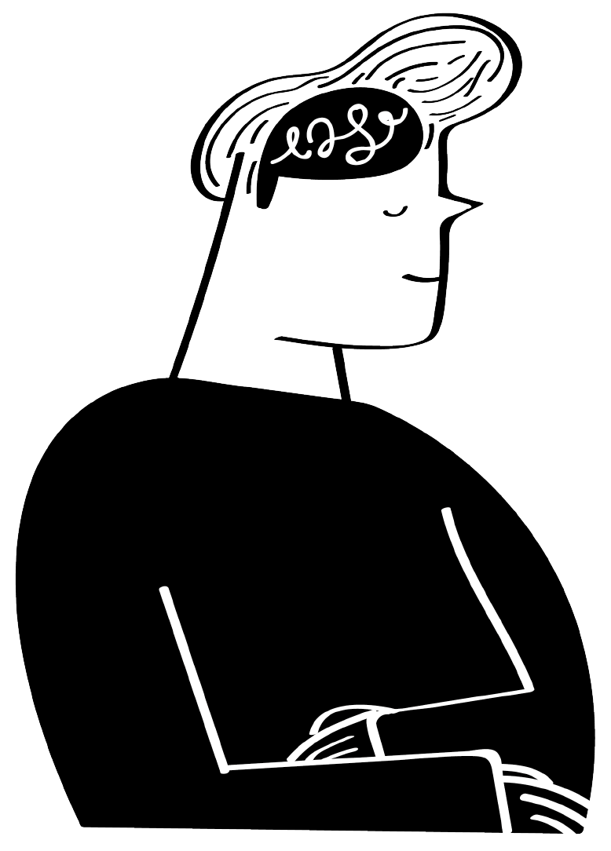

Domestic Violence
Emergency Helplines
Social
Housing
Youth mental health
Young people in care
Unemployment
Emergency care

Slide 8
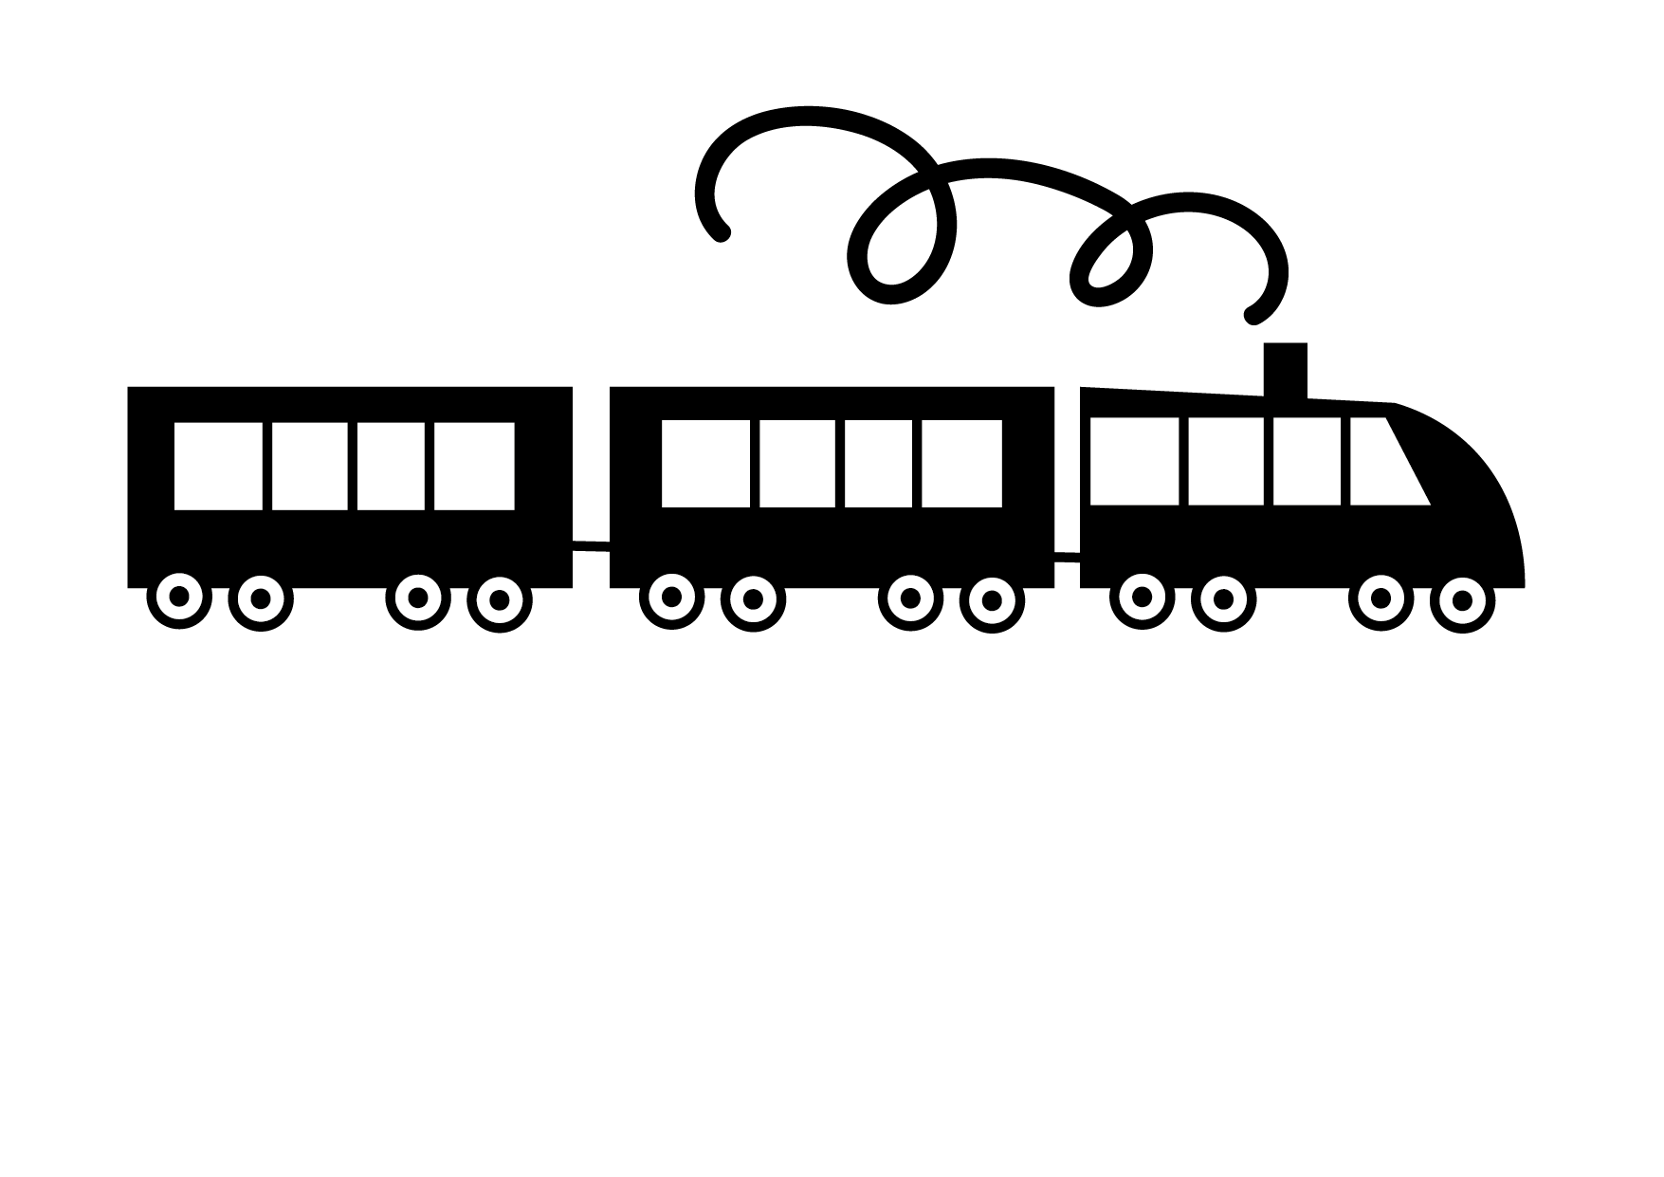
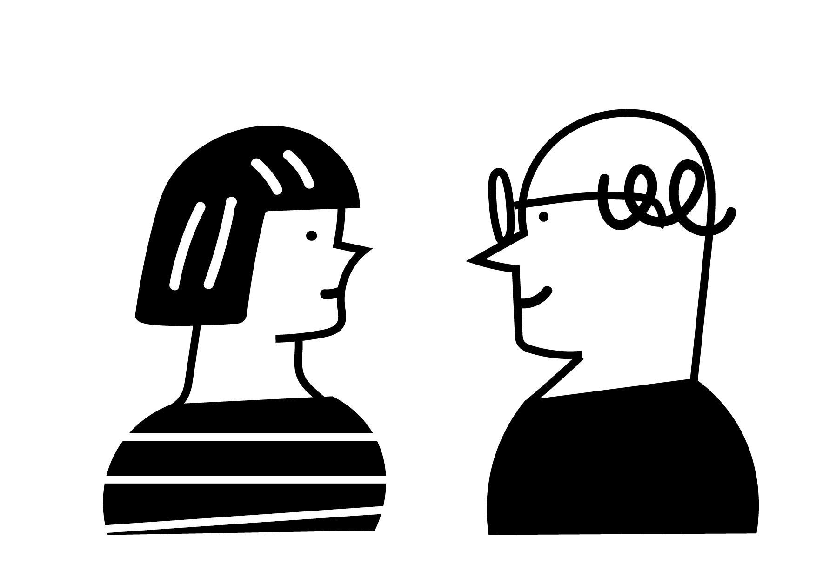
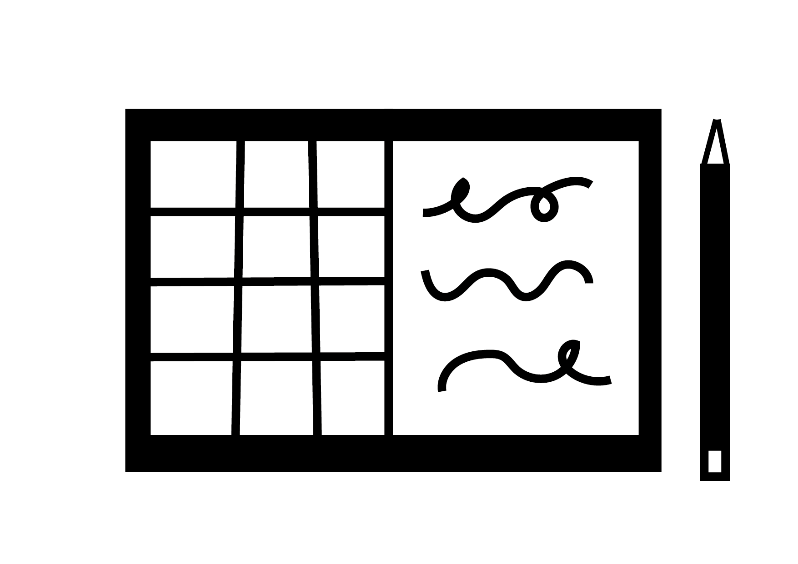
Travelling
for work
Managing
relationships
Juggling deadlines

Slide 9
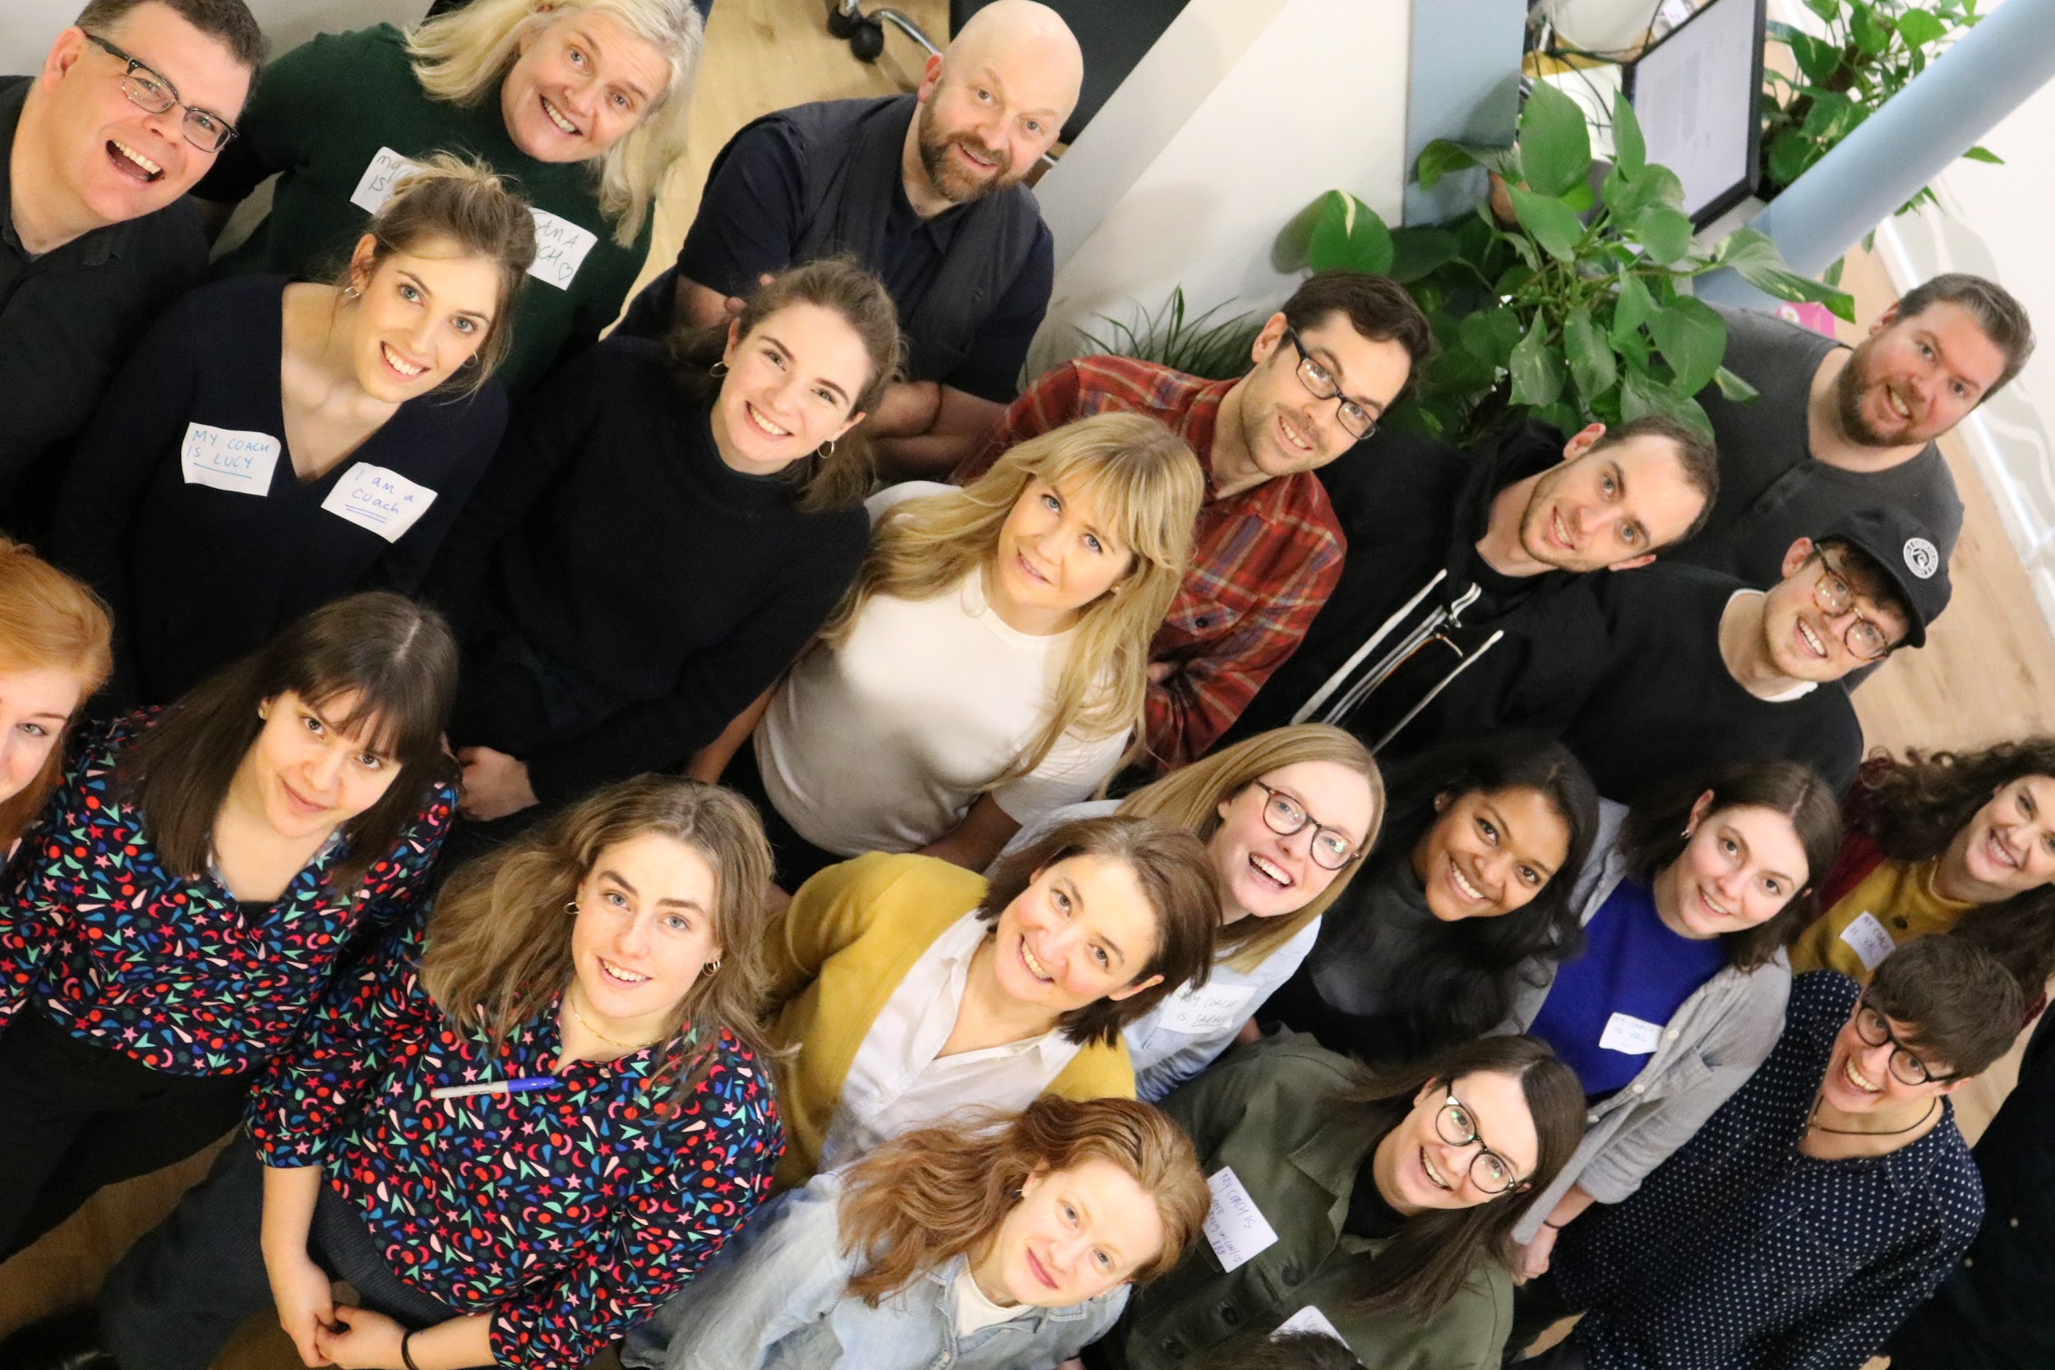
Anne Dhir | @brightkaos

Slide 10
Are we really ready for people to bring their whole selves to work?
Notes:
Notes

Slide 11
About needs
Notes:
Notes

Slide 12
As a team, we need to work with a balanced amount of engagement and detachment so that we can look after ourselves and each other.
Anne Dhir | @brightkaos
Notes:
So we always start by understanding what people really need. We use those needs to define what the outcome or change should be – always coming back to the people, in every part of the system.

Slide 13
As a team, we need to plan difficult projects carefully so we can achieve good outcomes for our client and our people.
Anne Dhir | @brightkaos
Notes:
So we always start by understanding what people really need. We use those needs to define what the outcome or change should be – always coming back to the people, in every part of the system.

Slide 14
As a team, we need to establish a culture where it’s OK to ask for help so that we practice what we preach.
Anne Dhir | @brightkaos
Notes:
So we always start by understanding what people really need. We use those needs to define what the outcome or change should be – always coming back to the people, in every part of the system.

Slide 15
We can’t design future experiences at the cost of present ones
Notes:
Notes

Slide 16
The Jenga of mental health
Self-care
Work culture
Design projects
Manage projects
Support staff
Support participants

Slide 17
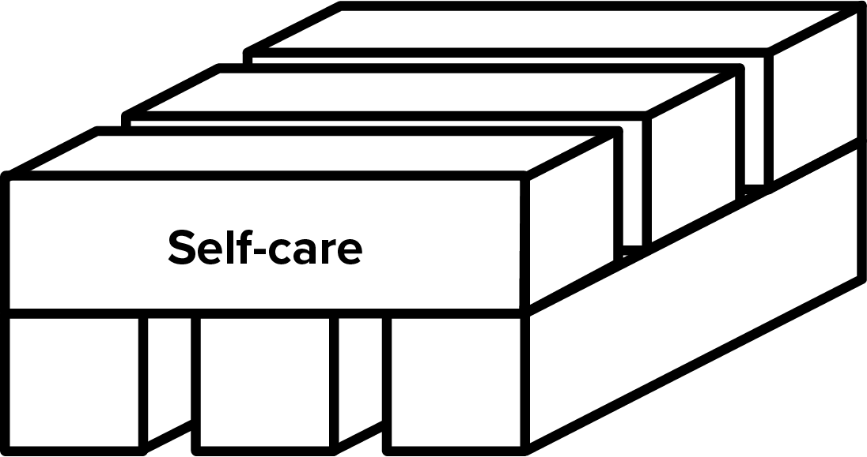
1. Self-care
Breathe
Ground yourself
Shake it off
Anne Dhir | @brightkaos
Notes:
So we always start by understanding what people really need. We use those needs to define what the outcome or change should be – always coming back to the people, in every part of the system.

Slide 18
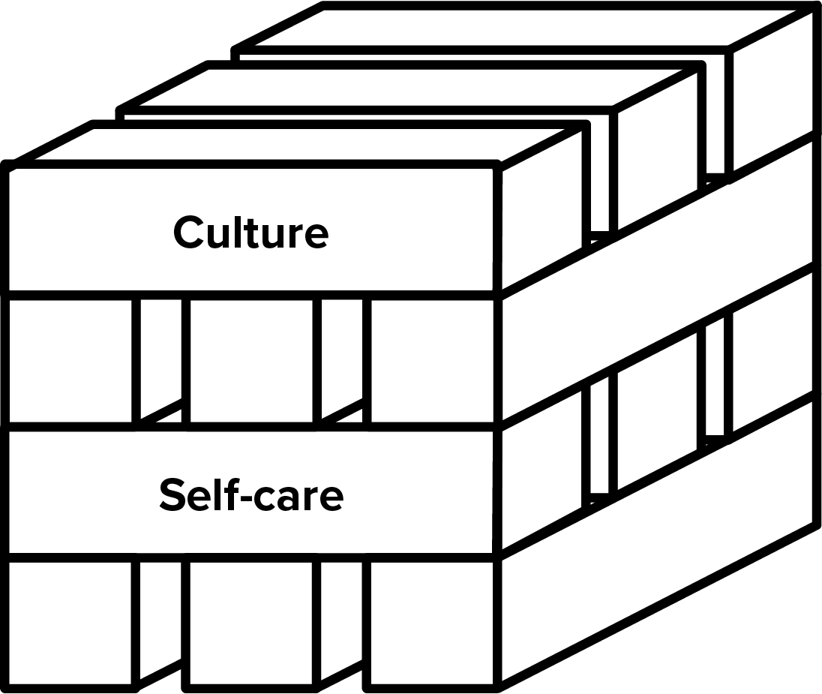
2. Open our work cultures
It’s OK not to be OK
Learn to communicate better
Set boundaries
Anne Dhir | @brightkaos

Slide 19
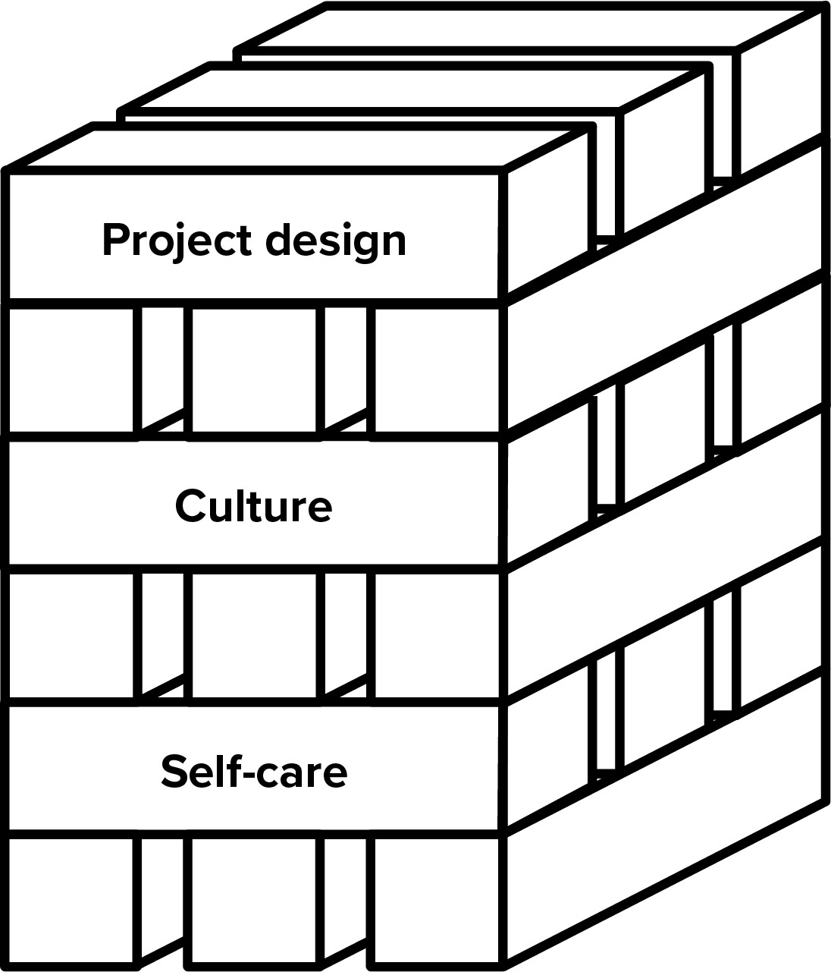
3. Design projects
Bring in the experts
Work with communities
Assign project mindfully
Anne Dhir | @brightkaos
Notes:
So we always start by understanding what people really need. We use those needs to define what the outcome or change should be – always coming back to the people, in every part of the system.

Slide 20
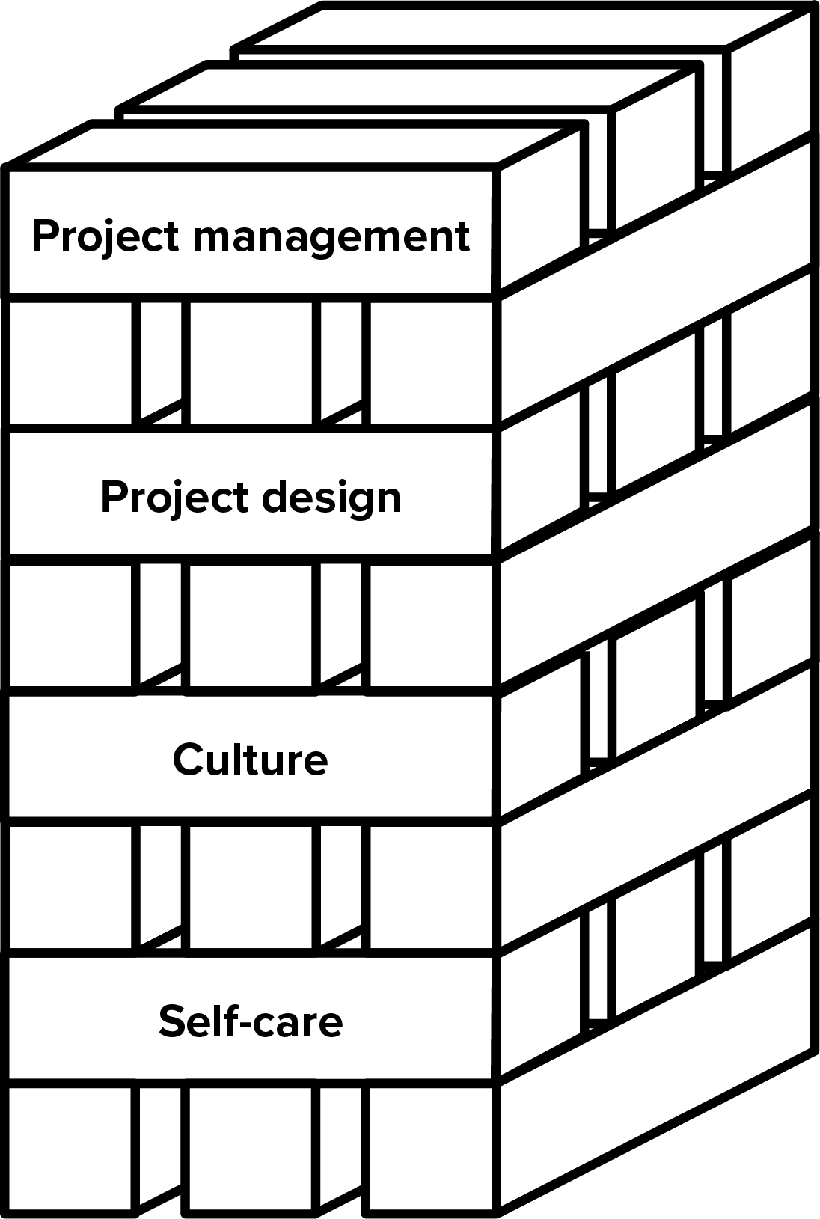
4. Manage projects
Slow down
Pair up
Include health in risk management
Anne Dhir | @brightkaos
Notes:
So we always start by understanding what people really need. We use those needs to define what the outcome or change should be – always coming back to the people, in every part of the system.

Slide 21
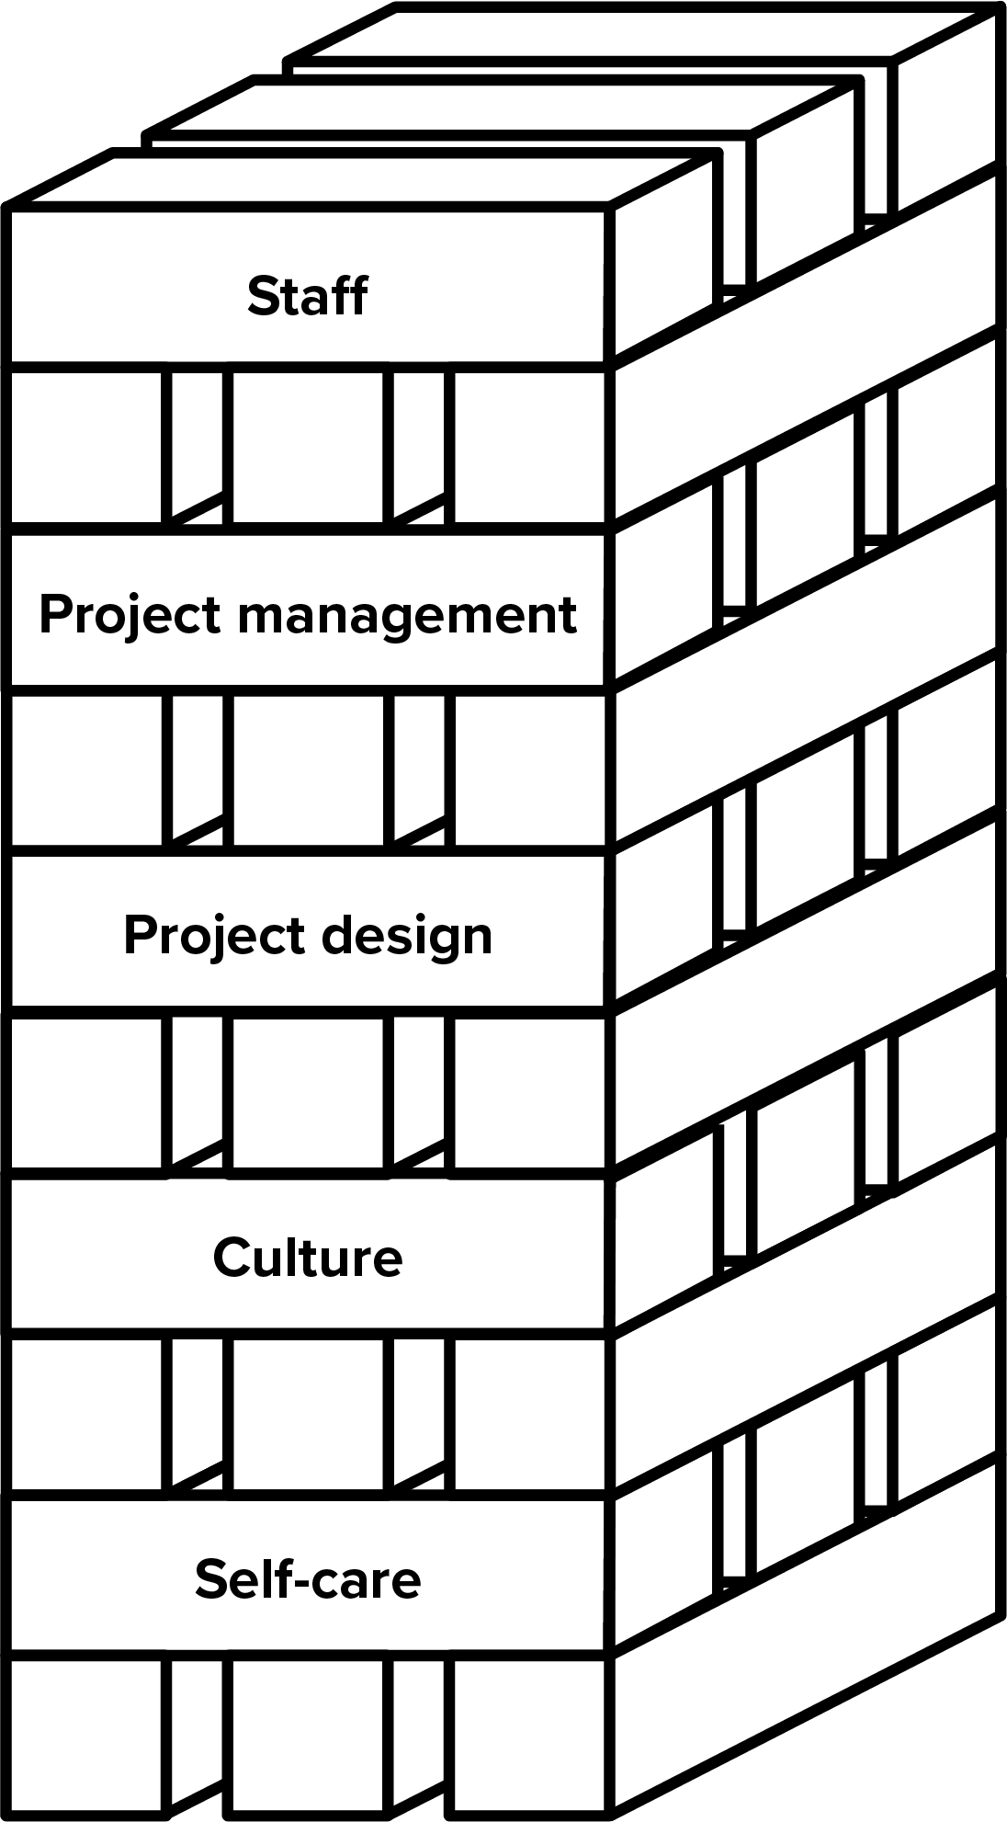
5. Support staff
Mental health first aid training
Internal support
External support
mhfaengland.org
sja.org.uk
smhfa.com
Anne Dhir | @brightkaos
Notes:
So we always start by understanding what people really need. We use those needs to define what the outcome or change should be – always coming back to the people, in every part of the system.

Slide 22
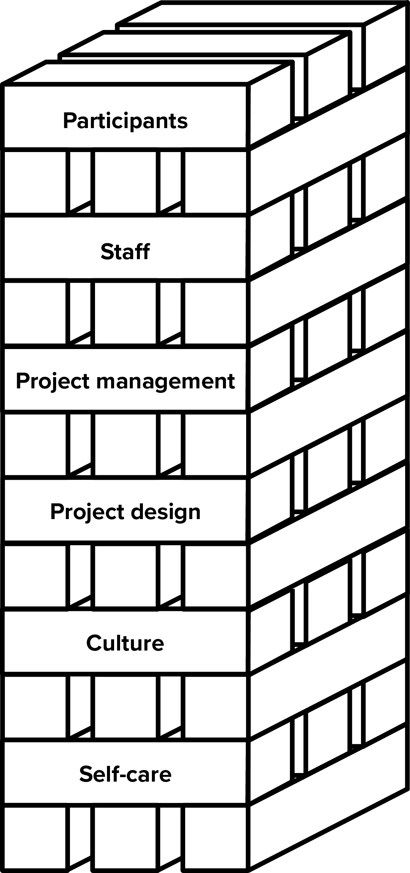
6. Support participants
Retelling stories can be traumatic
Give before you take
Design the whole interaction
Anne Dhir | @brightkaos
Notes:
So we always start by understanding what people really need. We use those needs to define what the outcome or change should be – always coming back to the people, in every part of the system.

Slide 23
Read more
https://bit.ly/2xBQ1bZ
Contact me:
anne@wearesnook.com

