Slide 1
“Name of the service or project”, for example: Ecosystem of the service v1.3
Last updated 03/09/2025

Slide 2
What is an ecosystem map?
This is mapping actors like people, teams, organisations, but also systems, documents and 3rd parties, anyone else that might be part of the service or affected by the service and the type of interactions/relationships between them at a high level.
This is a visual, which will help us understand better the different parts of the service and who we need to involved in the design/discussion.
The value is more in doing the map than the resulting map as it will highlights gaps we might have, but the finished map can still be useful for people who wants to understand the service.
Once we start discussing future changes to the service, it will help us see who will be affected by our changes.
Ecosystem maps are complex visuals. This presentation is providing the same information as text, with a bit more details and links where relevant.
We welcome your feedback, please contact [name of the team] or comment if something is not right, missing or unclear.
Thank you!

Slide 3
How to read this map
The map is on the next slide, There is a PDF version too [provide a link]
The colours and shapes are not always meaningful, same with lines being dashed or not. It’s more about making the visual easier to take in, with some exceptions:
yellow speech bubbles are questions we still have
black circles are for other government departments
dark purple oval shapes are 3rd parties
[would add any other meaningful points]
In the slides following the map, we describe the ecosystem as text.
Note:
The ecosystem is high level. We cannot show all the actors and relationships in just one visual, but it should capture the main ones.

Slide 4
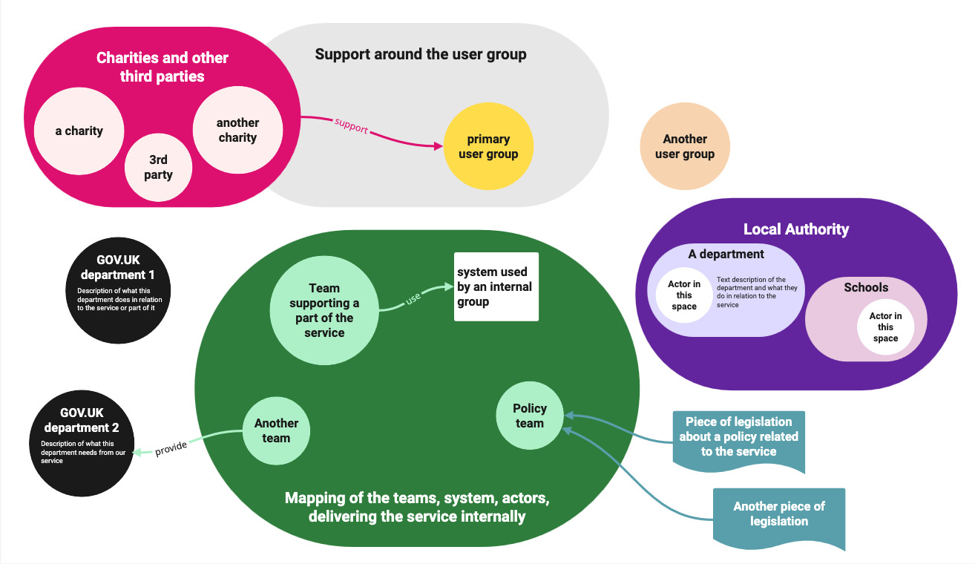
Ecosystem of the service v1.3

Slide 5
Description of the map

Slide 6
Our users

Slide 7
Primary users
[Description and links to more information if relevant]

Slide 8
Another group of users
[Description and links to more information if relevant]

Slide 9
Charities and third parties

Slide 10
Charity 1
[Explain their role and provide links]

Slide 11
The delivery of the service internally

Slide 12
An area of the department
[Description of the team and what they do]

Slide 13
Policy - Legal
[Description of the teams – provide links to relevant policies and legislations]

Slide 14
Systems and tools
[Names, descriptions, who uses them]

Slide 15
Other government departments

Slide 16
Government department 1
[Explain how our service interact with them – what they need for our service or what we need from them – contact name, links etc…]

Slide 17
We welcome your feedback Contact name@dept.gov.uk Thank you!

