Slide 1
“Name of the service or project”, for example: Service map v1.5
Last updated 03/09/2025

Slide 2
What is a service map?
A service map shows everything needed to maintain the live service with external users and includes the moving parts across the business. We are mapping across various service stages and for each stage, we provide: - a high-level description of what this stage is about - the main tasks/steps for external users: [list the actors]
- the main tasks/steps for internal users: [list the actors] - the main task/steps for 3rd parties: [list 3rd parties] - high-level technology/system involved – touchpoint and channels This will be used as a support for discussion with various actors to help us understand what people are doing, when, with who and what tool or system.
Service maps are complex visuals. This presentation is providing the same information as text, with a bit more details and links where relevant.
This prepares the work for a service blueprint.
We welcome your feedback, please contact [name of the team] or comment if something is not right, missing or unclear.
Thank you!

Slide 3
How to read this map
The map is on the next slide. There is a PDF version too [provide a link]
the colours and shapes are not always meaningful, same with lines.
the headings of the columns are the different service stages
the light pink row is for the external users, with their tasks/steps on pink rectangles and comments in burgundy speech bubbles
the burgundy row is for internal users, their tasks and steps are on grey rectangles and comments are in light pink speech bubbles
the grey row is for 3rd parties and their steps are on black rectangles.
yellow rectangles are questions we still have about the processes
the white row is for various systems, touchpoints and channels which are on grey rectangles
the last row provide data and statistics when we have it for that stage
In the slides following the map, we describe the service map as text.
Note:
The service map is high level. We cannot show all the steps on just one visual, but it should capture the main ones.
Process maps have been created as well to cover each stage in more details. They are not part of this document.

Slide 4
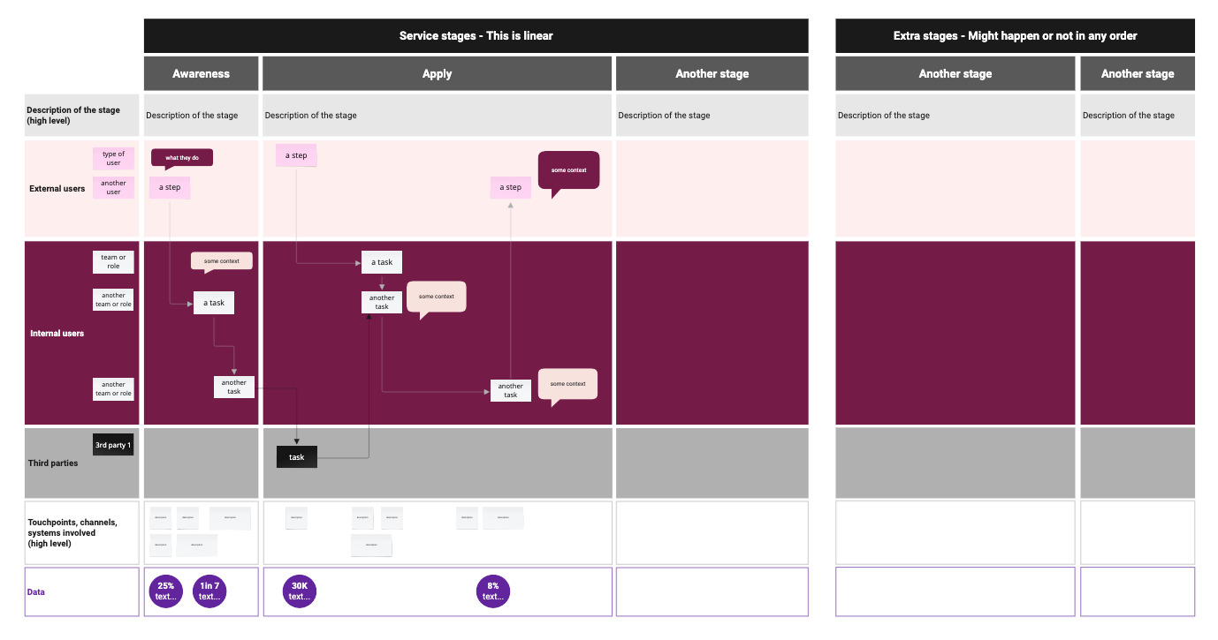
Service map v1.5

Slide 5
Description of the map

Slide 6
Linear part of the service

Slide 7
Awareness
25% of applicants find the service via social media
High level description of this stage
[Description of the sequence of task and events by different actors during that stage]
Touchpoints, channels, system involved

Slide 8
Apply
80% of applicants do not provide enough evidence
High level description of this stage
[Description of the sequence of task and events by different actors during that stage]
Touchpoints, channels, system involved

Slide 9
Another stage
X% of claims …
High level description of this stage
[Description of the sequence of task and events by different actors during that stage]
Touchpoints, channels, system involved

Slide 10
Extra stages – Might happen or not in any order

Slide 11
Appeal
X% of claims …
High level description of this stage
[Description of the sequence of task and events by different actors during that stage]
Touchpoints, channels, system involved

Slide 12
We welcome your feedback Contact name@dept.gov.uk Thank you!

