Slide 1

Spiritual Trauma
Trigger Warning: I tried to keep this as general as possible, but this topic can still be a trigger. Do not feel obligated to share personal experiences. You may pass on a question or step out if you need to. Please talk to me or your therapist after group if this brings up something you need to work through..

Slide 2










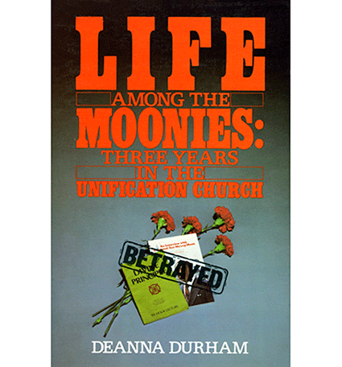
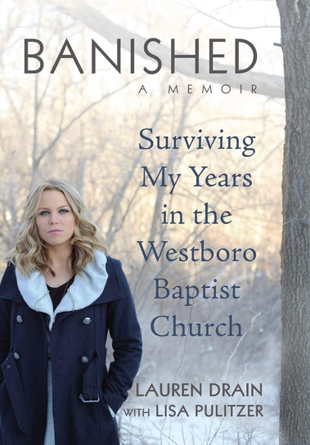
Notes:
Purpose: Let them tell you what they already think spiritual/religious harm looks like before you start defining it for them.
Ask what participants notice or recognize about the books/topics represented.
Use the images to open discussion about harmful, controlling, or high-control religious/spiritual environments.
Invite participants to identify patterns or characteristics, rather than deciding whether a particular religion/church/group is “good” or “bad.”
Clarify as needed that cult and occult are not the same thing.
Cult = a group organized around a set of beliefs or a leader, especially when the group uses high levels of control, coercion, or manipulation over members.
Occult = beliefs or practices involving hidden, mystical, supernatural, or esoteric knowledge—things like divination, magic, or astrology can fall under that umbrella.
They can overlap, but they absolutely aren't synonyms. A high-control religious group doesn't have to practice anything occult, and somebody engaging in an occult practice doesn't thereby belong to a cult.
Broaden the conversation beyond sensational examples: coercion, control, dependency, isolation, punishment for questioning, and misuse of authority can occur in environments that look very ordinary from the outside.
Normalize vulnerability: people can become involved in harmful systems for understandable human reasons—belonging, meaning, safety, family/community ties, certainty, support—not because they are gullible or unintelligent.
Avoid turning the discussion into diagnosis of a specific group based on one characteristic.

Slide 3
Religion vs. Spirituality
Religion = a specific set of doctrines, traditions, and beliefs
Spirituality = a broader understanding of life, meaning, purpose, and connection; may include religion, the sacred, or transcendence beyond the physical realm
A person may identify with either, both, or neither.
Notes:
RELIGION: Shared beliefs, practices, traditions, and/or community related to faith or the sacred.
SPIRITUALITY: A person’s experience of meaning, purpose, connection, values, the sacred, or the transcendent.
Religion and spirituality often overlap but aren't interchangeable.
Someone can be religious and spiritual, spiritual but not religious, religious without personally describing themselves as spiritual, or neither.
For purposes of this group, we're not prescribing what spirituality should mean or requiring belief in anything supernatural.
When we discuss spiritual trauma, we're interested in the person's own meaning system and experience rather than deciding whether their beliefs are correct.

Slide 4
Spirituality can be a BIG Part of Recovery
A source of healing
  Feeling connected to the larger world
  A sense of purpose
Spiritual Trauma can make it difficult to engage in some recovery programs
Notes:
Spirituality can be an important source of healing, connection, and purpose in recovery, but it is not required for recovery.
Many people associate recovery programs primarily with the Anonymous/12-Step model, which may include concepts such as a Higher Power, surrender, prayer, or spiritual awakening.
For someone with spiritual trauma, some of that language may feel uncomfortable, unsafe, or inaccessible. That does not mean 12-Step recovery is inherently harmful or that the person cannot participate; individual responses vary.
Remind participants that “recovery program” is not synonymous with “Anonymous program.” Other approaches exist, including Recovery Dharma and SMART Recovery.
The goal is not to steer participants toward or away from a particular pathway, but to reinforce that they have choices in building recovery support that fits their needs and values.

Slide 5
A Quick Recap of Trauma
Trauma: a deeply distressing or disturbing event or experience that overwhelms an individual's ability to cope and may affect mental, emotional, and physical well-being.
  ‘T’ Trauma: informal term often used for momentous, dangerous, or life-threatening experiences
Car Accident, Abuse, Death of Loved Ones, Natural Disaster
  ‘t’ Trauma: informal term often used for experiences that overwhelm our ability to cope, even when they are not life-threatening
Breakup, Death of Pet, Job Loss, Bullying
Notes:
“Big-T” and “little-t” trauma are informal teaching terms, not diagnostic categories. They can be useful for understanding that an experience does not have to be life-threatening to overwhelm a person’s ability to cope. The type or apparent “size” of an event does not determine how significantly someone will be affected, and people may respond very differently to similar experiences.
Emphasize that we sometimes minimize our own experiences because they do not seem “bad enough” compared with someone else’s. The purpose of this distinction is not to rank trauma, but to recognize that experiences involving loss, instability, humiliation, coercion, betrayal, or repeated stress can also have a significant impact.
Trauma can also be described more specifically as acute, chronic, cumulative, relational, coercive, or betrayal-based. PTSD is a separate clinical diagnosis with specific diagnostic criteria; experiencing trauma does not automatically mean that someone has PTSD.

Slide 6
A Quick Recap of Trauma
Trauma affects individuals, families, communities, and identity groups
Trauma can affect biological stress responses
  The Body Keeps The Score – trauma can continue to affect us after the danger has passed
A Quick Note: Abuse Is NEVER Your Fault.
Notes:
Trauma can affect stress-response systems as well as thoughts, emotions, relationships, identity, behavior, and physical well-being. These effects vary from person to person and are not necessarily permanent. People can heal, adapt, and develop new patterns of responding.
The Body Keeps the Score is used here as familiar shorthand for the idea that traumatic experiences can continue to influence how a person responds even after the immediate danger has ended. It should not be interpreted to mean that trauma is literally stored in the body indefinitely or that a person is permanently biologically changed.
Reinforce that trauma responses are adaptations to overwhelming experiences, not evidence that someone is weak or damaged. Transition to the final statement: regardless of how a person responded, abuse is never the victim’s fault.

Slide 7
Spiritual Abuse
adverse religious experience: an event, series of events, relationship, or circumstance connected to religious or spiritual beliefs, practices, or structures that is experienced as harmful, threatening, coercive, betraying, or deeply disruptive
spiritual trauma: lasting adverse responses that a person connects to overwhelming or deeply disruptive religious or spiritual experiences
the use of spiritual or religious beliefs, practices, relationships, or authority to coerce, control, exploit, intimidate, silence,
or otherwise harm another person
Notes:
Abuse describes what is being done/the harmful use of power.
Adverse experience describes an experience that may be harmful or deeply disruptive.
Trauma describes the lasting response associated with what happened.
And critically: adverse experience ≠ automatically trauma ≠ automatically PTSD.
The terms “religious abuse” and “spiritual abuse” are often used interchangeably. For the purposes of this group, we will generally use the broader term “spiritual abuse,” while recognizing that abuse can occur within religious organizations, spiritual communities, families, relationships, or other settings where religious or spiritual beliefs or authority are used in harmful ways.
These terms are related, but they are not interchangeable. An adverse religious or spiritual experience does not necessarily constitute abuse, and not every adverse experience results in trauma. Likewise, experiencing spiritual trauma does not automatically mean that a person meets criteria for PTSD or another mental health diagnosis.
The purpose of these definitions is to give us language for discussing experiences and their effects—not to require anyone to label their own experience in a particular way.

Slide 8
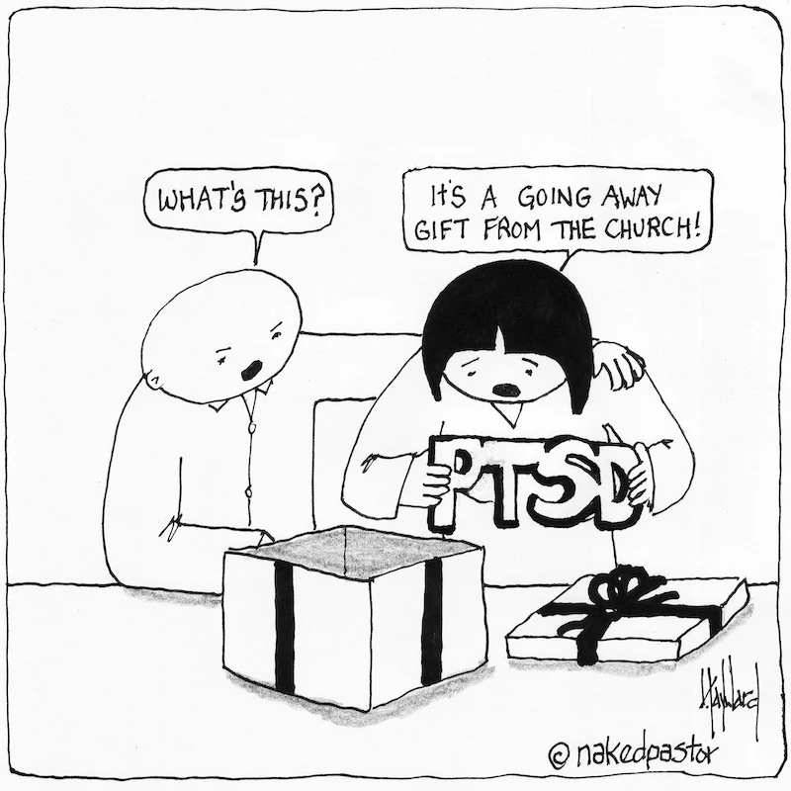
Spiritual Trauma
can separate you from awareness of your own wants and needs due to being told to be, do, and think a certain way
can contribute to existential anxiety, feelings of abandonment, loss of trust (in system and self), hypervigilance around the words people use, and/or hijacked sense of safety
Notes:
These are possible responses to spiritual trauma, not a checklist or a set of required symptoms. Experiences vary considerably from person to person. Someone may experience changes in trust, safety, identity, autonomy, relationships, meaning, or emotional responses without experiencing everything listed here.
When discussing these examples, invite recognition rather than diagnosis. Avoid asking participants to identify or disclose personal trauma experiences in the group. Experiencing one or more of these responses does not establish that someone has experienced trauma or meets criteria for PTSD.
The “Going Away Gift From the Church” graphic uses PTSD humor to represent the experience of leaving a harmful religious environment with lasting effects; it should not be interpreted as suggesting that everyone who experiences spiritual trauma develops PTSD.

Slide 9
A quick word about Spiritual Bypassing
Spiritual Bypassing = the use of spiritual beliefs, practices, or language to avoid dealing with uncomfortable issues; using “Bandaid Bible Verses” or religious platitudes to minimize or dismiss negative emotions
Can contribute to emotional detachment, mistrust or repression of emotions, lack of boundaries, codependency, spiritual obsession, low self-esteem, sense of powerlessness, and social isolation
Notes:
Spiritual bypassing is not defined by the use of prayer, scripture, forgiveness, faith, meaning-making, or other spiritual practices themselves. The important question is how the belief, practice, or language is being used. Spiritual coping can be supportive and meaningful; it becomes bypassing when it is used to avoid, suppress, invalidate, or prematurely close painful emotional or practical work.
Use the examples on the slide to distinguish supporting someone through distress from explaining away or dismissing distress. A religious response is not automatically spiritual bypassing simply because it uses scripture or spiritual language.
With the “Everything happens for a reason” graphic, verbally add that sometimes the “reason” is that other people make poor or harmful decisions that affect us. Not every painful experience needs to be assigned a larger spiritual purpose in order for the experience or the person's emotions to be valid.

Slide 10

A quick word about Spiritual Bypassing
Spiritual Bypassing = the use of spiritual beliefs, practices, or language to avoid dealing with uncomfortable issues; using “Bandaid Bible Verses” or religious platitudes to minimize or dismiss negative emotions
Can contribute to emotional detachment, mistrust or repression of emotions, lack of boundaries, codependency, spiritual obsession, low self-esteem, sense of powerlessness, and social isolation
Notes:
Spiritual bypassing is not defined by the use of prayer, scripture, forgiveness, faith, meaning-making, or other spiritual practices themselves. The important question is how the belief, practice, or language is being used. Spiritual coping can be supportive and meaningful; it becomes bypassing when it is used to avoid, suppress, invalidate, or prematurely close painful emotional or practical work.
Use the examples on the slide to distinguish supporting someone through distress from explaining away or dismissing distress. A religious response is not automatically spiritual bypassing simply because it uses scripture or spiritual language.
With the “Everything happens for a reason” graphic, verbally add that sometimes the “reason” is that other people make poor or harmful decisions that affect us. Not every painful experience needs to be assigned a larger spiritual purpose in order for the experience or the person's emotions to be valid.

Slide 11

A quick word about Spiritual Bypassing
Spiritual Bypassing = the use of spiritual beliefs, practices, or language to avoid dealing with uncomfortable issues; using “Bandaid Bible Verses” or religious platitudes to minimize or dismiss negative emotions
Can contribute to emotional detachment, mistrust or repression of emotions, lack of boundaries, codependency, spiritual obsession, low self-esteem, sense of powerlessness, and social isolation
Notes:
Spiritual bypassing is not defined by the use of prayer, scripture, forgiveness, faith, meaning-making, or other spiritual practices themselves. The important question is how the belief, practice, or language is being used. Spiritual coping can be supportive and meaningful; it becomes bypassing when it is used to avoid, suppress, invalidate, or prematurely close painful emotional or practical work.
Use the examples on the slide to distinguish supporting someone through distress from explaining away or dismissing distress. A religious response is not automatically spiritual bypassing simply because it uses scripture or spiritual language.
With the “Everything happens for a reason” graphic, verbally add that sometimes the “reason” is that other people make poor or harmful decisions that affect us. Not every painful experience needs to be assigned a larger spiritual purpose in order for the experience or the person's emotions to be valid.

Slide 12

A quick word about Spiritual Bypassing
Spiritual Bypassing = the use of spiritual beliefs, practices, or language to avoid dealing with uncomfortable issues; using “Bandaid Bible Verses” or religious platitudes to minimize or dismiss negative emotions
Can contribute to emotional detachment, mistrust or repression of emotions, lack of boundaries, codependency, spiritual obsession, low self-esteem, sense of powerlessness, and social isolation
Notes:
Spiritual bypassing is not defined by the use of prayer, scripture, forgiveness, faith, meaning-making, or other spiritual practices themselves. The important question is how the belief, practice, or language is being used. Spiritual coping can be supportive and meaningful; it becomes bypassing when it is used to avoid, suppress, invalidate, or prematurely close painful emotional or practical work.
Use the examples on the slide to distinguish supporting someone through distress from explaining away or dismissing distress. A religious response is not automatically spiritual bypassing simply because it uses scripture or spiritual language.
With the “Everything happens for a reason” graphic, verbally add that sometimes the “reason” is that other people make poor or harmful decisions that affect us. Not every painful experience needs to be assigned a larger spiritual purpose in order for the experience or the person's emotions to be valid.

Slide 13

A quick word about Spiritual Bypassing
Spiritual Bypassing = the use of spiritual beliefs, practices, or language to avoid dealing with uncomfortable issues; using “Bandaid Bible Verses” or religious platitudes to minimize or dismiss negative emotions
Can contribute to emotional detachment, mistrust or repression of emotions, lack of boundaries, codependency, spiritual obsession, low self-esteem, sense of powerlessness, and social isolation
Notes:
Spiritual bypassing is not defined by the use of prayer, scripture, forgiveness, faith, meaning-making, or other spiritual practices themselves. The important question is how the belief, practice, or language is being used. Spiritual coping can be supportive and meaningful; it becomes bypassing when it is used to avoid, suppress, invalidate, or prematurely close painful emotional or practical work.
Use the examples on the slide to distinguish supporting someone through distress from explaining away or dismissing distress. A religious response is not automatically spiritual bypassing simply because it uses scripture or spiritual language.
With the “Everything happens for a reason” graphic, verbally add that sometimes the “reason” is that other people make poor or harmful decisions that affect us. Not every painful experience needs to be assigned a larger spiritual purpose in order for the experience or the person's emotions to be valid.

Slide 14
What Does Spiritual Trauma Look Like?
Possible warning signs: bullying, manipulation, condemnation, excessive demands, and threats to personal identity or relationship with God or the sacred
Leaders use their spiritual position “to control or dominate another person” or use power “to bolster the position or needs of a leader.”
Experiencing coercive control or events that threaten or damage your core spiritual values and goals
Harm may be amplified by betrayal within a sacred system that was expected to comfort, protect, accept, and provide positive experiences.
Notes:
These are possible warning signs and patterns to consider, not a checklist for determining whether a person, church, religion, or spiritual community is abusive. Context matters. Consider the presence of power differences, coercion, control, dependency, manipulation, punishment for questioning or dissent, and the impact on the individual.
Disagreement with a religious teaching or a negative experience within a religious or spiritual community does not automatically constitute spiritual abuse. The concern is how spiritual beliefs, relationships, or authority are used and whether they facilitate coercion, control, exploitation, intimidation, silencing, or other harm.
Betrayal can be especially significant when harm occurs within a person, relationship, or system that was expected to provide safety, belonging, meaning, guidance, or care.

Slide 15
What Does Spiritual Trauma Look Like?
Claiming Divine Authority — Using God or spiritual authority to control others or serve the needs of the abuser
Emotional Abuse - Using Beliefs to Embarrass, Shame, or Humiliate you
Acceptance via performance
Financial Exploitation
Physical Abuse
Sexual Abuse
Using Fear to Coerce You into Following Beliefs or Scripture
Using Beliefs to Justify Abuse or to Maintain an Abusive Relationship
Isolating, or Threatening Isolation, If You Choose to Leave
Insulting or Belittling Other Belief Systems to Promote Fear, Superiority, or Isolation
Using Beliefs to Discriminate Against Your Gender, Race, or Sexuality
Notes:
Claiming divine authority: A religious leader speaking about or representing God is not, by itself, evidence of spiritual abuse. The concern is using claimed divine or spiritual authority to control, coerce, exploit, silence, intimidate, or punish others, or presenting the leader’s own wants or needs as divine requirements.
Acceptance via performance: Pay attention to environments in which acceptance, belonging, love, or spiritual worth are consistently made conditional on performance, obedience, conformity, or unquestioning loyalty. This can contribute to shame, fear, loss of autonomy, and difficulty identifying or trusting one’s own values and needs.
Insulting or belittling other belief systems: Disagreement with or criticism of another belief system is not automatically abuse. Consider how the message functions. It may become part of an abusive or high-control dynamic when it is used to create fear, establish superiority, discourage outside relationships or information, punish questioning, or increase dependence on the group or leader.
Physical, sexual, emotional, and financial abuse can occur within religious or spiritual environments just as they can occur elsewhere. Spiritual beliefs and authority may become part of the mechanism through which that abuse is facilitated or maintained.

Slide 16
What Does Spiritual Trauma Look Like?
Being blamed or shamed when your prayers are not answered immediately or completely
Being ignored or silenced when you report instances of abuse to your church leaders
Being coerced or prevented from practicing your religious or spiritual beliefs
Witnessing or experiencing mental health concerns being treated only as weakness or spiritual warfare
Witnessing or experiencing ex-communication or rejection from the faith community because of “misbehavior.”
Notes:
Unanswered prayers: The concern is not simply that a prayer was not answered or that someone offered a religious explanation. Pay attention to repeated blame or shame—for example, being told that a prayer was not answered because you did not pray correctly, did not have enough faith, or were somehow spiritually deficient.
Reporting abuse: Being ignored, silenced, blamed, or discouraged from seeking help after reporting abuse can compound the original harm.
Practicing religion: The concern is coercion or control over another person’s religious or spiritual practice. Someone setting an appropriate personal boundary around another person’s religious practice is not the same as coercively preventing that person from practicing their beliefs.
Mental health and spiritual warfare: Religious or spiritual beliefs may be meaningful parts of how someone understands mental health. The concern is when mental health concerns are treated only as weakness, sin, lack of faith, spiritual warfare, or another spiritual problem—particularly when that interpretation discourages or prevents someone from receiving appropriate mental health care.
Excommunication or rejection: Excommunication or religious discipline is not automatically spiritual abuse. Consider how exclusion is being used and whether belonging, relationships, status, or community acceptance are being used to shame, control, isolate, punish dissent, or enforce conformity.
One example is Scientology’s practice of declaring someone a “Suppressive Person” (SP), particularly when continued relationships with that person can affect the standing of family or friends who remain within the organization. The concern is not simply removal from a religious organization, but the use of rejection, threatened loss of community, and disruption of important relationships as mechanisms of control.
Another example is a pregnant teenager being required to leave a church and/or her family being expected to step down from leadership positions because of her pregnancy. The distinction is between a religious community holding particular beliefs or behavioral expectations and using belonging, family relationships, leadership status, or access to the community as leverage to punish or enforce conformity.
Safety/action reminder: If someone recognizes that they may currently be in an unsafe or abusive situation, remind them that the abuse is not their responsibility to fix. Possible next steps may include reporting inappropriate or abusive behavior, asking for help, developing a safety or escape plan, or speaking privately with an appropriate support person or professional.
Do not investigate current abuse or ask for detailed disclosures in the group setting. If someone discloses current violence, sexual abuse, abuse of a child or vulnerable person, or another immediate safety concern, follow up privately and follow applicable facility safety and mandated-reporting procedures.

Slide 17
What Does Spiritual Trauma Look Like?
Being pressured to receive in-house “counseling” from someone without appropriate training or expertise, particularly in place of needed mental health care
When someone close to you makes fun of your belief or dismisses you because of your religion
When someone tries to force you to learn or practice their religion when you do not share or agree with their beliefs
When someone uses religious texts to manipulate you into allowing physical, financial, emotional, or sexual abuse
Notes:
In-house counseling: Pastoral counseling, spiritual direction, peer support, or other support provided by someone who is not a licensed mental health professional is not automatically inappropriate or abusive. The concern is when someone misrepresents their competence, pressures a person to receive counseling from an unqualified provider, uses the counseling relationship to control or harm them, misuses confidential information, or discourages or prevents access to appropriate mental health or medical care when it is needed.
Ridiculing or dismissing someone’s beliefs: Disagreement with another person’s religious or spiritual beliefs is not automatically abuse. Pay attention to patterns of ridicule, humiliation, degradation, rejection, or attacks on a person’s identity or worth—particularly when they occur within an important relationship or are used to control, punish, or isolate the person.
Forced religious participation: People have the right to hold different religious or spiritual beliefs, to change those beliefs, or not to hold religious beliefs. The concern here is coercion—using pressure, threats, punishment, dependency, or authority to force religious learning, participation, or practice.
Using religious texts to facilitate abuse: Religious texts or teachings may be manipulated to convince someone that they are required to accept physical, financial, emotional, or sexual abuse, remain in an abusive relationship, remain silent about abuse, or submit to the person harming them. Religious beliefs do not make abuse acceptable, and scripture should not be used to transfer responsibility for abuse onto the person experiencing it.

Slide 18
What Is Religious Trauma Syndrome?
Religious Trauma Syndrome (RTS): a term used by some practitioners and communities to describe distress associated with harmful or authoritarian religious experiences or with leaving a high-control religious environment.
RTS is not a recognized mental health diagnosis, does not have established diagnostic criteria, and should not be considered equivalent to PTSD or C-PTSD.
You don't need an RTS label for your experience to matter.
Notes:
Religious Trauma Syndrome (RTS) is a term participants may encounter in books, online resources, support communities, or discussions about harmful religious experiences. It can provide useful language for some people, but it is not a recognized mental health diagnosis and does not have established diagnostic criteria.
RTS should not be described as a combination of PTSD and Complex PTSD. PTSD is a recognized diagnosis with specific diagnostic criteria. C-PTSD is recognized in the ICD-11 but is not a separate DSM-5-TR diagnosis. Similarities between some experiences described as religious trauma and symptoms associated with trauma-related disorders do not make the conditions equivalent.
A person does not need to qualify for PTSD—or any other diagnosis—for a harmful religious or spiritual experience to matter or deserve attention. Likewise, experiencing distress related to religion or spirituality does not automatically mean that a person has experienced trauma.
When assessing an individual clinically, focus on what happened, the person’s current symptoms and functioning, the meaning they assign to the experience, and whether they meet criteria for any recognized diagnosis when diagnosis is relevant.
Participants may use the term RTS if it is meaningful to them; the purpose of introducing it here is to explain the term, not to diagnose anyone with it.

Slide 19
Who Gets to Tell Your Story?
When spiritual authority is deeply trusted, it can be difficult to recognize when a church, leader, teacher, or parent is causing harm.
Abusive tactics can create confusion and uncertainty about your beliefs and make it difficult to ask questions or talk to others about your concerns.
Religious and spiritual abuse can involve stripping away your right to control your own narrative—who you are, what happened to you, and what your experience means.
Notes:
People who experience spiritual abuse are not necessarily unaware that something is wrong. Recognition can be complicated by trust, dependency, isolation, information control, fear of consequences, punishment for questioning, or the belief that a trusted leader, parent, teacher, or community has legitimate spiritual authority.
Avoid framing people who remain in harmful systems as gullible, passive, or “brainwashed.” People may recognize some harmful behavior while still trusting other parts of the system, questioning their own interpretation, fearing what they may lose by speaking up or leaving, or lacking access to alternative perspectives and support.
Spiritual abuse may also involve control over a person’s narrative: defining who they are, telling them what their experiences mean, denying or rewriting harmful events, or treating the authority’s interpretation as more legitimate than their own.
Reclaiming the right to understand and tell one’s own story can therefore become an important part of healing. This idea will return later when we discuss re-authoring or “rewriting your story.”

Slide 20
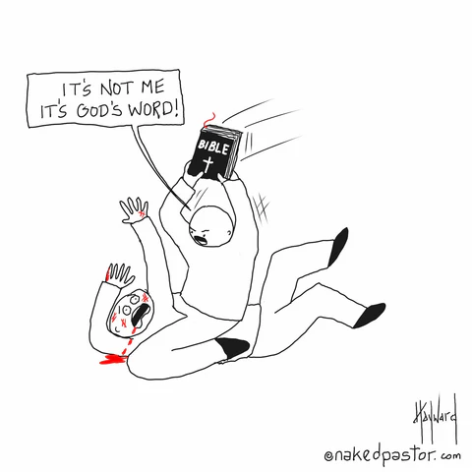
A Quick Word on Bigotry vs. Abuse
Bigotry: obstinate or unreasonable attachment to a belief, opinion, or faction, in particular prejudice against a person or people on the basis of their membership of a particular group.
  “The Bible says you are going to hell,” is religious bigotry.
Spiritual abuse involves using power, authority, beliefs, or relationships to coerce, control, exploit, intimidate, punish, or otherwise harm another person.
Bigotry and abuse are not mutually exclusive. Bigotry can become part of an abusive dynamic when it is used to shame, threaten, control, isolate, discriminate against, or punish someone.
Notes:
Bigotry can still be an adverse experience and may contribute to traumatic responses, even when it is not part of an abusive relationship or system.
The purpose of this distinction is not to minimize bigotry. Bigotry can be deeply harmful, can contribute to adverse religious or spiritual experiences, and may contribute to traumatic responses even when it is not part of an abusive relationship or system.
A prejudiced, hostile, or condemning belief is not automatically the same thing as an abusive pattern. When considering abuse, look at the broader context we have discussed throughout this section: power, coercion, control, exploitation, dependency, intimidation, isolation, punishment, manipulation, and impact on the individual.
Bigotry and abuse can also overlap. A bigoted belief or message may become one of the tools used within an abusive dynamic—for example, when beliefs about someone’s identity are used to shame them, threaten loss of family or community, restrict their autonomy, justify mistreatment, or force conformity.
“The Bible says you are going to hell” is used here as an example of religious bigotry rather than as a universal rule for classifying a statement. Context still matters, including how the statement is being used, the relationship between the people involved, and whether it is part of a larger pattern of coercion or harm.
The “It’s not me, it’s God’s Word” graphic illustrates how religious authority may be invoked to distance a person from responsibility for the way a belief or message is communicated or used.

Slide 21
Spiritual Trauma
Notes:
Use as a transition/re-entry slide. Briefly recap the first section without inviting personal disclosures, then transition from recognizing harmful patterns to exploring their possible impact.

Slide 22
Spiritual Harm & Abuse Scale - Clinical Screener (SHAS-CS)
This is a conversation aid, not a diagnostic test.
Examines harmful experiences and internal states associated with negative religious experiences.
Can be used to identify areas to explore for therapy sessions and healing.
Includes questions related to six areas:
Controlling Leadership Embracing Violence
Maintaining the System Gender Discrimination
Internal Distress Harmful God-Image
Notes:
The SHAS-CS is called a “Clinical Screener” by its developers, but it should be used here as a conversation aid rather than a diagnostic instrument. It does not diagnose spiritual trauma, establish that spiritual abuse occurred, or determine whether someone meets criteria for a mental health diagnosis.
The scale was developed within a Christian religious context, so some of its language and examples reflect that context. This may make many items particularly recognizable within our cultural setting, but it also means the measure does not represent every possible religious, spiritual, or cultural experience of harm.
The six areas listed on the slide represent domains explored by the SHAS-CS. They should not be presented as six clinical “types” of spiritual abuse or trauma.
The value of the measure is in helping someone notice experiences, beliefs, feelings, or concerns that may be worth exploring further. A response to an individual item may be more clinically useful than treating the total score as proof of whether abuse or trauma occurred.
Participation should remain voluntary and private. Participants do not need to share their answers or scores with the group.

Slide 23
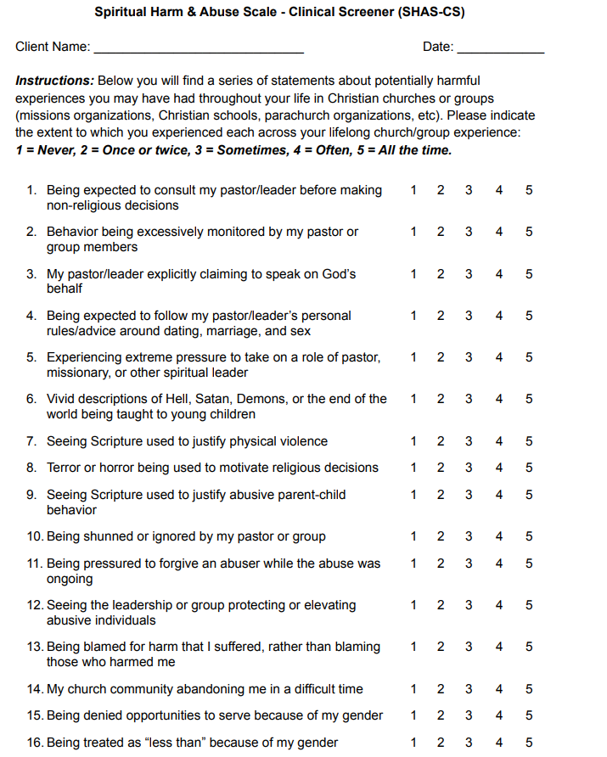
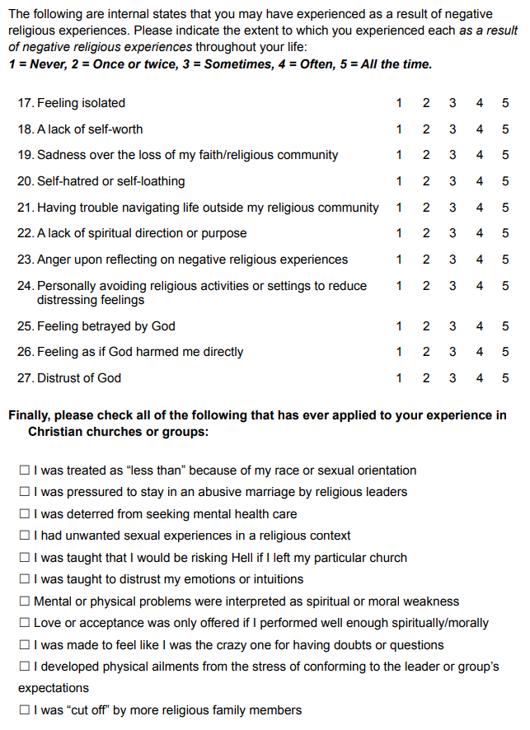
Notes:
The most useful way to look at this assessment is to notice individual items that stand out to you or seem important based on your own experiences.
Any item that you scored as “Often” or “All the Time,” and any critical item on this page that you marked “Yes,” may be especially important to explore further. These are experiences that you may want to explore with your therapist.
No individual response or score determines whether you have experienced spiritual trauma.

Slide 24
What Does the SHAS-CS Look At?
Controlling Leadership: Pastors/leaders may be significantly exalted above parishioners and considered to have a “direct line” to a deity. They may have increased access and control over the daily lives and minutiae of group members.
Embracing Violence: These communities may see violence in many forms as a necessary part of a higher power’s plan for the world. They may lack concern about what is appropriate for children in terms of fear, and they may often employ terror and horror to motivate religious commitment or moral behavior.
Maintaining the System: Both leadership and group members tend to act in ways that maintain the status quo. This can take many forms: victim-blaming, shunning, protecting leaders from consequences, social isolation, and more.
Notes:
These are three of the six areas explored by the SHAS-CS. They describe patterns or experiences that may be worth exploring; they are not separate diagnoses or “types” of trauma.
Controlling Leadership: The concern is not simply having respected or influential religious leaders. Pay attention to how much authority leaders have over members’ personal decisions and daily lives, whether questioning that authority is permitted, and what happens when someone disagrees or does not comply.
Embracing Violence: Consider how violence, punishment, fear, or frightening imagery may be incorporated into religious teaching, including what children may be exposed to and whether fear is used to encourage belief, obedience, or particular behavior.
Maintaining the System: Harmful systems can be maintained by people throughout a community, not only by formal leaders. Examples can include protecting leadership from consequences, blaming people who report harm, shunning or isolating people who challenge the system, or prioritizing the reputation or stability of the group over the well-being of an individual.

Slide 25
What Does the SHAS-CS Look At?
Gender Discrimination: People may be denied service or involvement opportunities or be discriminated against more broadly based on gender
Internal Distress: Common responses associated with spiritually abusive experiences show up on this scale: depression, anxiety, self-image issues, social isolation, anger, lack of meaning, and more.
Harmful God-image: May include fear, anger, betrayal, distrust, or other distress connected to a person's understanding or experience of God.
Notes:
These are the remaining three areas explored by the SHAS-CS. As with the previous slide, they represent areas explored by the scale rather than separate diagnoses or “types” of trauma.
Gender Discrimination: This domain looks at experiences in which opportunities, roles, authority, participation, or worth may be restricted or treated differently based on gender.
Internal Distress: These items focus more on the person’s internal experience, including depression, anxiety, anger, isolation, self-image concerns, and loss of meaning. These experiences can have many causes, so endorsing them does not by itself establish that spiritual abuse caused them.
Harmful God-Image: Harmful religious experiences can affect the way a person experiences or relates to God. Someone may experience fear, anger, betrayal, distrust, abandonment, or conflict in relation to God or their previous understanding of God.
I sometimes describe this as “God has become the villain of their story.” That is a way of illustrating the experience, not a clinical definition or an assumption about how every person will respond.

Slide 26
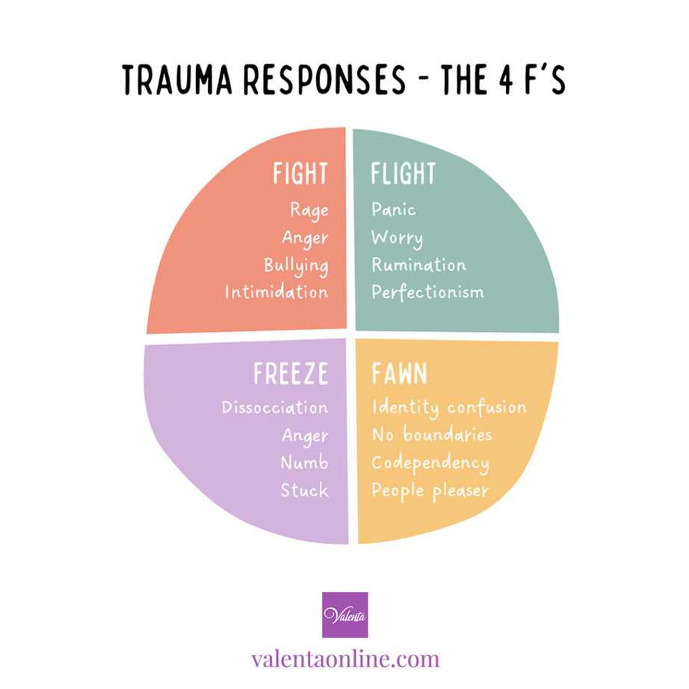
So, where does that leave me?
Feeling angry with God or with those in authority
Experiencing existential distress: feeling deeply unsettled, empty, or uncertain about meaning or purpose
Struggling to connect genuinely and deeply with other people
Feeling forgotten, forsaken, or neglected by God and/or the world
Difficulty trusting others or your own judgment
Experiencing shame or feelings of unworthiness
Loss of self-esteem
Identity struggles: uncertainty about personal values, beliefs, or purpose
Notes:
These are possible responses to harmful religious or spiritual experiences, not a checklist of symptoms that everyone will experience. People may experience some, many, or none of these responses, and they may change over time.
The Fight, Flight, Freeze, and Fawn framework can be a useful way to think about different ways people may respond when they feel threatened, unsafe, or overwhelmed. These are descriptive patterns rather than diagnoses, and a particular behavior does not always represent one specific trauma response.
For example, questioning authority could reflect fight in one situation, but in another situation it may simply reflect healthy disagreement or critical thinking. Withdrawing could reflect flight, but it could also be an intentional boundary. Context matters.
The goal is not to decide which “F” you are. The framework is simply another way to notice patterns in how you may respond to situations that feel threatening or unsafe.

Slide 27
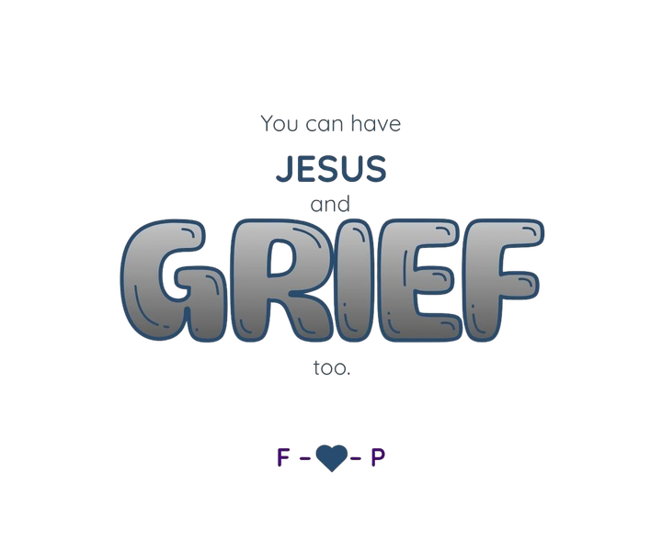
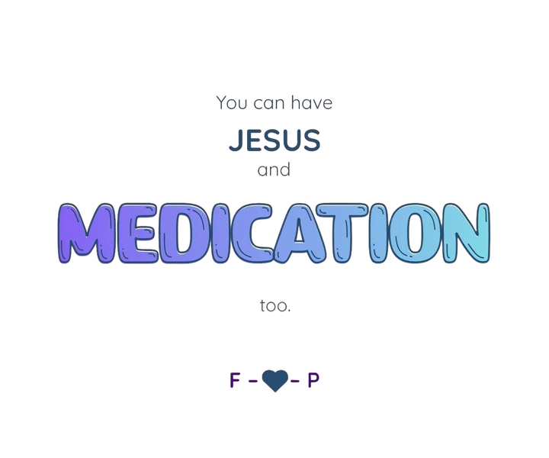




Great…. Now what?
Notes:
You may keep beliefs that remain meaningful to you, question or change others, explore different perspectives, remain uncertain, or decide that religion or spirituality is not something you want to pursue. Those choices belong to you.
The point of these examples is that healing and recovery do not always require an either/or choice. Faith can coexist with grief, medication, therapy, emotions, questions, and other forms of support. The goal is not to tell you what you should believe, but to restore room for choice.

Slide 28
Healing from Spiritual Trauma
Name What Happened in Language That Fits You
  May include experiences of loss of identity/community and/or betrayal
Acknowledge and accept your experience(s)
  Validating the Pain: Recognizing the trauma’s existence and impact on your life
Consider Support or Therapy
  Seeking Professional Help: A therapist can help you explore values, beliefs, identity, and the impact of your experiences in a supportive setting.
  Many different types of trauma therapy
Notes:
Healing from harmful religious or spiritual experiences is deeply personal and may be complex. There is no required label, timeline, spiritual conclusion, or single path through the process.
Name what happened in language that fits you: A person does not have to identify an experience as “trauma” in order to acknowledge that it was harmful or that it continues to affect them. Experiences may involve loss of identity, community, trust, belonging, meaning, or a sense of betrayal.
Acknowledge and accept your experience: Your experience is your experience. Validation does not require someone else to agree with every interpretation of what happened. It means recognizing what you experienced, how you experienced it, and the impact it has had on your life.
Personal belief and institutional worship: A person's individual beliefs or relationship with a Higher Power can be distinguished from the institution, community, leader, or other people through whom those beliefs may previously have been interpreted. You get to decide what your beliefs mean to you and whether or how they remain part of your life.
Consider support or therapy: Therapy can provide a place to explore the effects of harmful experiences as well as questions involving values, beliefs, identity, relationships, trust, and meaning. Therapy is one possible source of support rather than a requirement for healing. Treatment should fit the individual's needs, preferences, readiness, culture, access, and goals.
There are multiple approaches that may be used when trauma treatment is appropriate. We will look at some of those options shortly.

Slide 29
Healing from Spiritual Trauma
Let Yourself Feel Complicated Emotions
  Even if you (or others) don’t understand them
Grieve What You’ve Lost
  Self-Compassion and Patience
  Questions, doubt, and confusion are normal
  The abuse was not your fault. You get to choose what healing looks like for you.
Notes:
Let Yourself Feel Complicated Emotions: You have to feel your feelings, whether you or anyone else understands them or not. Your feelings are valid. You do not have to judge or justify them.
Grieve What You’ve Lost: Spiritual or religious harm may involve many kinds of loss—relationships, community, identity, certainty, traditions, beliefs, trust, or the future you thought you were going to have. Grief takes time.
Self-Compassion and Patience: Healing is not linear. Questions, doubt, and confusion are normal. Give yourself grace. Mistakes and difficult days are part of the process.
The abuse was not your fault. You get to choose when you are ready, what is helpful, what you want to explore, and the pace at which you do it.
Your entire system may feel like it is recalibrating. This is a way of describing the adjustment that can happen when familiar beliefs, relationships, routines, or ways of understanding yourself and the world are changing—not a claim that something is biologically “broken” and has to be reset.

Slide 30
Healing from Spiritual Trauma
Reclaim Your Values and Beliefs
  Rebuilding Trust, Where Appropriate: in others, your Higher Power, and yourself
  Creating Supportive Networks
  Exploring New Perspectives
    Examining religious trauma does not necessarily mean rejecting or opposing all religion or spirituality
      Don’t shame yourself if you do choose to walk away
Notes:
Reclaim Your Values and Beliefs
Rebuilding Trust: This may involve slowly and cautiously rebuilding trust in yourself, in other people, and—if it remains meaningful to you—in your Higher Power or spiritual beliefs. Trust does not have to be restored to everyone or everything. It can be gradual, selective, and based on what feels safe and appropriate.
This might include redefining your spiritual beliefs, finding a healthier faith community, changing how you participate in organized religion, or choosing not to participate at all.
Creating Supportive Networks: Building relationships with people who understand and support your journey can provide strength, connection, and comfort.
Exploring New Perspectives: This may involve learning about different spiritual beliefs, engaging with diverse viewpoints, exploring spirituality outside organized religion, or examining the difference between what you truly believe and what you were taught to believe.
Examining religious trauma does not necessarily mean rejecting or opposing all religion or spirituality. Some people preserve their faith, some redefine it, some remain uncertain, some explore other paths, and some walk away. Don’t shame yourself for the direction that is right for you.
Higher Power, Purpose, or Path can be about establishing or reclaiming a sense of identity and connection to yourself and integrating your thoughts, emotions, behavior, values, and embodied experience in a way that feels authentic to you.

Slide 31

Healing from Spiritual Trauma
Rewrite Your Story
  Articulating a New Narrative:
    Re-authoring your life story to include your experiences, struggles, and triumphs
Each person’s path to healing will be unique, and it’s important to find what works best for you.
Notes:
Rewrite Your Story — Articulating a New Narrative: Re-authoring your life story to include your experiences, struggles, and triumphs can be empowering.
Rewriting your story does not mean changing what happened, minimizing the harm, finding a positive lesson in it, or creating an inspirational ending. It means reclaiming your ability to decide how your experiences fit into the larger story of your life and what meaning—if any—you choose to give them.
Your story can still include grief, anger, uncertainty, unanswered questions, or things that do not feel resolved.
Each person’s path to healing will be unique, and it’s important to find what works best for you.

Slide 32
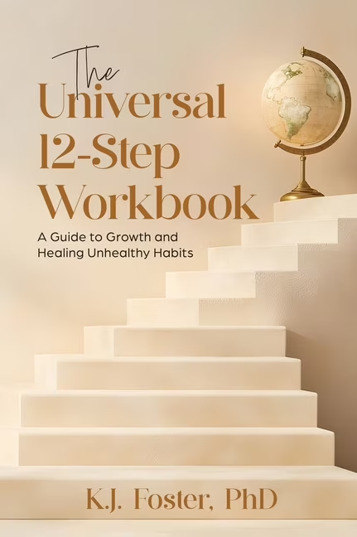
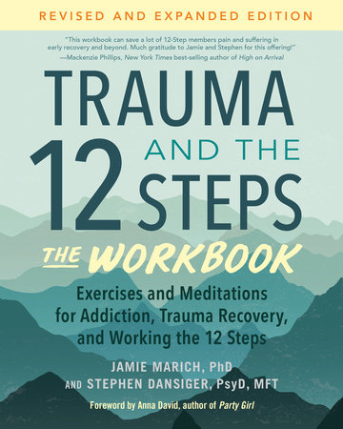
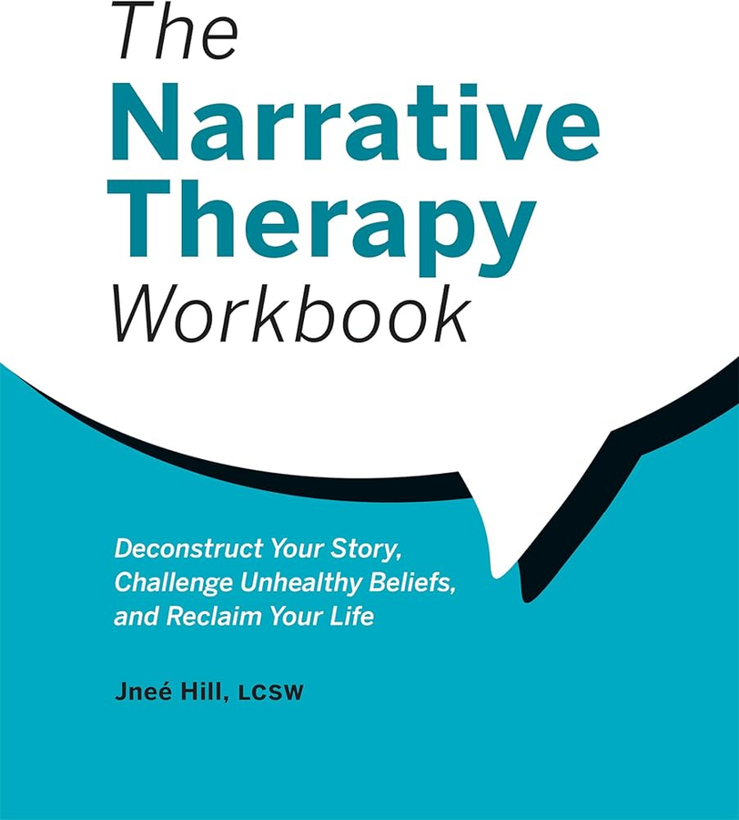
Notes:
These are three workbooks I own and have personally used or reviewed as resources related to religious and spiritual harm.
They are examples of resources that may be helpful for continued reflection and exploration; they are not an exhaustive or ranked list, and no workbook will be the right fit for everyone.
As with any self-guided resource, pay attention to what feels useful and relevant to your experience. You do not have to complete every exercise or agree with every perspective for a resource to be helpful.

Slide 33
Approaches Used in Trauma Treatment
1. Eye Movement Desensitization and Reprocessing (EMDR)
2. Cognitive Processing Theory (CPT)
3. Prolonged Exposure (PE)
4. Somatic Experiencing (SE)
5. Trauma-Focused Cognitive Behavioral Therapy (TF-CBT)
6. Internal Family Systems (IFS)
7. Narrative Therapy
8. Dialectical Behavior Therapy (DBT)
9. Polyvagal-Informed Approaches
10 Accelerated Experiential Dynamic Psychotherapy (AEDP)
11. Psychedelic-Assisted Therapy (Investigational/Emerging)
12. Trauma-Informed Yoga Therapy
13. Trauma-Informed Expressive Arts Therapy
Notes:
A note about trauma treatment: These approaches do not all have the same purpose or level of evidence. Some are established treatments for PTSD, some are designed for particular populations, some may be incorporated into broader trauma treatment, and others are adjunctive, emerging, or investigational. Treatment choice should be based on the individual’s symptoms, needs, preferences, readiness, culture, access, and clinical assessment.
1. Eye Movement Desensitization and Reprocessing (EMDR)
EMDR is an established trauma-focused psychotherapy used in the treatment of PTSD. During EMDR, clients briefly attend to aspects of a traumatic memory while engaging in bilateral stimulation, commonly through guided eye movements, taps, or tones. Treatment involves more than bilateral stimulation alone and follows a structured protocol intended to help traumatic memories become less distressing and disruptive. EMDR has substantial evidence for PTSD treatment, although explanations for exactly how its components produce change continue to be studied.
2. Cognitive Processing Therapy (CPT)
CPT is an established cognitive therapy for PTSD. It helps clients identify and examine beliefs that may have developed or changed following trauma, including beliefs involving safety, trust, power and control, esteem, and intimacy. Clients learn to evaluate trauma-related conclusions and develop more balanced ways of understanding the experience and its impact.
3. Prolonged Exposure (PE)
PE is an established behavioral treatment for PTSD. It helps clients gradually and systematically approach trauma-related memories, feelings, and situations that have been avoided because they feel dangerous or overwhelming. Repeated safe engagement can reduce avoidance and help clients learn that reminders of the trauma do not necessarily represent current danger.
4. Somatic Experiencing (SE)
Somatic Experiencing is a body-oriented approach that emphasizes awareness of physical sensations and responses associated with stress and trauma. Some clients find body-focused approaches helpful, and research on SE is developing. Avoid describing trauma as literally “stored” in the body or suggesting that physical tension must be released in order for trauma to heal.
5. Trauma-Focused Cognitive Behavioral Therapy (TF-CBT)
TF-CBT is an evidence-based treatment developed primarily for children and adolescents who have experienced trauma. It combines cognitive and behavioral strategies, coping skills, gradual trauma processing, and typically involvement of a nonoffending caregiver. TF-CBT should not be presented as a generic adult PTSD treatment simply because “CBT” appears in its name.
6. Internal Family Systems (IFS)
IFS conceptualizes the mind as containing different “parts,” each of which may carry particular emotions, beliefs, protective roles, or experiences. Some clinicians use IFS when working with trauma and clients may find the framework meaningful. It should not be presented as though trauma literally fragments the personality into parts or as having the same established PTSD evidence base as first-line trauma-focused treatments.
7. Narrative Therapy
Narrative Therapy helps clients examine the stories through which they understand themselves and their experiences. It may help clients separate their identity from problems or traumatic experiences and reclaim authorship of their personal narrative. Narrative Therapy is distinct from Narrative Exposure Therapy, which is a separate structured trauma-focused intervention.
8. Dialectical Behavior Therapy (DBT)
DBT teaches skills involving mindfulness, distress tolerance, emotion regulation, and interpersonal effectiveness. These skills can be useful for people who have experienced trauma, particularly when intense emotions, self-destructive behaviors, or difficulty tolerating distress are treatment concerns. Standard DBT is not itself a first-line PTSD treatment. Trauma-focused adaptations and treatments that incorporate DBT principles should be distinguished from standard DBT.
9. Polyvagal-Informed Approaches
Polyvagal Theory is a theoretical framework rather than a psychotherapy. Some clinicians use polyvagal-informed language to help clients think about experiences of safety, threat, connection, and autonomic arousal. Parts of the theory remain scientifically debated, so it is best used cautiously as a possible explanatory framework rather than established fact about how trauma operates in the nervous system.
10. Accelerated Experiential Dynamic Psychotherapy (AEDP)
AEDP is an experiential and attachment-focused psychotherapy that emphasizes emotional processing within a supportive therapeutic relationship. It may be used with trauma-related concerns, but its evidence base for PTSD is more limited than that of established trauma-focused treatments. Avoid promises of rapid emotional breakthroughs or unusually fast trauma resolution.
11. Psychedelic-Assisted Therapy — Investigational/Emerging
Psychedelic-a...

Slide 34
Approaches Used in Trauma Treatment
1. Eye Movement Desensitization and Reprocessing (EMDR)
2. Cognitive Processing Theory (CPT)
3. Prolonged Exposure (PE)
4. Somatic Experiencing (SE)
5. Trauma-Focused Cognitive Behavioral Therapy (TF-CBT)
6. Internal Family Systems (IFS)
7. Narrative Therapy
8. Dialectical Behavior Therapy (DBT)
9. Polyvagal-Informed Approaches
10 Accelerated Experiential Dynamic Psychotherapy (AEDP)
11. Psychedelic-Assisted Therapy (Investigational/Emerging)
12. Trauma-Informed Yoga Therapy
13. Trauma-Informed Expressive Arts Therapy
Notes:
These are the ones you could explore here, for any type of trauma. 13=equine
Psychedelic-Assisted Therapy: There is legitimate and developing research on psychedelic-assisted treatments for some mental health conditions, including PTSD. However, promising results from carefully controlled clinical research should not be generalized to independent or recreational psychedelic use.
Research protocols involve careful screening and selection of participants, controlled dosing, professional monitoring, preparation, psychotherapy or psychological support, and follow-up. These safeguards are part of the treatment being studied.
Psychedelic substances can also carry risks, including acute anxiety, panic, impaired judgment, perceptual disturbances, destabilization of some psychiatric conditions, and potential interactions with medications or other substances. Some individuals may be inappropriate candidates based on psychiatric, medical, medication, or substance-use history.
For people receiving treatment for a Substance Use Disorder, additional caution is appropriate. Recovery goals, relapse risk, the function substances have served for the individual, co-occurring conditions, and the possibility that medically framed substance use could complicate an established recovery plan all need to be considered individually.
So the evidence-based position is not “psychedelics are bad” or “psychedelics treat trauma.” It is that psychedelic-assisted therapies are an evolving area of clinical research and regulated care whose findings apply to specific treatments delivered under specific conditions. They should not be interpreted as support for self-directed psychedelic use.
And, yes—as an employee of a Substance Use Disorder treatment facility, I am also obligated to advise you against this one.

Slide 35
Six Principles of Trauma Informed Care
  Safety - Clients should feel physically, emotionally, and psychologically safe while under care.
  Trustworthiness & Transparency - Providers should communicate openly and consistently and work to build and maintain trust with clients.
  Peer Support - Support and connection with people who have shared or similar lived experiences.
  Collaboration & Mutuality - Clients and providers work together rather than treatment simply being done to the client..
  Empowerment & Choice - Clients are informed about treatment options and actively participate in decisions about their care.
  Cultural, Historical, & Gender Issues - Care recognizes the influence of culture, history, identity, and systemic inequities and works to identify and address bias.
Notes:
These are SAMHSA’s six guiding principles of a trauma-informed approach. They describe how care should be provided; they are not six trauma therapies or specific treatment techniques.
Safety: Safety includes physical safety as well as emotional and psychological safety. Trauma-informed care considers whether the environment, interactions, expectations, and procedures help people feel as safe as reasonably possible.
Trustworthiness & Transparency: Trust is supported through clear expectations, consistency, honesty, appropriate boundaries, and transparency about what is happening and why. This can be particularly important for people whose previous experiences involved betrayal, secrecy, manipulation, or misuse of authority.
Peer Support: Shared lived experience can reduce isolation, increase hope, and provide forms of understanding and connection that professional relationships alone may not provide.
Collaboration & Mutuality: Treatment should be something we do with people rather than to them. The clinician brings professional knowledge; the client brings expertise about their own life, experiences, needs, values, and goals.
Empowerment, Voice & Choice: Trauma can involve loss of control or choice. Trauma-informed care intentionally creates opportunities for people to ask questions, understand their options, express preferences, identify strengths, and participate meaningfully in decisions about their care.
Cultural, Historical & Gender Issues: Trauma does not occur outside of culture or history. Trauma-informed care recognizes cultural differences, historical and intergenerational experiences, identity, discrimination, and systemic inequities. Providers and organizations should examine their own practices and biases and provide care that is responsive to the people and communities they serve.
These principles do not mean that treatment has no boundaries, expectations, or clinical recommendations. They mean that those things should be communicated and implemented in ways that preserve dignity, transparency, collaboration, and as much meaningful choice as possible.

Slide 36
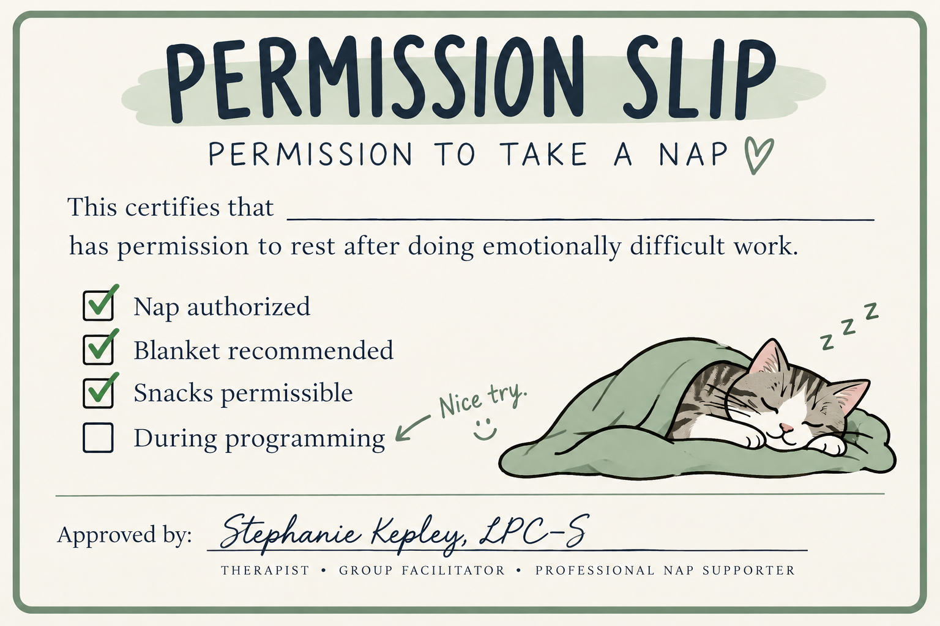
This Person
Notes:
End here.
Remind participants that they can follow up privately with you, their therapist, or another appropriate support person if the group brought up something they would like to explore further.
Then give them permission to rest.
Just not during programming.

