Slide 1
Somatic Variant Calling
in Canine Osteosarcoma
Reproduction of Das et al. (2021)
Stephanie Ballas | ISG5312 Final Project | Spring 2026

Slide 2
Background & Aims
Study Background
Reproduction Aims
Osteosarcoma (OSA) is the most common primary bone tumor in dogs, with a poor prognosis.
Das et al. (2021)
performed WES on 26 paired tumor-normal samples from canine OSA patients, identifying recurrent somatic mutations and linking mutation status to survival.
Key findings:
TP53 and SETD2 as top driver genes; TP53 missense mutations are associated with longer patient survival (DFI)
1. Somatic Variant Calling
Reproduce GATK Mutect2 somatic SNV/indel calls in 26 paired tumor-normal samples
2. Annotation & Filtering
Annotate variants with SnpEff and apply PASS filter
3. Key Figures
Reproduce Fig 1a (SNV counts), 1b (mutation types), 2a (oncoprint), 6a (TP53 KM plot)
Das et al. (2021) Reproduction | ISG5312 | Stephanie Ballas
2 / 12

Slide 3
Dataset
Category | Details
Paper | Das et al. (2021)
BioProject (Tumor) | PRJNA613479 — 26 canine OSA tumor WES samples
BioProject (Normal) | PRJNA503860 — matched normal WES samples
Reference Genome | CanFam3.1 (Ensembl release 104)
Sequencing Type | Paired-end whole exome sequencing (WES)
Sample Pairs Used | 24 paired tumor-normal samples (2 excluded -- see limitations)
Excluded Samples | T-343: matched normal unavailable in SRA T-1087 & M-1166: Mutect2 reruns timed out at 72hr
* This project was originally planned around a human glioblastoma dataset requiring dbGaP controlled access. After failing to identify a suitable public human WES dataset, the project was redirected to this fully public canine OSA dataset.
Das et al. (2021) Reproduction | ISG5312 | Stephanie Ballas
3 / 12

Slide 4
Pipeline Overview
1
Raw Data Download
2
Quality Control
3
Alignment
4
Alignment QC
SRA Toolkit
Trimmomatic + FastQC
BWA-MEM → CanFam3.1
SAMtools + MultiQC
5
Variant Calling
6
Filtering
7
Annotation
8
Analysis & Figures
GATK Mutect2
FilterMutectCalls
SnpEff 4.3q
R (ggplot2, maftools)
Note: BQSR skipped — required canine known variants VCF (Canis_familiaris_V89.vcf) is not publicly available.
Das et al. (2021) Reproduction | ISG5312 | Stephanie Ballas
4 / 12

Slide 5
Challenges Encountered
Alignment Issues (BWA-MEM)
Mutect2 Timeouts & Missing Outputs
Genome index failed -- wget blocked by Ensembl FTP
Fixed with curl (release-104)
19/52 samples failed mid-alignment: 'No space left on device’
Fixed by reducing job concurrency from %12 to %6
3 samples had corrupted BAMs
Required full re-alignment
6 of 26 pairs timed out at 24hr wall limit
Resubmitted with 48hr limit
8 pairs missing f1r2.tar.gz
Job ran without --f1r2-tar-gz flag
2 pairs (T-1087, M-1166) had corrupted VCFs
24hr, 48hr, and 72hr reruns also timed out
Excluded from analysis
SnpEff Annotation
Excluded Samples & BQSR
CanFam3.1.86 database not pre-installed on Xanadu
Fixed by downloading database to /scratch/sballas/snpEff_data/ with -dataDir flag
First run failed silently; second run produced empty VCFs — existing files blocked bgzip/tabix; fixed with -f flag
T-343 (SRR11352525) excluded: matched normal SRR11392176 unavailable in SRA
BQSR skipped
Required Canis_familiaris_V89.vcf
Not publicly available
Final analysis based on 24 paired samples instead of 26
Das et al. (2021) Reproduction | ISG5312 | Stephanie Ballas
5 / 12

Slide 6
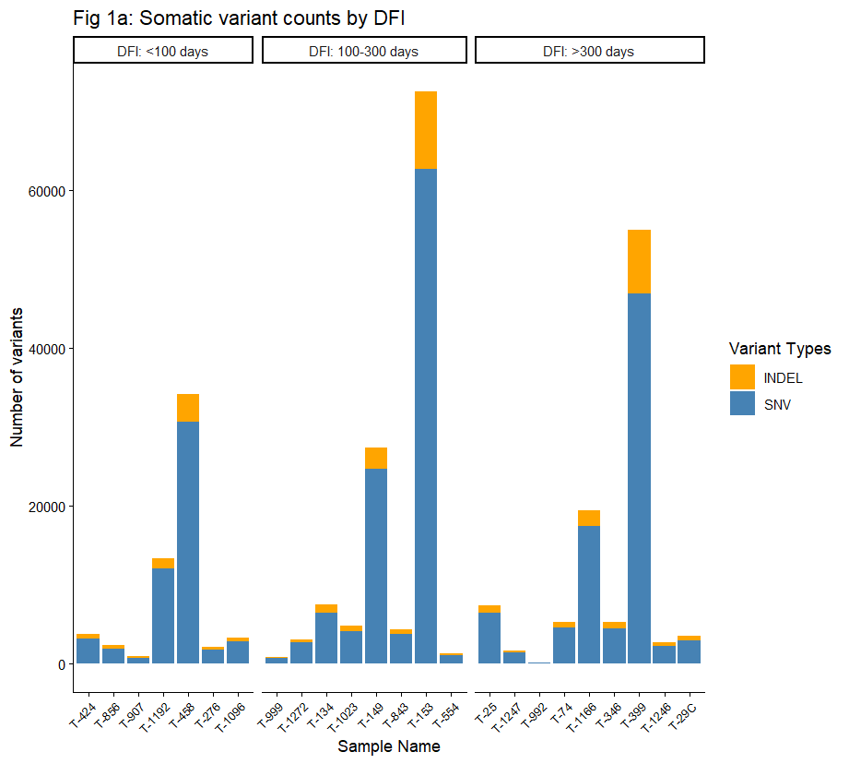
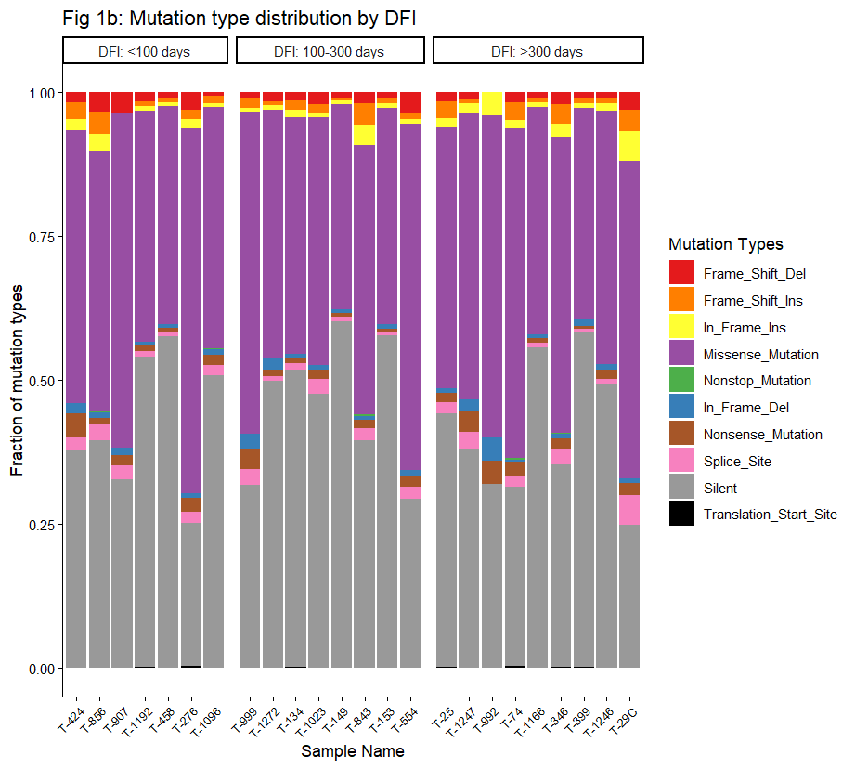
Results — Variant Summary
SNV counts per sample and mutation type distribution (Figures 1a & 1b)
Fig 1a — SNV Counts by Disease-Free Interval (DFI)
Fig 1b — Mutation Type Distribution
Note: My variant counts are higher than Das et al. because I used all PASS variants; the paper used protein-coding variants only. This difference is documented as a pipeline limitation.
Das et al. (2021) Reproduction | ISG5312 | Stephanie Ballas
6 / 12

Slide 7
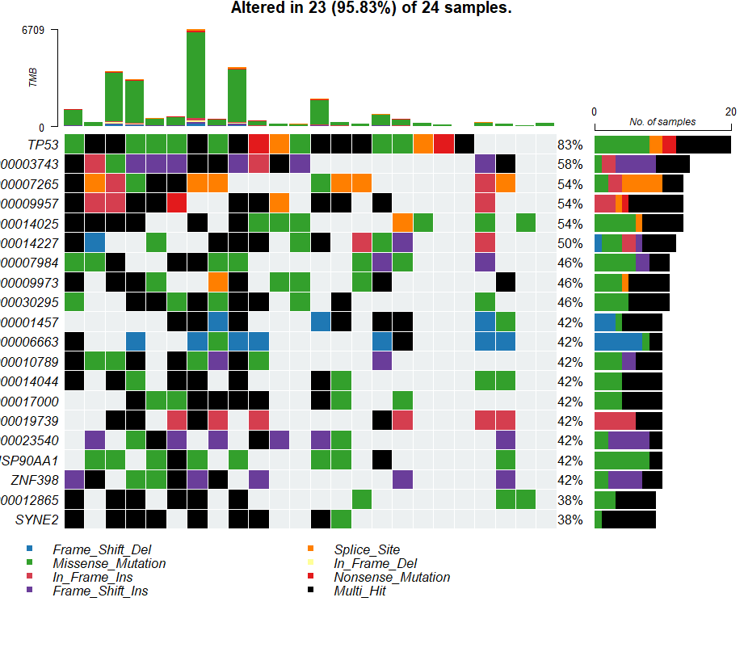
Results
Oncoprint of top recurrently mutated genes (Figure 2a)
Fig 2a — Oncoprint of recurrently mutated genes
Top recurrently mutated genes examined across 24 tumor samples. TP53 expected as most frequently mutated gene consistent with Das et al. findings.
Das et al. (2021) Reproduction | ISG5312 | Stephanie Ballas
7 / 12

Slide 8
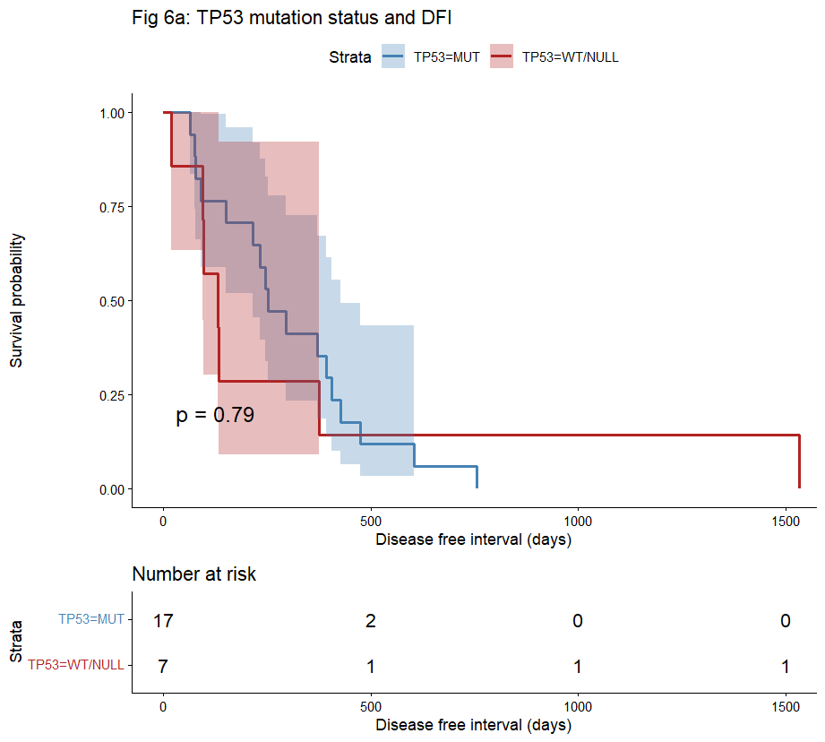
Results — TP53 & Survival
Kaplan-Meier: TP53 missense vs. wild-type/null (Figure 6a)
Comparison with Paper
 | Das et al. | My Result
p-value | 0.002 | 0.79
Significance | Significant | Not significant
n (pairs) | 26 | 24
BQSR | Applied | Skipped
TP53 filtering | Dominant allele | All PASS variants
Likely reasons for discrepancy:
BQSR skipped may affect variant sensitivity
No allele frequency data to select dominant TP53 mutation per sample
T-29C has no TP53 variants after PASS filtering
Reduced n (24 vs 26).
Fig 6a — KM plot: TP53 missense mutation status vs. disease-free interval
Das et al. (2021) Reproduction | ISG5312 | Stephanie Ballas
8 / 12

Slide 9
Limitations
1
BQSR Skipped
2
Samples Excluded
Canis_familiaris_V89.vcf required for BQSR is not publicly available. Instead the pipeline goes directly from MarkDuplicates to Mutect2, which may affect variant sensitivity.
T-343: matched normal unavailable in SRA.
T-1087 & M-1166: Mutect2 timed out at 72hr on chr15/chr12 respectively.
Final n = 24 pairs.
3
Variant Filtering Difference
4
TP53 Dominant Allele
Used all PASS variants. Das et al. used protein-coding variants only. My SNV counts per sample are higher as a result (Fig 1a).
We could not select the dominant TP53 mutation per sample due to lack of allele frequency data. Which likely contributes to the non-significant KM result (p=0.79 vs p=0.002).
5
Figures Not Reproduced
6
SnpEff Version
Figs 1c/1d (NMF signatures), 2b (CNV — Sequenza not run), 3a-3d (microarray data) were out of scope for this analysis.
SnpEff 4.3q used (same as pre-installed on Xanadu)
Database CanFam3.1.86 downloaded to scratch
Das et al. (2021) Reproduction | ISG5312 | Stephanie Ballas
9 / 12

Slide 10
Reflection & Key Takeaways
What I learned from this project
Reproducibility is Hard
HPC Troubleshooting
Even with a well-documented paper and public data, strict technical reproduction was impossible (BQSR) and impractical in some areas (protein-coding-only filtering). Broad conceptual reproduction is a more realistic goal.
Systematic log forensics — checking timestamps, file integrity, etc— is essential. Silent failures (empty VCFs, blocked downloads) are common.
Pipeline Robustness
Biological Insight
Concurrency limits, staged reruns, and modular scripts made it possible to recover from failures without restarting from scratch.
Despite the non-significant KM result, the oncoprint and mutation landscape still reflect the core finding of Das et al. In which TP53 was seen as the dominant driver gene in canine osteosarcoma.
Das et al. (2021) Reproduction | ISG5312 | Stephanie Ballas
11 / 12

Slide 11
GitHub Repository
https://github.com/stephanieballas/ISG5312FinalProject
Das et al. (2021) Reproduction | ISG5312 | Stephanie Ballas
10 / 12

Slide 12
Thank You
Somatic Variant Calling in Canine Osteosarcoma
Reproduction of
Das S, Idate R, Regan DP, Fowles JS, Lana SE, Thamm DH, Gustafson DL, Duval DL. (2021). Immune pathways and TP53 missense mutations are associated with longer survival in canine osteosarcoma. Communications Biology, 4:1178. https://doi.org/10.1038/s42003-021-02683-0
24 of 26 tumor-normal pairs successfully processed through GATK Mutect2 pipeline
Variants annotated with SnpEff (CanFam3.1.86); SNV landscape broadly consistent with Das et al.
Key limitation: BQSR skipped; protein-coding filter not applied; TP53 KM result non-significant (p=0.79)
Full pipeline documented and reproducible at github.com/stephanieballas/ISG5312FinalProject
ISG5312 | Spring 2026 | Stephanie Ballas

