Slide 1
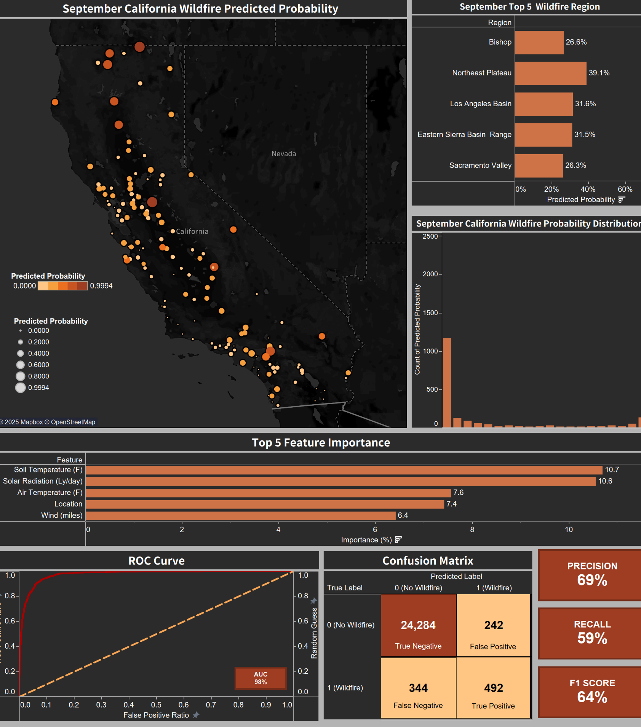
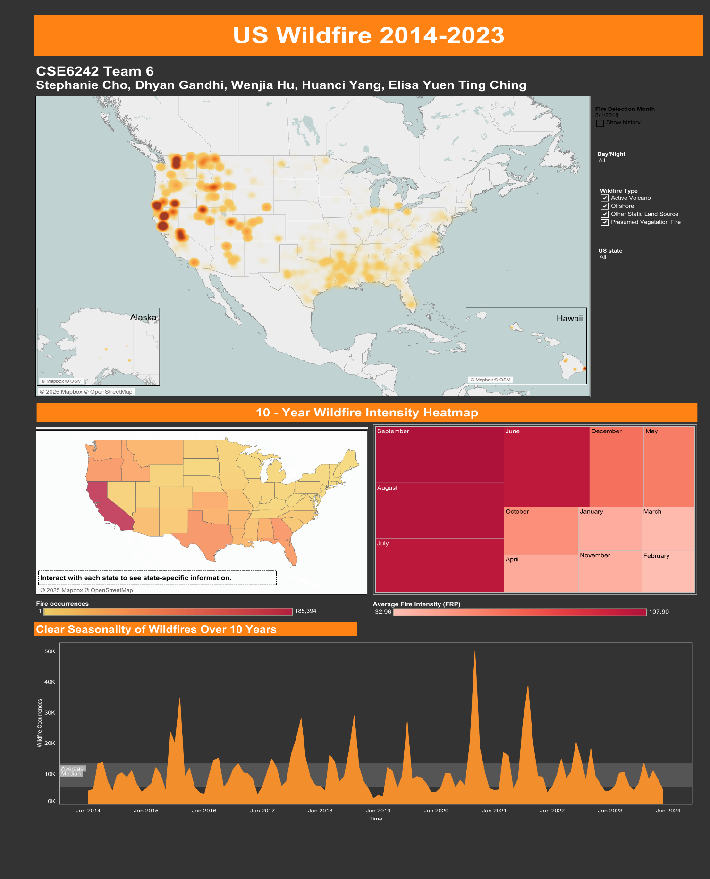
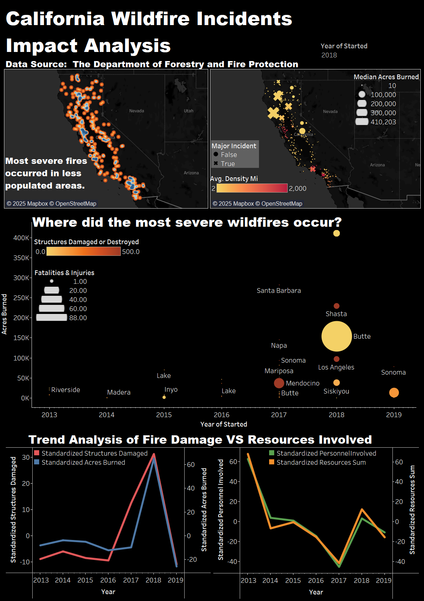
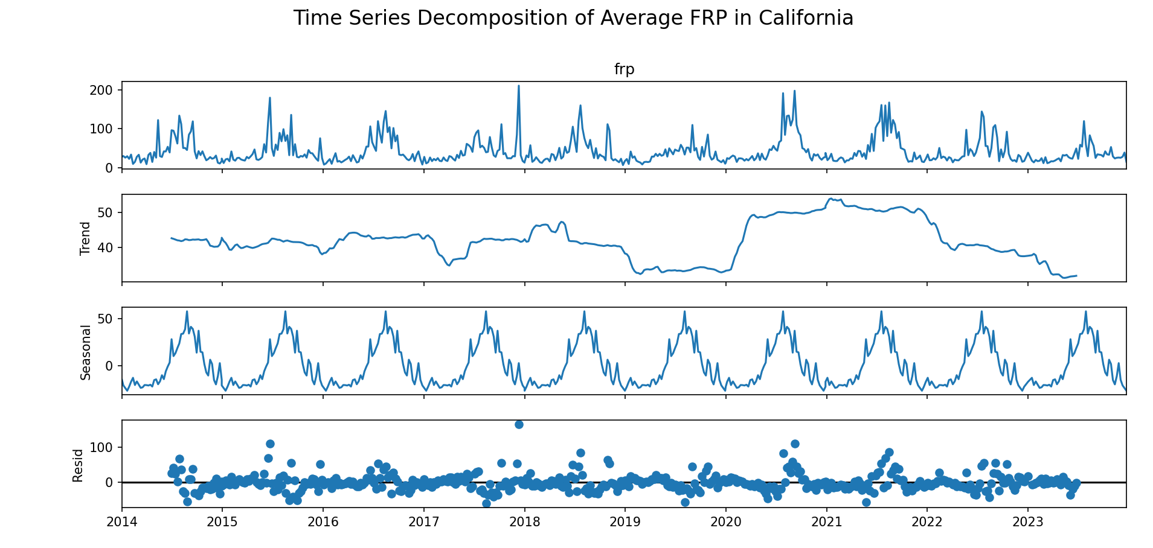
An interactive visualization platform for California wildfires
Stephanie Cho¹, Dhyan Gandhi¹, Wenjia Hu¹, Huanci Yang¹, Elisa Yuen Ting Ching¹
Georgia Institute of Technology – CSE 6242 Team 6
Introduction & Motivation
Evaluation & Results
What is the problem? Wildfires continue to devastate communities in California, with rising occurrences and climate change. Yet, there is a gap in tools that effectively predict and communicate wildfire risks.
Why should we care? Predictive modeling and intuitive visualization tools can support emergency services, policy-makers, and the public in understanding wildfire risks. This would help enable better preparation, early response, and resource allocation.
Model Evaluation:
Metrics: Precision, F1 Score, ROC-AUC
Hold-out test set with stratified sampling
Model Performance:
Precision: 0.6930
F1 Score: 0.6365
ROC-AUC: 0.9771 (excellent class separation)
Comparison & Observations:
XGBoost outperformed traditional methods (Random Forest, Logistic Regression)
Dynamic thresholding enhanced minority class recall
Top predictors: Soil Temperature, Solar Radiation, Air Temperature, Location, Wind
Problem Statement & Research Gap
We aim to build a wildfire probability prediction model and visualization tool focused on California, while also covering the broader U.S. landscape. Our goal is not just to predict fire events but also to explain when, where, and how severe these fires might be. We also hope to effectively visualize the extent and trends of these wildfires across California exhaustively.
Visualization Evaluation - User Study
Avg rating: 4.88/5 from 17 survey participants
Strong agreement on clarity, design, usefulness
Some suggestions for improving interactivity and layout
Findings:
Two seasonal peaks in U.S. wildfires (Spring and Summer)
California’s highest predicted risk occurs in August and September
Most major wildfire incidents occurred in less populated regions in California
Data
Sources downloaded from:
CIMIS Environmental Data (OpenML): 128,126 obs.
California Fire Incident Data (Department of Forestry and Fire Protection): 1,647 obs.
NASA MODIS Satellite Data: 1.29 million obs.
Characteristics:
Spanning 2013 –2023
Weekly/daily granularity
Environmental, temporal, and geospatial features
Our Innovation
Prior studies largely focused on binary wildfire classification or static maps. We improve upon this by:
Using multi-class probabilistic predictions
Integrating Bayesian hyperparameter optimization
Developing interactive dashboards based on NASA and California datasets
Dynamically tuning classification thresholds for better real-world calibration
Our Approach
Algorithms:
XGBoost for wildfire probability prediction using environmental and geospatial data
Bayesian optimization for hyperparameter tuning
SMOTE to address class imbalance
Visualizations:
Tableau dashboards to show national and California-specific wildfire trends, impacts, and model predictions
How They Work:
CIMIS environmental data (e.g., temperature, humidity, solar radiation) is used to train a machine learning model to predict wildfire risk.
Dashboards allow our users to explore both spatial and temporal wildfire patterns and model insights interactively.
Intuition:
Higher temperatures and lower humidity are known to elevate wildfire risks—ML models learn from these correlations.
Interactivity helps emergency planners zoom into risky zones and months.
Conclusion
Integrated ML and dashboards improve wildfire risk analysis and communication
Highlighted misalignment in resource deployment and fire severity
Insights applicable to emergency planning and public awareness

