Slide 1
SHOPPING BEHAVIORS
Abrea Jyles
Johnny Truong
Melissa Mosby
Stephanie Samperio

Slide 2
Shopping behaviors can be explained by age, gender, location, seasons, and purchasing frequencies
We have selected 4 hypotheses:
Abrea: People in the northern regions of the US will purchase more sweaters than people in the southern regions.
Melissa: Purchases over $50 are shipped express more than standard shipping.
Stephanie: The top three states will spend 30% more than the combined states average.
Johnny:

Slide 3
Consumer Behavior and Shopping Habits Data Set
Data Set Information:
- This dataset has shopping information for 3899 consumers.
- Here is a list of the categories in the dataset:
Age, Gender, Item Purchased, Item Category, Purchase Amount (USD), Location, Size, Color, Season, Review Rating, Subscription, Shipping Type, Discount Applied, Promo Code, Previous Purchase, Payment Method, and Frequency of Purchases
Solver, Z. “Consumer Behavior and Shopping Habits Dataset: E-Commerce Transaction Trends: A Comprehensive Dataset.” Assessed October 26, 2023. https://www.kaggle.com/datasets/zeesolver/consumer-behavior-and-shopping-habits-dataset

Slide 4
Introduction

Slide 5
Abrea

Slide 6
Abrea

Slide 7
Melissa

Slide 8
Melissa - Purchases over $50 are shipped express more than standard shipping

Slide 9
Hypothesis and T-Test Results
Hypothesis: The top three states will spend 30% more than the combined states average.
This shows that my hypothesis was correct because the statistic is 39 and the P-Value is < .05 which confirms my hypothesis is not null.

Slide 10
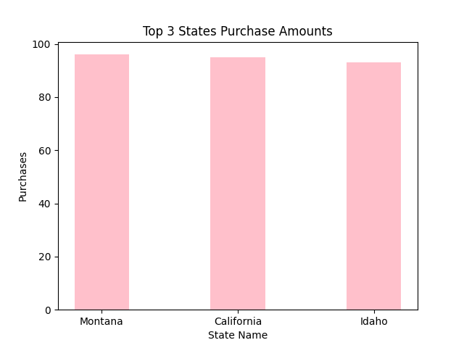
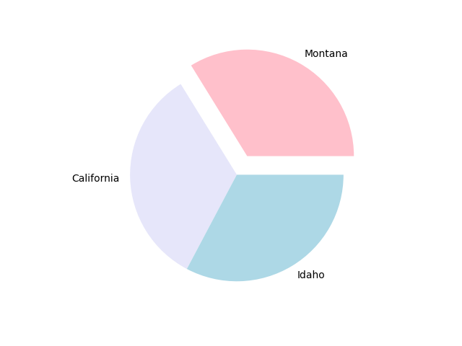
Top 3 States Purchase Amounts.
96
95
93

Slide 11
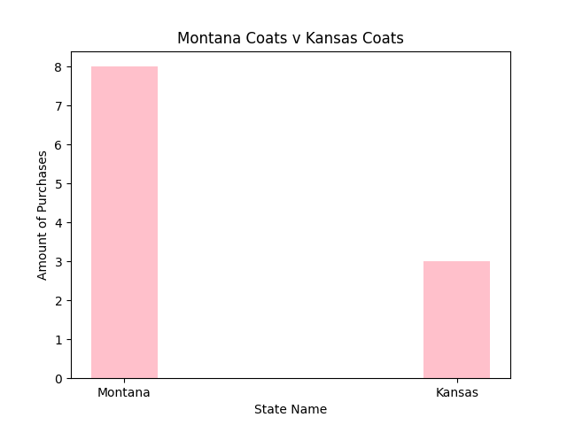
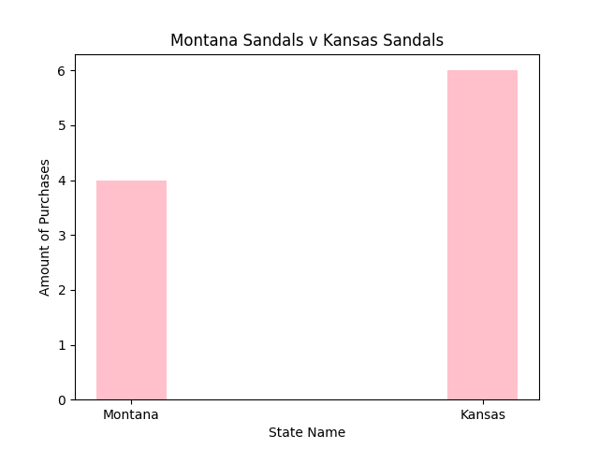
Statistical Analysis: Comparison Between Highest Purchased Item in Montana and Kansas

Slide 12
Johnny

Slide 13
Johnny

Slide 14
Conclusion

