Slide 1
SHOPPING BEHAVIORS
Abrea Jyles
Johnny Truong
Melissa Mosby
Stephanie Samperio

Slide 2
Shopping behaviors can be explained by age, gender, location, seasons, and purchasing frequencies
We have selected 4 hypotheses:
Abrea: People in the northern regions of the US will purchase more sweaters than people in the southern regions.
Melissa: Purchases over $50 are shipped express more than standard shipping.
Stephanie: The top three states will spend 30% more than the combined states average.
Johnny:

Slide 3
Consumer Behavior and Shopping Habits Data Set
Data Set Information:
- This dataset has shopping information for 3899 consumers.
- Here is a list of the categories in the dataset:
Age, Gender, Item Purchased, Item Category, Purchase Amount (USD), Location, Size, Color, Season, Review Rating, Subscription, Shipping Type, Discount Applied, Promo Code, Previous Purchase, Payment Method, and Frequency of Purchases
Solver, Z. “Consumer Behavior and Shopping Habits Dataset: E-Commerce Transaction Trends: A Comprehensive Dataset.” Assessed October 26, 2023. https://www.kaggle.com/datasets/zeesolver/consumer-behavior-and-shopping-habits-dataset

Slide 4
Abrea

Slide 5
Abrea

Slide 6
Hypothesis and T-Test Results
Hypothesis: Purchases over $50 are shipped express more than
standard shipping.
Mean of Purchase Price Less Than $50 $34.09
Mean of Purchase Price Greater than $50 $75.74
T-Test Results
Statistic 1.5108011258870513
P-value 0.131082523
This result shows that my hypothesis is false, null, and not statistically significant.

Slide 7
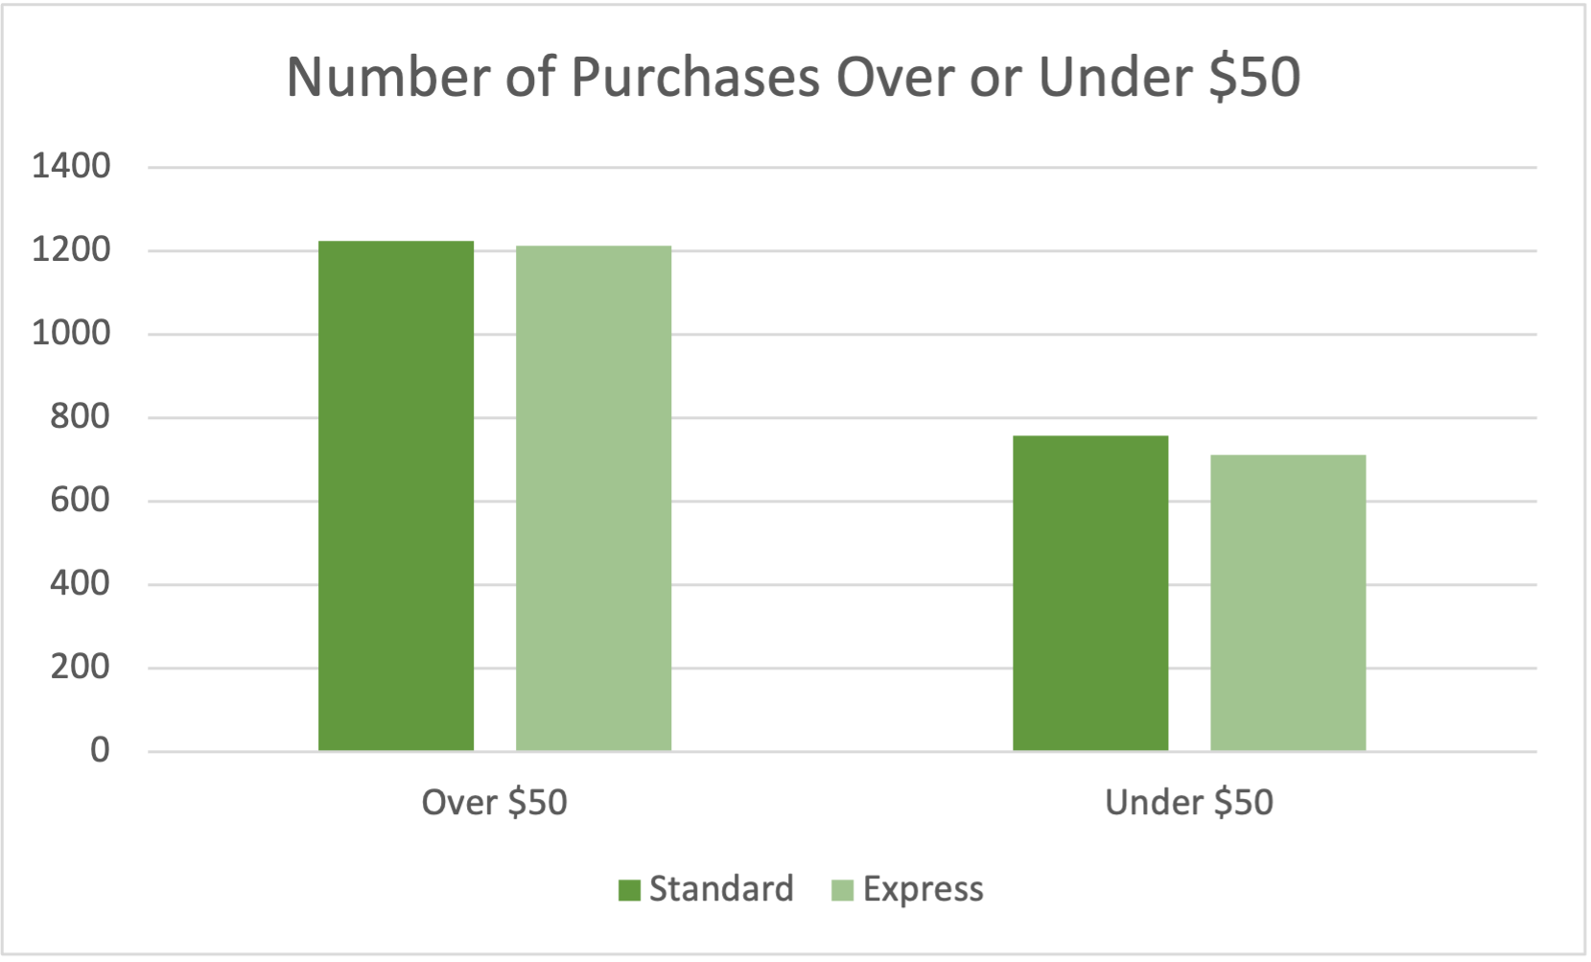
Purchases Over or Under $50

Slide 8
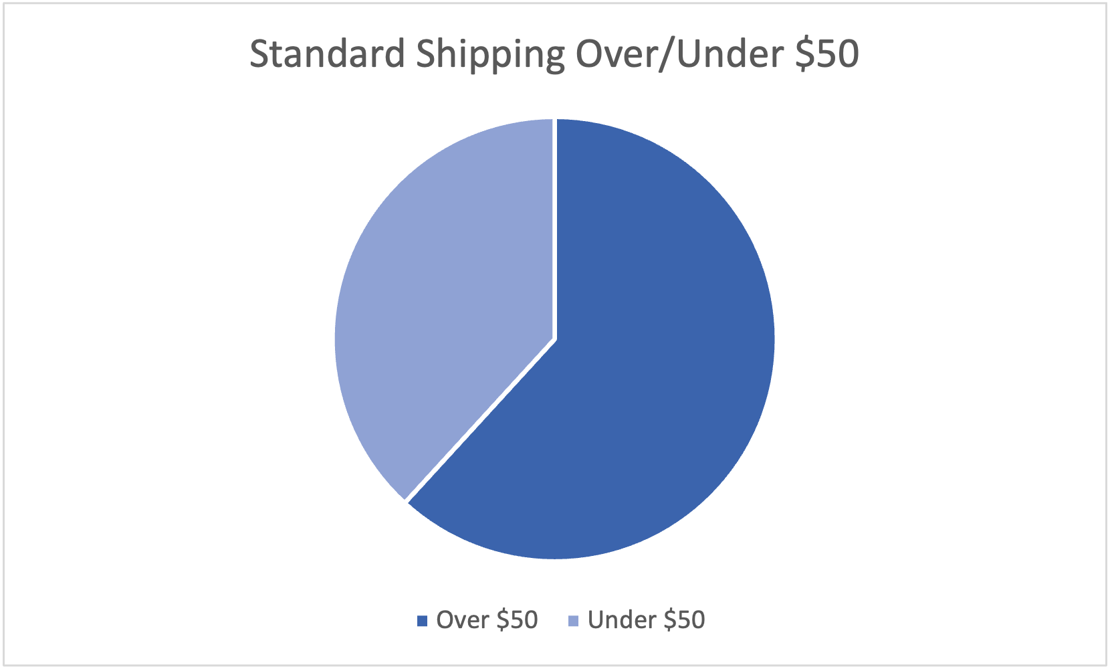
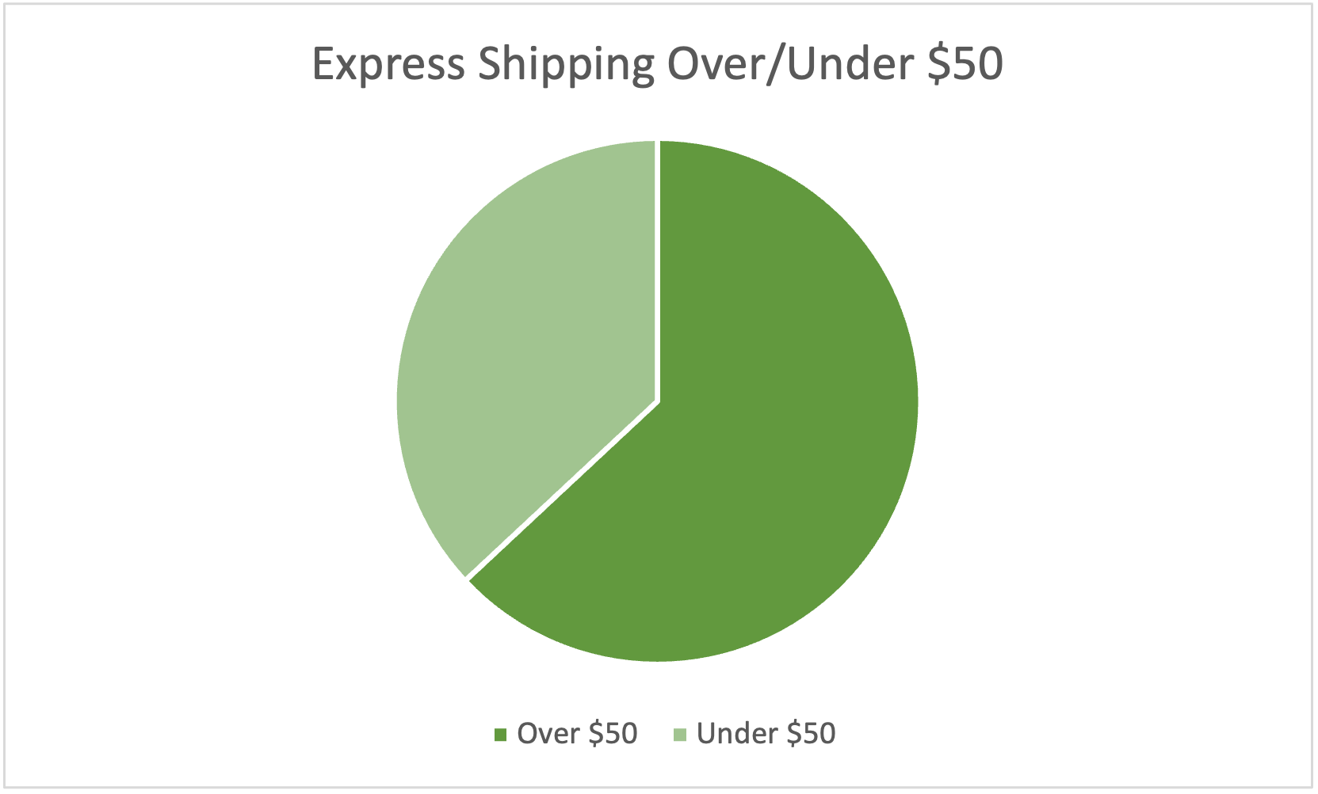
Purchases Over or Under $50 and Shipping Types

Slide 9
Hypothesis and T-Test Results
Question: What are the top three states with the most purchases? What regions are the top three states from?
Answer: The top three states with the most purchases are California, Idaho and Montana; Only one state is West Coast and the other two are the Rocky Mts. region.
Hypothesis: The top three states will spend 30% more than all combined states average.
This shows that my hypothesis was correct because the statistic is 39 and the P-Value is < .05 which confirms my hypothesis is not null.
Notes:
My question was what are the top three states with the most purchases? Which then I also had a sub question Will at least two out of the three states with best west coast states?
I got both of my question answered California, Idaho, Montana were the states with the most purchases with Montana having the max purchases amount of 96.
My original hypothesis was at least two out of three states will be west coast states but I didn’t know how to approach that hypothesis with the ttest so my hypothesis then became the top three states will spend at least 30% more than all combined states.
My state combined mean was 59.7%
Top three states combined mean was 94%
With the top three states being Montana with a purchase amount of 96, California 95 and Idaho 93. In the next slide we will be able to see it visually through a bar graph.

Slide 10
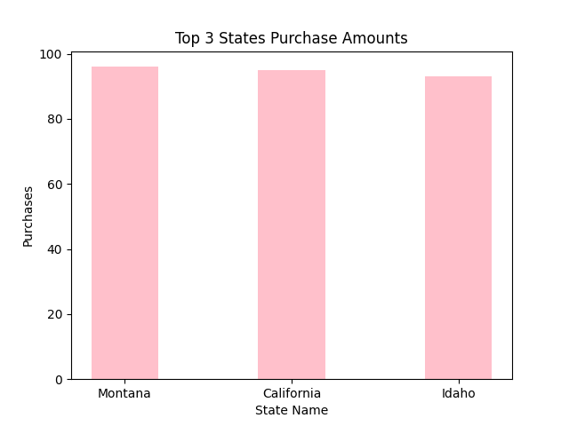
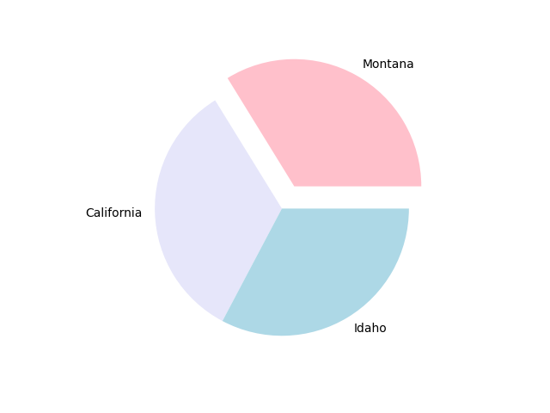
Top 3 States Purchase Amounts.
96
95
93

Slide 11
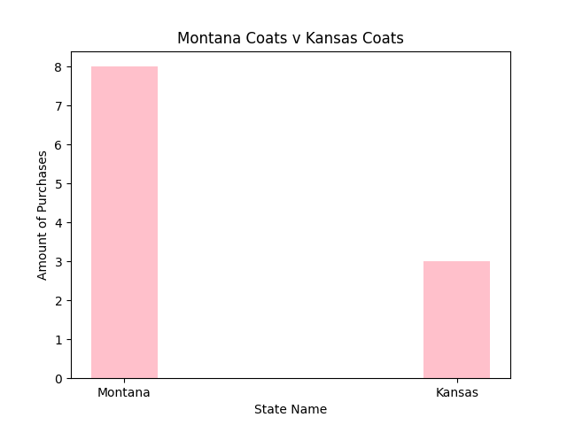
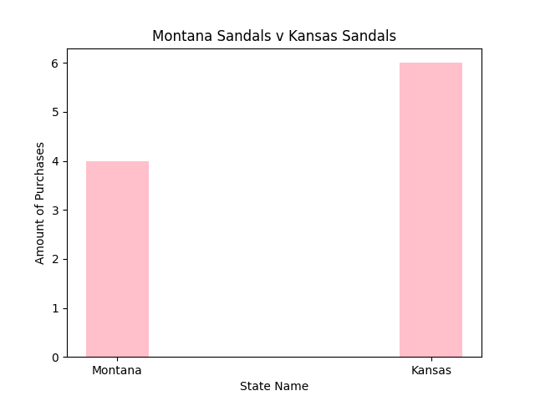
Statistical Analysis: Comparison Between Highest Purchased Item in Montana and Kansas
Notes:
For my statistical analysis I decided to do a comparison between the highest spending state which is Montana and the lowest spending state which is Kansas.
I think Montana having the most coats purchases makes sense because they’re further up north than Kansas.
For Montana the highest purchased item was coats and for Kansas it was sandals.

Slide 12
Johnny

Slide 13
Johnny

Slide 14
Conclusion
Hypothesis: Purchases over $50 are shipped express more than standard shipping.
This hypothesis is false.
Hypothesis: The top three states will spend 30% more than all combined states average.
This hypothesis is correct.

