Slide 1

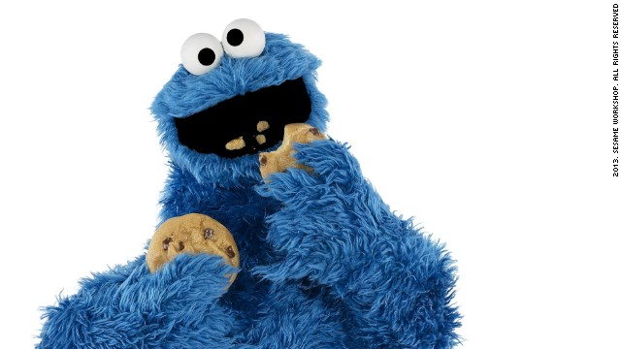
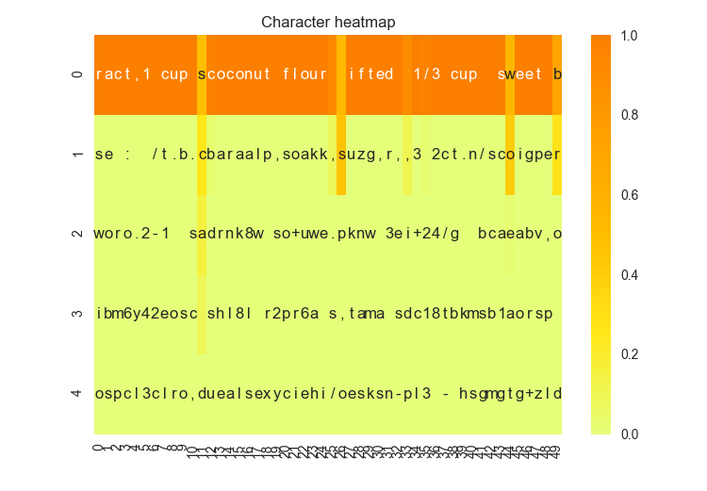
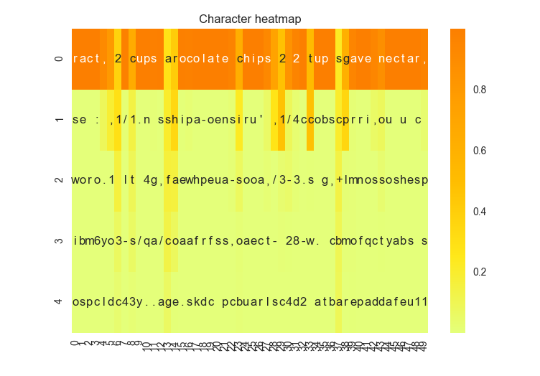
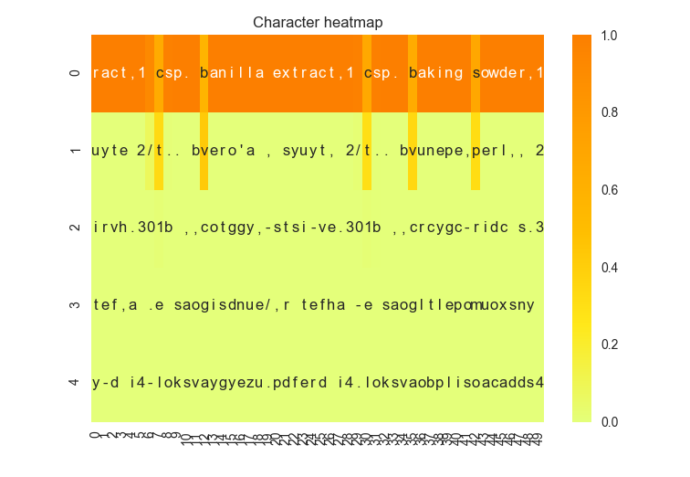
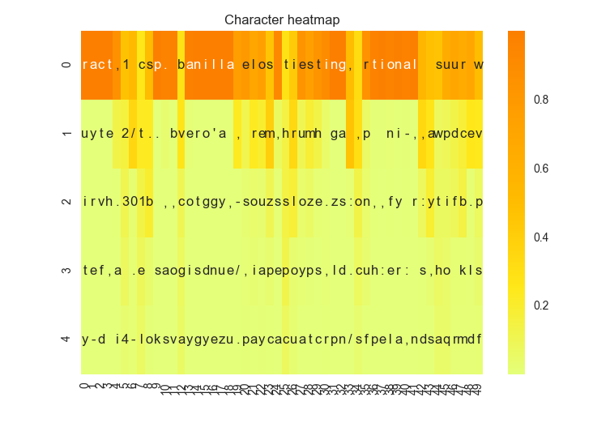
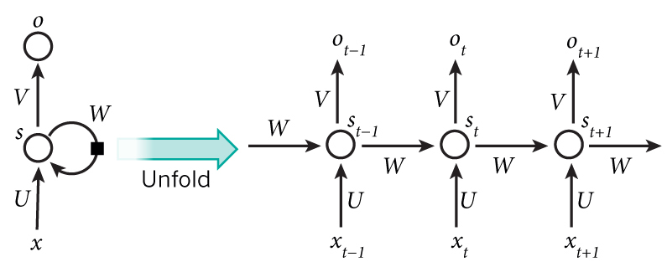
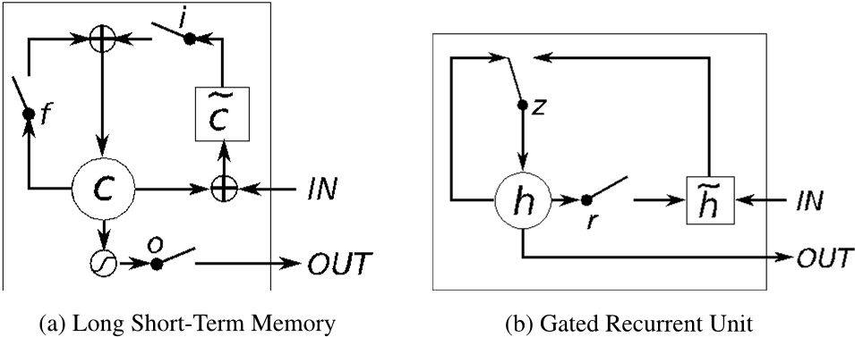
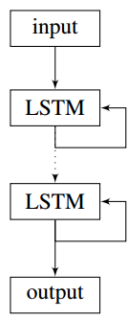
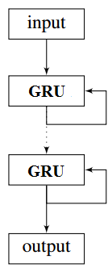
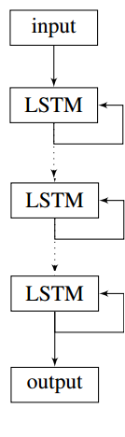
Convectional Neural Networks
Lydia Chang, Stephanie Ger, Ik-Hwan Kim, Craig Ng | MSiA 490-30 Deep Learning | Spring 2017 | Northwestern University
Problem Statement
Technical Approach
Results
Problem:
Creative combination of ingredients can be difficult for most people who lack cooking experience
With help of machine learning (and a lot of data), a model can generate new recipes for them to experiment with
Difficulty:
Current machine learning models are effective at copying and regurgitating inputs
Generating original output from those inputs can be bit more problematic
Other approaches:
Models have been trained on a very general set of recipes including multiple types of food
Some common ingredient like salt appears in recipes as varied as cakes, burgers and pizzas, confusing the model
Training with both directions and ingredients adds to the complexity and the models focused on learning format rather than content
Step 1
Step 2
Step 3
Seed text generated from first 40 characters of oatmeal cookie recipe
Character level embedding with CNN
Preprocess the data
Prepended the title of the recipe to the beginning of the recipe
Created synthetic data by shuffling the ingredient list for each recipe to combat order dependency
Consider embedding
Use phrase2vec with different levels of embedding:
character-level
word-level
phrase-level
Window length
Character-level: 40
Word- and phrase-level: 50
Model evaluation
Ran the code with each levels of the embedding for at least 60 epochs
Evaluate model success by looking at generated recipes
Heat map with diversity = 0.2
Heat map with diversity = 1.2
Step 4
Step 5
Step 6
Character level embedding with LSTM
Hyper-parameter Tuning
Compared GRU and LSTM performance
Compared CNN and RNN performance
Varied number of layers in the model (from 2 to 3)
Adjusted the number of neurons in the hidden layers(128, 256, 512)
Generate Recipes
Use keyword (e.g. recipe title) to randomly select recipe from corpus
Use first 40 characters of selected recipe as the seed
Generate a recipe with trained model
Bake cookies.
Eat cookies.
Profit.
Heat map with diversity = 0.2
Heat map with diversity = 1.2
Current Approach
Recurrent Neural Networks (RNNs):
Figure 1 Illustration of RNN Figure 2 LSTM vs GRU
Long short-term memory (LSTM) improves upon RNNs using memory cells that remember long-term values
Gated recurrent units’ (GRUs) are similar to LSTMs, but lack an output gate
Example Output: 1/2 tsp. baking soda,1 tsp. vanilla extract,1 cup all purpose flour,1 teaspoon baking soda,1 teaspoon salt,6 tablespoons brown sugar,2 cups candy covered plus 1/4 finely diced,1/2 cup firmly packed brown sugar,1 egg 1 3/4 cups sugar,2 la 1/2 tsp. baking soda,1 tsp. vanilla extract 2 cups chocolate chips,1/2 cup agave nectar,1 teaspoon coconut extract ,1 teaspoon salt,1 cup nutella, 1/2 cup rainbow sprinkles of chopped nuts,1/3 cup chocolate hot cocoa powder,1 tsp vanilla
Dataset
Scraped 80,000 ingredient lists from Yummly using the search parameter ‘cookie’
Data was cleaned for better performance:
Removed any recipes that didn’t have cookie in the title
Removed special characters from corpus
Inspected the final dictionary and removed any words that were instructions or were unrelated to cookies
Removed any words not in the final dictionary from the corpus
Example raw observation:
Example post-processed observation:
Conclusion
Brief summary of what you discovered based on results
All three embeddings capable of producing reasonable recipes
Difficult to determine the differences in model performance from hyper-parameter tuning because the output evaluation is subjective
Limitations of approach
Dictionary limited to those words/recipes available via Yummly
How to improve/future work
Use prepended titles as part of training observations to give models the ability to generate recipes using created titles
Generalize to include other recipe types, then generate hybrid recipes
['2 cups flour', '1 teaspoon baking powder', '1 teaspoon baking soda', '1 teaspoon salt', '3/4 cup butter, room temperature', '3/4 cup brown sugar (packed)', '3/4 cup granulated sugar', '2 large eggs', u'2 teaspoons vanilla (or slightly more, to taste)', '3 1/2 cups old-fashioned oatmeal', '2 cups raisins (soaked in hot water flavored with vanilla, then drained)']
Alternative Approaches
Bidirectional RNNs: connect two hidden layers of opposite directions to the same output, so the output layer can get information from both past and future states
Convolutional NNs: use layers with different numbers of hidden neurons to capture a range of time dependent features
References and Related Work
[Favorite Oatmeal Raisin Cookies] 2 cups flour,1 teaspoon baking powder,1 teaspoon baking soda,1 teaspoon salt,3/4 cup butter room temperature,3/4 cup brown sugar ,3/4 cup granulated sugar,2 large eggs,2 teaspoons vanilla ,3 1/2 cups old-fashioned oatmeal,2 cups raisins
Do Androids Dream of Cooking? (Tom Brewe)
Keras LSTM Text Generation Example Code (François Chollet)
Word RNN Tensorflow Code (Sung Kim)
The Unreasonable Effectiveness of Recurrent Neural Networks (Andrej Karpathy)
Generating Text with Recurrent Neural Networks (Ilya Sutskever, James Martens, Geoffrey Hinton)
Figure 3: The structures of our models

