Slide 1
Forms of doom
Come to the dark side. We have cookies.

Slide 2
Behold The Powers of HTML5
Attributes
Input Types
JavaScript API
Styling
Notes:
Mobile vs Desktop
Some can be used today

Slide 3
Attributes TO RULE THEM ALL
Placeholder
Required
Autofocus
Autocomplete
Spellcheck
Pattern
Notes:
These apply to almost all input types, existing and new

Slide 4

<input placeholder=“Full Name”>
Disappears as the user types.
NOT a replacement for a proper label. I will hunt you down.

Slide 5

<input required>
Validated by supporting browsers.

Slide 6
<input autofocus>
Gives the first field in the source order with autofocus focus on page load.
Will scroll the page to give it focus.
Not supported by mobile browsers.

Slide 7
<input autocomplete=“off”>
Suggests to browsers that they not auto fill that form field.
Suggested for use on form fields the browser will probably auto fill wrong. For example: Name when you want a pet’s name.

Slide 8
<input spellcheck=“false”>
Also accepts “true”.
Tells the browser explicitly whether or not to spell check the field.
Good for fields where the input is expected to be interpreted as a misspelling.

Slide 9

<input pattern="[a-zA-Z0-9]+" title=“Letters and numbers only please.”>
Matches a regular expression.
Only validates if something has been entered.
Error message is non-specific. Some browsers will use title attribute to explain.
Use the title attribute to add additional help text. Please.
This works with all the input types.

Slide 10
CODING Impressive.
Download the sample form: stephaniehobson.ca/html5forms
Add:
Placeholder
Required
Autofocus
Autocomplete (to the nemesis name field – wouldn’t want to submit your own name as your nemesis, that’d be awkward)
Spellcheck (to the nemesis name field)
Pattern
Notes:
You are WEB MASTER for the Guild of Calamitous Intent

Slide 11
Input types And your little dog too
Email
URL
Tel
Search
Number
Range
Date
Datalist

Slide 12

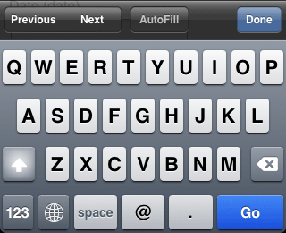
<input type=“email”>
For email addresses.
Gives email keyboard.
Is validated as an email address.
Special attribute:
multiple (enables acceptance of a comma separated list of addresses)

Slide 13

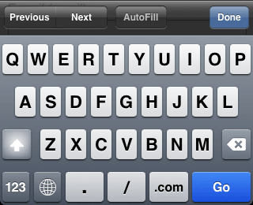
<input type=“url”>
For urls.
Gives url keyboard.
Is validated as a url – very loosely.
URL validation is actually really complicated.
Use in combination with pattern if you want something specific.

Slide 14
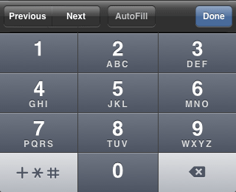
<input type=“tel”>
For phone numbers.
Gives number pad.
Very loosely validated.
Handy since the nice big number pad is handy for inputting any number so you can use it for anything else you like. thisisourstop.com uses it for bus stop number.
Use with pattern if you have something specific in mind.
Notes:
Use pattern if you want it in a certain format

Slide 15
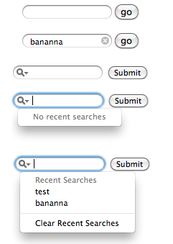
<input type=“search”>
No standard functionality.
Remembered search terms on some.
Rounded corners on some.
Over ride with -webkit-appearance:none;
Little grey clear field “x” on some.
Notes:
Apple’s baby so Safari handles it best.
Some remember last few searches.
Some give little grey X.
Can be combined with datalist to provide search suggestions

Slide 16
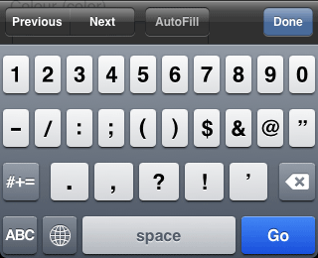

<input type=“number”>
For numbers. Also called a “spinbox”.
Gives number keypad.
Validated as a number (one day).
Special attributes:
min
max
step
Special pseudo classes:
:in-range { }
:out-of-range { }

Slide 17

<input type=“range”>
For numbers. Also called a “slider”.
Exact number not displayed to user.
Special attributes:
min
max
step
Special pseudo classes:
:in-range { }
:out-of-range { }

Slide 18
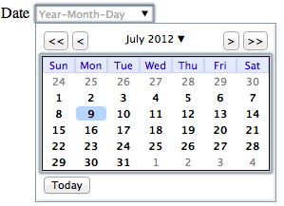
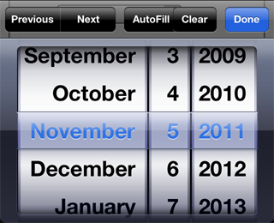
<input type=“date”>
On focus displays a date picker.
Configurable formats:
type=“date”
type=“datetime”
type=“datetime-local”
type=“month”
type=“week”
type=“time”
Support for everything except type=“date” is spotty.
Notes:
Support for this one is really spotty

Slide 19
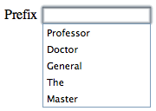
<input type=“text” list=“sources"> <datalist id=“sources"> <option>Professor</option> <option>Master</option> </datalist>
Text box with filtered list of suggestions.
Replaces a select box with an “other please specify” option.
Entire list isn’t usually visible, appears as user types, filtered by what they’ve entered.
Backwards compatible: http://goo.gl/GhfEl

Slide 20
CODING Most Impressive.
Using the same form change:
Birth/death date to date
Army size to range
Nemesis to datalist (Use Jeremy Keiths’ backwards compatible version http://goo.gl/GhfEl)
Notes:
You are WEB MASTER for the Guild of Calamitous Intent

Slide 21
Support Do you know how I got these scars?
Compatibility Tables
http://wufoo.com/html5/ In depth and up to date.
Fallbacks
All new inputs fall back to text automatically. Isn’t that awesome!
That means if you have a form with no validation today, you have have validation for modern browsers with small changes! So cool! You should run home and do this.
Backwards compatible datalist: http://adactio.com/journal/4272/
Shims
https://github.com/ryanseddon/H5F
In early 2012 not all played nice with jQuery form validation plug-ins. Not sure if this has changed.
Notes:
Fallbacks – to text! Isn’t that awesome!
Shims
These do not place nice with many existing jQuery plug ins :(

Slide 22
JavaScript API with frickin Laser beams
FormData
Constraint Validation
A Few More Elements

Slide 23
formData
Create and send a virtual form. No need to create DOM elements.
var formData = new FormData();
formData.append(“weapon”, “Death Ray”);
formData.append(“cybernetics”, “eye, left arm”)
var xhr = new XMLHttpRequest();
xhr.open("POST", "http://goci.com/submission.php");
xhr.send(formData);
Notes:
Create a form altogether. Virtually in JavaSript. No need to create hidden forms in the DOM.

Slide 24
formData
Can also be used to append data to an existing form before sending.
var formElement = document.getElementById(”myForm");
var formData = new FormData(formElement);
formData.append(”Sidekick", "Harley Quinn,");
var xhr = new XMLHttpRequest();
xhr.open("POST", "http://goci.com/submission.php");
xhr.send(formData);
Notes:
Append to an existing form

Slide 25
Constraint Validation
Form elements have an object you can access with several attributes that will tell you if and how a form field is failing validation.
el.validity.valid
el.validity.valueMissing
el.validity.typeMismatch
el.validity.patternMismatch
el.validity.tooLong
el.validity.rangeUnderflow and rangeOverflow
el.validity.stepMismatch
el.validity.customError
Yes, custom errors! You can create your own errors using their API.
Notes:
New attribute called validity
Returns the validityState object which has several boolean attributes (basically a series of true/false tests)

Slide 26
Constraint Validation
Create a custom error message. Like, checking two email addresses match.
<input type="email" id="email_addr" name="email_addr">
<input type="email" id="email_addr_repeat" name="email_addr_repeat" oninput="check(this)">
<script>
function check(input) {
if (input.value != document.getElementById('email_addr').value) {
input.setCustomValidity('The two email addresses must match.');
} else {
// input is valid -- reset the error message
input.setCustomValidity('');
}
}
</script>

Slide 27
CODING
Add the code to check the email address (I hate these but it *is* an evil application form after all).
You can copy and paste the code from here:
http://www.html5rocks.com/en/tutorials/forms/html5forms/
Notes:
You are WEB MASTER for the Guild of Calamitous Intent

Slide 28
Styling Custom Baby Seal Leather Boots Anyone?
:required
:optional
:valid
:invalid
:default
[attribute]
Notes:
Some of the problems with timing.

Slide 29
Resources I see you brought a friend.
Basic Introductions
http://diveintohtml5.info/forms.html
http://24ways.org/2009/have-a-field-day-with-html5-forms/
http://www.html5rocks.com/en/tutorials/forms/html5forms/
http://www.alistapart.com/articles/forward-thinking-form-validation/
CSS
http://html5doctor.com/css3-pseudo-classes-and-html5-forms/
Compatibility Specifics
http://wufoo.com/html5/
http://miketaylr.com/code/input-type-attr.html

