Slide 1

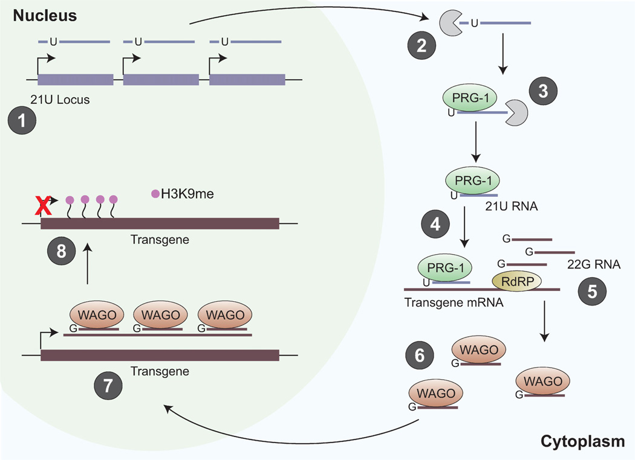
Nucleus
piRNA locus
HRDE-1
HRDE-1
HRDE-1
HRDE-1
HRDE-1
HRDE-1

Slide 2
Transgenerational inheritance in C. elegans involves small RNA pathways
DCR-1
siRNA
piRNA locus
piRNA
PRG-1
SET-25
SET-25
PRG-1
RDE-1
PRG-1
HRDE-1
HRDE-1
HRDE-1
HRDE-1
Adapted from Mani and Juliano 2013, Brown and Montgomery 2017

Slide 3
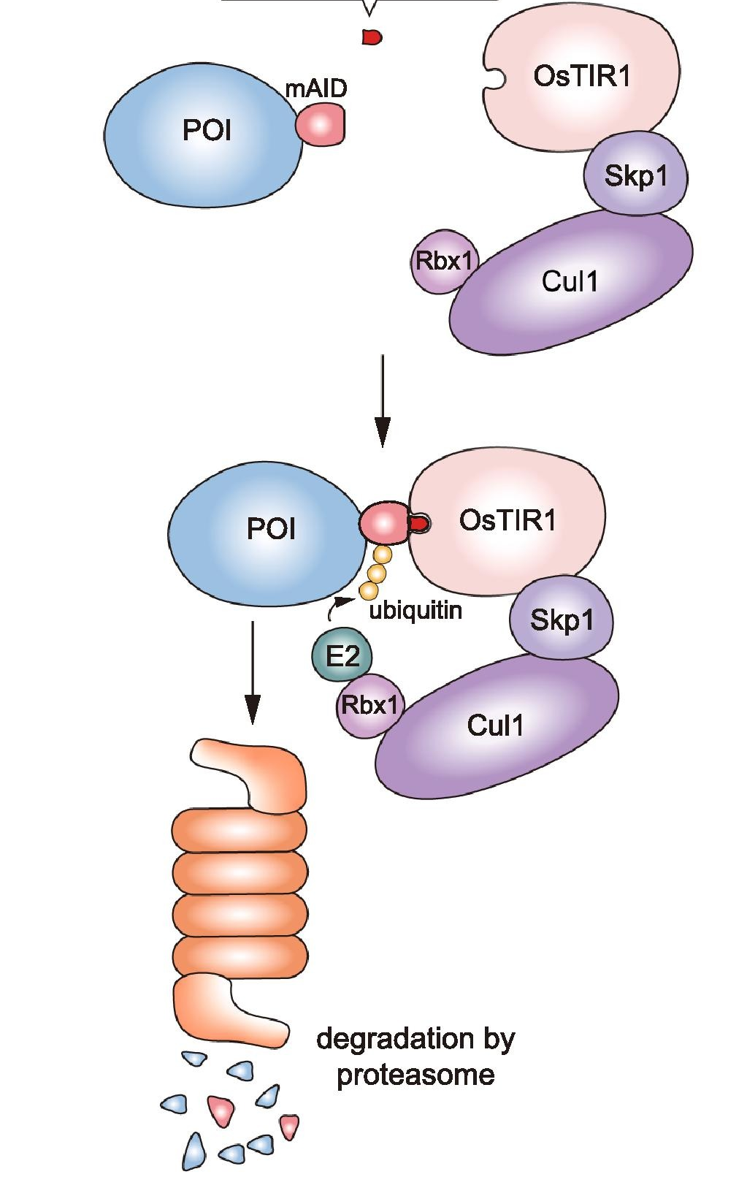

AID tag
TIR1
E3
+ auxin
TIR1
E3
Degradation in proteasome

Slide 4
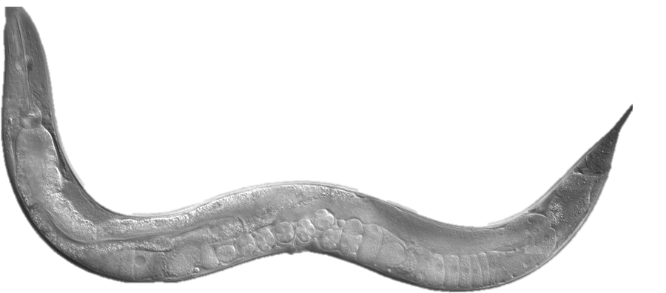
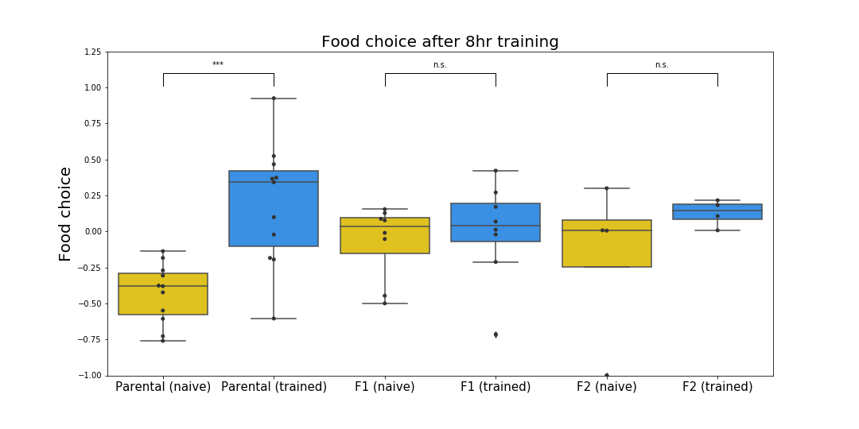

8hr training may be insufficient for F1 learning
E. coli
Parental
F1
F2
P. aeruginosa

