Slide 1
Week 3 Workshop
Web Development Fundamentals
HTML, CSS, and JavaScript

Slide 2

Agenda
Activity​​ | Time​​ | ~Start
Get Prepared: Log in to Nucamp Learning Portal • Slack • Screenshare​​ | 10 minutes | 9:00am
Check-In​​ | 10 minutes​​ | 9:10am
Review | 60 minutes | 9:20am
Task 1​ | 40 minutes​​ | 10:20am
BREAK​​ | 15 minutes​​ | 11:00am
Task 2 & 3 | 90 minutes​​ | 11:15am
Check-Out​​ | 15 minutes​​ | 12:45pm

Slide 3
Check-In
How was this week for you? Any particular challenges or accomplishments?
Did you understand the Exercises and were you able to complete them?
How were the Challenges and Quiz this week?
We know that this was a difficult week for many. Please ask if you have questions.

Slide 4
Week 3 Review - Overview
What is JavaScript? HTML: The script element HTML: The onclick attribute Variables Data types Functions Function Parameters & Arguments The JavaScript console If … Else If … Else | Comparison Operators Logical Operators Truthy & Falsy Switch Statements += -= ++ -- While Loops Arrays Scope Math.random() & Math.floor()

Slide 5
What is JavaScript?
Programming language originally created to run inside browsers
Most popular programming language for web development, used in browsers, desktops, servers, mobile apps
ECMAScript: Official specification for JavaScript – last major version was in 2015, called ECMAScript 2015 or ES6
Current version is ES9, but changes since ES6 have been minor
Many technologies use JavaScript (jQuery, Node.js, React, etc); you must first learn "vanilla JavaScript" to use them

Slide 6
HTML: The script element
Use <script> element to add JavaScript to HTML page
Add JavaScript between <script></script> tags
...or link to external JS file: <script src="index.js"></script>
You can link to multiple JS files
Generally, JavaScript inside <script> tags or in external JS file that is not inside a function will run automatically when the page is loaded

Slide 7
HTML: The onclick attribute
Add onclick attribute to HTML element such as button to run JS function when element is clicked:
There are multiple ways to trigger JavaScript from an HTML page, this is one way

Slide 8
Variables
A named container for some value
Create/Declare a variable using let or const
let for variables that will have their values reassigned
const for variables whose values will be assigned only once
Pre-ES6 variable declaration keyword var is commonly seen in older codebases – avoid when writing new code
Values stored in variables can be of several different data types

Slide 9
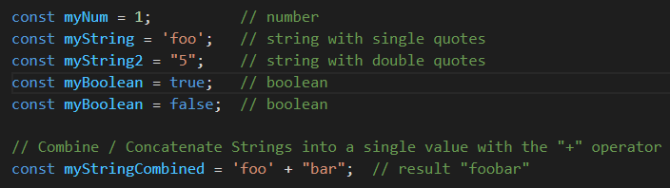
Variables (cont)
Use the assignment operator = to set a variable's value
You learned about: number, string, boolean
Two more data types: null and undefined
null is an intended non-value set by the programmer
undefined is the value of a variable that has been declared but not initialized
There are other data types that will not be covered for this introductory class
"5" is a String and not a number since it is surrounded by quotes
boolean can be either true or false
Use the + operator to combine (concatenate) strings

Slide 10


Variables (cont)
The first time you assign a value to a variable is called initialization
You must initialize const variables at declaration:
You can declare let variables then initialize later, but best practice: initialize at declaration to prevent issues with undefined variables
<-- OK, technically permitted
<-- Better
Only use let keyword when you first create the variable
To assign/reassign its value later after declaration, use only the variable name
Declaration: Defining a name for your variable for use in your code (var, let & const). i.e. let varName;
Assignment: Sets/re-sets the value of your variable( = , +=, -=, *=, and /= ). i.e. varName = "hello"
Initialization: Specifying an initial value for your variable to start with. i.e. let varName = "hello";

Slide 11

Functions
A segment of code that can be grouped together, given a name, and called by that name from other places in the code
Multiple ways to define a function, simplest way is with function declaration syntax:
Defining/declaring a function does not run it. It must be called.
Call a function (run the code inside it) with the function's name followed by an argument list:

Slide 12
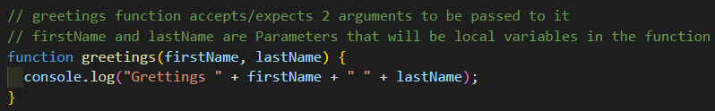
Functions – Parameters and Arguments
Function definitions must include a parameter list
Variable names for values that will be passed in when function is called
Function call's pass an argument list for the parameter values
Parameter list can be empty:
If so, function is called with empty argument list:
Otherwise, call with arguments that correspond to parameters:
Pass arguments TO functions when calling it
The arguments passed then become parameters (variables) to be used inside a function
No need to declare these variables using let or const! The parameter list does it for you

Slide 13
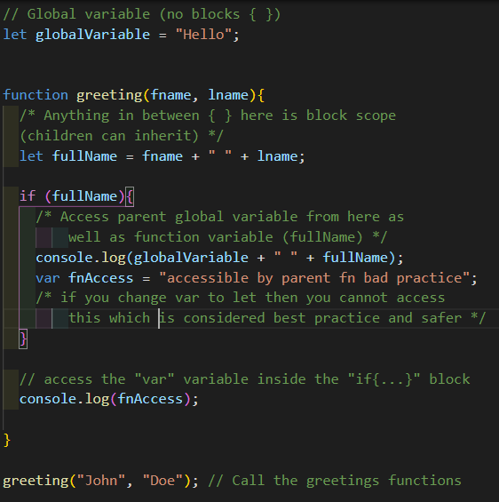
Scope
Variables declared with let and const are block scoped
Variables declared with var are function scoped
Child blocks inherit their parent blocks' variables
Only exist inside the code block { … } in which they were declared, such as a function, if, switch, or while/do…while block.
Function scope is like block scope, but only for functions
Variables declared outside of any code blocks are global and can be accessed from anywhere – use sparingly

Slide 14

The JavaScript console
Three primary uses:
View error/warning messages
Log your own messages using console.log('…');
Test out small pieces of JavaScript and have their values immediately evaluated and echoed back to you

Slide 15
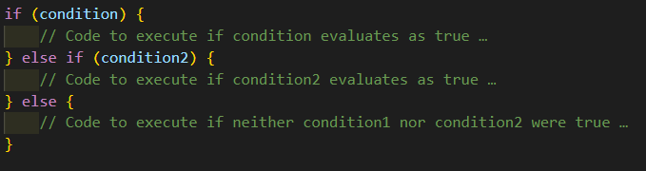
If … Else If … Else
Conditional statement, allows forks in your code
else if and else are optional, you do not need them
You can have either or both, following an if block
You can have multiple else if blocks
You can have only one else block at the very end

Slide 16
Comparison Operators
Equality Operators
Strict equality (aka triple equals/identity): ===
Loose equality (aka double equals/equality): ==
Strict inequality (aka non-identity): !==
Loose inequality (aka inequality): !=
Discuss: What's the difference between the strict and loose versions of the equality operators, and which are best practice to use?
Relational Operators
> >= < <=
Greater than, greater than or equal to, less than, less than or equal to
Works as you would expect with numbers
Works in lexicographical order with strings; 'a' is lower/less than 'z'
== does NOT evaluate the data type (i.e 1 == "1" will return true)
=== is a strict equality where the data types must match (i.e 1 === "1" will return false)
=== Strict is best practice

Slide 17
Truthy & Falsy
Boolean values true and false are of the Boolean data type only
The concept of truthy and falsy mean that if a value was converted to the Boolean data type, it would be true or false.
Example: the number 3 is truthy, the number 0 is falsy
Discuss: Is the number -1 falsy?
No, -1 is truthy
Falsy – Any value that is false, 0, an empty string (""), undefined, null, and NaN will be interpreted as false
Truthy – Any other value that NOT Falsy will be interpreted as true

Slide 18
Truthy & Falsy (cont)
There are only 6 falsy values:
false
null
undefined
empty string: "" and ''
0
NaN (Not a Number)
Everything else is truthy!

Slide 19
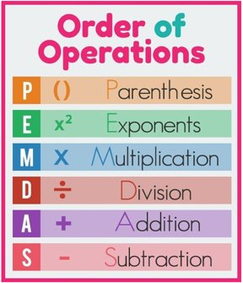
Logical Operators
Logical AND &&: Returns first falsy value or last truthy value
Discuss: What is returned from evaluating (true && (3 >= 5))?
(For practice, enter into your JavaScript console to confirm your answer)
Logical OR ||: Returns first truthy value or last falsy value
Discuss: What is returned from evaluating (false || (5 - 10))?
false
-5 -5 is the first truthy value and is returned

Slide 20
Logical Operators
Logical Not !: Coerces its operand to Boolean then returns its opposite
Discuss: What is returned from evaluating
!(true && false)?
!true && false?
Double Not !!
Discuss: What is this used as a shorthand for and why/how does it work?
True - !false (not false) evaluates to true
False - false && false = false
Can coerce (implicit type conversion) a value to its truthy/falsy Boolean value
The first "!" will convert it to the oppisite boolean and then the second "!" converts it back to it's actual truthy/falsy boolean value

Slide 21
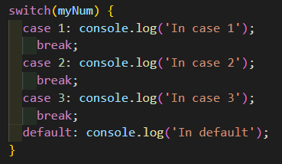
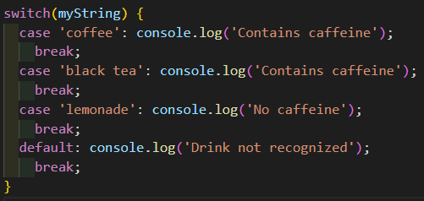
Switch
Conditional statement – evaluates an expression depending on its value, then executes one of multiple case clauses and an optional default clause:
Once the program enters a case, it will executing all following statements until it reaches the end of the switch block, or a break, even the statements for other cases.
Always use a break unless you know what you're doing and you want that behavior.
default clause is like the "else" in an if statement, will run if nothing else matches, best practice is to always use it

Slide 22
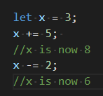


More Operators: += -= ++ --
+= and -= are binary operators
++ and - - are unary operators that only add or subtract 1
can be used prefix (++variable) or postfix (variable++) and have different behaviors
++varName will increase "varName" by +1 first and then perform an evaluation
varName++ will evaluate "varName" at it's current value first and then increase by +1 after that
recommended to use += 1 and -= 1 instead of these in most cases, more clear
Same as x = x + 5
Same as x = x - 2

Slide 23
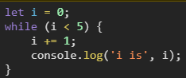
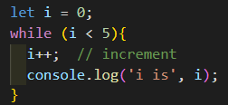
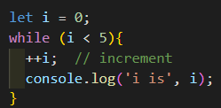
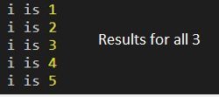
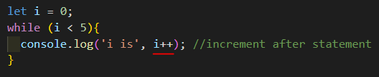
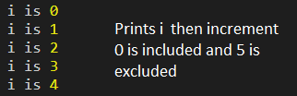
While Loops
Repeat a block of code until a condition evaluates as false

Slide 24
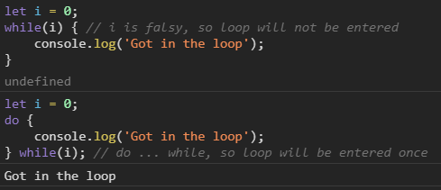
Do … While Loops
Variant of while loops where the code block always executes at least once, even if the while condition is false

Slide 25
Arrays
Numerically indexed list of values: [ item1, item2, item3, …]
Zero-indexed – index starts at 0, not 1
Example:
'apple' is at index 0 and can be accessed with fruits[0]
'banana' is at index 1 and can be accessed with fruits[1]
'cherry' is at index 2 and can be accessed with fruits[2]
arrayname.length is an array property will give you the count of items in the array
For example: fruits.length is 3
You can modify the value: fruits[1] = 'boysenberry'; will result in the array being changed to: ['apple', 'boysenberry', 'cherry']

Slide 26
Array Methods
Some are mutator methods – they change the array
Others are not – only access the array
Some have parameters, others don't
Most will return some value, different for each method
Very useful – there are many, it will take time to learn them all

Slide 27


Array Methods – push(), pop(), unshift(), shift()
push() adds an item to end of array, returns the new array length
Use with argument of item(s) to add
pop() removes an item from end of array, returns the removed item
No arguments
unshift() adds 1 or more item to start of array, returns new array length
Use with argument of item(s) to add
shift() removes an item from start of array, returns removed item
No arguments
All four of these are mutator methods
Discuss: Which two of these four affect the index of all other items in the array and why?
unshift() - When adding to the start of an array your increasing the other item indexes by the number of items being added shift() - When removing from the start of an array your decreasing the other item indexes by 1

Slide 28

Array Methods – join()
join() – returns a string with the array items
Takes an argument of a string that will be used as the separator between array items in the returned string
If no argument is given, comma is used
Does not mutate the original array – the array fruits will still be the same after you use join() on it
default

Slide 29
Array Methods: includes(), indexOf()
Both array methods will check to see if a value exists in an array
includes(value to check for) will return true if so, false if not
indexOf(value to check for) will return the numeric index of the item if it exists in the array, and –1 if not
Example: for an array of:
fruits.includes('banana') would return true
fruits.indexOf('banana') would return 1
Discuss: Why does indexOf return -1 and not 0 for a not found item?
0 is a valid index number – it's the first item in the array

Slide 30
Math.random()
Math.random() generates a random number between 0 and 1 such as:
0.03439834432
0.99999999999
0
Potential values include 0 but not 1
If you want a value between 0 and a max number (not inclusive of the max number), multiply by the max number:
Math.random() * 10 would generate a random number between 0 and 9.99999999999...

Slide 31
Math.floor()
Math.floor() takes a number as an argument and returns an integer
Math.floor(9.9999) would return 9
Math.floor(9.1111) would return 9
Math.floor(3.14) would return 3
Use it along with Math.random() to generate a random integer:
Math.floor(Math.random() * 10) would generate a random integer between 0 and 9, including 0 and 9
Add 1 to the result to get a value that's between 1 and the max number, inclusive of the max number:
Math.floor(Math.random() * 10) + 1 would generate a random integer between 1 and 10, including 1 and 10

Slide 32
This Week's Tasks
If we have extra time before the Workshop then feel free to bring up any unresolved questions, and to discuss any Challenge Questions or Code Challenges.
Otherwise, please start the Workshop Assignment and save the discussion for after the assignment is finished, or online.

Slide 33
Workshop Assignment
It's time to start the workshop assignment!
Break out into groups of 2-3.
Sit near your workshop partner(s) in in person
For online Workshops your instructor may break you out into different virtual rooms
Work closely with each other.
Don't forget that the 20-minute rule becomes the 10-minute rule during workshops!
10-minute rule does not apply to talking to your partner(s). Work together throughout. This will be useful practice for working with teams in real life.
Follow the workshop instructions very closely.
Talk to your instructor if any of the instructions are unclear to you.

Slide 34
Assignment Submission & Check-Out
Submit the color-guessing-game.html page at the bottom of the assignment page in the learning portal.
Example instruction on the next slide

Slide 35

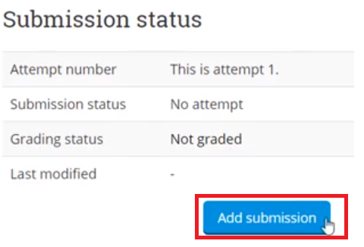
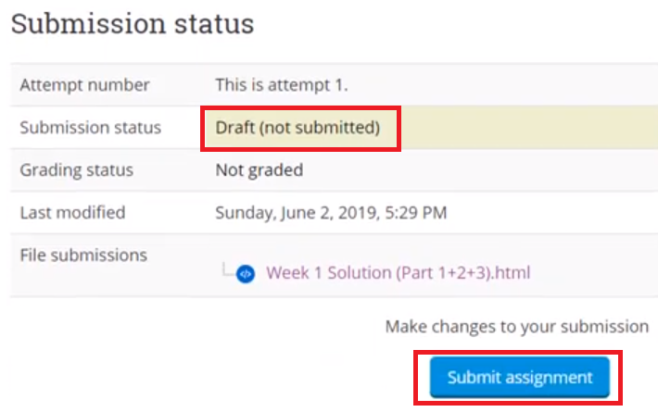
Submitting Your Assignment
Go to https://learn.nucamp.co
Click "Workshop Assignment: Students' Work"
Upload your work by clicking "Add Submission", select the file, and then click "save"
Note that your work is in Draft status
Click "Submit assignment" to submit it

Slide 36
Happy learning!

