Slide 1
Evaluating the handwriter Open Set Method on Different Document Lengths
January 22, 2025

Slide 2
Test Dataset
CVL Handwriting Database
In total, 290 samples from 59 writers
6 samples from 27 writers
4 samples from 32 writers
Each sample is split into individual lines
The shortest sample has 4 lines, and the longest has 14

Slide 3
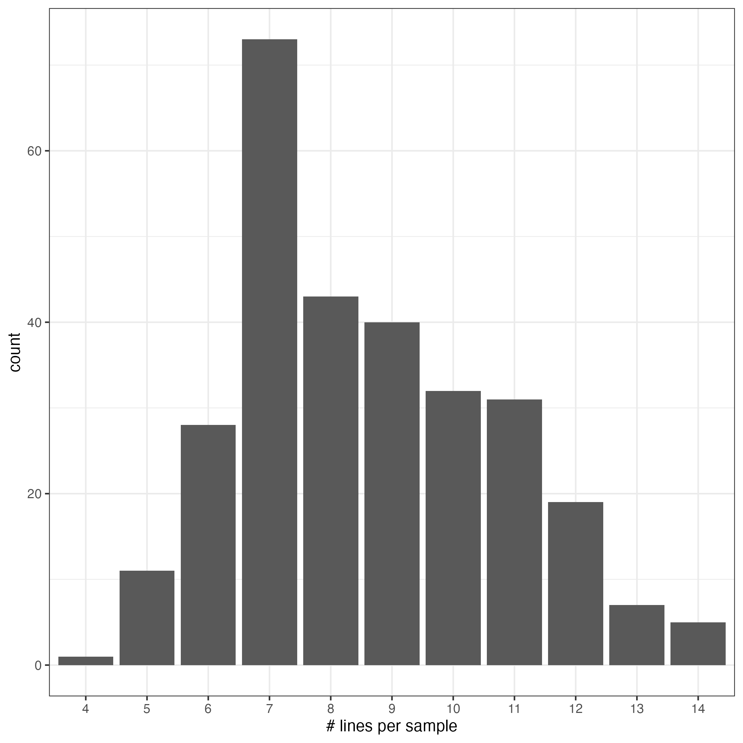
Histogram of # Lines Per Sample in Test Dataset

Slide 4
Experiment Design
n lines compared to a full sample (for n=1, 2,…,14)
For n=1,2,…,14:
Randomly select two samples from each of the 59 writers
Randomly select n lines from the first sample. Sum the cluster fill counts from the lines to make a writer profile from the n-line pseudo-doc
Use the full second sample for comparison
Calculate the SLR
Repeat 20 times for each n

Slide 5
Evaluation
A False Positive occurs when the SLR is greater than 1 for a known non-matching (KNM) pair
A False Negative occurs when the SLR is less than 1 for a known matching (KM) pair
For each number of lines n,
There are 59 x 58 x 20 = 68,440 KNM pairs
The number is 59 x 58 instead of 59 choose 2 because two comparisons are made between each pair of writers. The first comparison uses n lines from the first writer and the full sample from the second writer. The second comparison uses n lines from the second writer and the full sample from the first writer.
There are 59 x 20 = 1,180 KM pairs

Slide 6
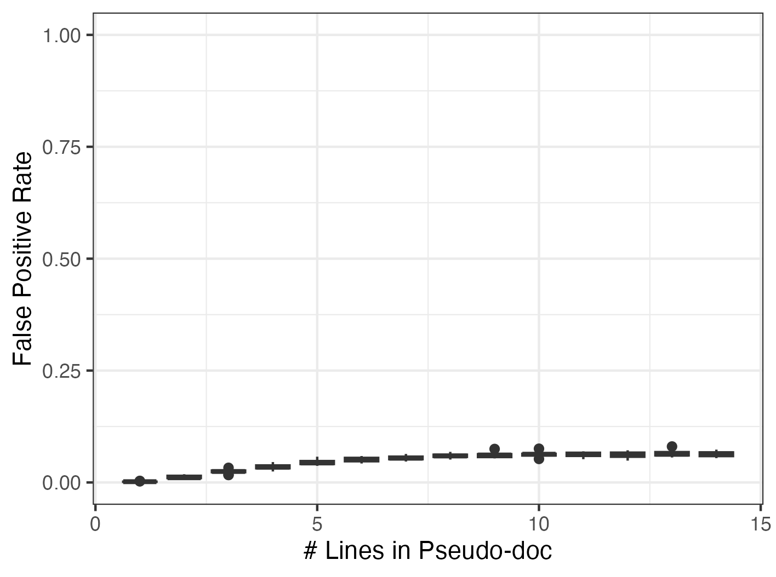
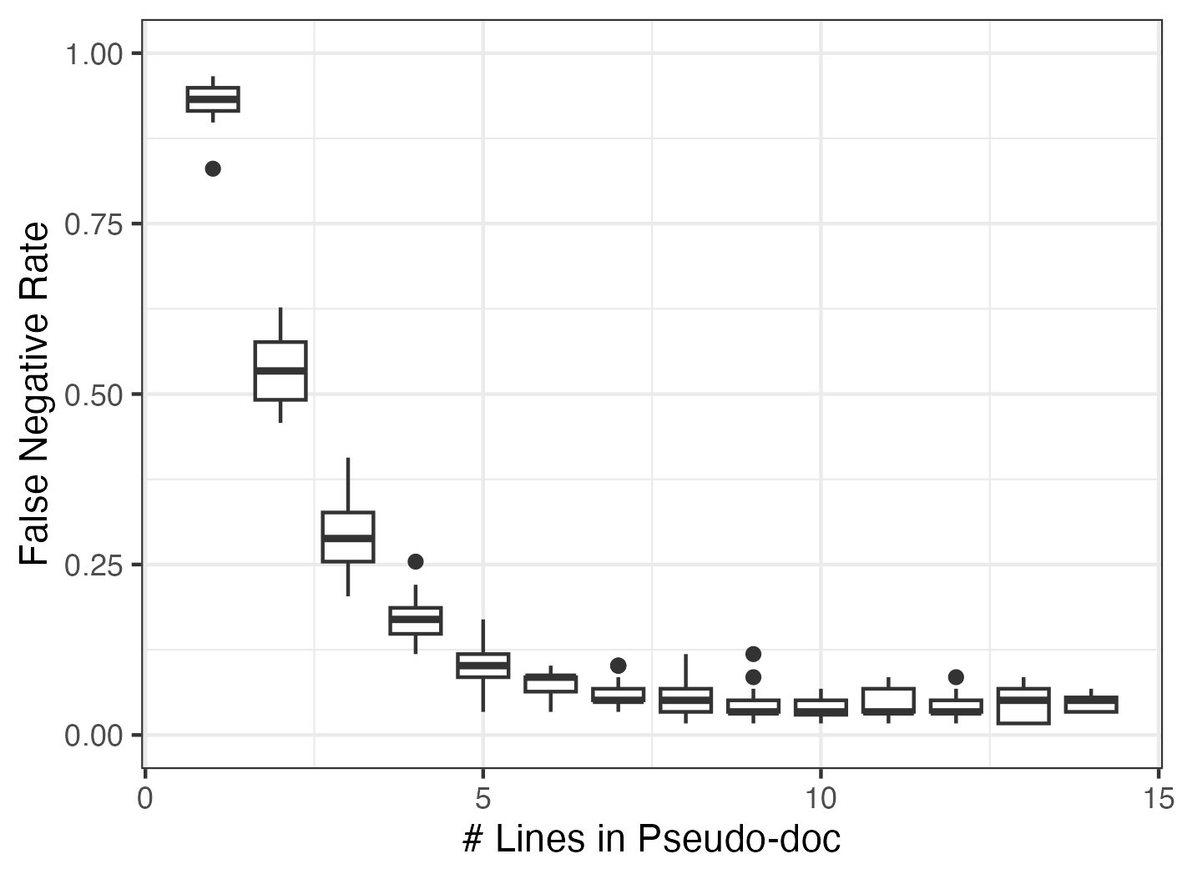
Evaluation
A False Positive occurs when the SLR is greater than 1 for a known non-matching pair
A False Negative occurs when the SLR is less than 1 for a known non-matching pair

