Slide 1


Electronic Imaging 2020
www.forensicstats.org
Score-based likelihood ratios
for camera device identification
Stephanie Reinders, PhD. Candidate, Mathematics Dept, Iowa State University
Li Lin, PhD. Candidate, Mathematics Dept, Iowa State University
Wenhao Chen, PhD. Candidate, Electrical and Computer Engineering Dept, Iowa State University
Dr. Yong Guan, Professor, Electrical and Computer Engineering Dept, Iowa State University
Dr. Jennifer Newman, Associate Professor, Mathematics Dept, Iowa State University

Slide 2
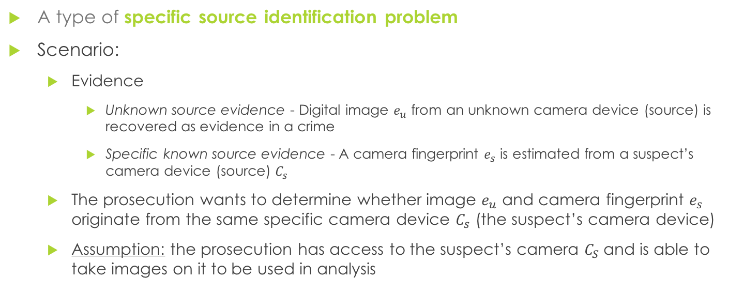
The camera device identification problem
A type of specific source identification problem
Scenario:
Evidence
Unknown source evidence - Digital image $e_{u}$ from an unknown camera device (source) is recovered as evidence in a crime
Specific known source evidence - A camera fingerprint $e_{s}$ is estimated from a suspect’s camera device (source) $C_{s}$
The prosecution wants to determine whether image $e_{u}$ and camera fingerprint $e_{s}$ originate from the same specific camera device $C_{s}$ (the suspect’s camera device)
Assumption: the prosecution has access to the suspect’s camera $C_{S}$and is able to take images on it to be used in analysis

Slide 3
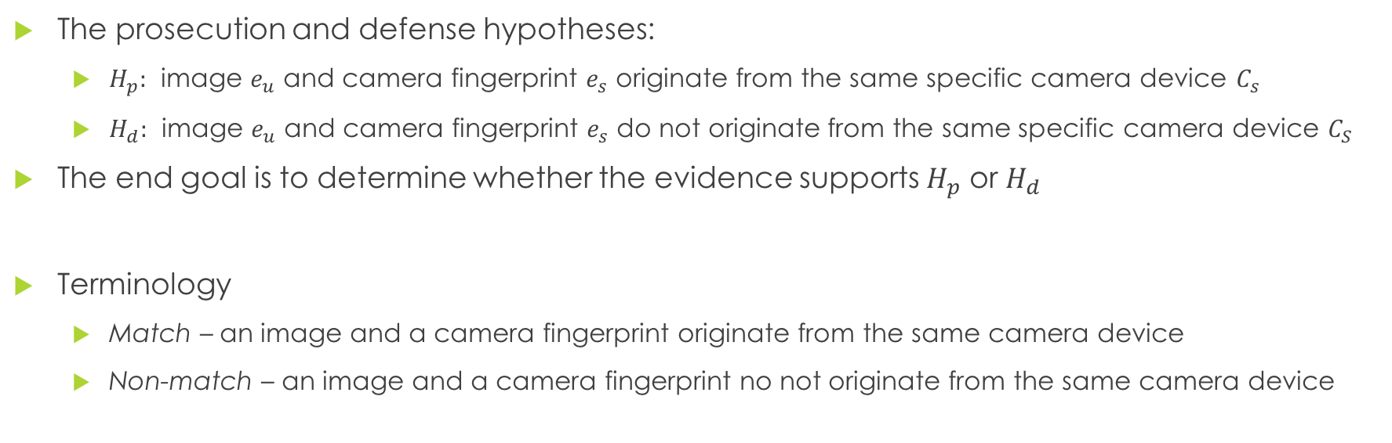
The camera device identification problem
The prosecution and defense hypotheses:
$H_{p}:$ image $e_{u}$ and camera fingerprint $e_{s}$ originate from the same specific camera device $C_{s}$
$H_{d}:$ image $e_{u}$ and camera fingerprint $e_{s}$ do not originate from the same specific camera device $C_{S}$
The end goal is to determine whether the evidence supports $H_{p}$ or $H_{d}$
Terminology
Match – an image and a camera fingerprint originate from the same camera device
Non-match – an image and a camera fingerprint no not originate from the same camera device
Notes:
These are the hypotheses commonly used for SLRs in other forensic areas
Prior work in device identification labels the first hypothesis as H_1 and the second as H_0

Slide 4
Score-based likelihood ratios (SLR)
Quantify the weight of forensic evidence
Describe the strength of evidence in favor of match or non-match, giving stakeholders more information than a binary decision of match or non-match
Implemented in handwriting¹, shoeprint², and glass evidence²
Limited implementation in camera device identifcation^{3,4}

Slide 5
Score-based likelihood ratios v. Likelihood Ratios
Score-based likelihood ratios
Likelihood ratios
Model similarity scores applied to features
Directly model features
SLRs and LRs have different statistical properties!¹

Slide 6
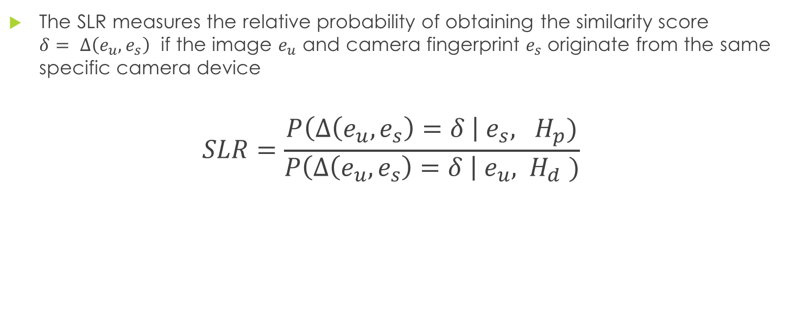
Score-based likelihood ratios (SLR)
The SLR measures the relative probability of obtaining the similarity score $δ= Δ\left(e_{u},e_{s}\right)$ if the image $e_{u}$ and camera fingerprint $e_{s}$ originate from the same specific camera device
$$SLR=\frac{P\left(Δ\left(e_{u},e_{s}\right)=δ \right| e_{s}, H_{p})}{P\left(Δ\left(e_{u}, e_{s}\right)=δ \right| e_{u}, { H}_{d})}$$
there are 3 ways to define this¹

Slide 7
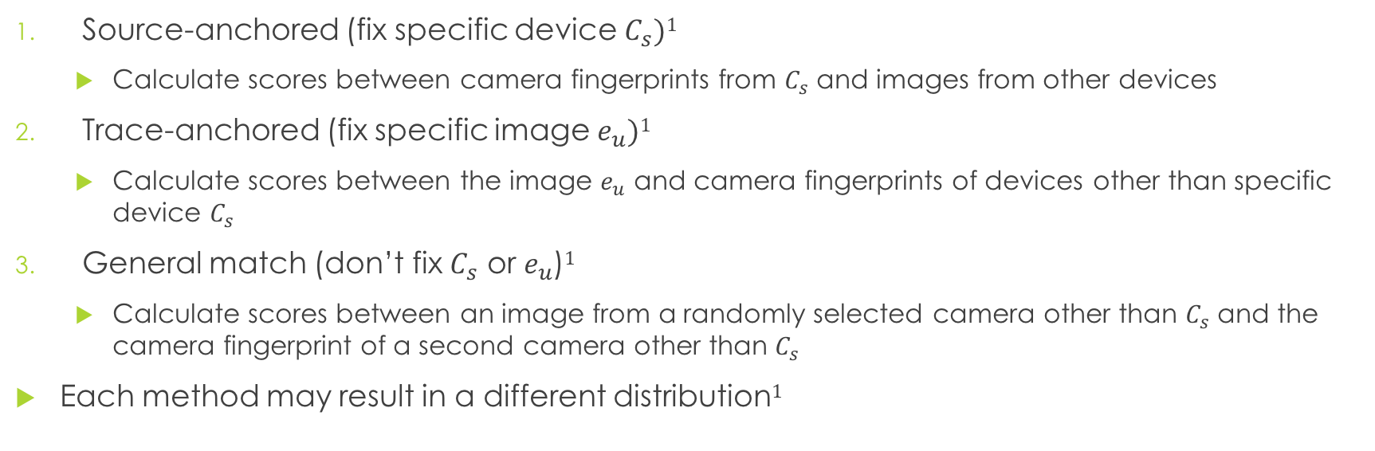
Three methods for defining and calculating non-matches
Source-anchored (fix specific device $C_{s})1$
Calculate scores between camera fingerprints from $C_{s}$ and images from other devices
Trace-anchored (fix specific image $e_{u})1$
Calculate scores between the image $e_{u}$ and camera fingerprints of devices other than specific device $C_{s}$
General match (don’t fix $C_{s}$ or $e_{u}$)$1$
Calculate scores between an image from a randomly selected camera other than $C_{s}$ and the camera fingerprint of a second camera other than $C_{s}$
Each method may result in a different distribution$1$

Slide 8
Definitions of non-matches used in prior device id work
Source-anchored
Trace-anchored
General Match
Lukas, Fridrich, and Goljan 2005
Chen, Fridrich, and Goljan 2007
Chen et. al. 2008
Hu, Yu, and Jian 2009
Nordgaard and Hoglund 2011
van Houten et. al. 2011
Costa et. al. 2012
Goljan and Fridrich 2012
Lukas, Fridrich, and Goljan 2005
Goljan, Fridrich, and Filler 2009

Slide 9
Definitions of non-matches used in prior device id work
Source-anchored
Trace-anchored
General Match
Lukas, Fridrich, and Goljan 2005
Chen, Fridrich, and Goljan 2007
Chen et. al. 2008
Hu, Yu, and Jian 2009
Nordgaard and Hoglund 2011
van Houten et. al. 2011
Costa et. al. 2012
Goljan and Fridrich 2012
Lukas, Fridrich, and Goljan 2005
We use this method
Goljan, Fridrich, and Filler 2009

Slide 10
Prior work with SLRs in device identification
Nordgaard and Höglund¹
Introduced SLRs for camera device identification
Only considered two devices
Only implemented the source-anchored definition of non-matches
van Houten, Alberink and Geradts²
Expanded Nordgaard and Höglund’s results to more devices
Only implemented the source-anchored definition of non-matches
Our research
Current work - Implement trace-anchored SLRs in device id for the first time
Future work – compare results of all three methods in SLRs

Slide 11
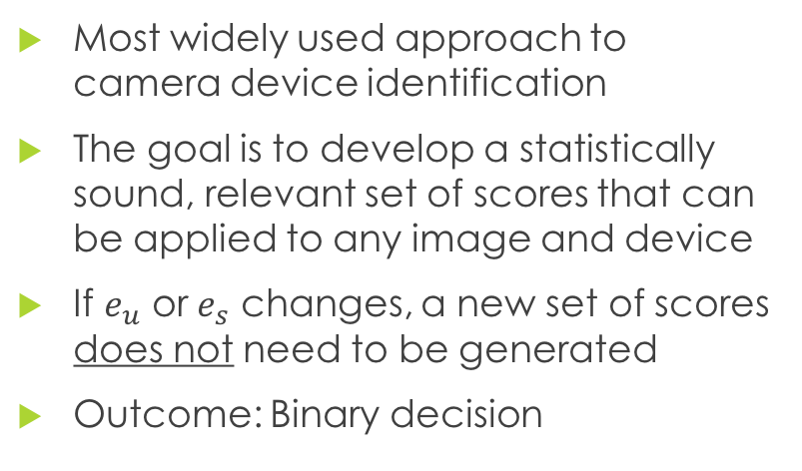
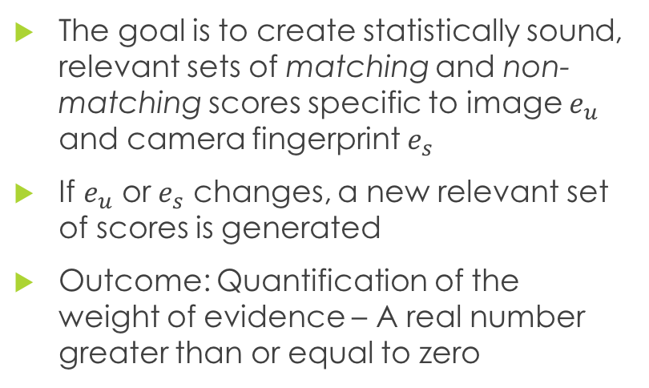
Comparing SLR approach and previous approach to camera device identification
Universal Detector
Score-based likelihood ratios
Most widely used approach to camera device identification
The goal is to develop a statistically sound, relevant set of scores that can be applied to any image and device
If $e_{u}$ or $e_{s}$ changes, a new set of scores does not need to be generated
Outcome: Binary decision
The goal is to create statistically sound, relevant sets of matching and non-matching scores specific to image $e_{u}$ and camera fingerprint $e_{s}$
If $e_{u}$ or $e_{s}$ changes, a new relevant set of scores is generated
Outcome: Quantification of the weight of evidence – A real number greater than or equal to zero

Slide 12
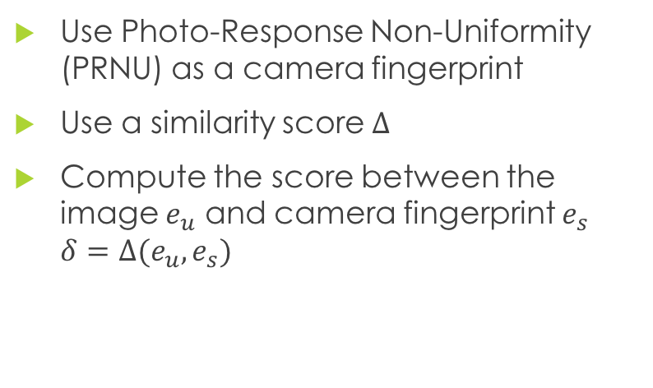
Comparing SLR approach and previous approach to camera device identification
Universal detector
Score-based likelihood ratios
Use Photo-Response Non-Uniformity (PRNU) as a camera fingerprint
Use a similarity score $Δ$
Compute the score between the image $e_{u}$ and camera fingerprint $e_{s}$ $δ=Δ(e_{u},e_{s})$
Use Photo-Response Non-Uniformity (PRNU) as a camera fingerprint
Use a similarity score
Evaluate probability density functions fit to a sets of matching and non-matching scores at Quantify the weight of evidence in favor of a match or non-match

Slide 13
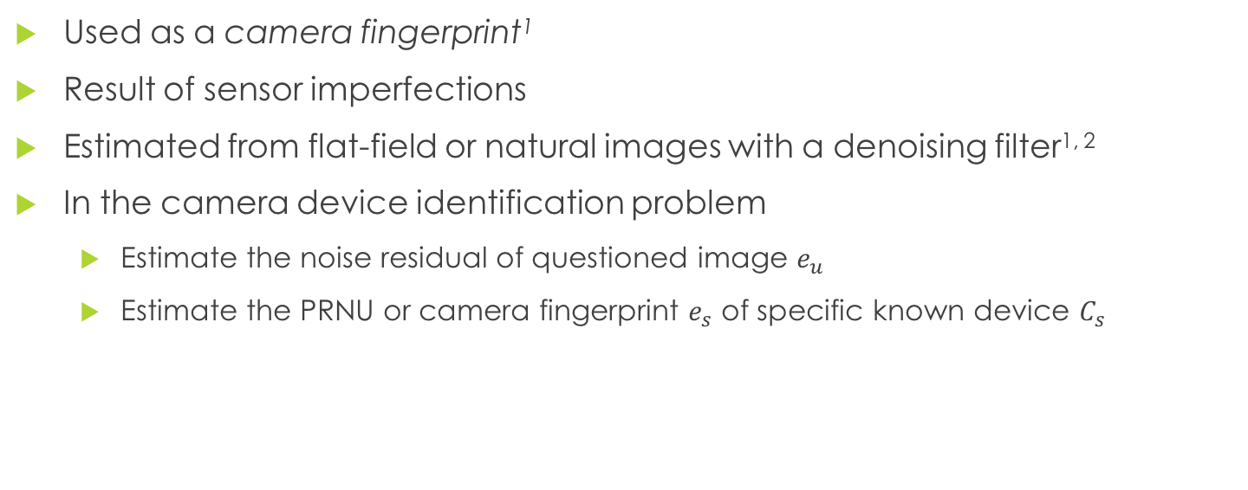
Photo Response Non-Uniformity (PRNU)
Used as a camera fingerprint¹
Result of sensor imperfections
Estimated from flat-field or natural images with a denoising filter^{1, 2}
In the camera device identification problem
Estimate the noise residual of questioned image $e_{u}$
Estimate the PRNU or camera fingerprint $e_{s}$ of specific known device $C_{s}$

Slide 14
Similarity scores
In the universal detector approach
Normalized correlation used in earlier works¹
Peak-to-Correlation Energy (PCE) replaced normalized correlation²
If using PCE, the decision threshold does not need to be adjusted if a periodic component such as linear pattern is present
If using PCE, the decision threshold does not need to be recalculated if the image size changes

Slide 15
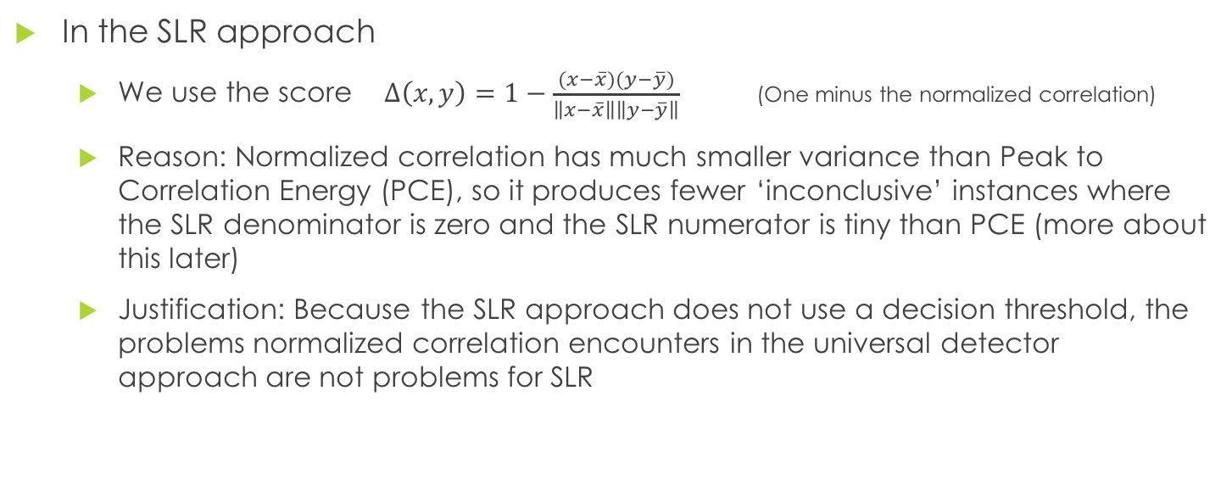
Similarity scores
In the SLR approach
We use the score $Δ\left(x,y\right)=1−\frac{(x−\overline{x})(y−\overline{y})}{\left\|x−\overline{x}\right\|\left\|y−\overline{y}\right\|}$ (One minus the normalized correlation)
Reason: Normalized correlation has much smaller variance than Peak to Correlation Energy (PCE), so it produces fewer ‘inconclusive’ instances where the SLR denominator is zero and the SLR numerator is tiny than PCE (more about this later)
Justification: Because the SLR approach does not use a decision threshold, the problems normalized correlation encounters in the universal detector approach are not problems for SLR

Slide 16
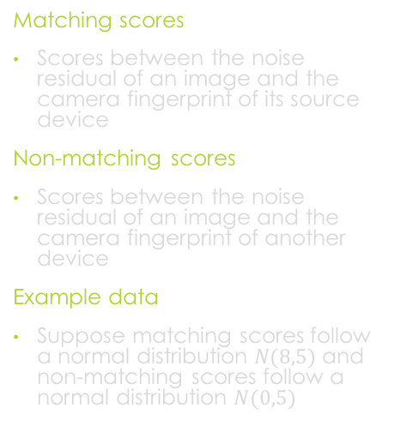
Generate two sets of scores
Histograms of 300 randomly generated matching and non-matching scores
Example using idealized data
Matching scores
Scores between the noise residual of an image and the camera fingerprint of its source device
Non-matching scores
Scores between the noise residual of an image and the camera fingerprint of another device
Example data
Suppose matching scores follow a normal distribution $N(8,5)$ and non-matching scores follow a normal distribution $N(0,5)$

Slide 17
Fit pdfs to both sets of scores
Normal pdfs fit to the matching and non-matching scores
Example
Fit a normal probability density function to each set of scores

Slide 18
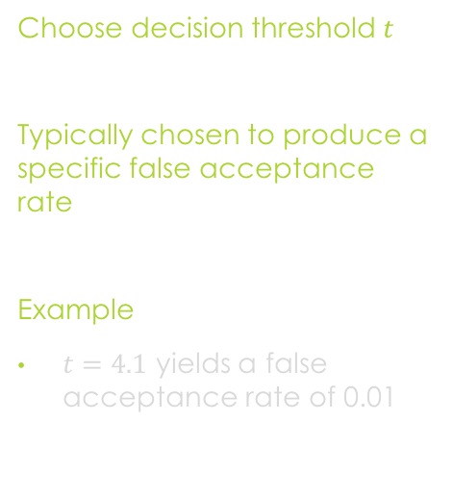
Universal Detector Set Threshold
The decision threshold and normal pdfs fit to the matching and non-matching scores
Choose decision threshold $t$
Typically chosen to produce a specific false acceptance rate
Example
$t=4.1$ yields a false acceptance rate of 0.01

Slide 19
Universal Detector Set Threshold
The decision threshold and normal pdfs fit to the matching and non-matching scores
Choose decision threshold $t$
Typically chosen to produce a specific false acceptance rate
Example
$t=4.1$ yields a false acceptance rate of 0.01

Slide 20
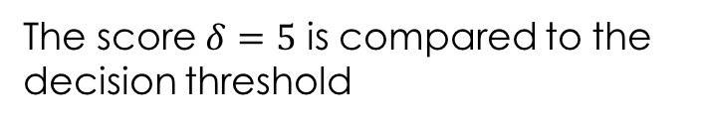
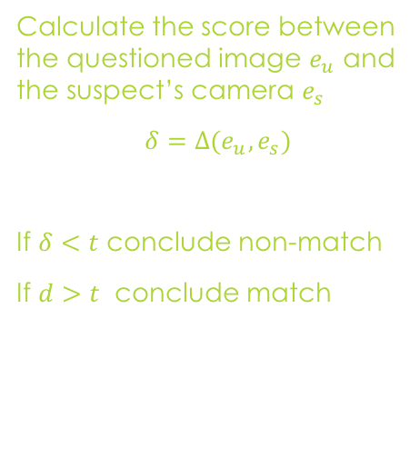
Universal Detector Make decision
The score $δ=5$ is compared to the decision threshold
Calculate the score between the questioned image $e_{u}$ and the suspect’s camera $e_{s}$
$δ=Δ(e_{u},e_{s})$
If $δ<t$ conclude non-match
If $d>t$ conclude match

Slide 21
SLR
Normal pdfs fit to the matching and non-matching scores

Slide 22
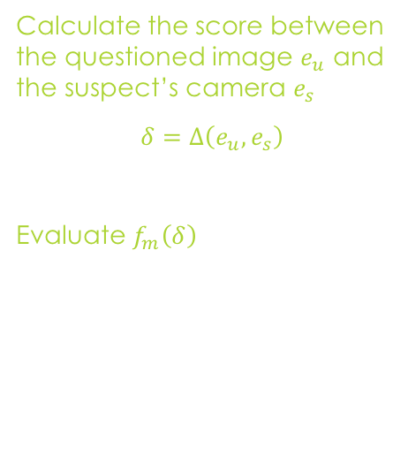

SLR Evaluate pdfs at score $δ$
Normal pdfs fit to the matching and non-matching scores
Calculate the score between the questioned image $e_{u}$ and the suspect’s camera $e_{s}$
$δ=Δ\left(e_{u},e_{s}\right)$
Evaluate $f_{m}\left(δ\right)$

Slide 23
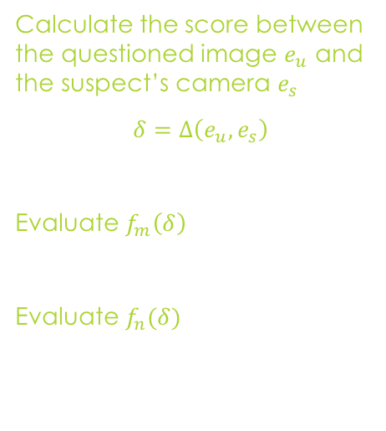
SLR Evaluate pdfs at score $δ$
Normal pdfs fit to the matching and non-matching scores
Calculate the score between the questioned image $e_{u}$ and the suspect’s camera $e_{s}$
$δ=Δ\left(e_{u},e_{s}\right)$
Evaluate $f_{m}\left(δ\right)$
Evaluate $f_{n}(δ)$

Slide 24
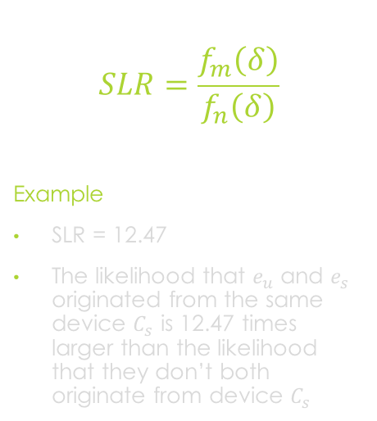
SLR Compute the SLR
Normal pdfs fit to the matching and non-matching scores
$$SLR=\frac{f_{m}\left(δ\right)}{f_{n}\left(δ\right)}$$
Example
SLR = 12.47
The likelihood that $e_{u}$ and $e_{s}$ originated from the same device $C_{s}$ is 12.47 times larger than the likelihood that they don’t both originate from device $C_{s}$

Slide 25
Experiments
10,000 images from BOSSbase image dataset
7 digital still camera devices
The original images were taken in the native camera formats
We processed the images:
Converted images to TIFF in Photoshop
Center-cropped to 512 x 512 and saved as PNG in Matlab
We used the PRNU extraction code created by DDE Labs
http://dde.binghamton.edu/download/camera_fingerprint/
(Thanks DDE labs!)

Slide 26
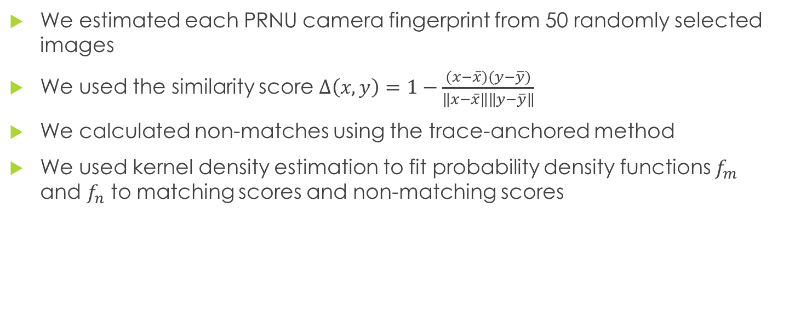
Experiment settings
We estimated each PRNU camera fingerprint from 50 randomly selected images
We used the similarity score $Δ\left(x,y\right)=1−\frac{(x−\overline{x})(y−\overline{y})}{\left\|x−\overline{x}\right\|\left\|y−\overline{y}\right\|}$
We calculated non-matches using the trace-anchored method
We used kernel density estimation to fit probability density functions $f_{m}$ and $f_{n}$ to matching scores and non-matching scores

Slide 27
Assumptions
All images are the same size
Images have not been resized, compressed, or transformed in other ways

Slide 28
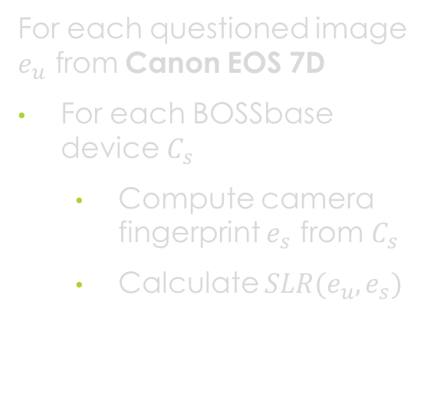
Algorithm
Boxplots of SLR values. Questioned images are from Canon EOS 7D
For each questioned image $e_{u} \text{from}$ Canon EOS 7D
For each BOSSbase device $C_{s}$
Compute camera fingerprint $e_{s}$ from $C_{s}$
Calculate $SLR(e_{u}, e_{s})$

Slide 29
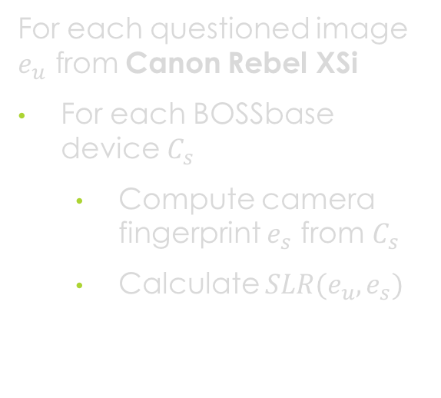
Experiments
Boxplots of SLR values. Questioned images are from Canon Rebel XSi
For each questioned image $e_{u} \text{from}$ Canon Rebel XSi
For each BOSSbase device $C_{s}$
Compute camera fingerprint $e_{s}$ from $C_{s}$
Calculate $SLR(e_{u}, e_{s})$

Slide 30
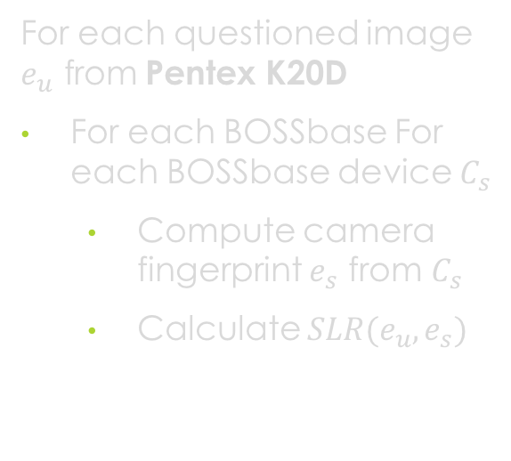
Experiments
Boxplots of SLR values. Questioned images are from Pentex K20D
For each questioned image $e_{u} \text{from}$ Pentex K20D
For each BOSSbase For each BOSSbase device $C_{s}$
Compute camera fingerprint $e_{s}$ from $C_{s}$
Calculate $SLR(e_{u}, e_{s})$

Slide 31
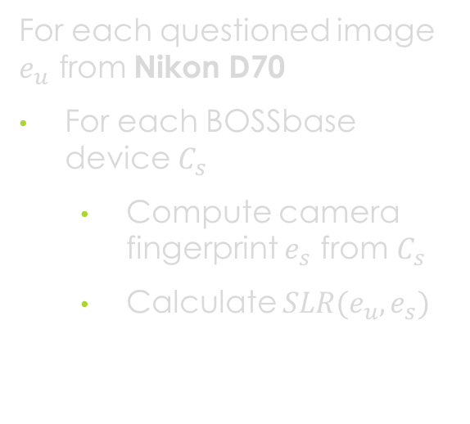
Experiments
Boxplots of SLR values. Questioned images are from Nikon D70
For each questioned image $e_{u} \text{from}$ Nikon D70
For each BOSSbase device $C_{s}$
Compute camera fingerprint $e_{s}$ from $C_{s}$
Calculate $SLR(e_{u}, e_{s})$

Slide 32
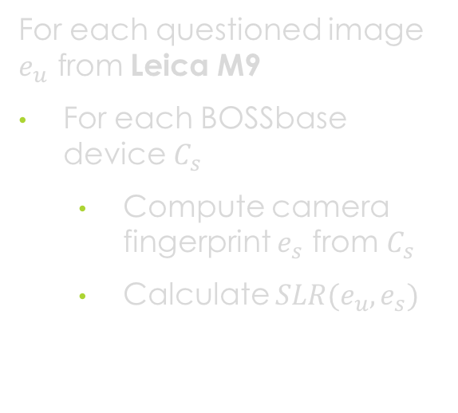
Experiments
Boxplots of SLR values. Questioned images are from Leica M9
For each questioned image $e_{u} \text{from}$ Leica M9
For each BOSSbase device $C_{s}$
Compute camera fingerprint $e_{s}$ from $C_{s}$
Calculate $SLR(e_{u}, e_{s})$

Slide 33
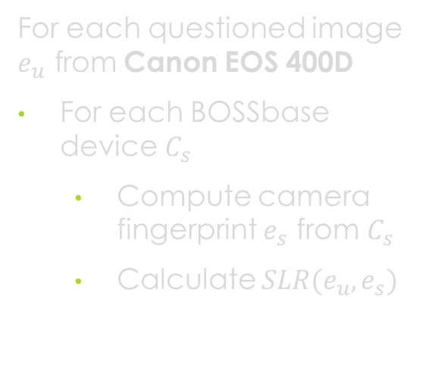
Experiments
Boxplots of SLR values. Questioned images are from Canon EOS 400D
For each questioned image $e_{u} \text{from}$ Canon EOS 400D
For each BOSSbase device $C_{s}$
Compute camera fingerprint $e_{s}$ from $C_{s}$
Calculate $SLR(e_{u}, e_{s})$

Slide 34
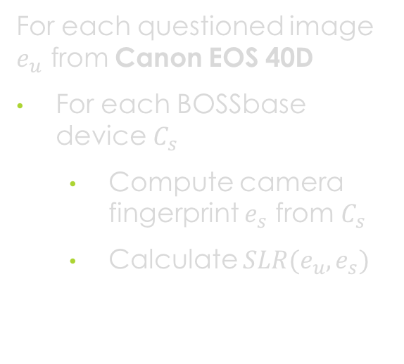
Experiments
Boxplots of SLR values. Questioned images are from Canon EOS 40D
For each questioned image $e_{u} \text{from}$ Canon EOS 40D
For each BOSSbase device $C_{s}$
Compute camera fingerprint $e_{s}$ from $C_{s}$
Calculate $SLR(e_{u}, e_{s})$

Slide 35
Summary and conclusions
SLR provides a quantification of the weight of evidence
SLR correctly returns high values for true matches (an image and the device it came from) for all 7 devices
SLR incorrectly returns high values for images from Canon EOS 400D or Canon EOS 40D when compared to the other device

Slide 36
Future work
Identify the cause of misleading SLR values for the Canon EOS 400D and Canon EOS 40D
Compare source-anchored, trace-anchored and general match SLRs for camera device identification
Extend results to more camera devices using other image datasets
ALASKA
StegoAppDB
Extend results to different sized images and image that have been resized or compressed

Slide 37
Acknowledgements
This work was partially funded by the Center for Statistics and Applications in Forensic Evidence (CSAFE) through Cooperative Agreement #70NANB15H176 between NIST and Iowa State University, which includes activities carried out at Carnegie Mellon University, University of California Irvine, and University of Virginia.

Slide 38

Maximum SLR
We calculated the SLR for questioned image $e_{u}$ and each specific device $e_{s}$
Each image $e_{u}$ has 7 SLR values, one for each device
For each image $e_{u}$ we find the device $e_{s}$ that produces the maximum SLR for $e_{u}$

Slide 39
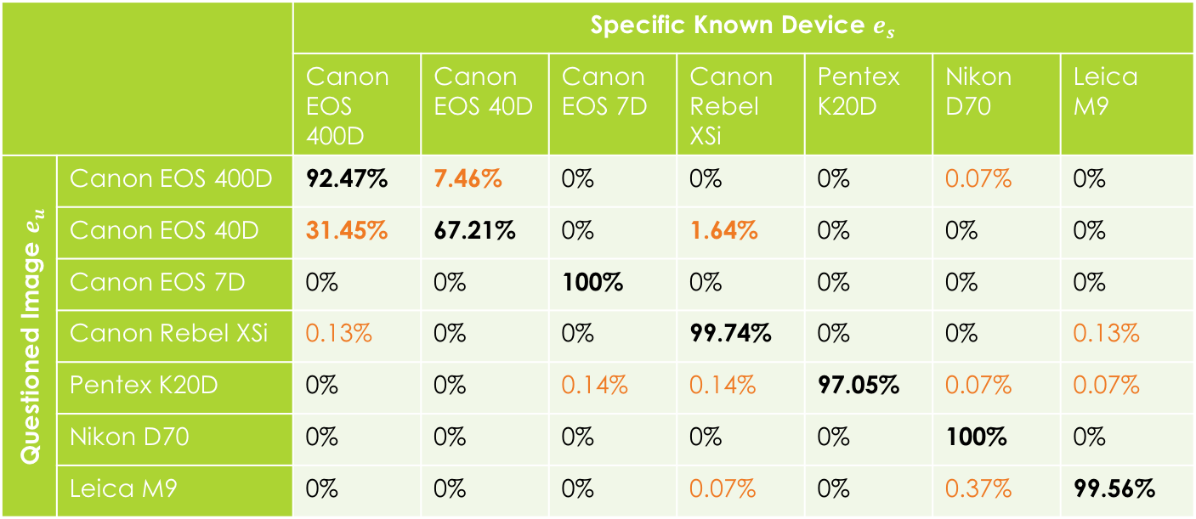
Maximum SLR
 |  | Specific Known Device $e_{s}$
 |  | Canon EOS 400D | Canon EOS 40D | Canon EOS 7D | Canon Rebel XSi | Pentex K20D | Nikon D70 | Leica M9
Questioned Image $e_{u}$ | Canon EOS 400D | 92.47% | 7.46% | 0% | 0% | 0% | 0.07% | 0%
 | Canon EOS 40D | 31.45% | 67.21% | 0% | 1.64% | 0% | 0% | 0%
 | Canon EOS 7D | 0% | 0% | 100% | 0% | 0% | 0% | 0%
 | Canon Rebel XSi | 0.13% | 0% | 0% | 99.74% | 0% | 0% | 0.13%
 | Pentex K20D | 0% | 0% | 0.14% | 0.14% | 97.05% | 0.07% | 0.07%
 | Nikon D70 | 0% | 0% | 0% | 0% | 0% | 100% | 0%
 | Leica M9 | 0% | 0% | 0% | 0.07% | 0% | 0.37% | 99.56%
For 92.47% of the images from Canon EOS 400D, the highest SLR value occurred when Canon EOS 400D was set as the specific known device

