Slide 1
Double dot, more sims, more options ☺
Stephan

Slide 2
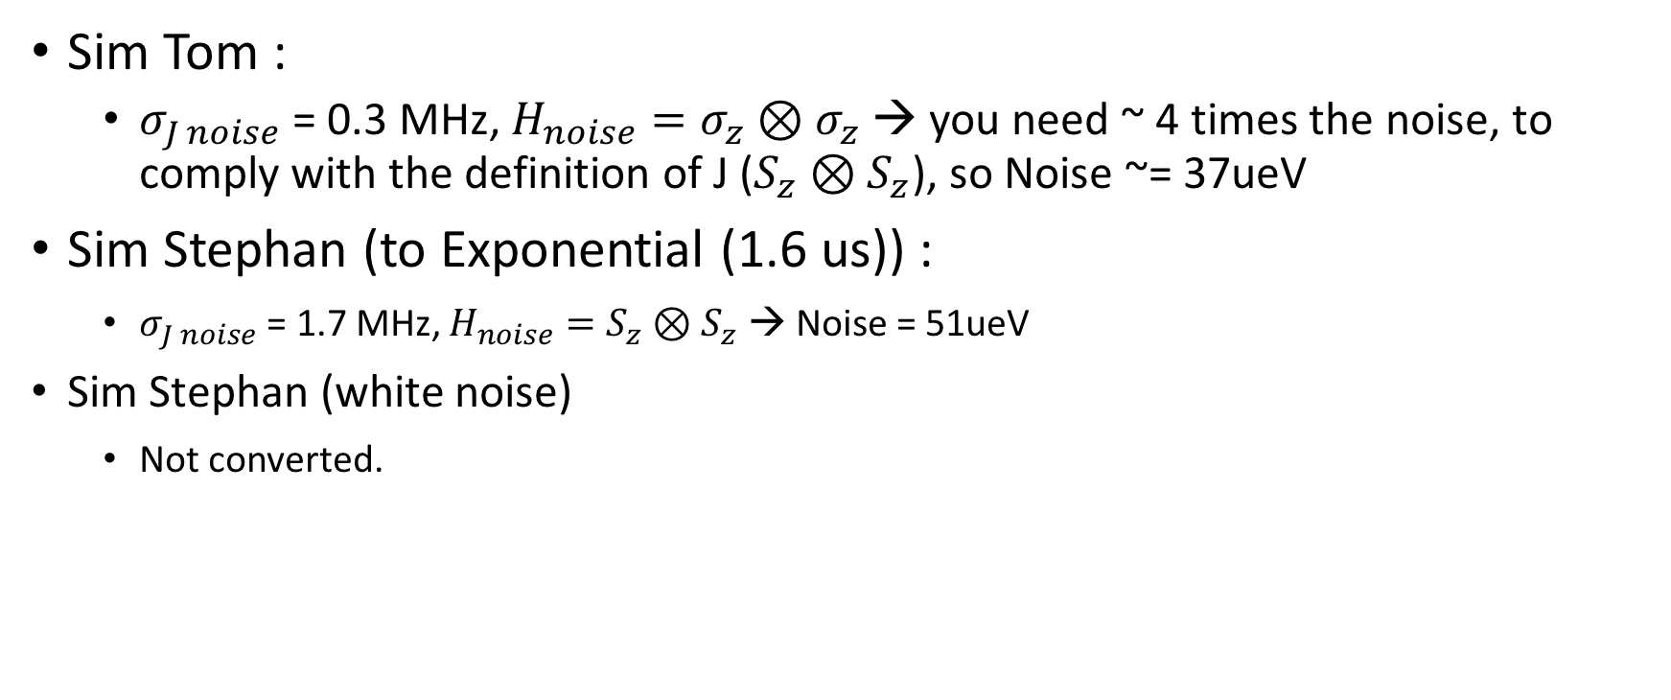
Values
Q -> T2* Gaussian / exp. fit?
dJ/deps = 33 Mhz/mev
Sim Tom :
$σ_{J noise}$ = 0.3 MHz, $H_{noise}=σ_{z}⊗σ_{z}$ → you need ~ 4 times the noise, to comply with the definition of J ($S_{z}⊗S_{z}$), so Noise ~= 37ueV
Sim Stephan (to Exponential (1.6 us)) :
$σ_{J noise}$ = 1.7 MHz, $H_{noise}=S_{z}⊗S_{z}$ → Noise = 51ueV
Sim Stephan (white noise)
Not converted.

Slide 3
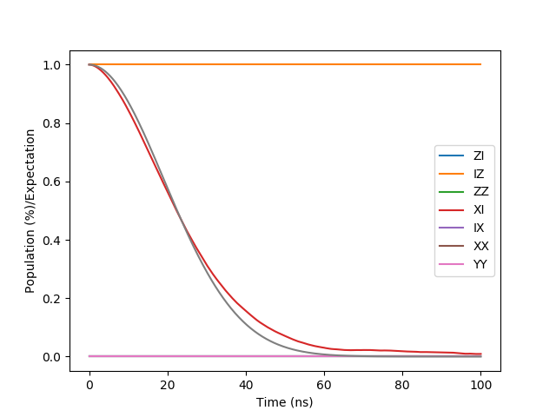
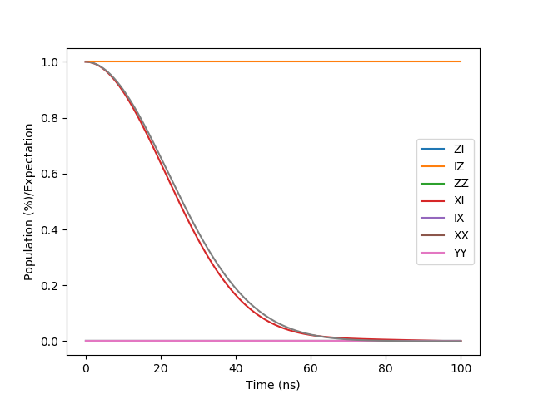
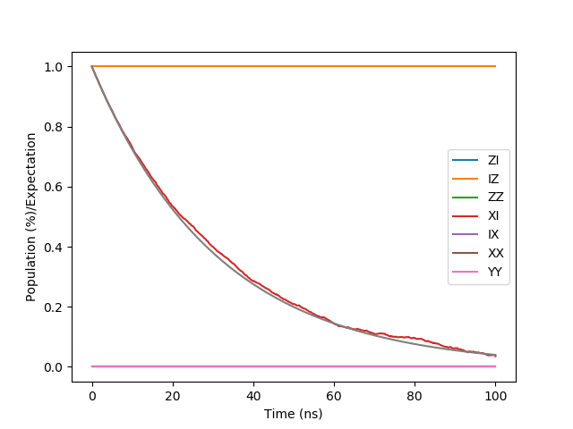
Profile decays
1/f
Gaussian fit
Exponential fit
Static Gaussian
White noise

Slide 4
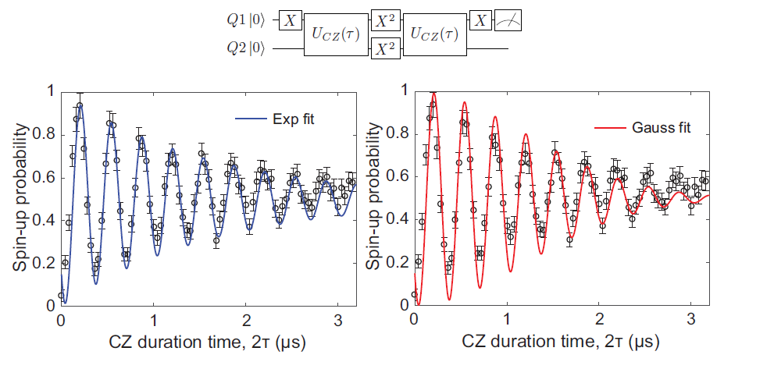
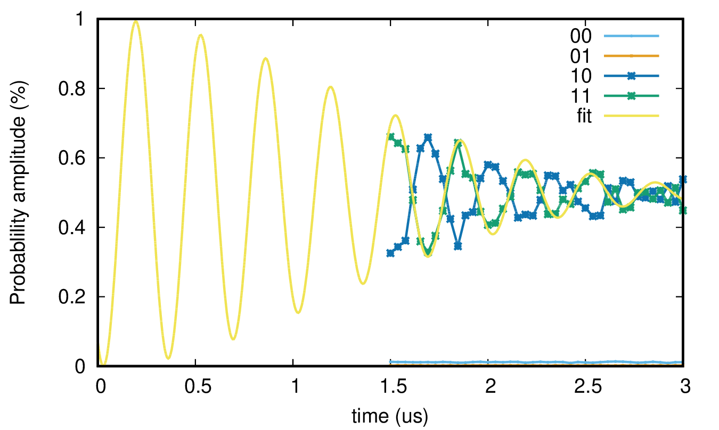
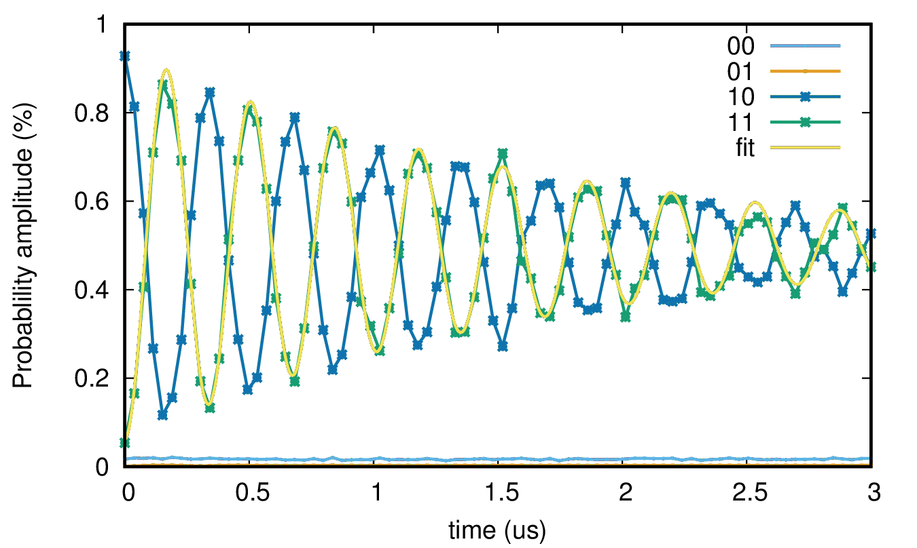
CPhase Oscillations (decoupled)
~ 1.6 us
~ 1.6 us
EXPERIMENT
SIMULATION
Static Gaussian
White noise
~ 1.6 us
~ 1.6 us
(Gaussian fit)
(Exp fit)

Slide 5
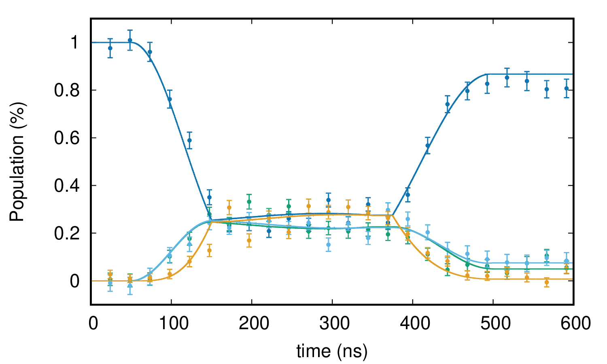
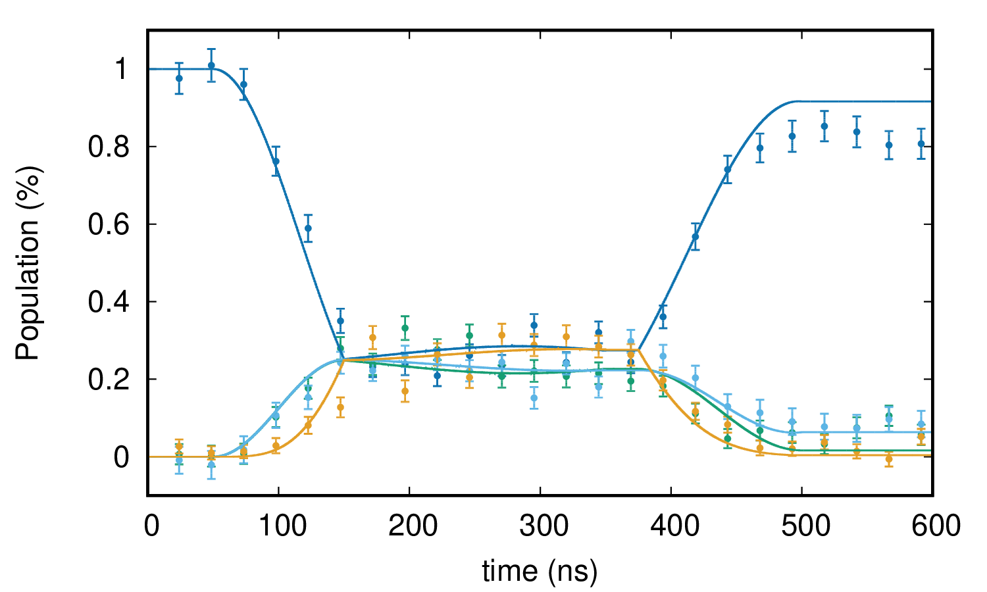
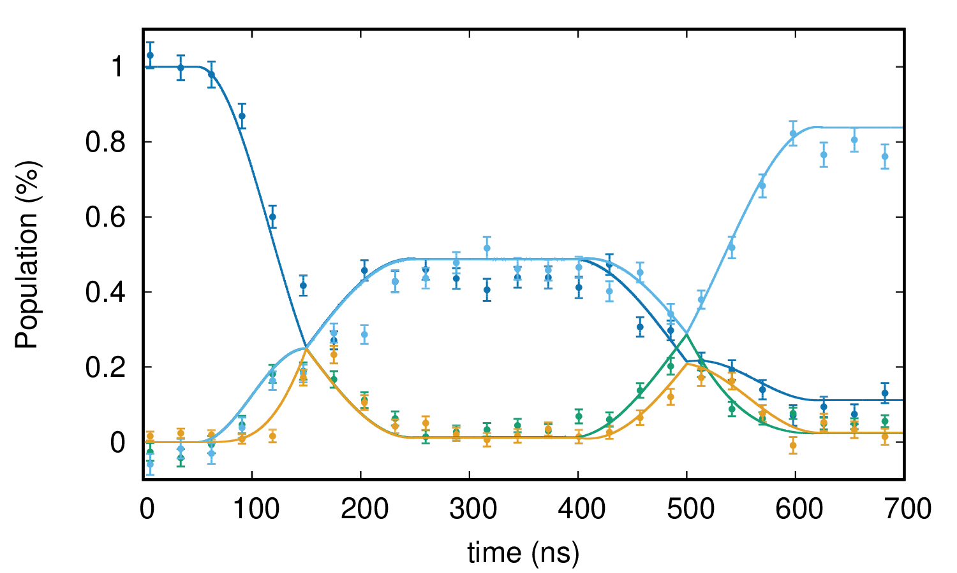
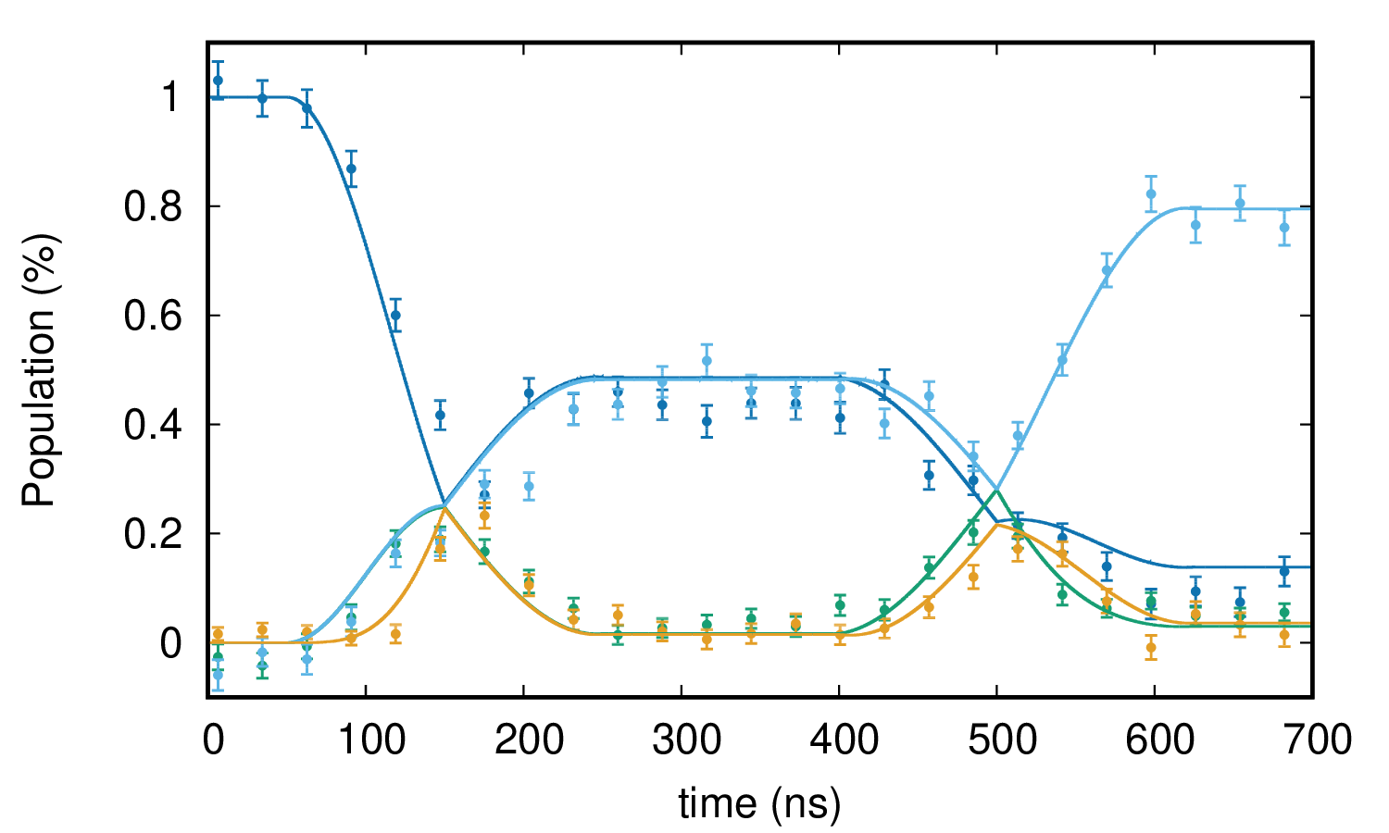
DJ Normal
White noise
Static Gaussian

Slide 6
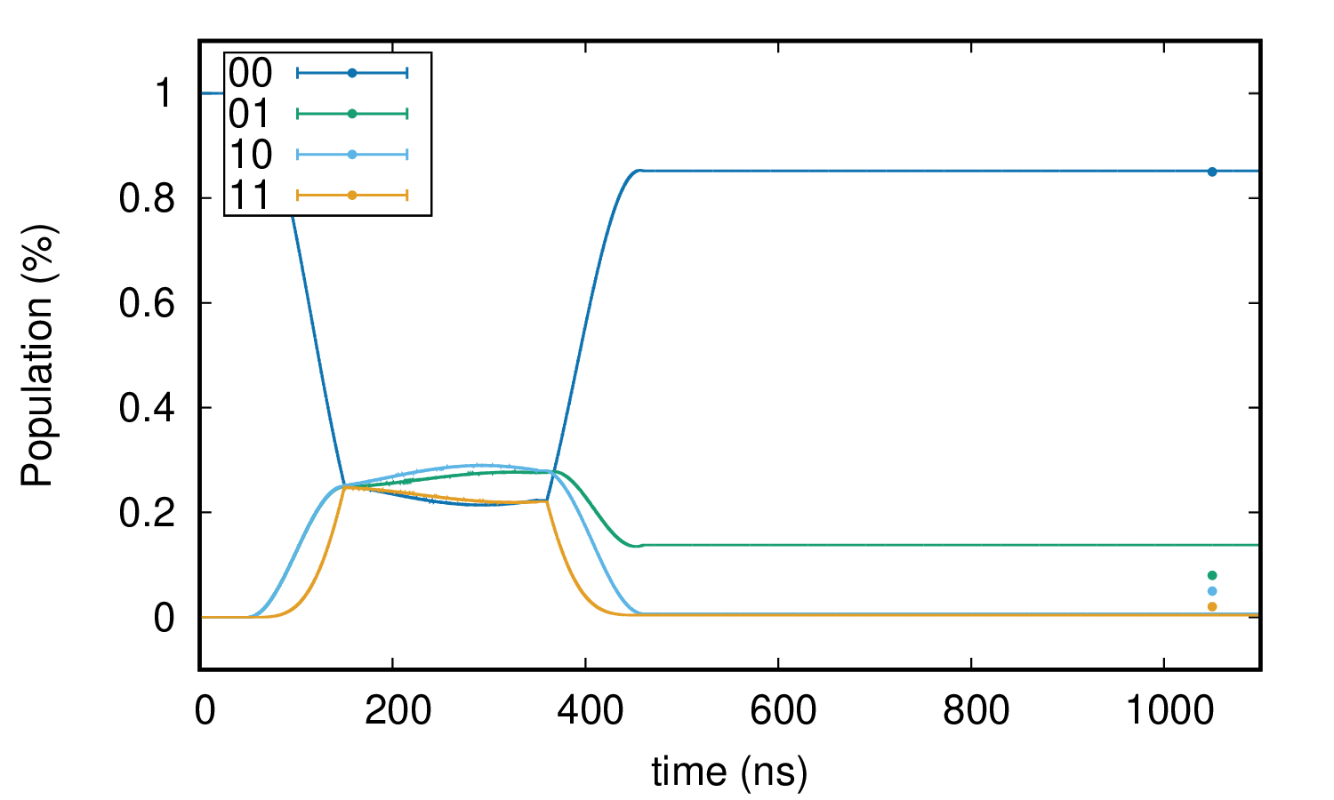
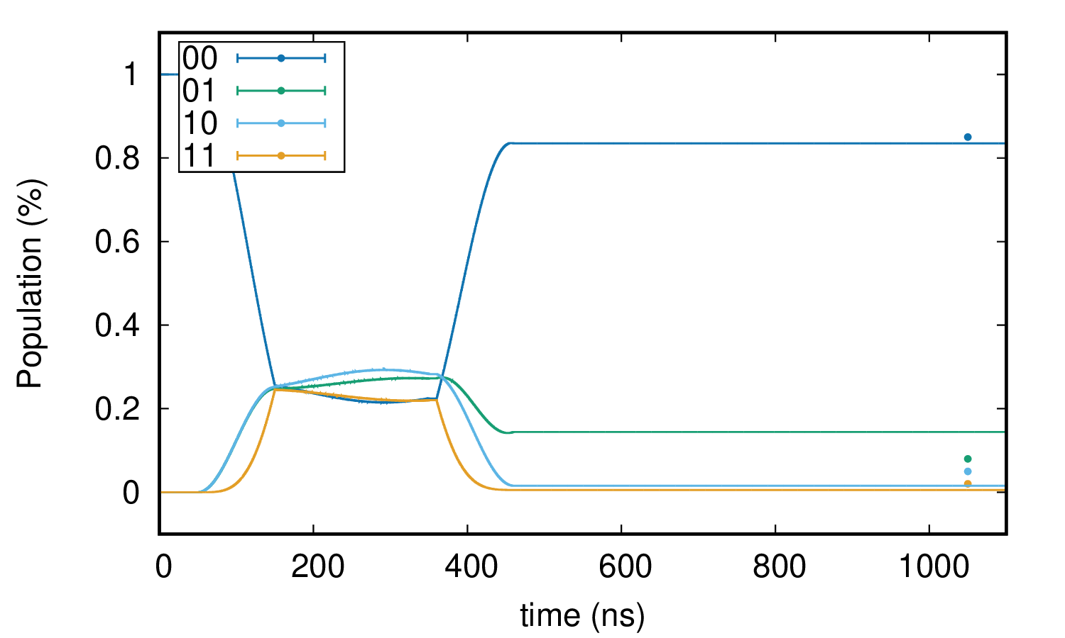
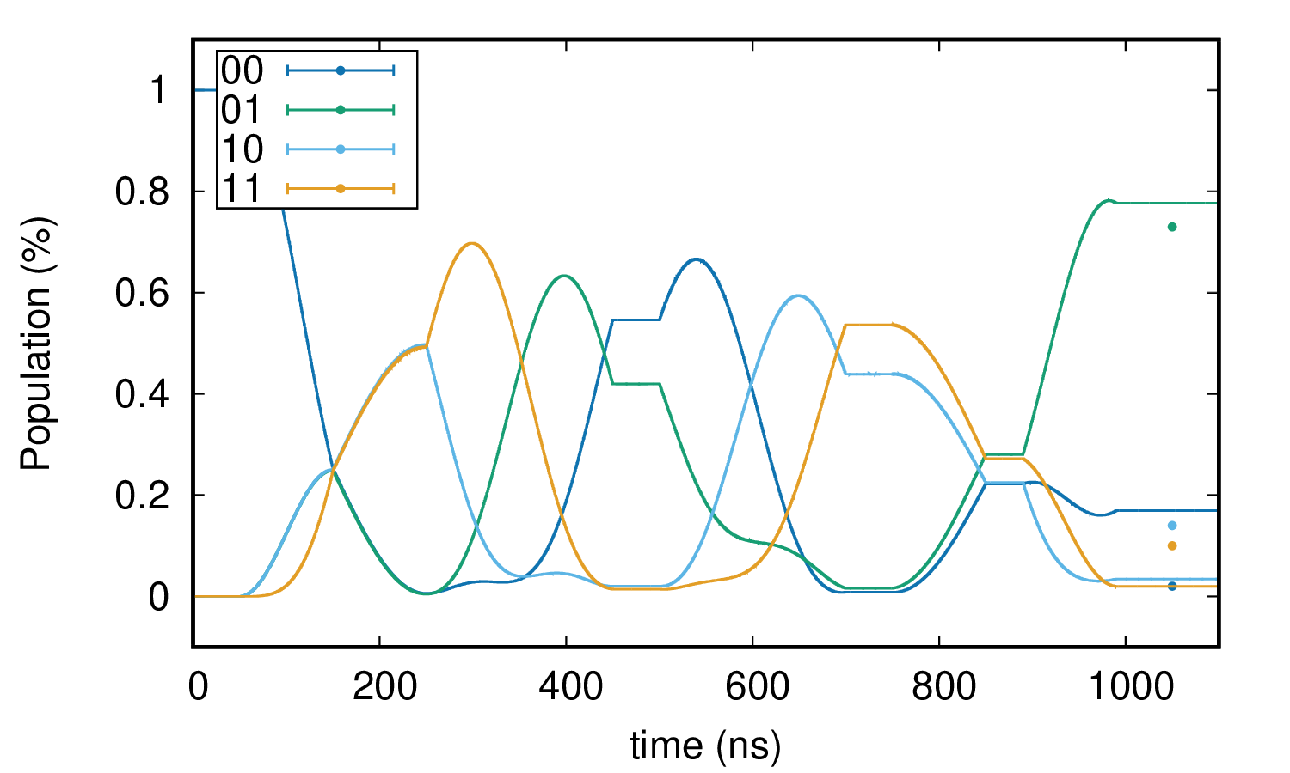
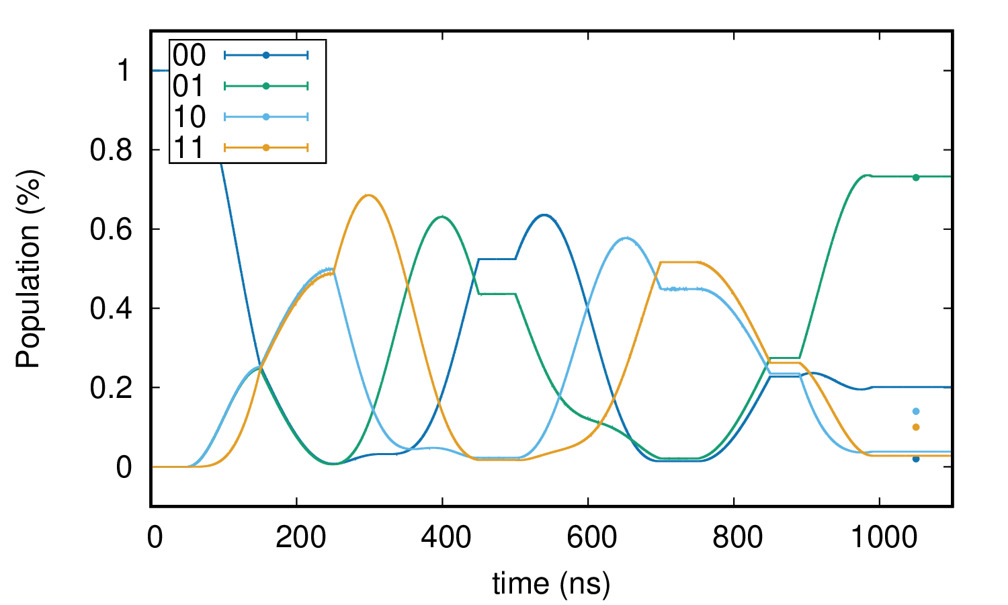
DJ DEC
White noise

Slide 7
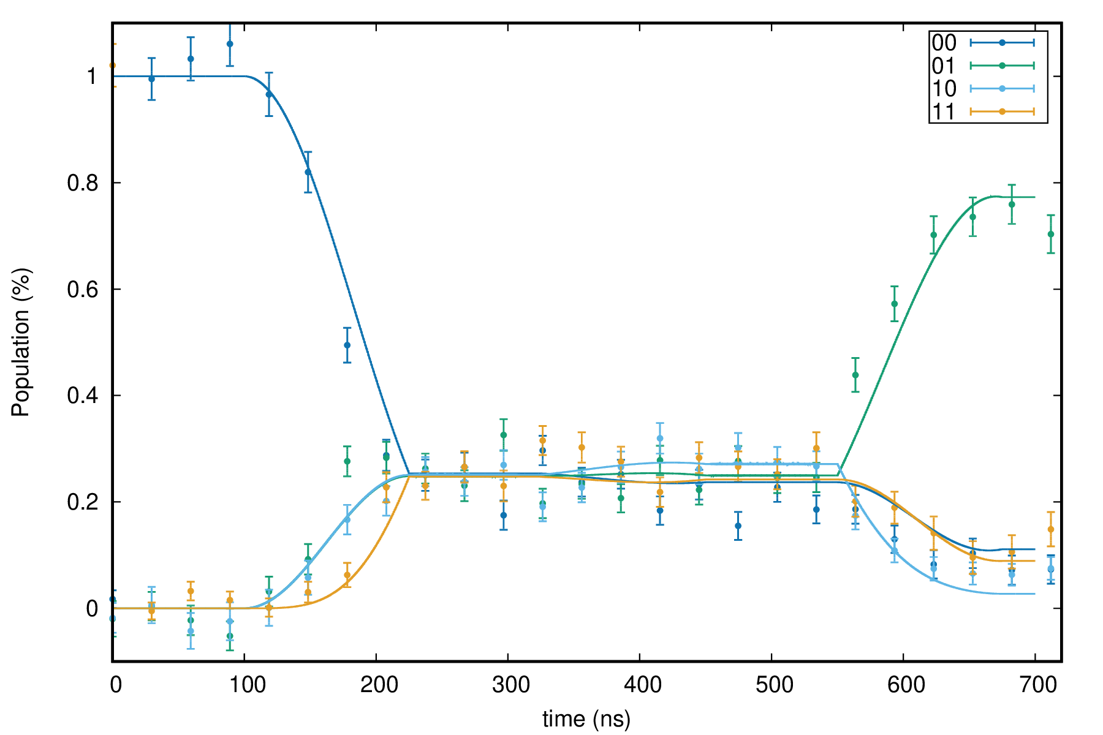
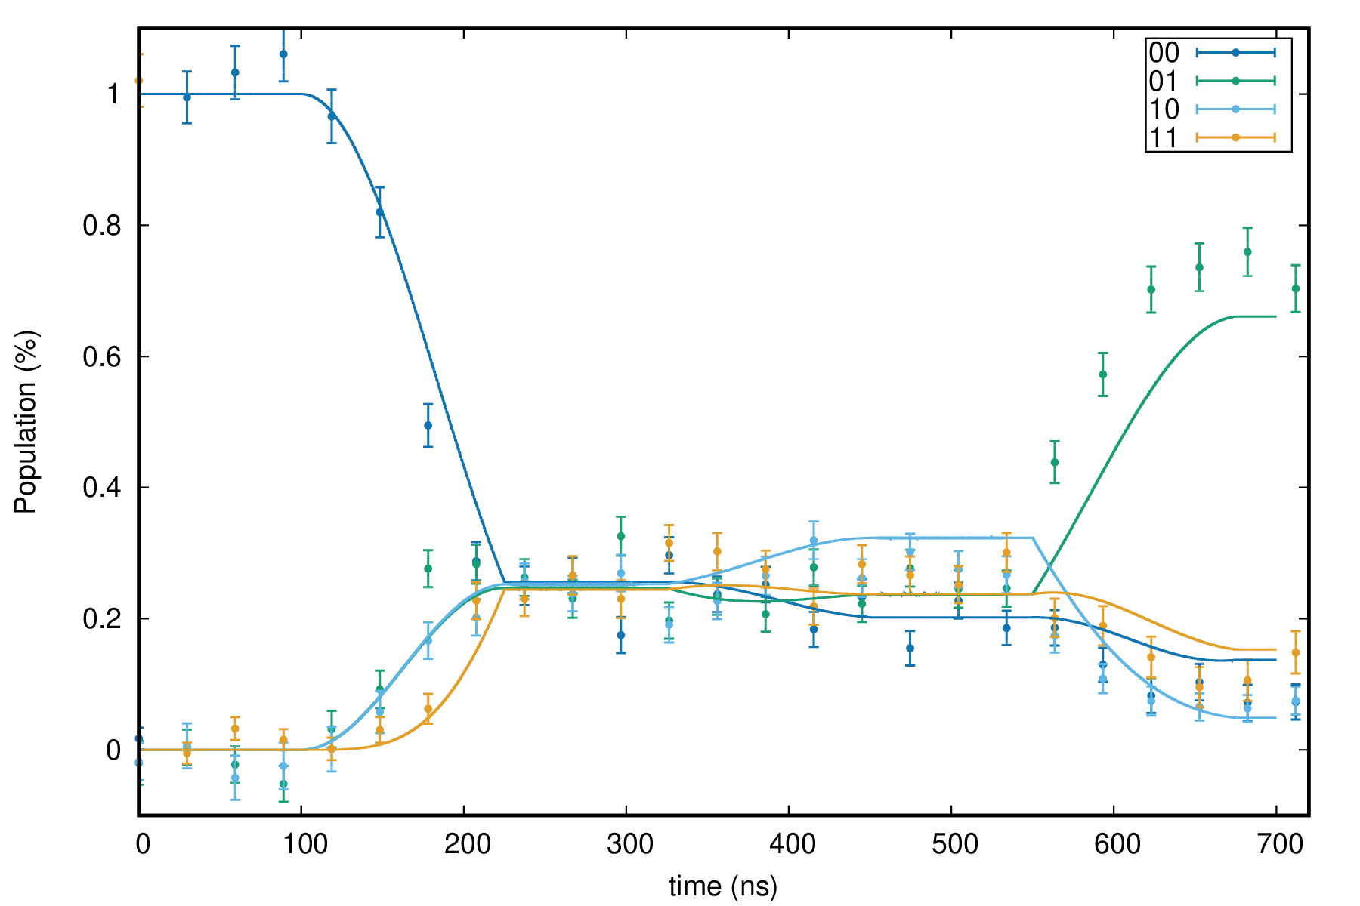
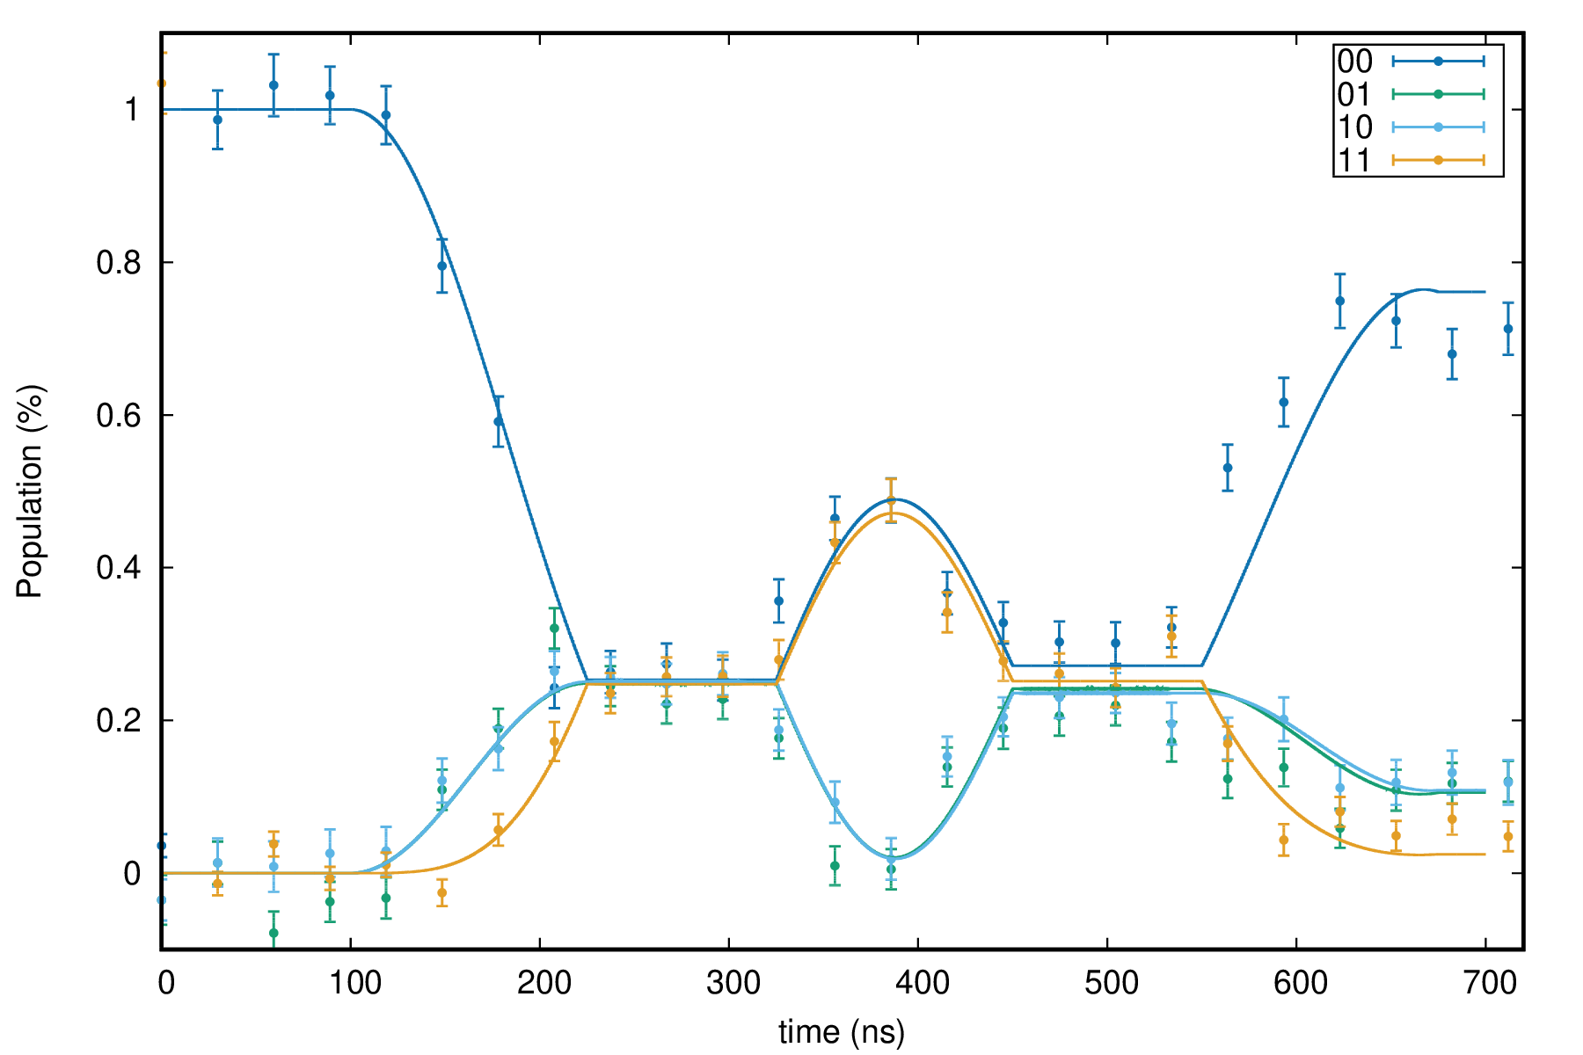
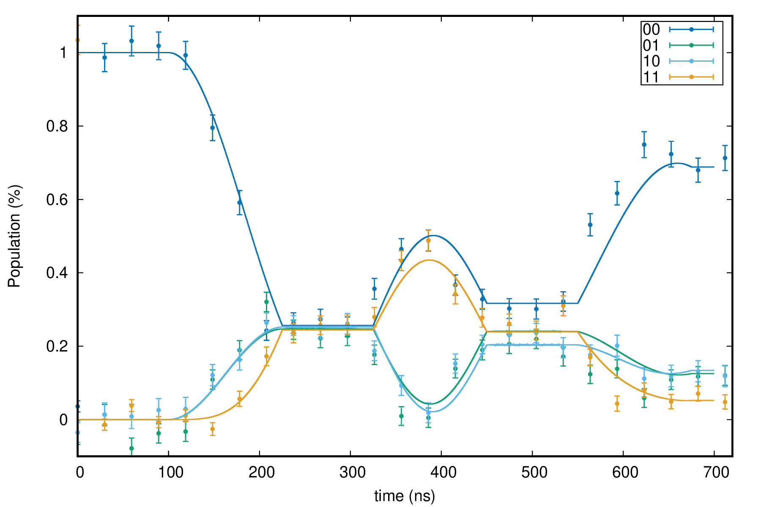
Grovers Normal
White noise

Slide 8
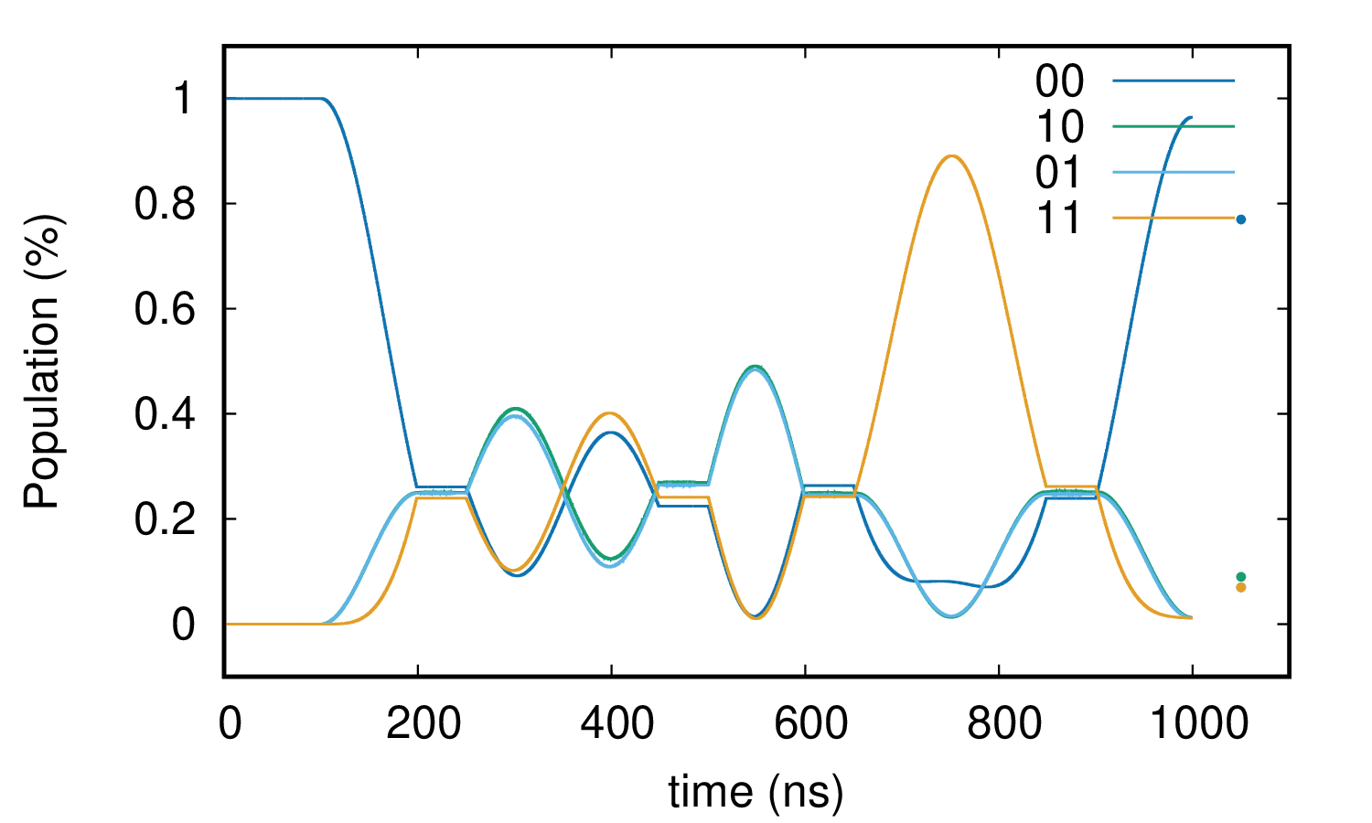
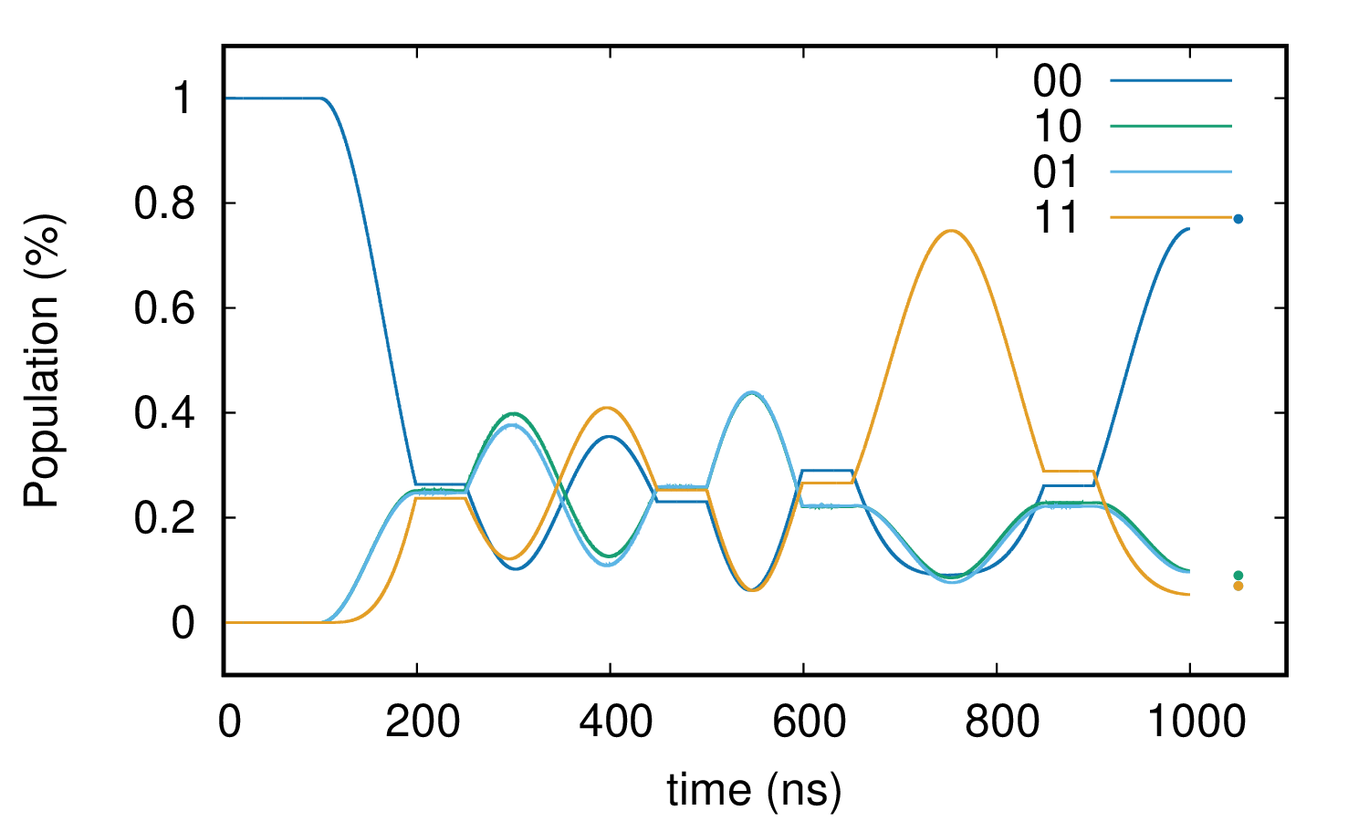
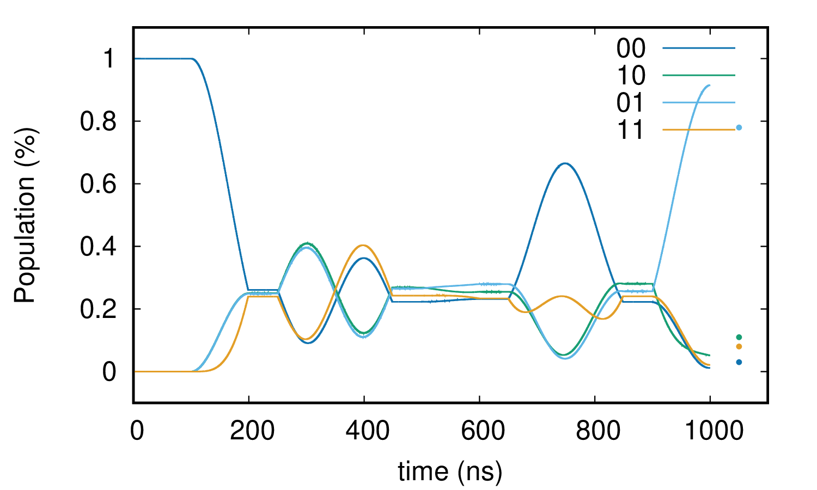
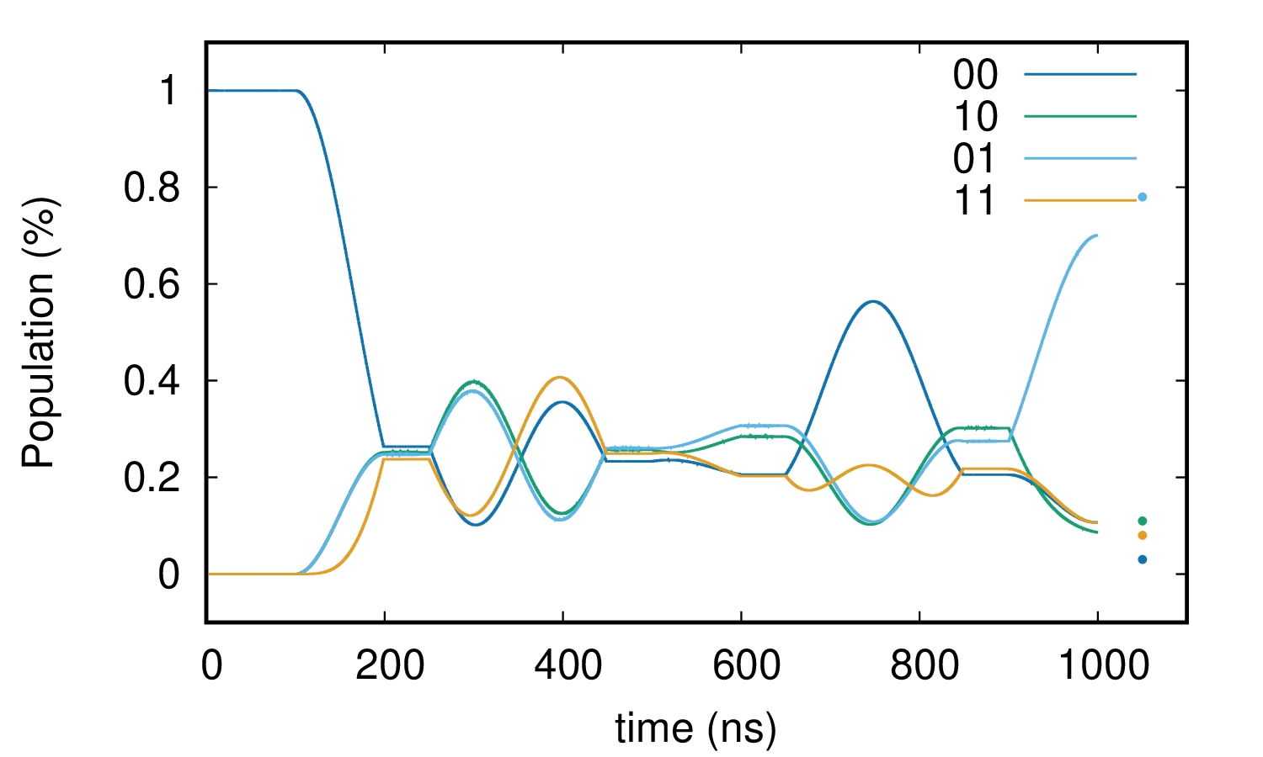
Grovers Dec
White noise

Slide 9
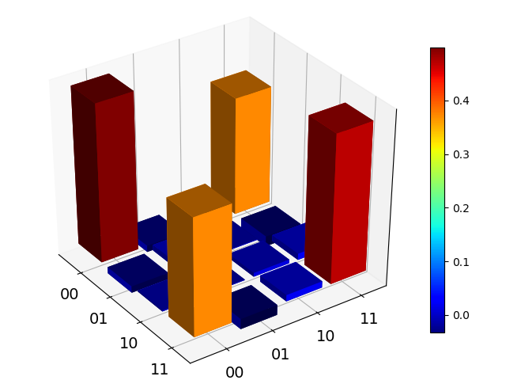
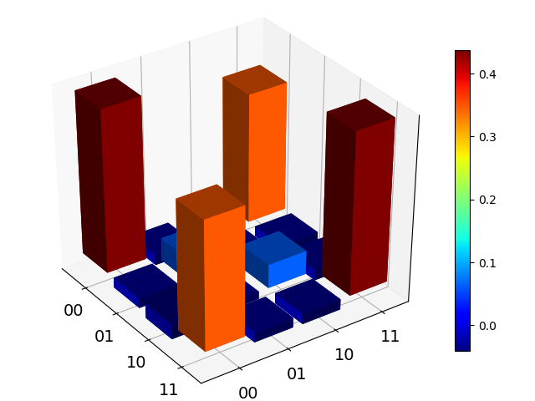
Bell states (00 +11 example)
WHITE
F = 85 %
C = 73 %
F = 75 %
C = 60 %

Slide 10
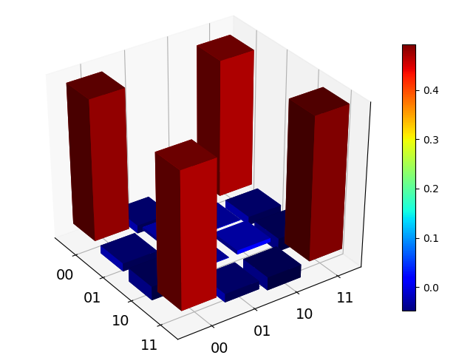
Bell states (00 +11 example)
Static Gaussian
F = 85 %
C = 73 %
F = 95,7
C = 92,3

Slide 11
Conclusion
~ ½ thermal noise + ½ 1/f noise (~ static Gaussian)?
Conversion to sigma?
Seems to more accurately describe the
decoupling we see experimentally (but too much)
Also too much for Bell states

Slide 12
Other stuff
V2 coax upgrade?
Veldhoven -> Ok?
Tijdelijk werken op GaAs samples (AM helpen)
Theorie samenwerking voor MW pulses -> Slava

