Slide 1
Double dot, more sims, more options ☺
Stephan

Slide 2
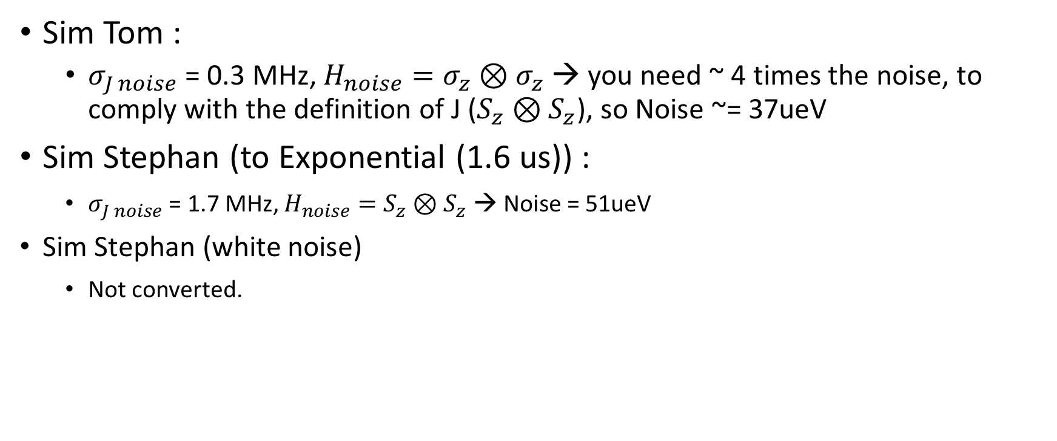
Values
Q -> T2* Gaussian / exp. fit?
Sim Tom :
$σ_{J noise}$ = 0.3 MHz, $H_{noise}=σ_{z}⊗σ_{z}$ → you need ~ 4 times the noise, to comply with the definition of J ($S_{z}⊗S_{z}$), so Noise ~= 37ueV
Sim Stephan (to Exponential (1.6 us)) :
$σ_{J noise}$ = 1.7 MHz, $H_{noise}=S_{z}⊗S_{z}$ → Noise = 51ueV
Sim Stephan (white noise)
Not converted.

Slide 3
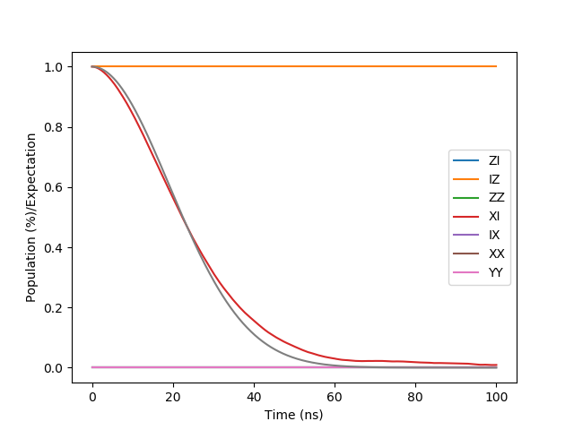
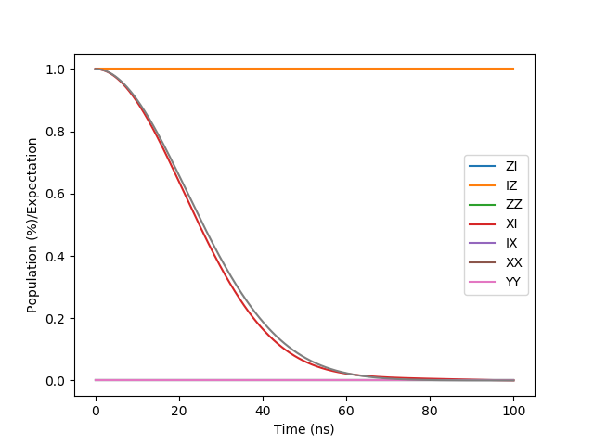
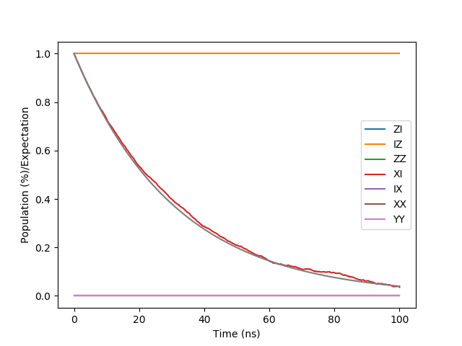
Profile decays
1/f
Gaussian fit
Exponential fit
Static Gaussian
White noise

Slide 4
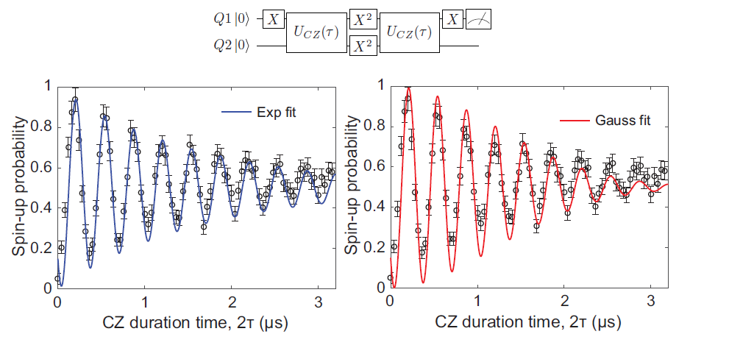
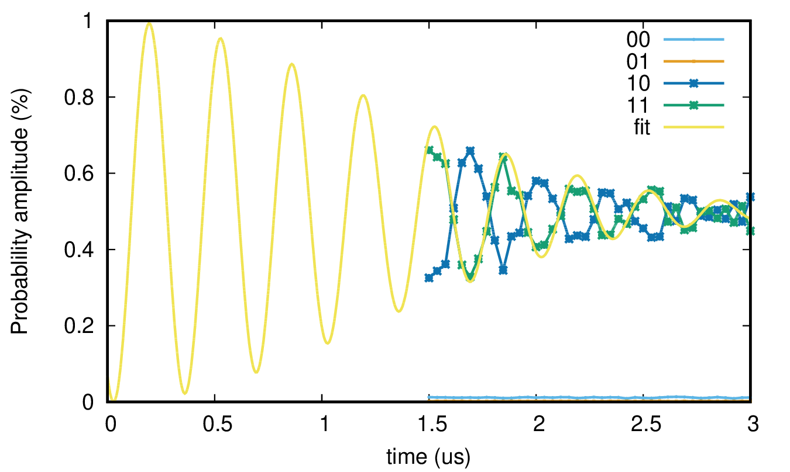
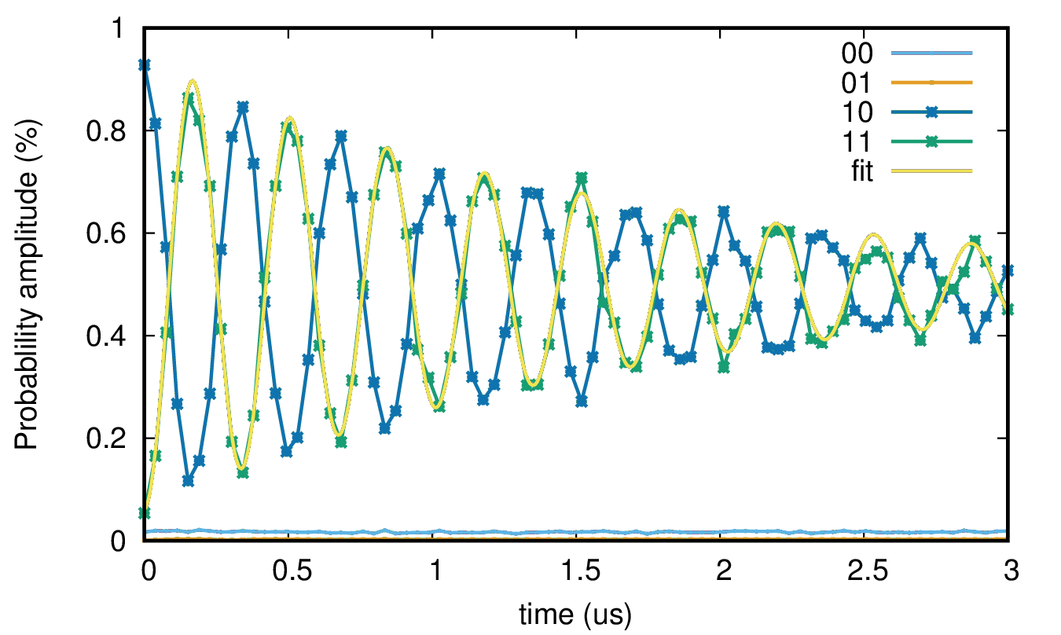
CPhase Oscillations (decoupled)
~ 1.6 us
~ 1.6 us
EXPERIMENT
SIMULATION
Static Gaussian
White noise
~ 1.6 us
~ 1.6 us
(Gaussian fit)
(Exp fit)

Slide 5
DJ Normal
White noise
Static Gaussian (1.2 us)

Slide 6
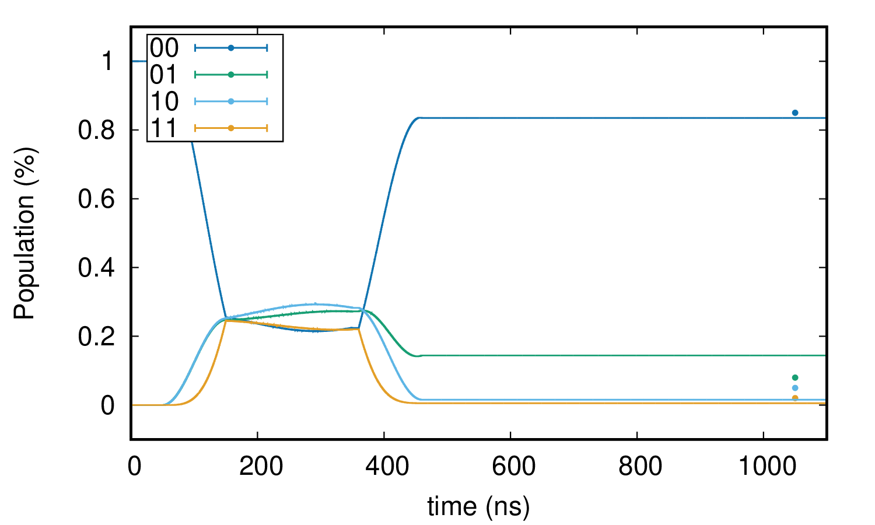
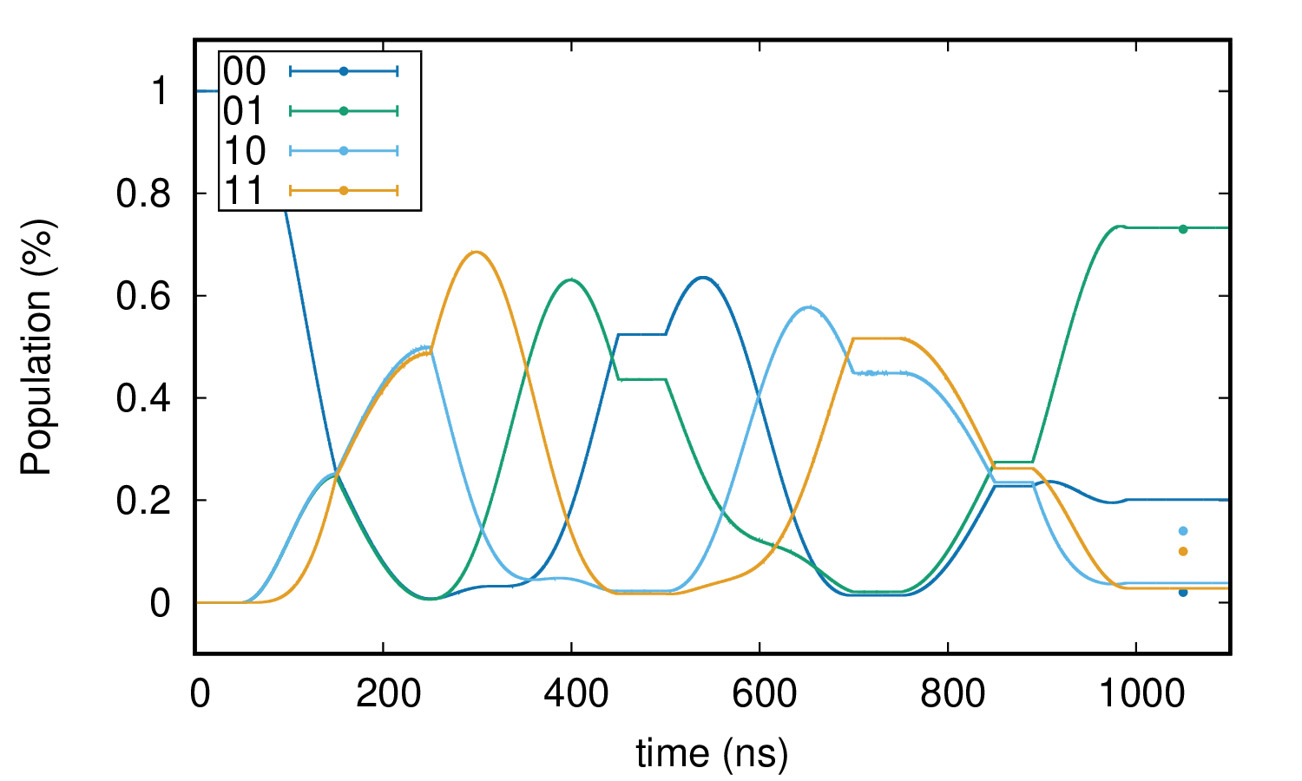
DJ DEC
White noise

Slide 7
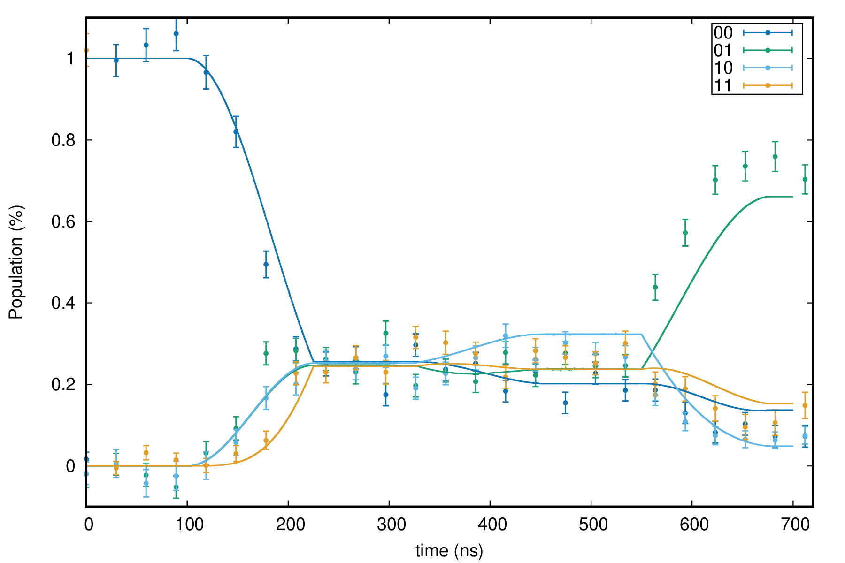
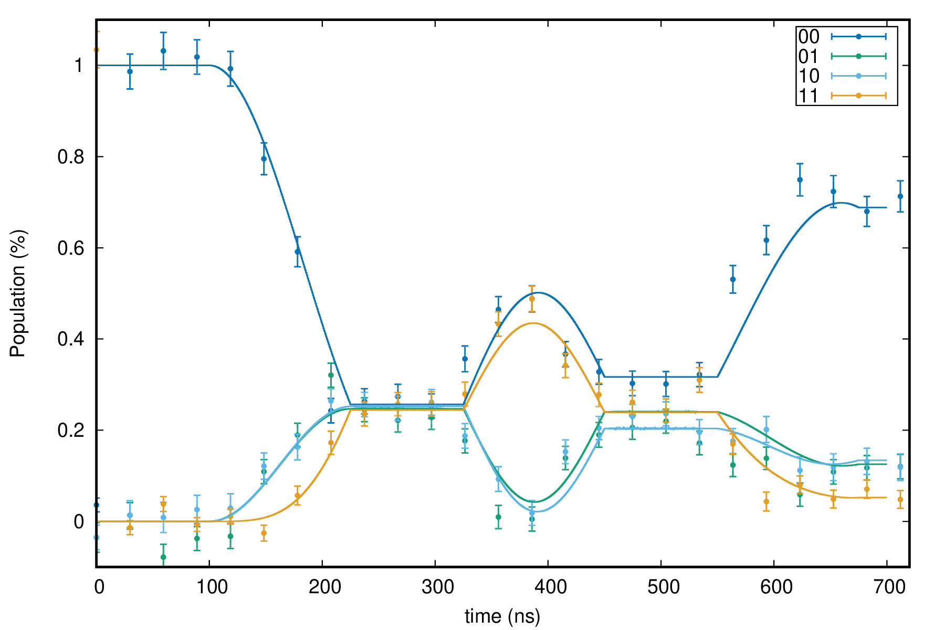
Grovers Normal
White noise

Slide 8
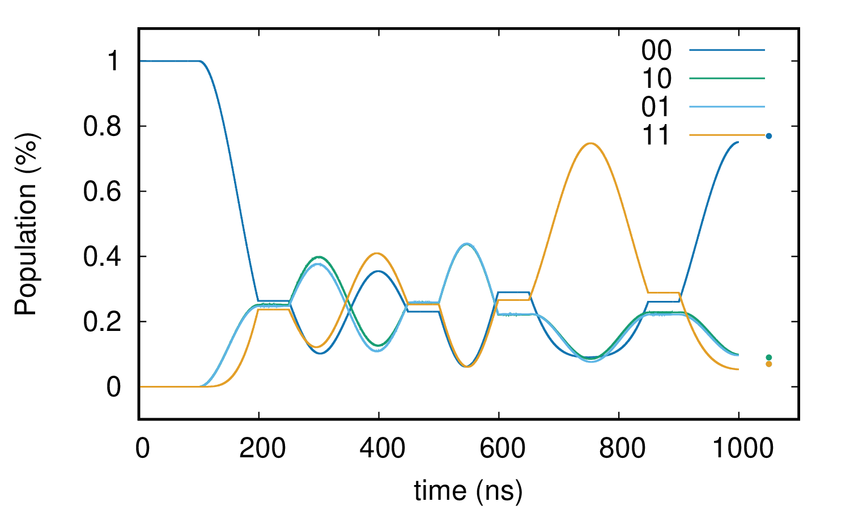
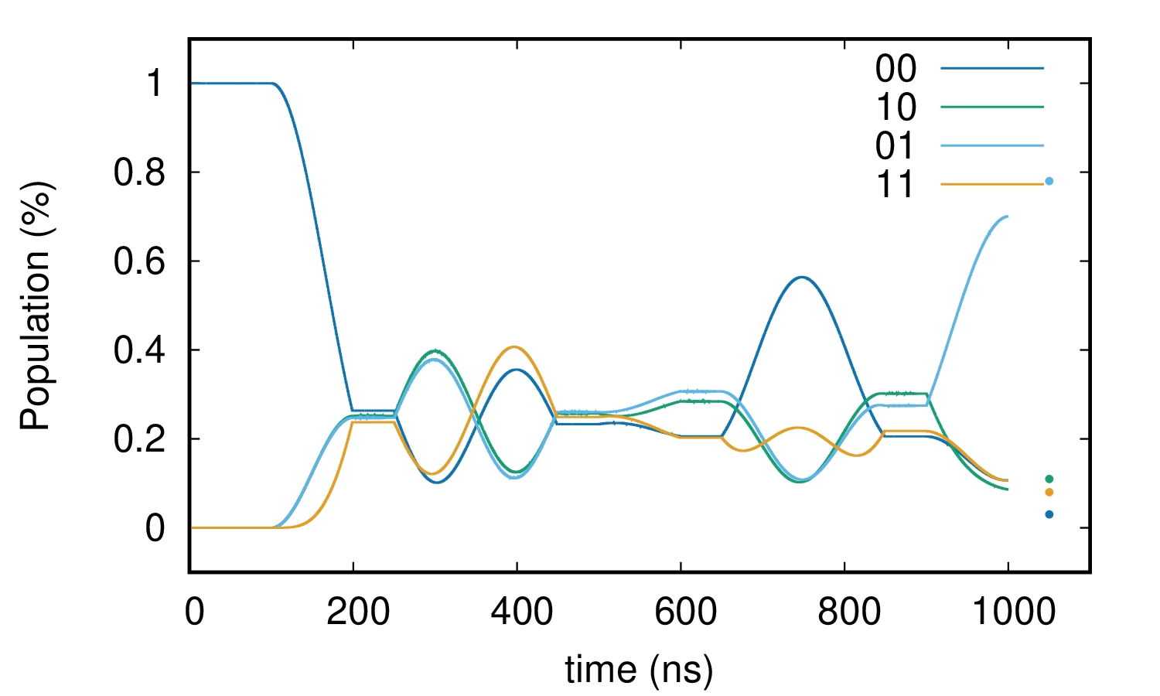
Grovers Dec
White noise

