Slide 1

Supplementary data

Slide 2

S1. ext sim - $χ_{2DEG}$
TODO

Slide 3
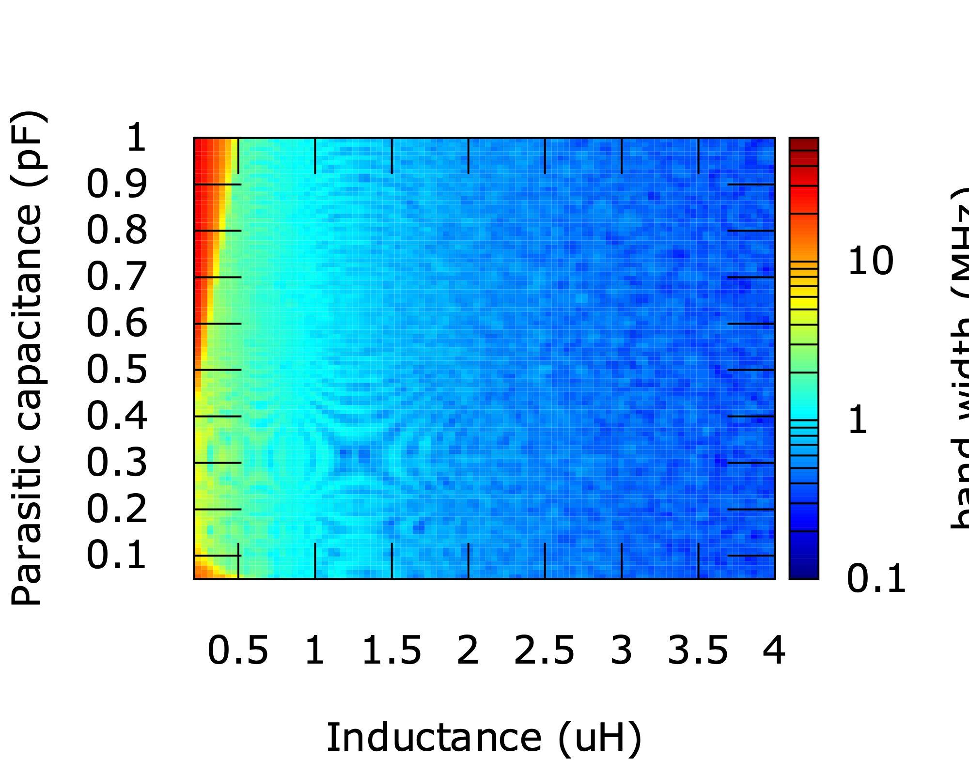
S2. ext sim - BW information (FWHM)
In range 1-> 4uh BW rather constant
With low inductance →high bandwidth, but hard to match well

Slide 4
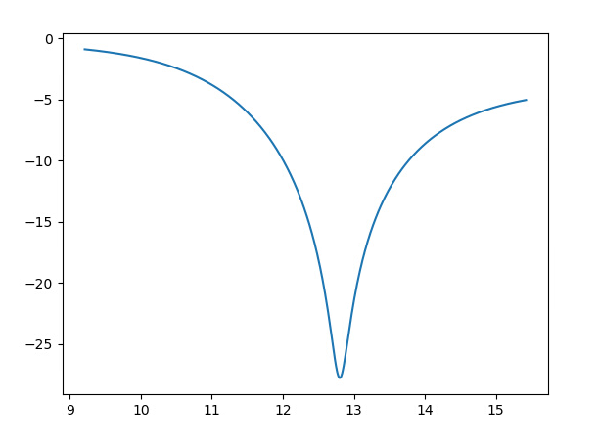
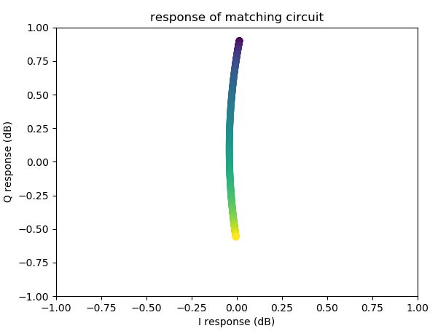
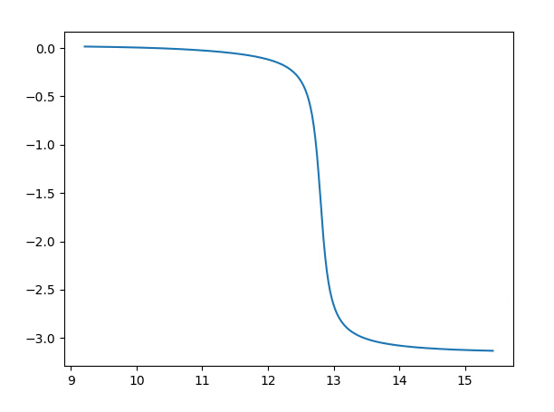
S3. What should my matching point be?
Amplitude
Measuring in the IQ plane
Here matching
occurs
= no signal
R > Rmatch
Log resistance(SD)
(a.u.)
180 degree phase flip
Around match
= Mirror in IQ plane
Phase
R < Rmatch
Log resistance(SD)
(a.u.)

