Slide 1

National Oak Distributors Technology Business Unit
Presented by: Your Information Technology Team

Slide 2
National Oak Distributors Technology Business Unit
Develop Standards
Just Do It, Better! Energized People Better at Everything!

Slide 3

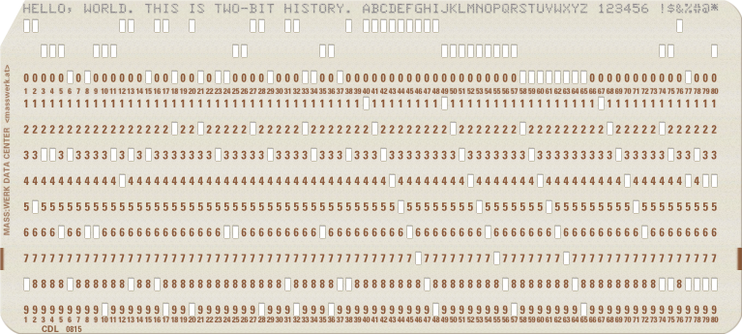
National Oak Distributors Technology Business Unit
Steps
Create programs

Slide 4
National Oak Distributors Technology Business Unit
Attributes to Discuss
Naming Conventions (nomenclature & repos)
Documentation
Versioning Workflow

Slide 5
National Oak Distributors Technology Business Unit
Naming Convention
Classifications (prefixes)
bts (bits) raw work, does not function as stand alone; typically works in progress
scr (scripts) - stand alone blocks of code that are executed by installed software (ie .bat, .sh, .py, .sql, etcetera)
app (applications) - finished standalone programs that typically have a UI; can be compiled or interpreted; an assembly of scripts
dbs (database) - database files

Slide 6
National Oak Distributors Technology Business Unit
Naming Convention
Repos
prefix {1,} _ server {0,1} _ descriptive name {1}
example: app_edi-eoms-orderweb
ALL lower case separated by underscores

Slide 7
National Oak Distributors Technology Business Unit
Documentation
# INFO or NAME
Copyright YYYY National Oak Distributors, Inc.
## TEST
Example usage w expected result
## WORLD ABOUT
Purpose and biz environment here
## REQUIREMENTS
Needed features and prerequisites here
## PROGRAM
Logic summary here
## LEGAL DEVELOPMENT
### Developers Authors
Bulleted list of who wrote the code here
## History
Major version history here

Slide 8
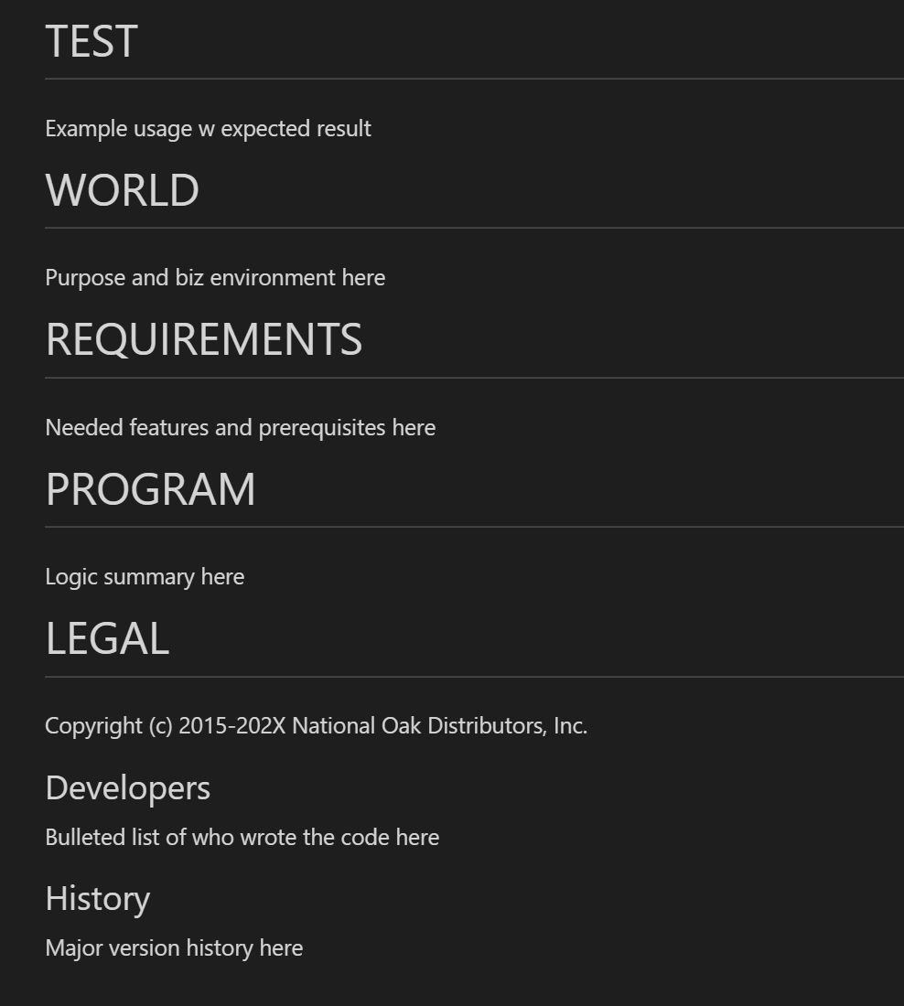
National Oak Distributors Technology Business Unit
Documentation

Slide 9
National Oak Distributors Technology Business Unit
Work Flow
Development done locally (laptop)
Push updates to Github
Prod servers “pull” from Github

Slide 10
National Oak Distributors Technology Business Unit
B Sides
Naming Conventions
Prefixes
prg (programs) - stand alone programs that DO not have a UI; an assembly of scripts
Repos
prefix {1,} & functional area {0,} & action verb {0,1} & descriptive name {1}

Slide 11

National Oak Distributors Technology Business Unit

