Slide 1


Load Tests with Gatling

Slide 2
In a Nutshell
Scala DSL
write test with full IDE support
Maven integration
Jenkins integration
Recorder gives you a head start
Five-Minutes quick start tutorial
get productive within the day

Slide 3
Quickstart
Tidying up
Refactoring
Simulating many users

Slide 4
Getting Started
Download Gatling
unzip it

Slide 5
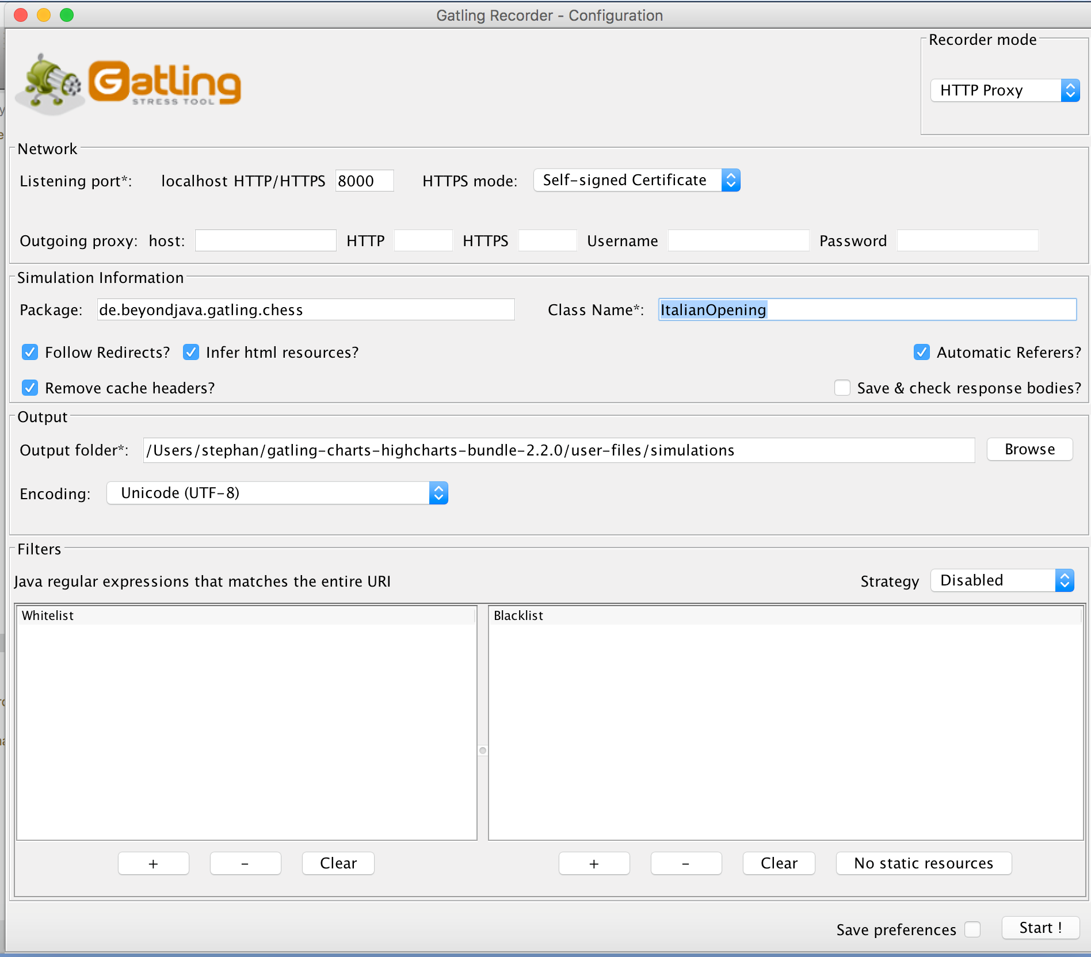
Getting Started
Download Gatling
unzip it
./bin/recorder.sh
set proxy and settings

Slide 6

Getting Started
Download Gatling
unzip it
./bin/recorder.sh
set proxy and settings
start recording

Slide 7

Getting Started
Download Gatling
unzip it
./bin/recorder.sh
set proxy and settings
start recording

Slide 8
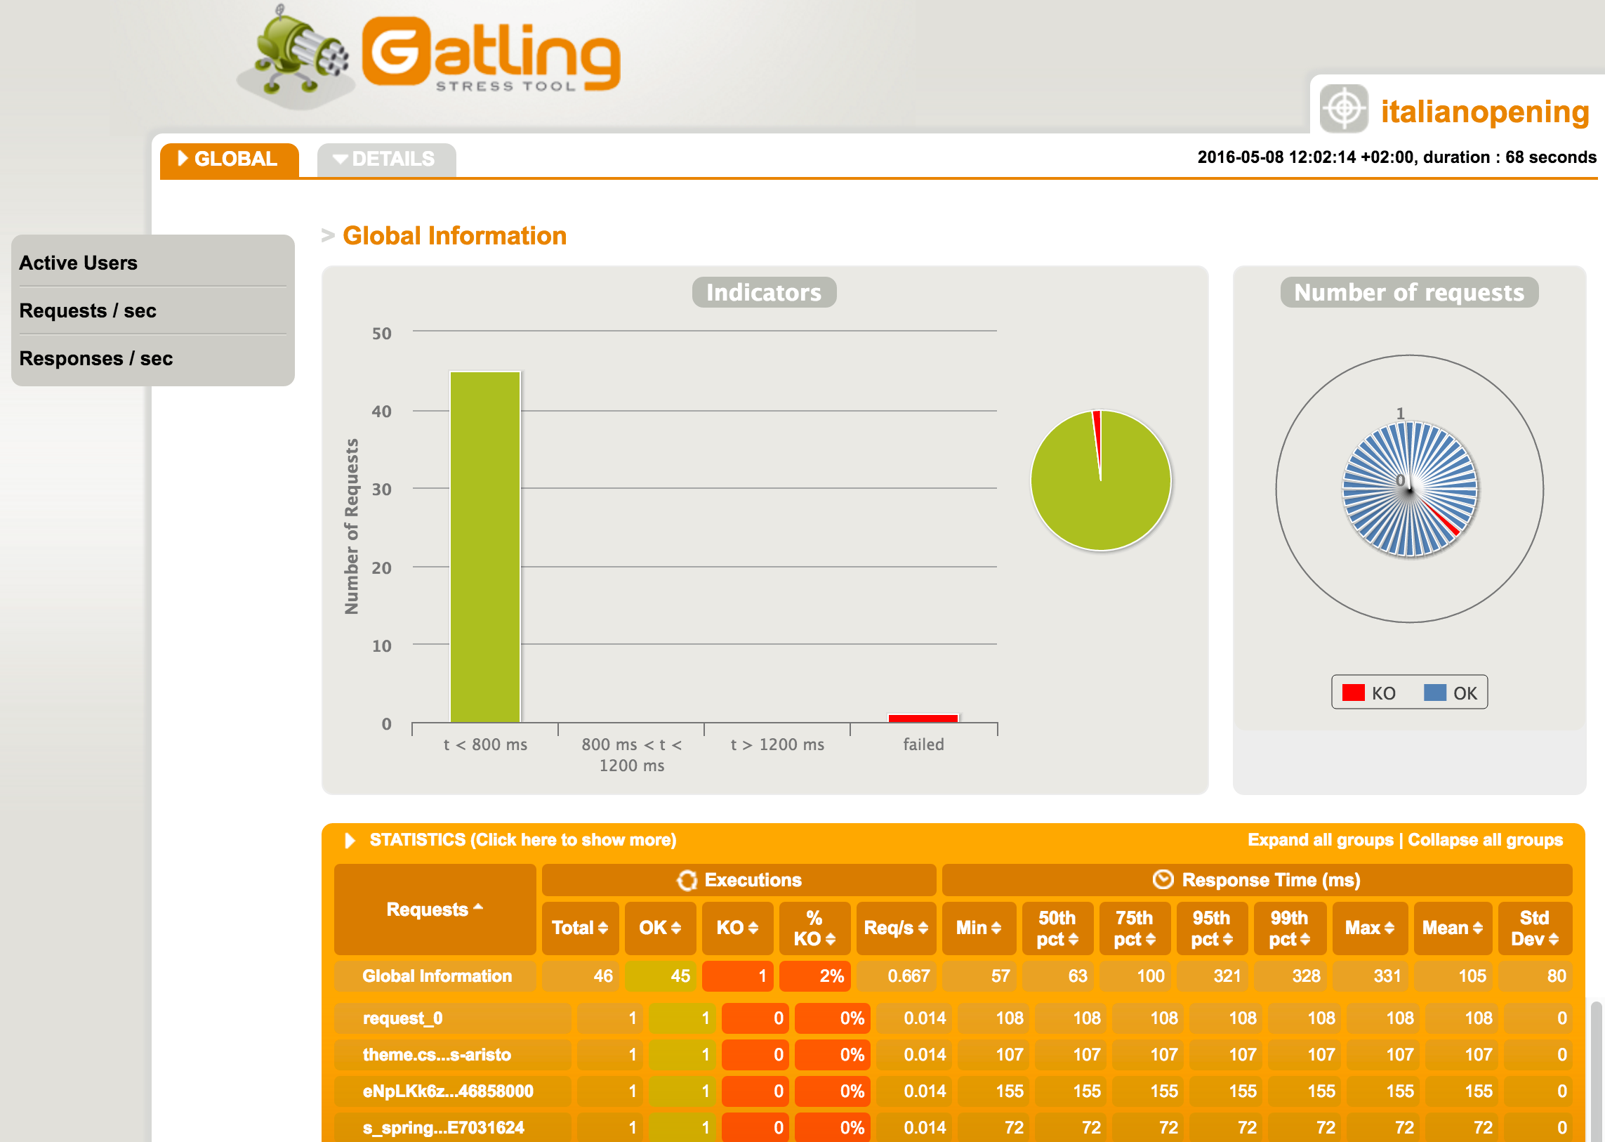
Getting Started
Download Gatling
unzip it
./bin/recorder.sh
set proxy and settings
start recording
./bin/gatling.sh
open index.html to start analyzing

Slide 9
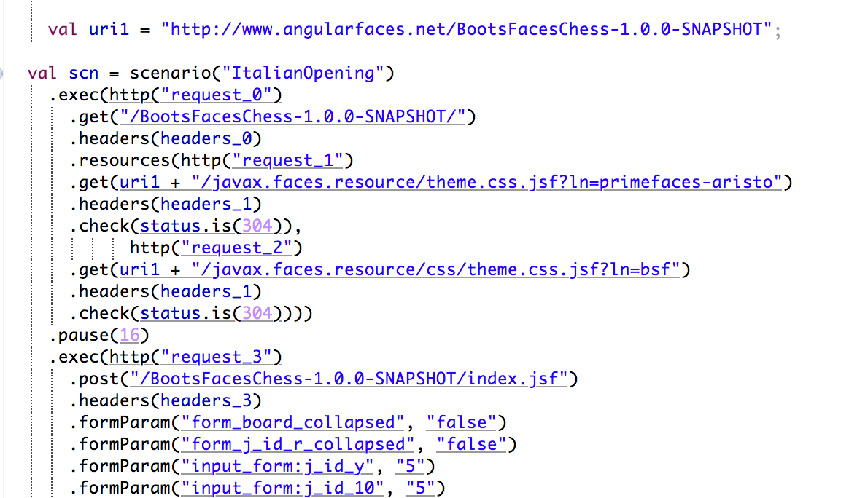
Getting Started
Download Gatling
unzip it
./bin/recorder.sh
set proxy and settings
start recording
./bin/gatling.sh
open index.html to start analyzing
modify script in your IDE

Slide 10
Quickstart
Tidying up
Refactoring
Simulating many users

Slide 11
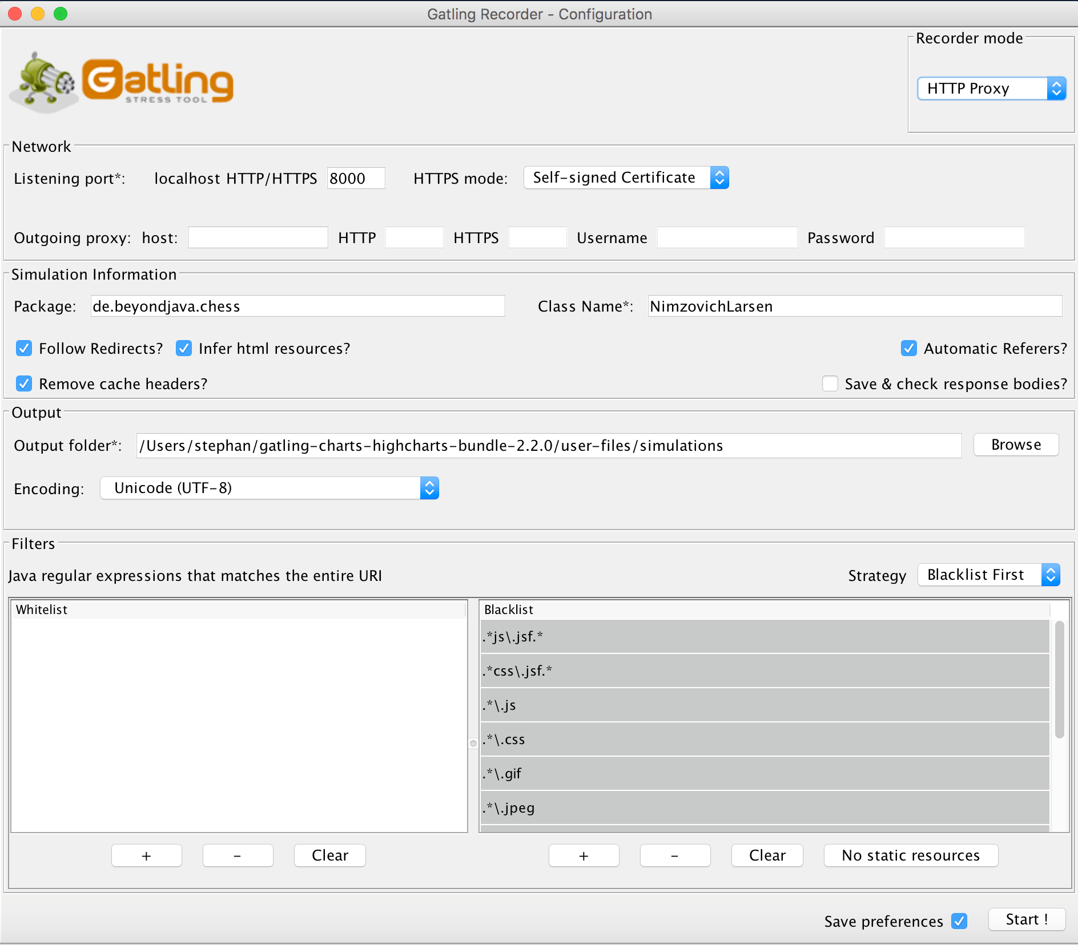
Tidying up
Ignore static resources when recording
fix "304" errors (Cache management)
Delete irrelevant code from the script
reduce pauses

Slide 12
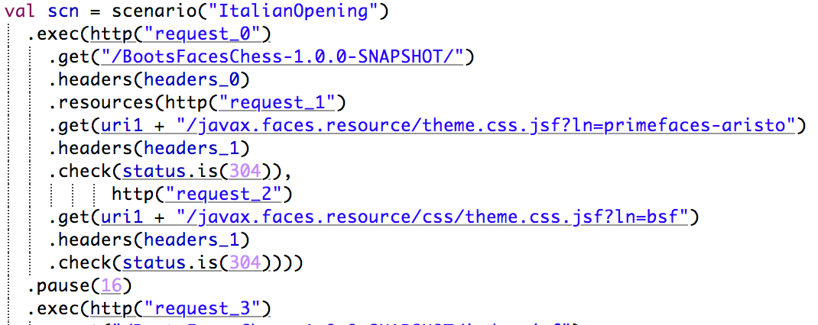
Tidying up
Ignore static resources when recording
fix "304" errors (Cache management)
Delete irrelevant code from the script
reduce pauses

Slide 13
Tidying up
Ignore static resources when recording
fix "304" errors (Cache management)
Delete irrelevant code from the script
reduce pauses

Slide 14
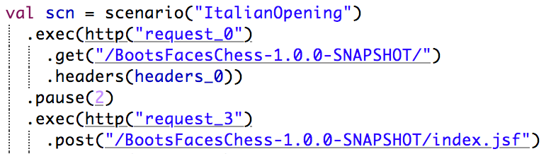
Tidying up
Ignore static resources when recording
fix "304" errors (Cache management)
Delete irrelevant code from the script
reduce pauses

Slide 15
Quickstart
Tidying up
Refactoring
Simulating many users

Slide 16
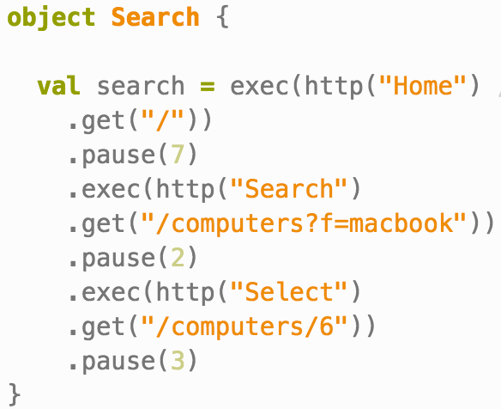
Refactoring
reduce code duplication
extract exec() to variable

Slide 17
Quickstart
Tidying up
Refactoring
Simulating many users

Slide 18
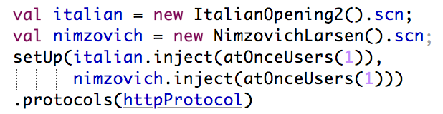
Multiple scenarios

Slide 19
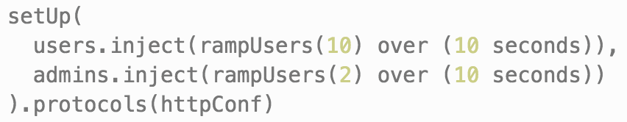
Multiple users

Slide 20
Feeders
Feeders allow you to add varying data to scenarios:
CSV files
Json objects
Database tables
Sitemaps
...

Slide 21
Create virtual Users
val users = scenario("Users").exec(Search.search, Browse.browse)
val admins = scenario("Admins").exec(Search.search, Browse.browse, Edit.edit)
setUp(users.inject(atOnceUsers(10)).protocols(httpConf))
setUp(
users.inject(rampUsers(10) over (10 seconds)),
admins.inject(rampUsers(2) over (10 seconds))
).protocols(httpConf)

