Slide 1

Bluetooth devices

Slide 2
Bluetooth – find devices
At first, we have to find available devices nearby.
The app should be able to do a ‘swipe’: find all Bluetooth devices nearby
The found devices should be communicated to the MP (EXTRA_UUID or what fields of BluetoothDevice?) in an array in the planning options. The provide-ids must be ‘true’.
The MP should contact the bike operators (TOs) with Bluetooth in the region with a planning-option request. The TO should only respond assets that are in the list of found Bluetooth devices.

Slide 3
Bluetooth - booking
No difference to other scenarios
Eventually data to open the Bluetooth device can be delivered in the response of the booking (token object).

Slide 4
Bluetooth – opening locks
A ‘prepare’ event should be used to request something to open a Bluetooth device.
Different technical options to communicate with Bluetooth devices
Get Bluetooth data to open device (response contains a token object with?)
Deep link option (response contains a token object with a deep link URI).

Slide 5
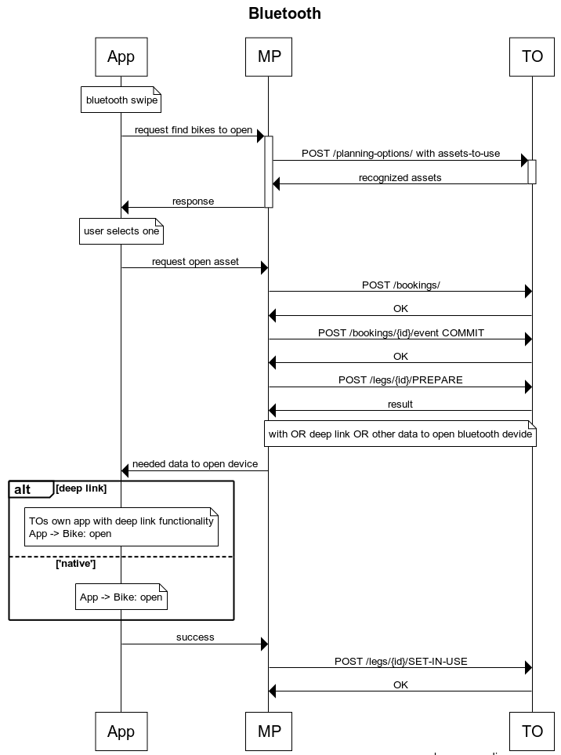

Slide 6
What do we need?
In the API: add an extra field to planning-options (or change asset-to-use to assets-to-use, but this is breaking)
A common shared library, developed by Bluetooth operators that can be integrated into other apps, but in a trustworthy way.
What data is needed to make it trustworthy?
Location
Token/key
Items in area (wifi networks)?
And must/should we facilitate/provide this?
This data must be send to the MP->TO and with this information a confirmation should be send back to open the Bluetooth lock. This operation should be encapsulated and in a standardised way. The business logic to provide ‘unlock data’ is still on the TOs side, as long they are get the needed input information.

