Slide 1
App for sharing food

Slide 2
Agenda
Motivation
Concept
Implementation
Problems

Slide 3
Motivation
Current problem of our society:
People buy too much food
Consequence: They throw away 30% of their food
=> 90kg food p.p./p.a.

Slide 4
Motivation
Why do we throw away that much food?
Food packages are too big [for singles]
Oversupply of food
Not enough time for cooking
Wrong calculation

Slide 5
Motivation
How can we reduce wasting food?
There are several projects about foodsharing:
Share or give away unused food [that is still eatable]
But these projects are still a desktop website…

Slide 6
Concept
Concept of foodsharing.de
After registration, the user is able to participate in the foodsharing community:
  create baskets with food the user doesn‘t need anymore
  Look for baskets the user needs or can consume

Slide 7
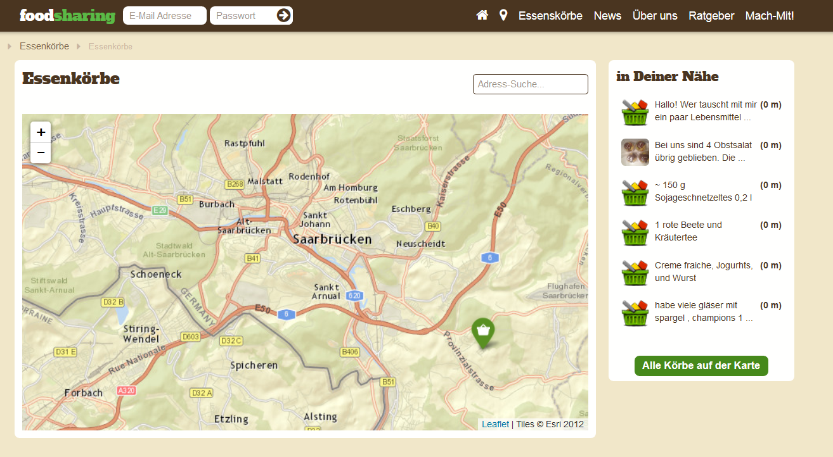
Concept

Slide 8
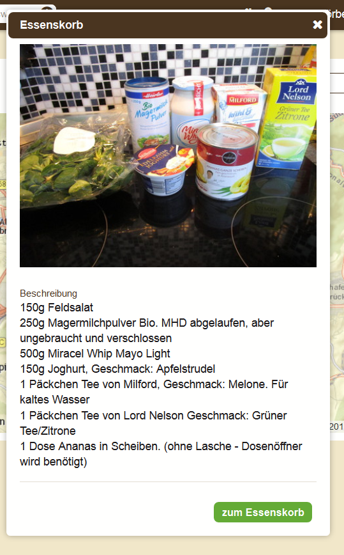
Concept
Rules for creating a food basket:
Not allowed:
Food with a so called „Verbrauchsdatum“ like raw fish, poultry, meat (espacially mince) or eggs.
Allowed:
Food with a best-before-date
Food which passes the Eye-Nose-Tounge test (food you would eat)

Slide 9
Concept
What does a food-sharer need in an app?
a browser to browse the offers
a search for finding offers
a filter which filters the offers in the browser („Show me only the veggy or vegan stuff!“)
a map where all offers are visualized
the possibility to open Google Maps for navigating to an offer

Slide 10
Concept
How can we improve the food-sharing process?
Closing Transactions:
via NFC
Rating:
improves the trustworthiness of owner and customer
Chat:
In-App-Communication improves the logistical coordination
Environmental Sensor Use
Be transparent for the customers and show them where and how your basket is stored (humidity, temperature)

Slide 11
Implementation
Database-Server
PHP
Client-Server Architecture:
JSON/HTTP
JSON/HTTP
Client
Client
Communication via JSON:
no plain SQL-queries between client and server
only HTTP requests to PHP scripts on server possible

Slide 12
Implementation
The 3 core objects in our App:
User
password, ID, address, real- and nickname, email
Offer
description, a picture, a best-before date, Transaction ID
Transaction
ID, offerID, customerID, ownerID, ratingID, createDate, closingDate

Slide 13
Implementation
Furthermore:
Categories and attributes (such as vegeterian, vegan etc…) as a maptable
each SQL query is executed by a single PHP script

Slide 14
Implementation
Core-App
Login
Creating offers
Browse + select offers
Show transaction history

Slide 15
Implementation
Extended-App
Googlemaps-API
Chat
Closing transactions via NFC
Be more transparent with sensor-data for offers

Slide 16
Problems
Camerabug

Slide 17
Any Questions?

Slide 18
Thank you for your kind attention

