Slide 1

OH ! OH ! OH !
stephe – mirkub – jdupuy – belepich

Slide 2


Slide 3
Only 7 days before Christmas
Approximately 2.2 billion children around the world !

Slide 4
Challenge for Santa :
Deliver 1 gift for each child in less than 12 hours

Slide 5
Production
Manage Child Satisfaction
Ensure production
Delevry

Slide 6
Approcymatly 2.2 billion children around the world (source : UNICEF)
Challenge for SANTA : Delivered 1 gifts for each in less than 12 hours
Production
Manage Child Satisfaction
Ensure production
Delevry

Slide 7
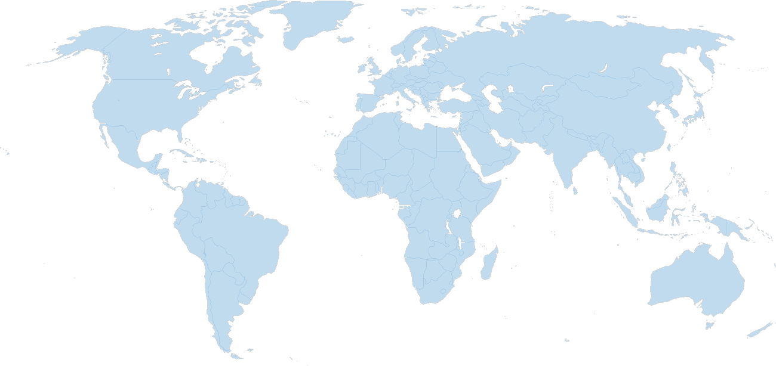


: |
: )
: )
: )
: (
Production
Distribution
Satisfaction

Slide 8

Gift Lifecycle Management

Slide 9

The GLM benefits
Identify and provisioning the gifts
Track the gift in all is state by using cloud
Combine the data and get the child emotion
Generate new insights to improve next year Xmas
RPI 2
Camera
Sensors
IoT Hub
Stream Analytic
Azure BLOB Storage
Project Oxford
Power Bi
Machine Learning

Slide 10
Rapberry
Scaling
IoT Hub
SteamAnal
Power bi
ML

Slide 11
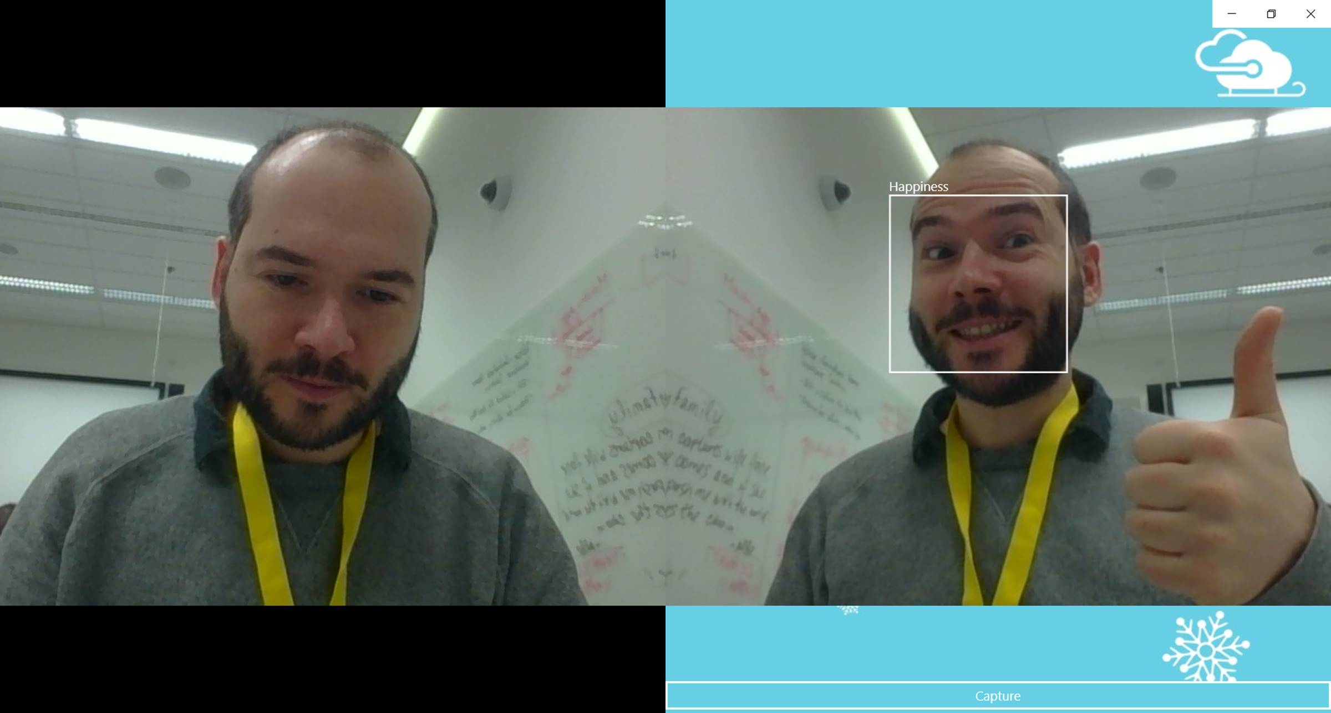

Slide 12
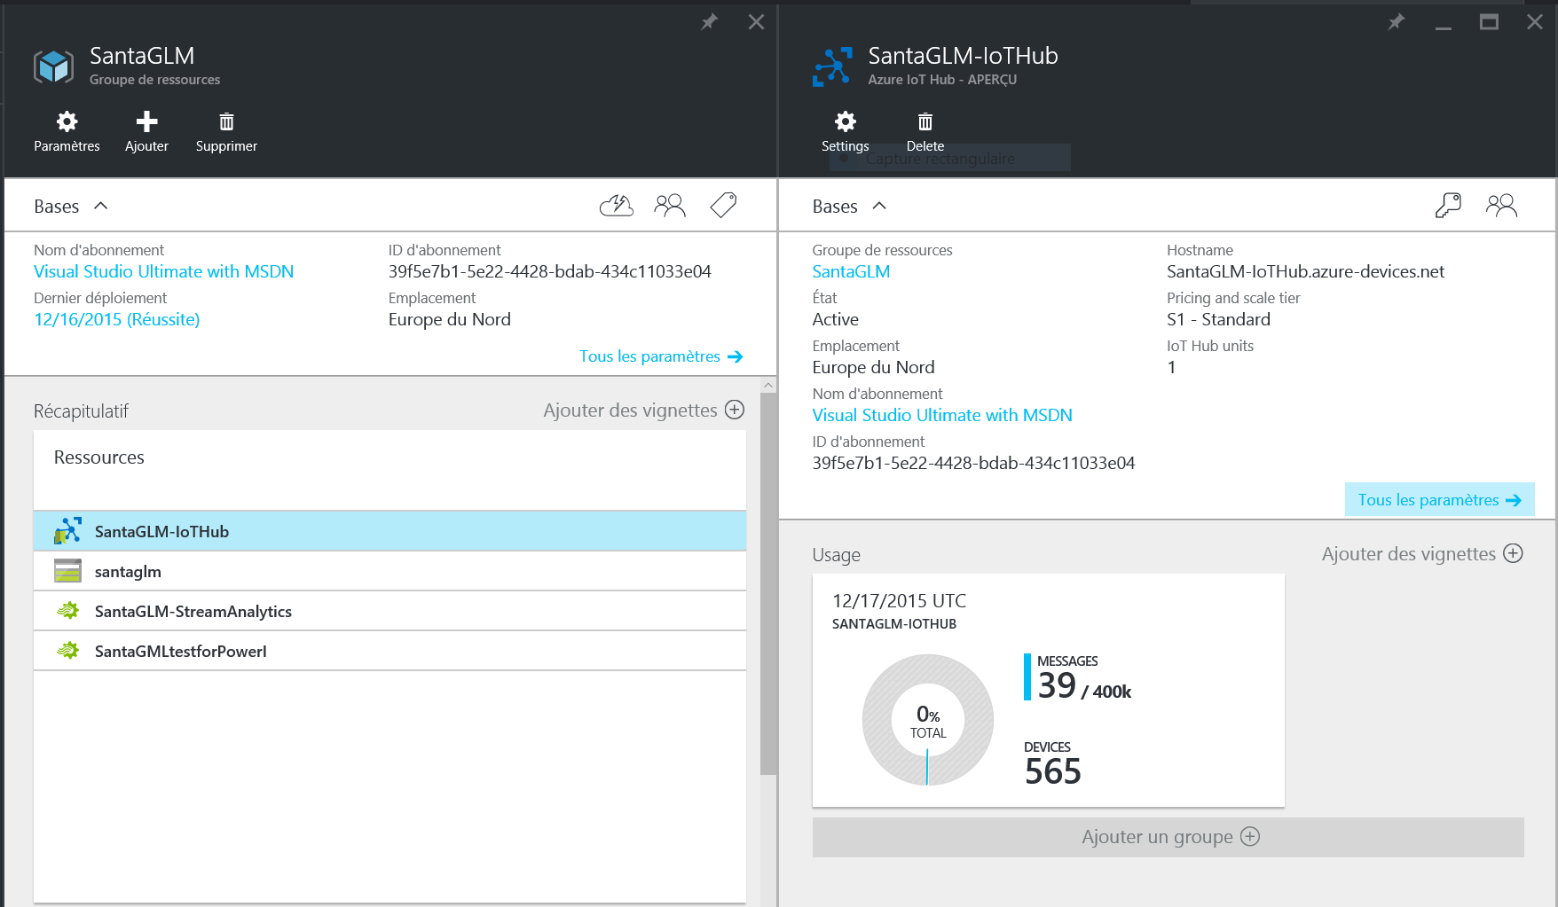

Slide 13
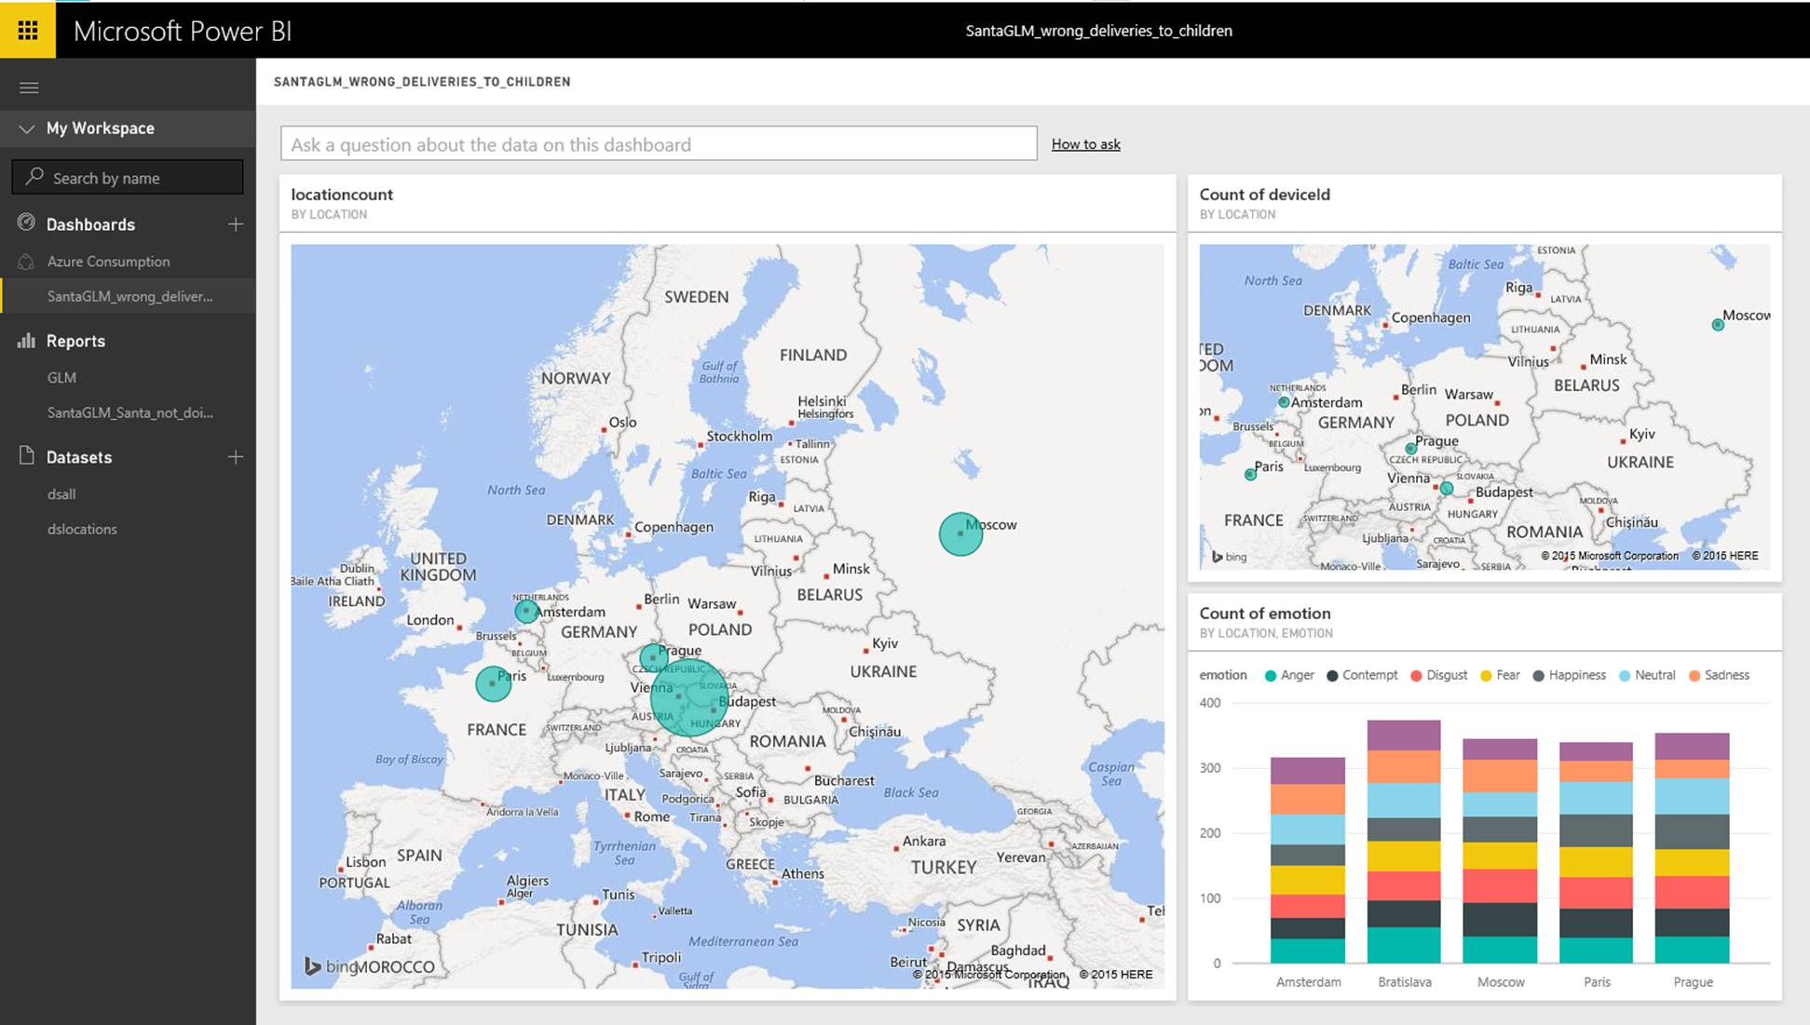

Slide 14
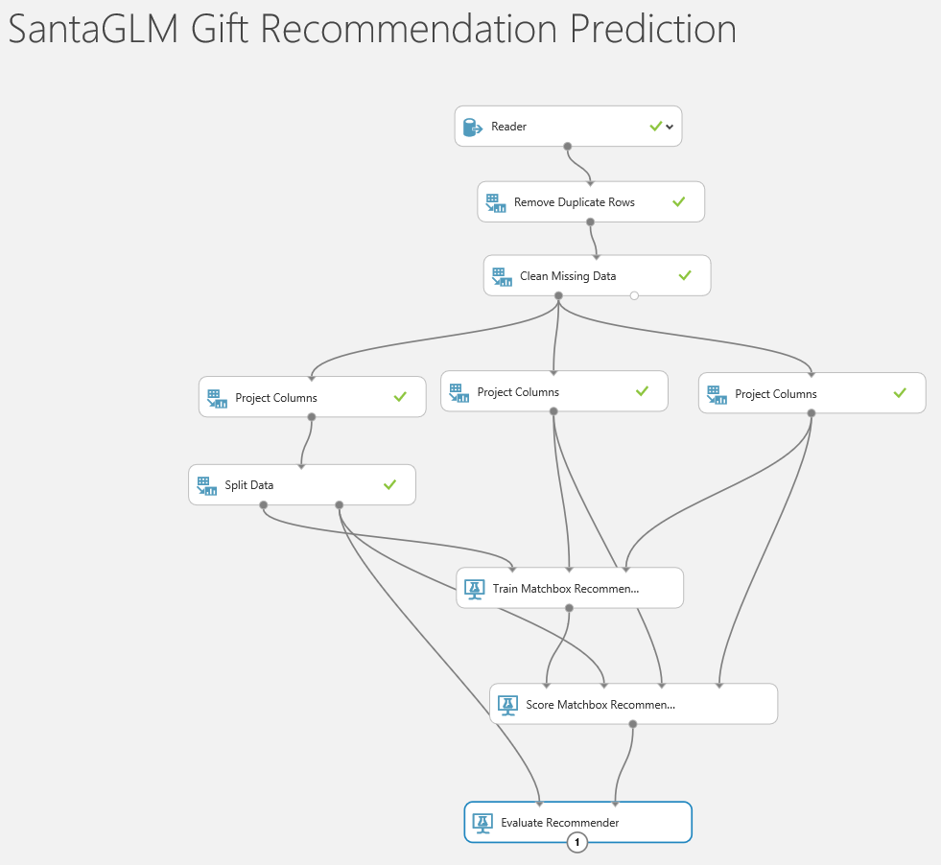

Slide 15




Happy Christmas !

