Slide 1

Predicting Winning New York Mega Millions Lottery Numbers
Stephen Haslett
Data 698 Capstone Project

Slide 2
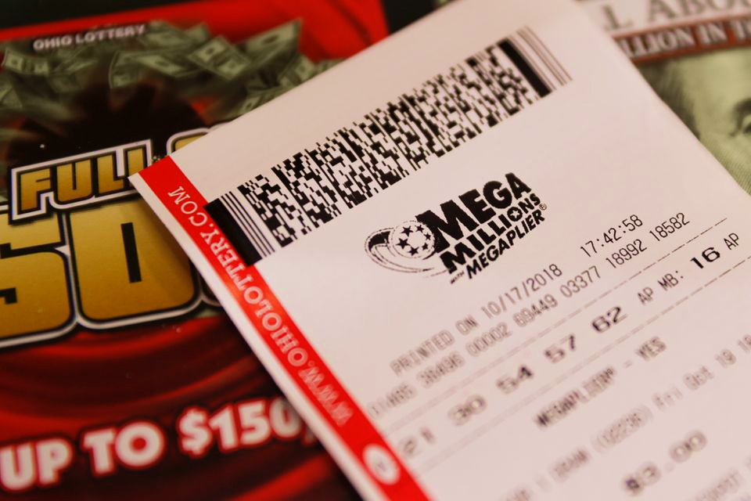
Introduction
Problem Statement
Is it possible to strategically play the lottery in order to increase one’s chances of winning, or is it merely a game of chance?
Questions to Be Answered
Is it possible to predict winning lottery numbers based on previous results?
Can a pattern be identified regarding which winning numbers are drawn most often over time?
Can playing these numbers increase our chances of winning, and how does this strategy relate to the Hot Hand Fallacy?
Conversely, can avoiding these numbers increase the odds of winning, and how does this strategy relate to the Gambler’s Fallacy?
In terms of winning, is it better to play the same numbers, or pick random numbers every game?

Slide 3
Mega Millions Lottery
Game Rules
US Lottery game that is drawn twice a week on Tuesdays and Friday
Game Rules
Players pick 5 unique numbers between 1 – 70 for the base numbers, and 1 between 1 and 25 for the Mega Ball.
If the player matches all the winning base numbers and the Mega Ball, they win the Jackpot.
A standard ticket costs $2 – players can pay an extra dollar to pick a multiplier number (1 number between 2 and 5). If they match winning lottery numbers plus a winning multiplier number, their winnings and multiplied by the multiplier number.
If multiple players win the jackpot, it is divided evenly among the winners. If no one wins, it rolls over to the next drawing.
75% of allocated prize money is assigned to the jackpot, the remaining 25% is allocated to lower prize tiers.

Slide 4
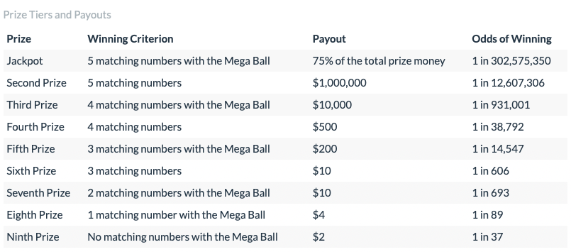
Mega Millions Lottery
Prize Tiers and Odds

Slide 5
Methodology
Approach
Identified 5 different approaches to playing the lottery:
1. Consistent Numbers Strategy
Playing the same numbers every game.
2. Most Frequent Numbers Strategy (Hot Hand Fallacy)
Playing numbers that occurred most frequently in past winning numbers sets.
3. Least Frequent Numbers Strategy (Gambler’s Fallacy)
Playing numbers that occurred least frequently in past winning numbers sets.
4. Random Numbers Strategy
Playing random numbers every game.
5. Multiplier Strategy
Applying the multiplier number to the Consistent Numbers Strategy.

Slide 6
Methodology
Approach
Using Hypothesis Testing, we compared the average winnings of each strategy against the Consistent Numbers strategy which we used as the base case.
A true win was evaluated as total winnings – total ticket spend.
T-Tests were used to determine the significance of difference between each strategy’s mean winnings.
Null Hypothesis: A specific strategy is the same as the base case in terms of average winnings generated and therefore neither strategy will result in more winnings.
Alternative Hypothesis: A specific strategy is not the same as the base case in terms of average winnings generated and therefore playing the strategy under comparison, or the base strategy, will result in more winnings.

Slide 7
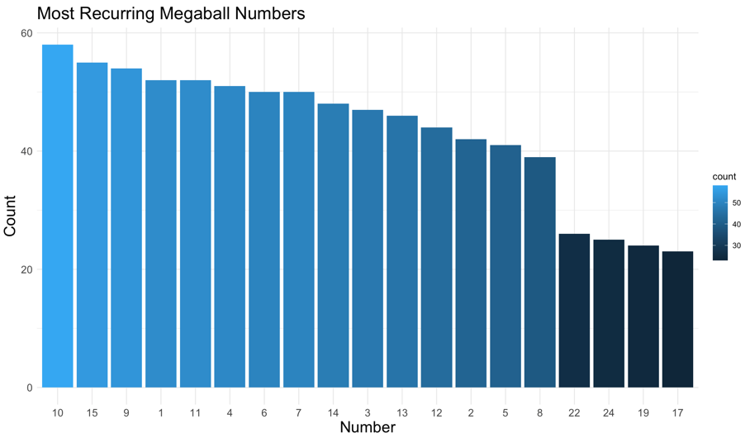
Methodology
Most & Least Frequent Numbers Strategies
To generate the numbers for the Least and Most Numbers strategies, We ran through the last 20 years of winning Mega Millions numbers and identified the most and least frequently occurring winning Mega Ball and base numbers.
The top 50 percentile was used to generate random numbers for the Most Frequent Numbers strategy.

Slide 8
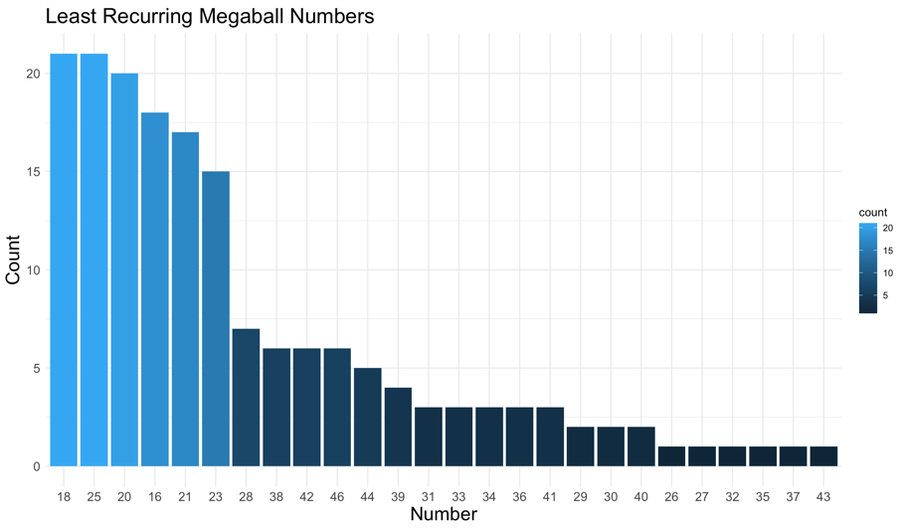
Methodology
Most & Least Frequent Numbers Strategies
The bottom 50 percentile was used to generate random numbers for the Least Frequent Numbers strategy.

Slide 9
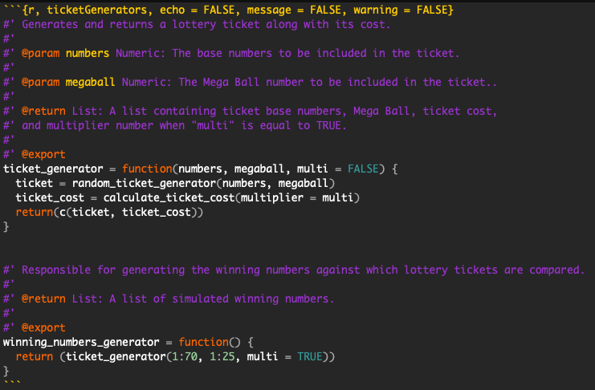
Methodology
Simulations
We then created simulators in R that simulated playing each strategy against randomly generated winning numbers.
The simulations adhered to the Mega Millions game rules.

Slide 10
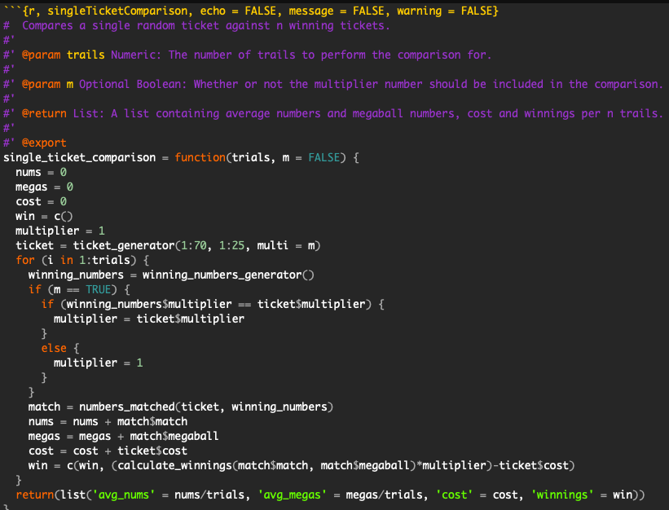
Methodology
Simulations
We compared the average winnings from each strategy against the Consistent Numbers base case.
10,000 trails were run for each individual strategy.

Slide 11
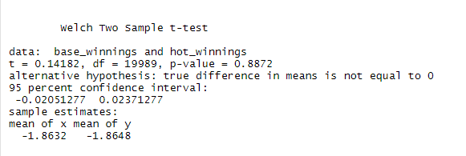
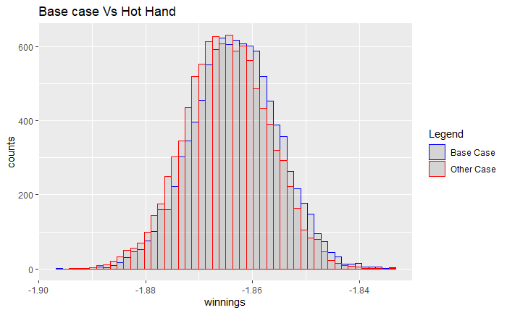
Results
Most Frequent
Numbers Strategy
A P value of 0.8872, and T value of 0.14182 tell us that the average
winnings of the Most Frequent Numbers strategy are not significantly
different from those of the base case.
The average winnings generated by the Most Frequent Numbers strategy fall within the expected values of the base case and so we reject the alternative hypothesis.

Slide 12
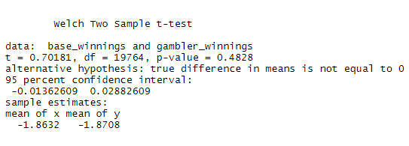
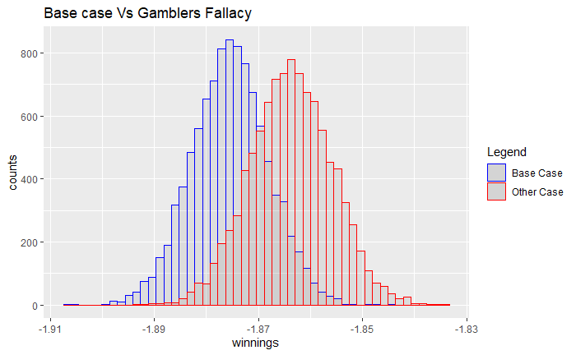
Results
Least Frequent
Numbers Strategy
A P value of 0.4828, and T value of 0.70181 tell us that the average
winnings of the Least Frequent Numbers strategy are not significantly
different from those of the base case.
The average winnings generated by the Least Frequent Numbers strategy fall within the expected values of the base case so we reject the alternative hypothesis.

Slide 13
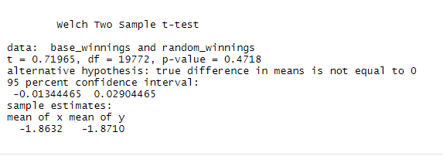
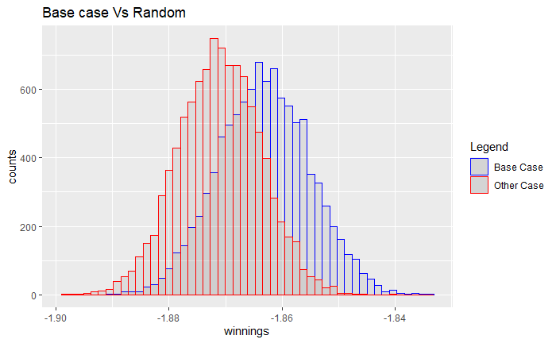
Results
Random
Numbers Strategy
A P value of 0.4718, and T value of 0.71965 tell us that the average
winnings of the Random Numbers strategy are not significantly
different from those of the base case.
The distribution plot shows that the means are within 95% of each other and so we reject the alternative hypothesis.

Slide 14
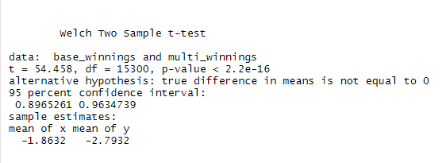
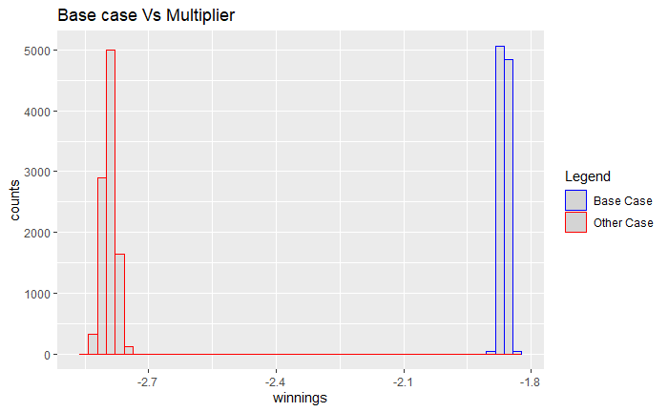
Results
Multiplier Strategy
A P value of near 0, and T value of 54.458 tell us that the average
winnings of the Multiplier strategy are significantly
different from those of the base case.
We are dealing with negative winnings and considering that
A win is considered to be “total winnings – total ticket spend”, the
Multiplier strategy results in us losing even more money.
The distribution plot provides visual evidence of the difference in average winnings between the Multiplier strategy and the base case, and so we reject the null hypothesis this time.

Slide 15
Conclusion
Non of the strategies we investigated provide an edge when it comes to bettering one’s odds at winning the lottery.
Implementing the Multiplier strategy (a strategy that is supposed to increase your winnings), results in higher losses due to higher cost of the ticket.
The Mega Millions lottery is a game of chance, and not a game of strategy.
The game is not worth playing as the average amount won is less than the amount spent on tickets.

