Slide 1
Gitting Along With Git
Data Science in Context
Stephen Haslett

Slide 2
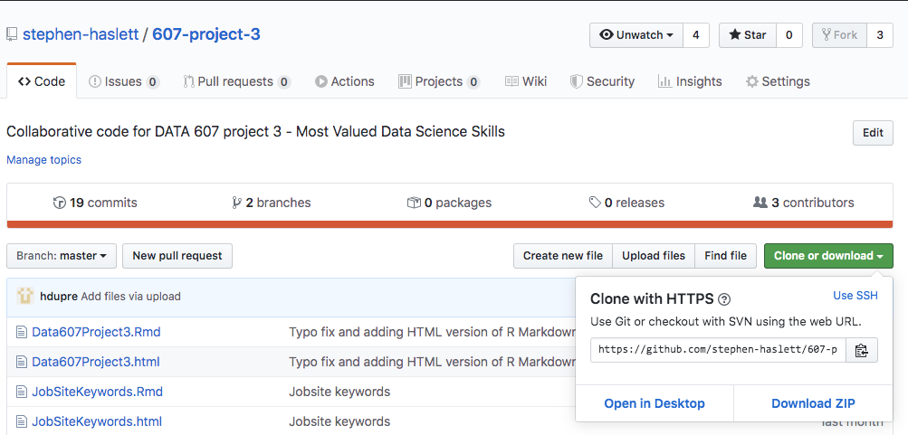
Gitting Down to Business Essential Git workflow commands
Cloning
Cloning a repository with git clone
(git clone <url>)
The git clone command is the first git command you will use when starting a new project and only needs to be used once for each repository that you want to clone to your local environment.
Step 1:
Navigate to the GitHub repository that you want to clone and click on the “Clone or download” button. Copy the link to your clipboard by
clicking on the clipboard Icon, and move on ->

Slide 3
Gitting Down to Business Essential Git workflow commands
Cloning
Cloning a repository with git clone continued ….
Step 2:
Switch over to the command line, CD into the directory that you want to download the repository to, and insert the following command
(switching out “my_project” with the name of the directory that you want the project to reside in) :

Slide 4
Gitting Down to Business Essential Git workflow commands
Feature
Branches
Creating Feature branches with git checkout
(git checkout -b <branch-name>)
I have a copy of the repository, - now what? Committing to master is a messy business and 9 times out of 10, results in merge conflicts. To avoid this situation, always create a feature branch from the master branch of the repository you eventually want to merge your code into.

Slide 5
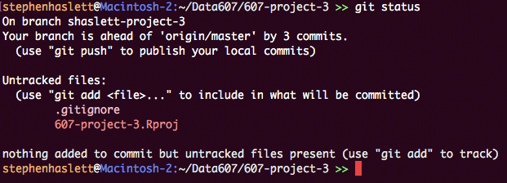
Gitting Down to Business Essential Git workflow commands
Committing
Code
Committing code
1. (git status) Provides important information about you current branch. It will tell you:
If your branch is up to date with the origin branch.
If you have unstaged changes.
If you have untracked files that have not been added to your staging index.

Slide 6
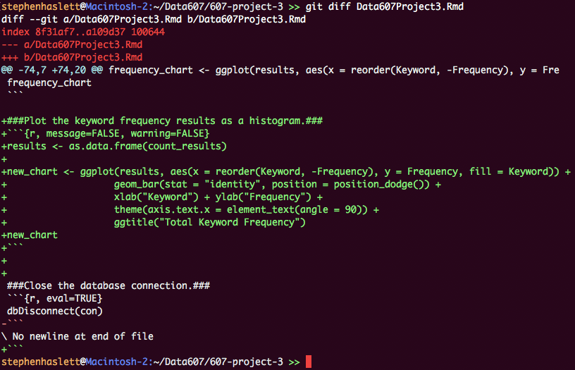
Gitting Down to Business Essential Git workflow commands
Committing
Code
Committing code
2. (git diff) Displays the unstaged changes you have made to a file.

Slide 7
Gitting Down to Business Essential Git workflow commands
Committing
Code
Committing code
3. (git add <filename>) Adds your changes to the staging index.
4. (git commit –m “A concise commit description.”) Commits your changes to the local repository.
5. (git push) Pushes your changes up to the remote repository.
Pulling code
(git pull) Pulls code from a remote repository to your local repository.

Slide 8
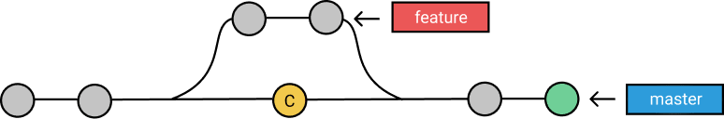
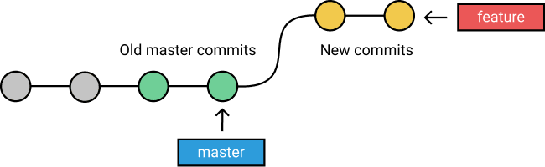
Gitting Out of Trouble Resolving merge conflicts – git rebase – the bridge too far.
Merge
Conflicts
What is git rebase, and how does it differ from git merge?
Git Merge – Combines multiple sequences of commits into one unified history by integrating a feature branch into the master branch. In this scenario, only the master branch’s history is changed; the feature branch history remains same.
Git Rebase - Moves the entire feature branch to begin at the master branch’s end point, forming a linear history. In this scenario, it is as though all of the commits were made on the master branch, rather than on two separate branches.

Slide 9

Gitting Out of Trouble Resolving merge conflicts
Merge
Conflicts
Why do merge conflicts happen?
Conflicts generally arise when two or more people have changed the same lines in a file.

Slide 10

Gitting Out of Trouble Resolving merge conflicts
Merge
Conflicts
– I have conflicts – now what?
Crap! – I have to deal with this guy again?
Resolving merge conflicts with git rebase
(git fetch) downloads commits and files from a remote repository to your local repo.
2. (git rebase –i branch) rebases a feature branch on top of the master branch. During the rebase, if git detects a conflict, the rebase will pause, and you will be prompted to fix the conflict.

Slide 11
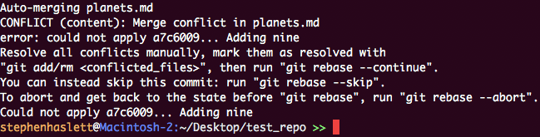
Gitting Out of Trouble Resolving merge conflicts
Merge
Conflicts
Resolving merge conflicts with git rebase continued …
3. Git has discovered a conflict and is now prompting you to resolve it.

Slide 12
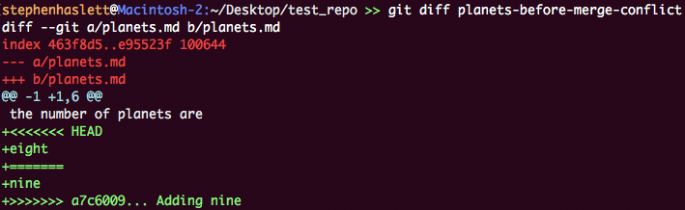
Gitting Out of Trouble Resolving merge conflicts
Merge
Conflicts
Resolving merge conflicts with git rebase continued …
3. Running git diff against the file will show the conflicts.
4. Edit the file and decide which version should be kept (HEAD marks the changes in the branch you are on,
and “=======“ marks the changes in the branch you are rebasing with).

Slide 13

Gitting Out of Trouble Resolving merge conflicts
Merge
Conflicts
Resolving merge conflicts with git rebase continued …
5. Once you’ve made your amendments, run git add to add the file, then git rebase –-continue to continue with the rebase.
6. Once the rebase has completed successfully, you need to push the rebased changes up to your feature branch. Because git rebase changes the commit history, you will need to force push your changes by adding a “+” sign in front of the branch name as follows:

Slide 14
Useful Git Resources
Further
Reading
Merging vs. Rebasing
https://www.atlassian.com/git/tutorials/merging-vs-rebasing
2. Dealing with Merge Conflicts
https://www.git-tower.com/learn/git/ebook/en/command-line/advanced-topics/merge-conflicts
3. Learn Git Branching
https://learngitbranching.js.org/?locale=en_US
4. Git Documentation
https://git-scm.com/docs

