Slide 1
Data624 Presentation
Jagdish Chhabria
Stephen Haslett
Time Series Decomposition

Slide 2
Time Series Decomposition
Why
Transformations?
Transformations and Adjustments
Why Make Transformation and Adjustments?

Slide 3
Time Series Decomposition
Mathematical
Transformations
Transformation and Adjustment Types
Mathematical Transformations
Power Transformations √(𝑥), (𝑥)^{1/3}, log(𝑥), Box Cox
Power transformations are used for variance stabilization and normalization.
In the context of a time series, power transformations are useful for removing change in variance over time.
The most common power transformations are:
Square root -> (√𝑥)
Cube root -> (𝑥)^{1/3}
Log -> log(𝑥)
Box Cox

Slide 4
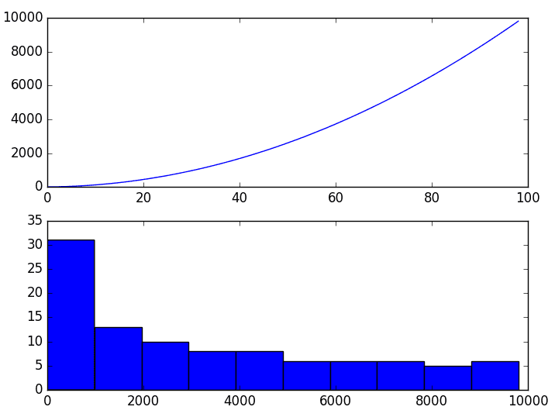
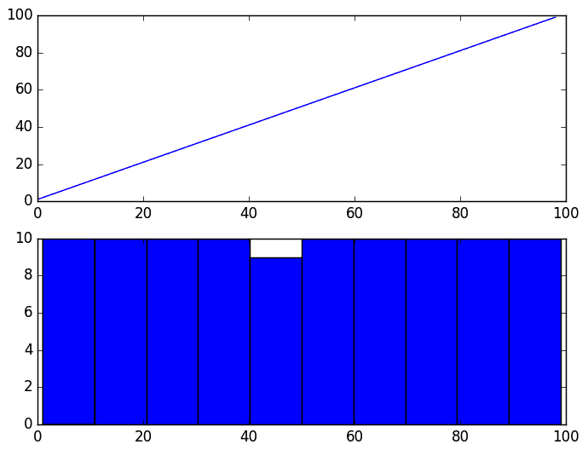
Time Series Decomposition
Mathematical
Transformations
Transformation and Adjustment Types
A. Square root -> (√𝑥)
Used to make a time series with a quadratic growth trend linear by taking the square root.
Before Square Root transformation. After Square Root transformation.

Slide 5
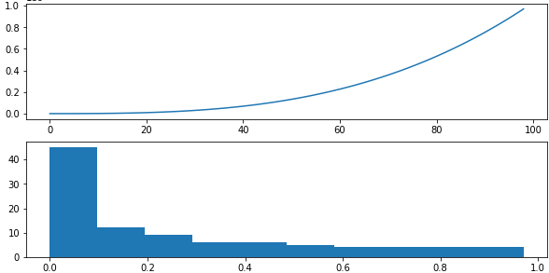
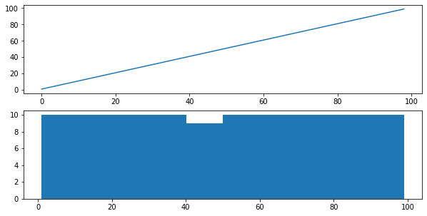
Time Series Decomposition
Mathematical
Transformations
Transformation and Adjustment Types
B. Cube root -> (𝑥)^{1/3}
Used to make a time series with a cubic growth trend linear by transforming the data to its cube root.
Before Cube Root transformation. After Cube Root transformation.

Slide 6
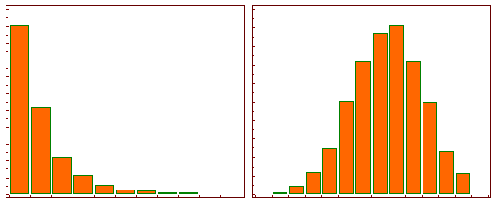
Time Series Decomposition
Mathematical
Transformations
Transformation and Adjustment Types
C. Log -> log(𝑥)
A log transform will transform skewed data to approximately conform to normality.
Before Logarithmic Transformation. After Logarithmic Transformation.

Slide 7
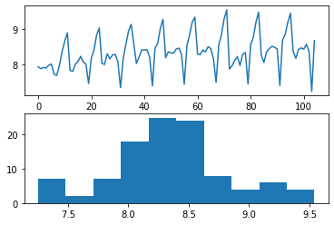
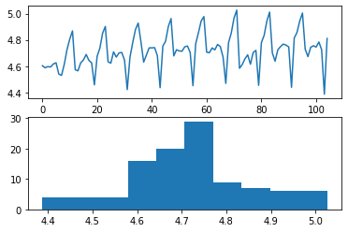
Time Series Decomposition
Mathematical
Transformations
Transformation and Adjustment Types
D. Box Cox
Used to identify the ideal Lambda needed to normalize the time series. The Lambda value indicates the power to which all data should be raised.
Manual Log transformation with Lambda set to 0 . Box Cox transformation with selected ideal Lambda value of -0.152542.

Slide 8
Time Series Decomposition
Calendar
Adjustment
Transformation and Adjustment Types
Calendar Adjustment
Used to remove calendar variations from a time series.
Calendar variations include:

Slide 9
Time Series Decomposition
Population
Adjustments
Transformation and Adjustment Types
Population Adjustments
Logarithmic
Some text.
Power (x√,x3)
Some text.
Inverse

Slide 10
Time Series Decomposition
Inflation
Adjustments
Transformation and Adjustment Types
Inflation Adjustments
Logarithmic
Some text.
Power (x√,x3)
Some text.
Inverse

