Slide 1
Data624 Presentation
Jagdish Chhabria
Stephen Haslett
Time Series Decomposition

Slide 2
Time Series Decomposition
Mathematical
Transformations
Transformation and Adjustment
Mathematical Transformations
Power Transformations √(𝑥), (𝑥)^{1/3}, log(𝑥), Box Cox
Power transformations are used for variance stabilization and normalization.
In the context of a time series, power transformations are useful for removing change in variance over time.
The most common power transformations are:
Square root -> (√𝑥)
Cube root -> (𝑥)^{1/3}
Log -> log(𝑥)
Box Cox

Slide 3
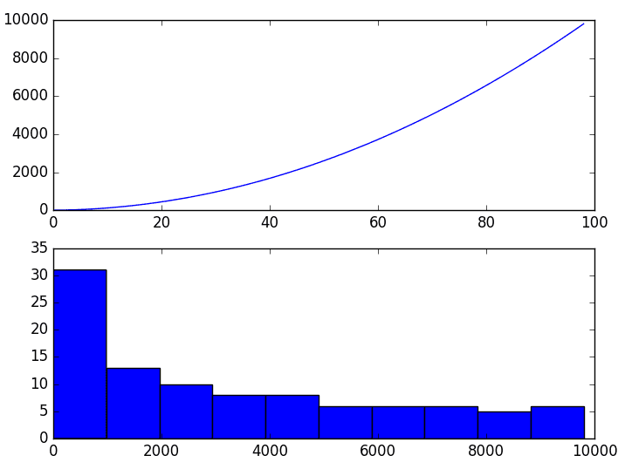
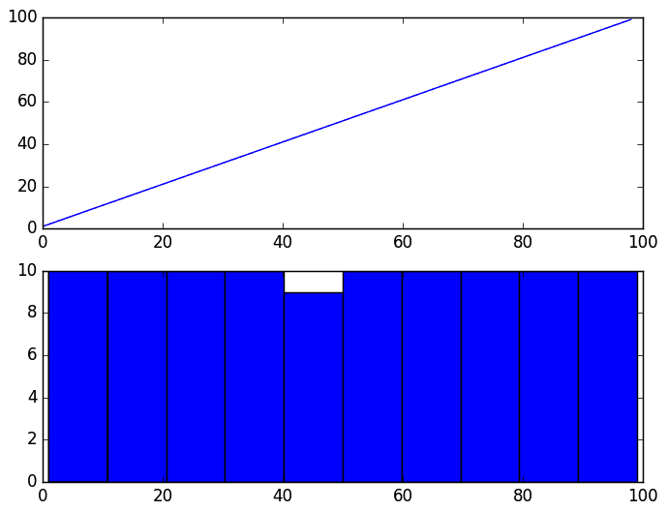
Time Series Decomposition
Square Root
Transformation
Transformation and Adjustment
A. Square root -> (√𝑥)
Used to make a time series with a quadratic growth trend linear by taking the square root.
Before Square Root transformation. After Square Root transformation.

Slide 4
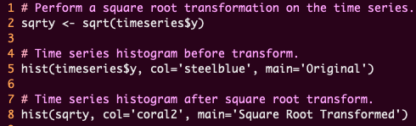
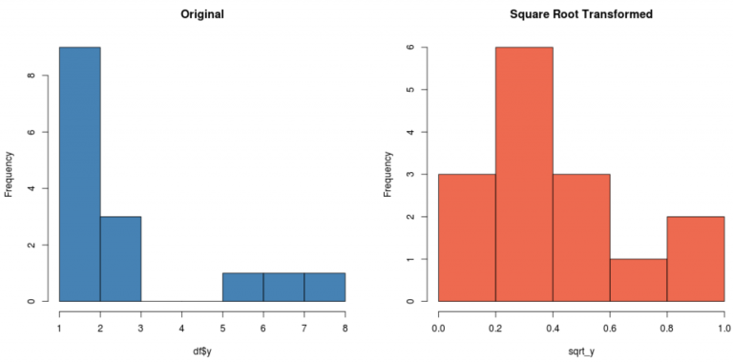
Time Series Decomposition
Performing a
Square root
transform in R
Transformations and Adjustments
Performing a Square Root Transform In R Using The R sqrt() function

Slide 5
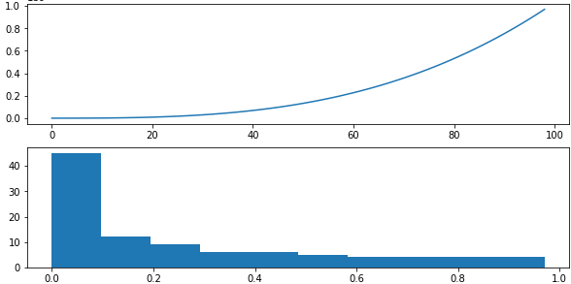
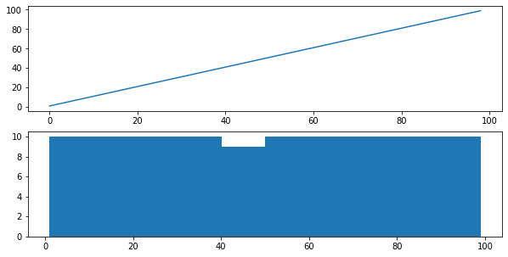
Time Series Decomposition
Cube Root
Transformations
Transformation and Adjustment Types
B. Cube root -> (𝑥)^{1/3}
Used to make a time series with a cubic growth trend linear by transforming the data to its cube root.
Before Cube Root transformation. After Cube Root transformation.

Slide 6
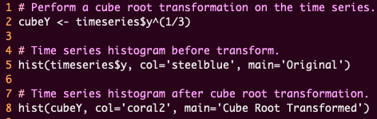
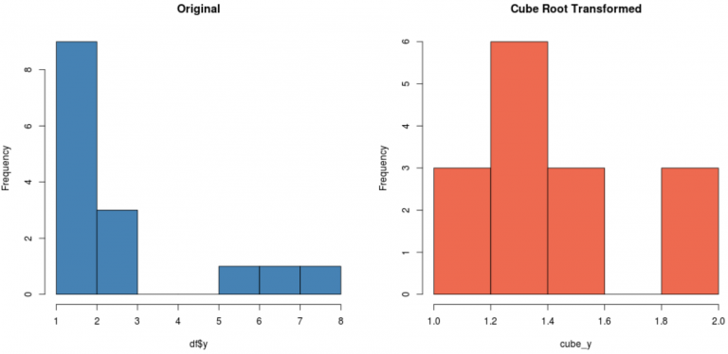
Time Series Decomposition
Performing a
Cube root
transform in R
Transformations and Adjustments
Performing a Cube Root Transform In R

Slide 7
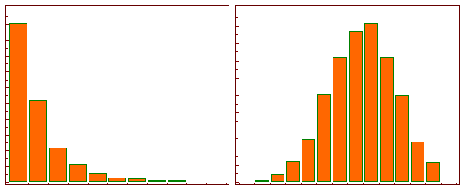
Time Series Decomposition
Log
Transformations
Transformation and Adjustment
C. Log -> log(𝑥)
A log transform will transform skewed data to approximately conform to normality.
Before Logarithmic Transformation. After Logarithmic Transformation.

Slide 8
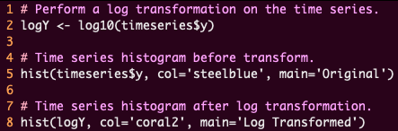
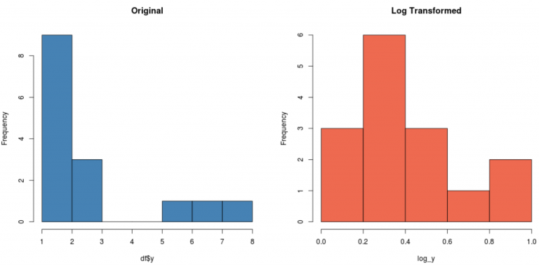
Time Series Decomposition
Performing a
Log
transform in R
Transformations and Adjustments
Performing a Log Transform In R

Slide 9
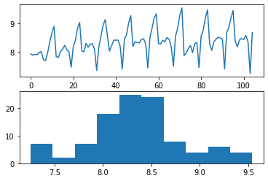
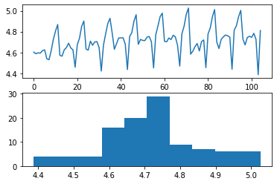
Time Series Decomposition
Box Cox
Transformations
Transformation and Adjustment
D. Box Cox
Used to identify the ideal Lambda needed to normalize the time series. The Lambda value indicates the power to which all data should be raised.
Manual Log transformation with Lambda set to 0 . Box Cox transformation with selected ideal Lambda value of -0.152542.

Slide 10

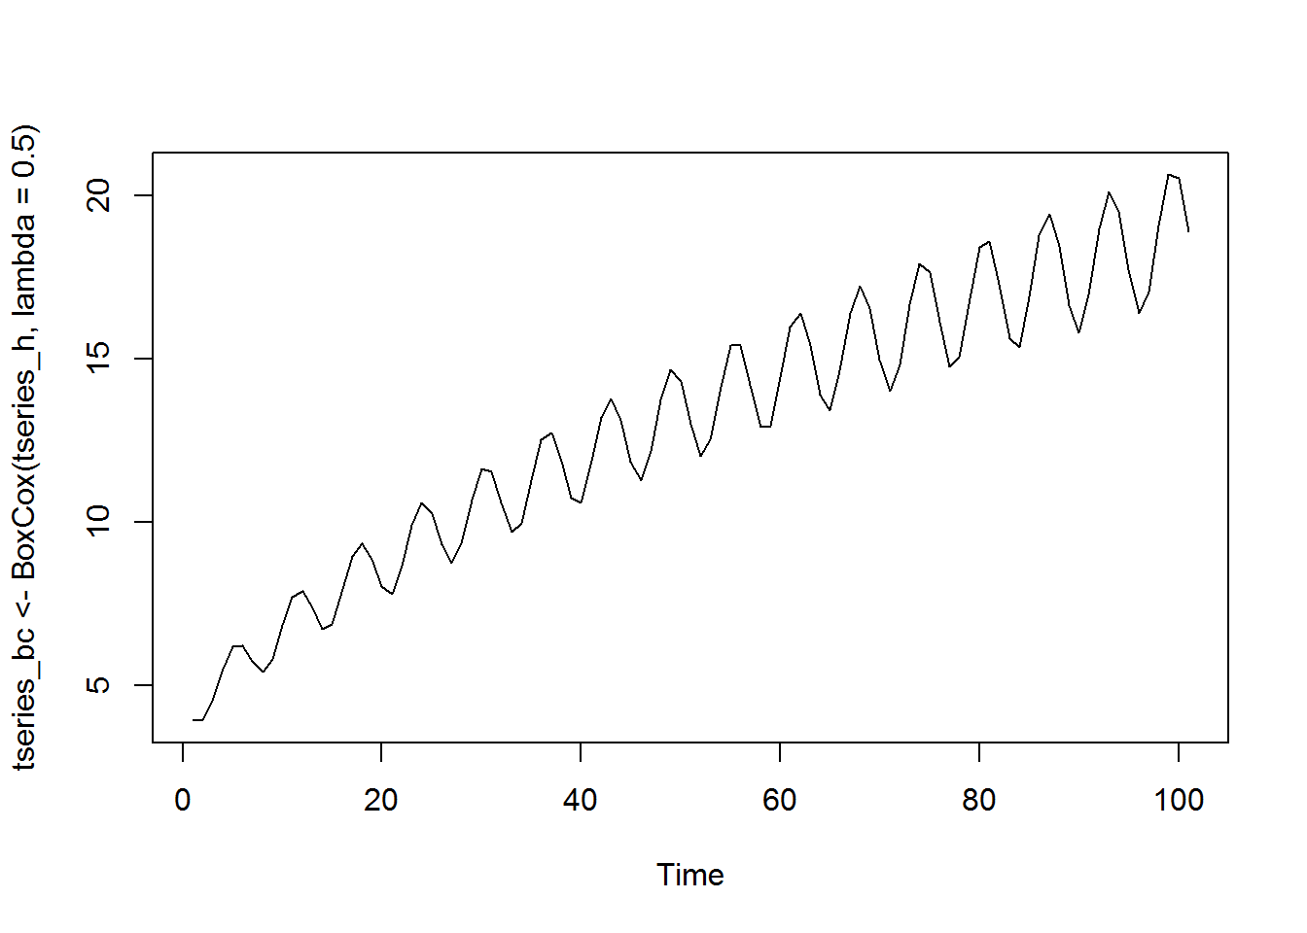
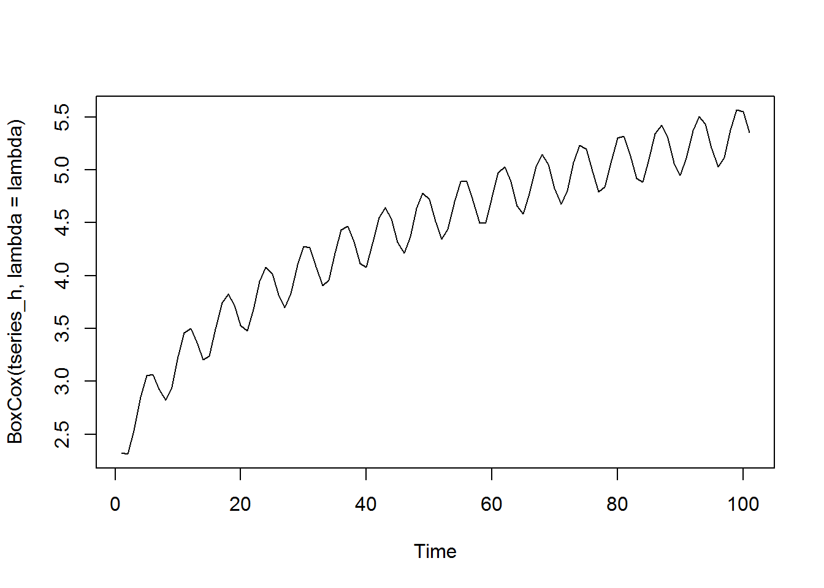
Time Series Decomposition
Performing a
Box Cox
transform in R
Transformations and Adjustments
Performing a Box Cox Adjustment In R Using The Forecast Package
The forecast package provides the BoxCox() function for performing Box Cox transformations.
Lambda value can be defined, or if undefined, the function will provide the optimal lambda value.
Defining a lambda value of 0.5 generates the following plot: Allowing the function to select the optimal lambda value (0.055) produces:

Slide 11
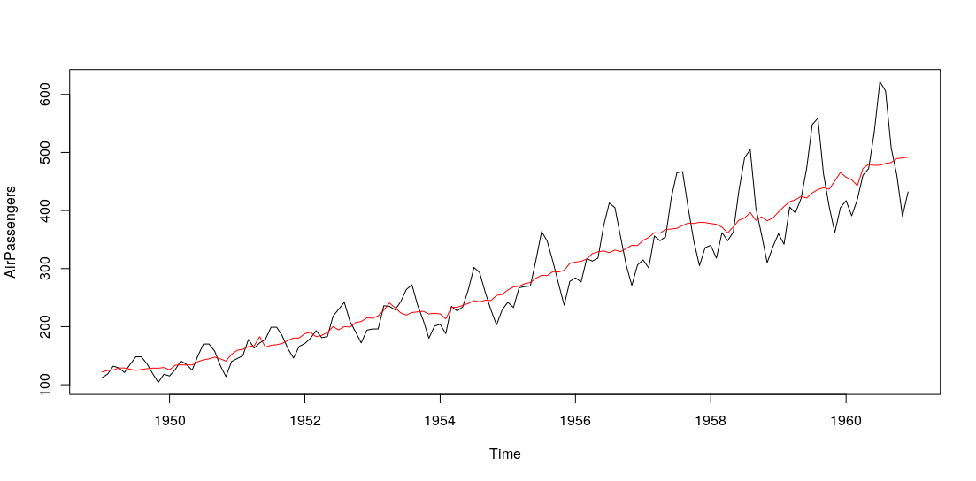
Time Series Decomposition
Seasonal
Adjustments
Transformation and Adjustment
Seasonal Adjustments
Used to remove seasonal variations (cycles that repeat regularly over time) from a time series.
Depending on the type of time series, seasonal variations may include:
Seasons (summer, winter, etc.)
Holidays such as Christmas, Thanksgiving, etc. (retail based time series)
University graduations (job market based time series)
Animal migration and hibernation (wildlife based time series)

Slide 12
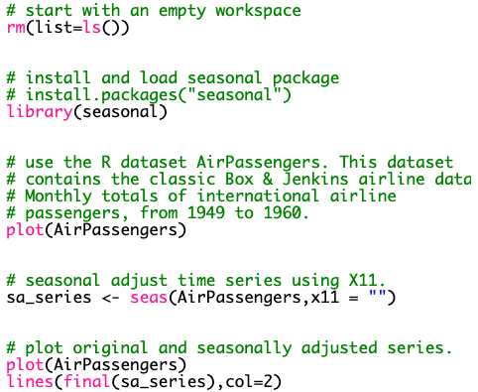
Time Series Decomposition
Performing a
Seasonal
Adjustment
In R
Transformation and Adjustment
Performing a Seasonal Adjustment In R Using The Seasonal Package
The seasonal package was developed by the United States Census Bureau.
Very easy to use – call the seas() function, and your time series data is seasonally adjusted.
Uses the seats adjustment procedure by default. This can be changed to X11 by adding the X11 = “” parameter.

