Slide 1
Data624 Presentation
Jagdish Chhabria
Stephen Haslett
Time Series Decomposition

Slide 2
Time Series Decomposition
Why
Transformations?
Transformations and Adjustments
Why Make Transformation and Adjustments?

Slide 3
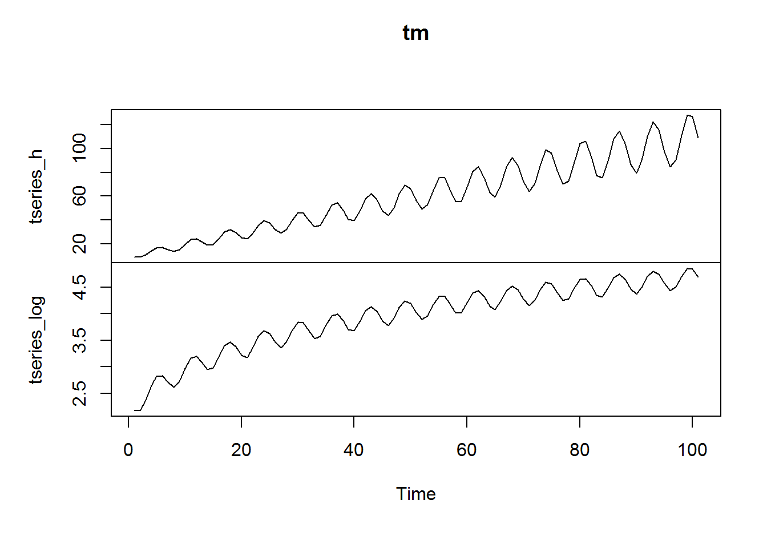
Time Series Decomposition
Mathematical
Transformations
Transformation and Adjustment Types
Mathematical Transformations
Logarithmic
Useful for correcting heteroskedasticity (variance gets larger over time) prior to modeling.

Slide 4
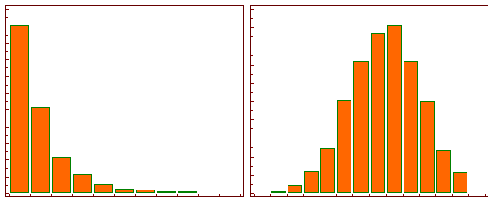
Time Series Decomposition
Mathematical
Transformations
Transformation and Adjustment Types
Logarithmic
Useful for normalizing data.
A log transform will transform skewed data to approximately conform to normality.
Before Logarithmic Transformation After Logarithmic Transformation

Slide 5
Time Series Decomposition
Mathematical
Transformations
Transformation and Adjustment Types
Power (x√,x3)
Some text.
Inverse
(Before Logarithmic Transformation) (After Logarithmic Transformation)

Slide 6
Time Series Decomposition
Calendar
Adjustments
Transformation and Adjustment Types
Calendar Adjustments
Logarithmic
Some text.
Power (x√,x3)
Some text.
Inverse

Slide 7
Time Series Decomposition
Population
Adjustments
Transformation and Adjustment Types
Population Adjustments
Logarithmic
Some text.
Power (x√,x3)
Some text.
Inverse

Slide 8
Time Series Decomposition
Inflation
Adjustments
Transformation and Adjustment Types
Inflation Adjustments
Logarithmic
Some text.
Power (x√,x3)
Some text.
Inverse

