Slide 1
Context Aware Recommender Systems (CARS)
Stephen Haslett
Data 612 – Recommender Systems in Context

Slide 2
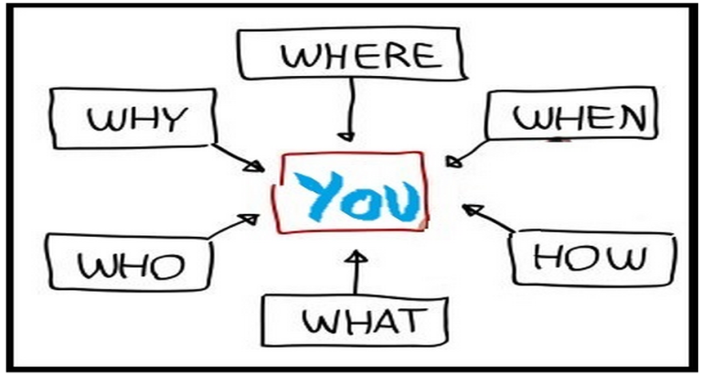
What is Context?
Context
Context consists of a number of components:
Who
Who is the person experiencing the item with?
Where
Where are they experiencing the item?
When
When are they experiencing the item?
Why
Why are they experiencing the item?
How
How are they experiencing the item?

Slide 3
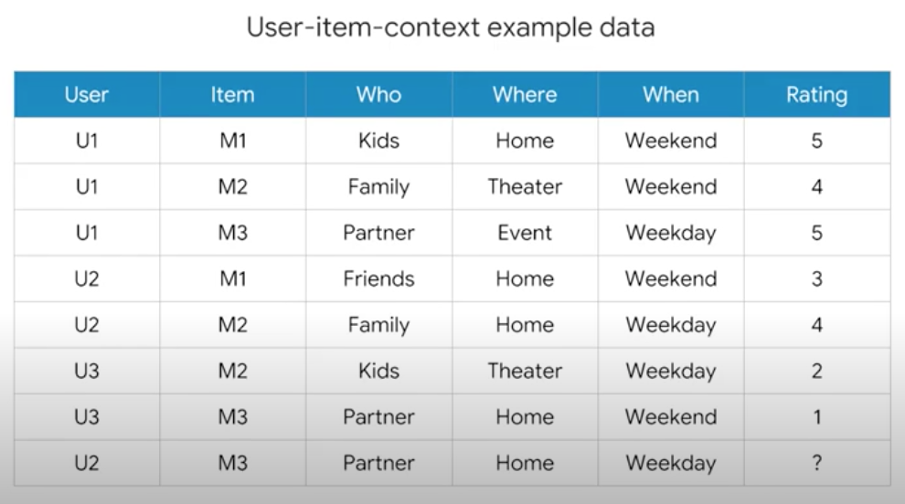
Context-aware Recommendation Systems (CARS)
CARS
What are CARS and how are they different from traditional recommendation systems?
Traditional recommendation systems
Users x Items -> Ratings
Context-aware recommendation systems
Users x Items x Contexts -> Ratings

Slide 4

The Technical Stuff
R Packages
Main R packages used in this project:
jsonlite (For pulling data in from NYC OpenData’s JSON endpoints)
kableExtra (For making ugly R tables look pretty)
prettydoc (For making HTML documents look pretty)
tidyverse (For pretty much everything else)
ggplot (Data plots)
dplyr (Data manipulation)

Slide 5

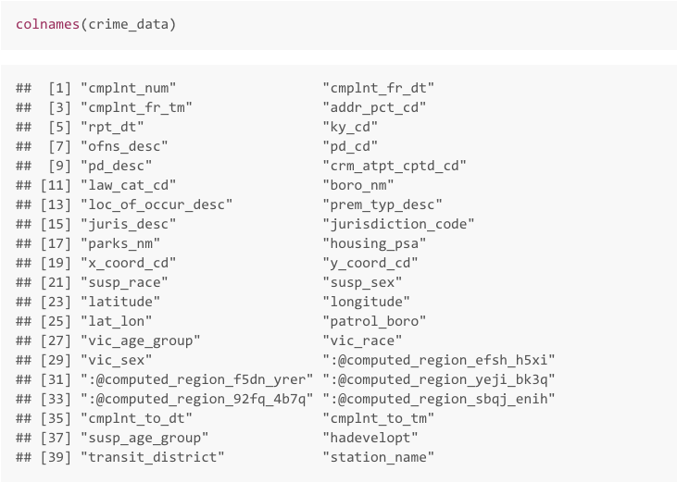
Cleaning The Data
Part 1
Take What You Need, Leave the Rest.
The original arrest info dataset had a lot of columns we didn't need,
So we dropped them.

Slide 6

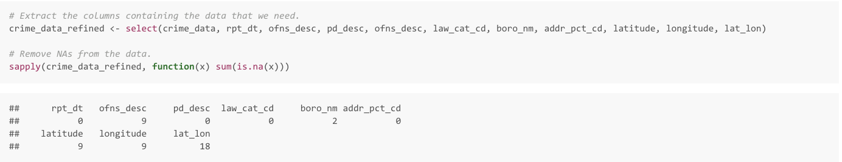
Cleaning The Data ..
Part 2
Used “select()” to grab the columns that we needed ->

Slide 7
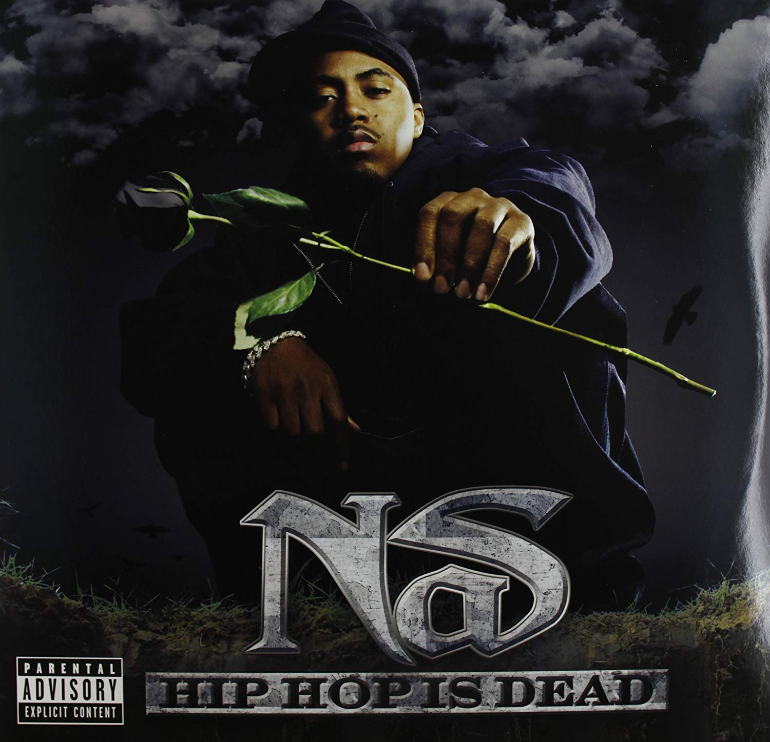
Cleaning The Data …
Part 3
Got rid of NAs, and ended up with a clean dataset.

Slide 8
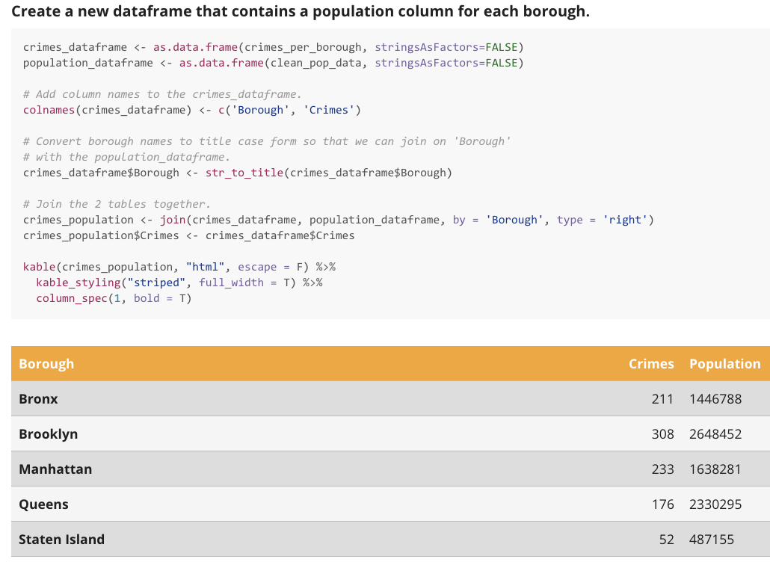
Joining with The Population Dataset
Joins
Merged the Population and Crime Data tables
together with the help of the Dplry package.

Slide 9
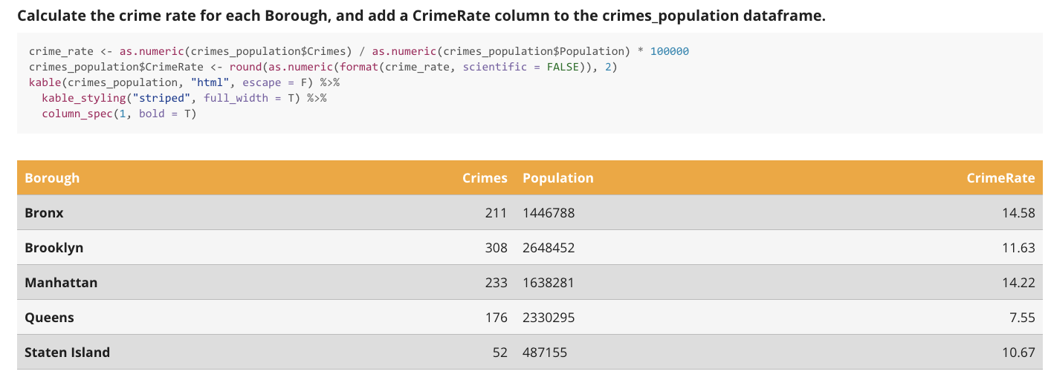
Calculating the Crime Rate
Data

Slide 10
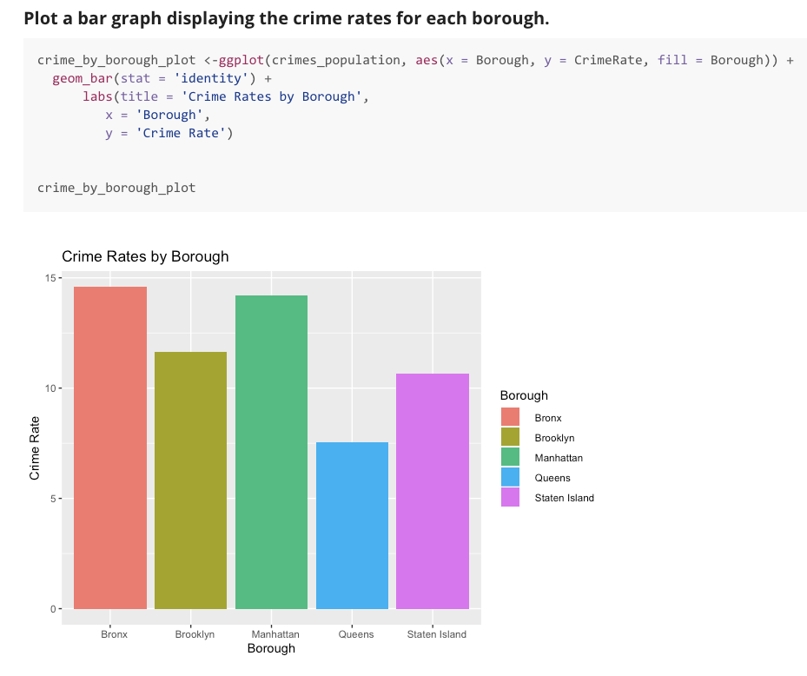
Crime Rate per Borough Bar Graph
Data Analysis
The highest amount of arrests occur in the
Bronx, followed by Manhattan and Brooklyn.
The least amount of arrests occur in Queens,
followed by Staten Island.

Slide 11
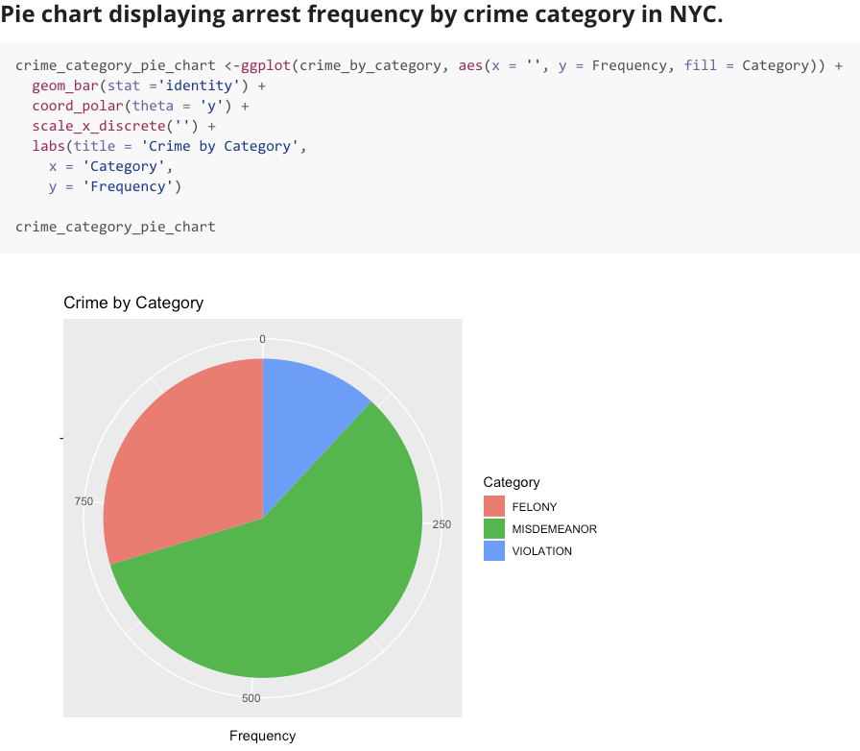
Arrest Frequency by Crime Category
Data Analysis
Over half of all arrests in NYC are for misdemeanor offences (crimes such as petty theft, disorderly conduct, public intoxication, assault, etc.).
Just under half as many felony arrests were made (crimes such as murder, burglary, arson, etc.), and the remainder of arrests were for violations (disorderly conduct, loitering, etc.).
The low level of violation arrests is not surprising as these are low level crimes which rarely result in arrest.
These statistics make sense as felonies are less likely crimes, misdemeanors are less serious crimes, but often result in arrest, and violations rarely lead to arrest.

Slide 12
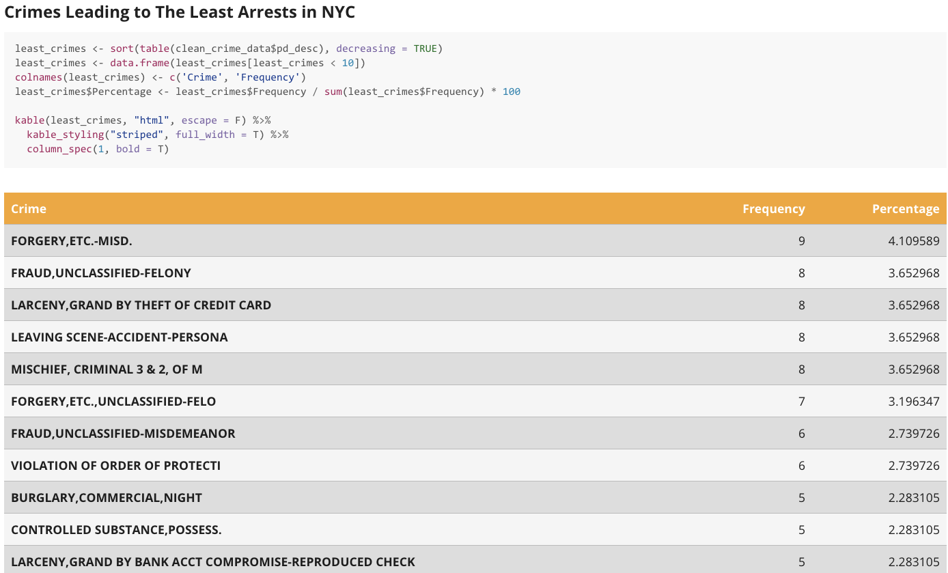
Crimes Leading to The Least Arrests
Data Analysis
Finally, I wanted to look at the crimes that lead to the least amount of arrests in NYC. It is interesting that these are all low level crimes. This would suggest that they are crimes that people rarely get arrested for, or that they are so low level that people rarely report these crimes.

Slide 13
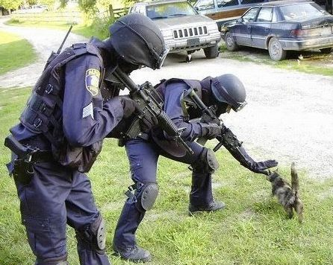
Conclusion
Conclusion
The number of arrests for low level crimes are consistently low throughout this report. This would suggest that such crimes often go unreported, or they are so low level that they do
not warrant arrest.
The fact that misdemeanors lead to the most arrests is of no surprise. Such crimes are low level,but they lead to arrest. The fact that they are low level probably means people are more likely to commit these crimes with little effort to hide their actions.
When it comes to safe boroughs in New York, it appears that Queens is the safest borough,
followed by Staten Island. The most dangerous borough is the Bronx, followed by Manhattan.
I would not have expected Manhattan to have a high crime rate, so given more time,
this would have been an interesting point to explore further. Either there are interesting reasons for this lurking below the surface, or the data is somehow skewed.

