Slide 1
Context Aware Recommender Systems (CARS)
Stephen Haslett
Data 612 – Recommender Systems in Context

Slide 2
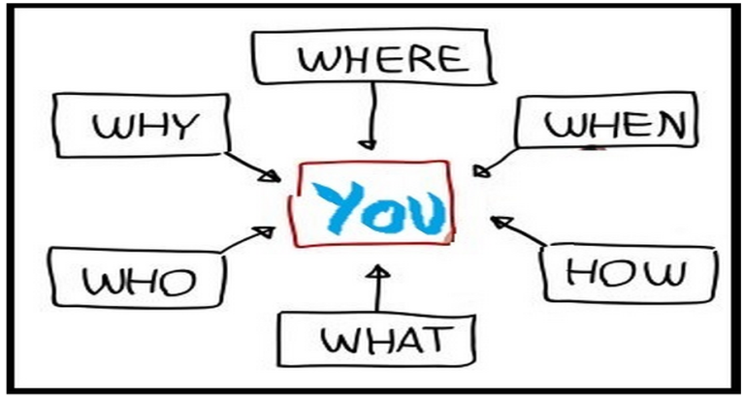
What is Context?
Context
Context consists of a number of components:
Who
Who is the person experiencing the item with?
Where
Where are they experiencing the item?
When
When are they experiencing the item?
Why
Why are they experiencing the item?
How
How are they experiencing the item?

Slide 3
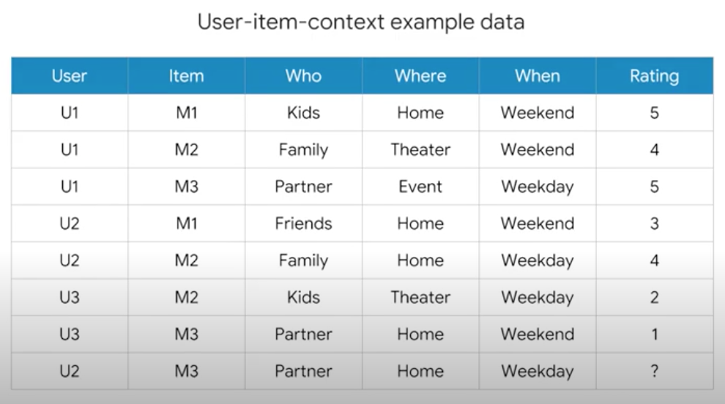
Context-aware Recommendation Systems (CARS)
CARS
What are CARS and how are they different from traditional recommendation systems?
Traditional recommendation systems
Users x Items -> Ratings
Context-aware recommendation systems
Users x Items x Contexts -> Ratings

Slide 4
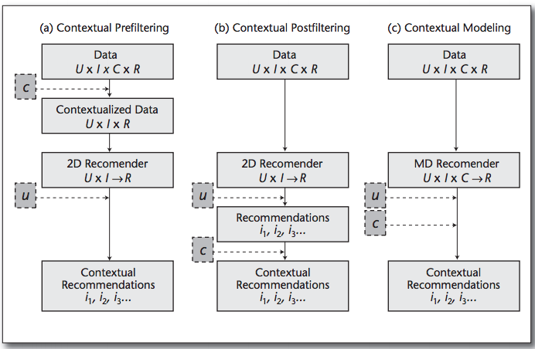
CARS Paradigms
Paradigms
CARS utilize 3 paradigms to incorporate context into recommendations:
Contextual Prefiltering Items that do not match the specified context are removed from the dataset. For example, if a user wants to watch a movie on the weekend, all weekday movies will be removed from the dataset.
Contextual Postfiltering Contextual information is initially ignored, and the ratings are predicted using traditional recommender system algorithms. The recommendations are then adjusted for each user using the contextual information.
Contextual Modeling Uses contextual information directly in the recommendation function as an explicit predictor of a user’s rating for an item.

Slide 5

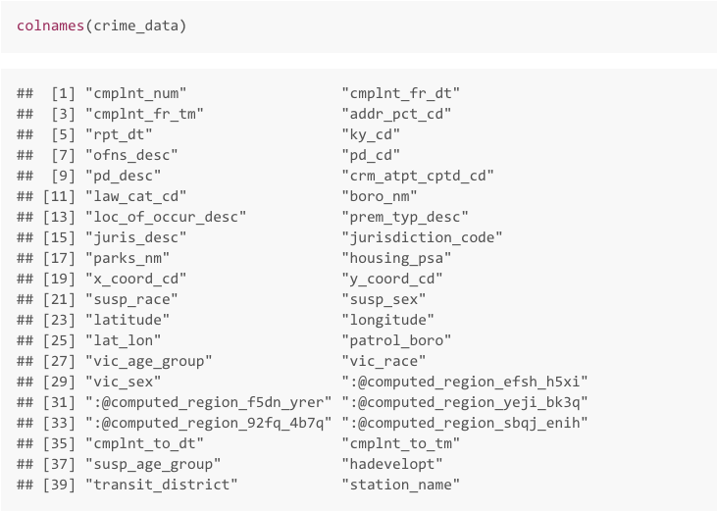
Possible Applications for CARS
Applications
Take What You Need, Leave the Rest.
The original arrest info dataset had a lot of columns we didn't need,
So we dropped them.

Slide 6
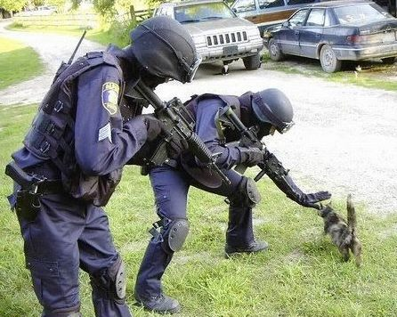
Conclusion
Conclusion
The number of arrests for low level crimes are consistently low throughout this report. This would suggest that such crimes often go unreported, or they are so low level that they do
not warrant arrest.
The fact that misdemeanors lead to the most arrests is of no surprise. Such crimes are low level,but they lead to arrest. The fact that they are low level probably means people are more likely to commit these crimes with little effort to hide their actions.
When it comes to safe boroughs in New York, it appears that Queens is the safest borough,
followed by Staten Island. The most dangerous borough is the Bronx, followed by Manhattan.
I would not have expected Manhattan to have a high crime rate, so given more time,
this would have been an interesting point to explore further. Either there are interesting reasons for this lurking below the surface, or the data is somehow skewed.

