Slide 1
Context Aware Recommender Systems (CARS)
Stephen Haslett
Data 612 – Recommender Systems in Context

Slide 2
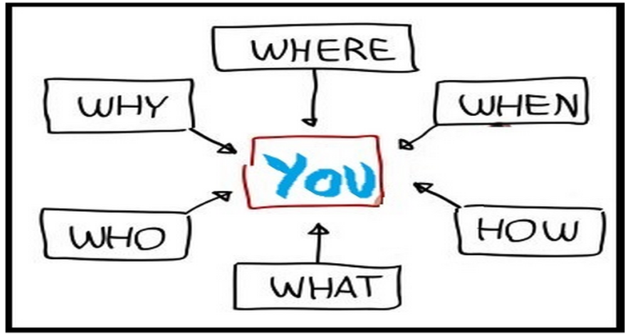
What is Context?
Context
Context consists of a number of components:
Who
Who is the person experiencing the item with?
Where
Where are they experiencing the item?
When
When are they experiencing the item?
Why
Why are they experiencing the item?
How
How are they experiencing the item?

Slide 3
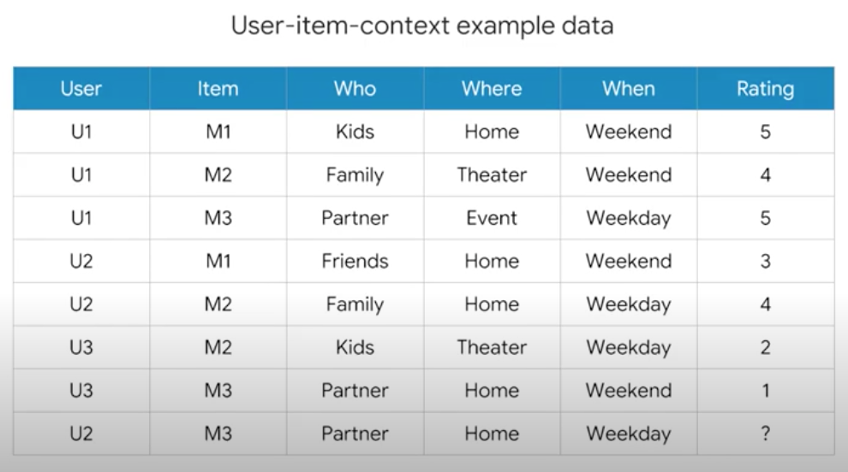
Context-aware Recommendation Systems (CARS)
CARS
What are CARS and how are they different from traditional recommendation systems?
Traditional recommendation systems
Users x Items -> Ratings
Context-aware recommendation systems
Users x Items x Contexts -> Ratings

Slide 4
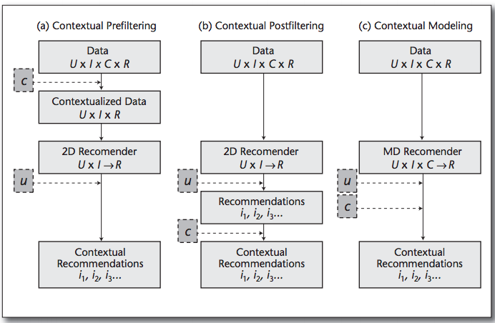
CARS Paradigms
Paradigms
CARS utilize 3 paradigms to incorporate context into recommendations:
Contextual Prefiltering Items that do not match the specified context are removed from the dataset. For example, if a user wants to watch a movie on the weekend, all weekday movies will be removed from the dataset.
Contextual Postfiltering Contextual information is initially ignored, and the ratings are predicted using traditional recommender system algorithms. The recommendations are then adjusted for each user using the contextual information.
Contextual Modeling Uses contextual information directly in the recommendation function as an explicit predictor of a user’s rating for an item.

Slide 5

CARS Applications
Applications
Travel Guides
Music Recommender Systems

Slide 6

Further Reading
Reading
Context-Aware Recommender Systems AI Magazine - https://www.aaai.org/ojs/index.php/aimagazine/article/view/2364
2.2.1. Context-Aware Recommendation Systems AI First - https://www.youtube.com/watch?v=TBg9FSAb8zw&t=15s
2.2.2 Context-Aware Algorithms AI First - https://www.youtube.com/watch?v=HoScjz-ymL8&t=4s

