Slide 1
Question 1
Given the worst case, every partition would result in one sub-array containing one element, and another sub-array containing the remaining elements. The algorithm will continue partitioning until left with two elements where it no longer will need to traverse the sub-array. This results in a formula of the form:
n + (n - 1) + (n - 2) + ... + 3 + 2
which simplifies to
[n * (n + 1)] / 2 – 1
and is simply O(n²).

Slide 2
Question 2
An example of the worst case would be an already sorted list and an implementation of quick sort that takes the pivot from the lower index.
[0, 1, 2, 3, 4, 5, 6, 7, 8, 9, 10, 11, 12, 13, 14, 15]

Slide 3
Question 2
0 | 1 | 2 | 3 | 4 | 5 | 6 | 7 | 8 | 9 | 10 | 11 | 12 | 13 | 14 | 15

Slide 4
Question 2
Left ptr
Right ptr
Pivot: 0
0 | 1 | 2 | 3 | 4 | 5 | 6 | 7 | 8 | 9 | 10 | 11 | 12 | 13 | 14 | 15

Slide 5
Question 2
Left ptr
Right ptr
Pivot: 0
0 | 1 | 2 | 3 | 4 | 5 | 6 | 7 | 8 | 9 | 10 | 11 | 12 | 13 | 14 | 15

Slide 6
Question 2
Left ptr
Right ptr
Pivot: 0
0 | 1 | 2 | 3 | 4 | 5 | 6 | 7 | 8 | 9 | 10 | 11 | 12 | 13 | 14 | 15

Slide 7
Question 2
Left ptr
Right ptr
Pivot: 0
0 | 1 | 2 | 3 | 4 | 5 | 6 | 7 | 8 | 9 | 10 | 11 | 12 | 13 | 14 | 15

Slide 8
Question 2
Left ptr
Right ptr
Pivot: 0
0 | 1 | 2 | 3 | 4 | 5 | 6 | 7 | 8 | 9 | 10 | 11 | 12 | 13 | 14 | 15

Slide 9
Question 2
Left ptr
Right ptr
Pivot: 0
0 | 1 | 2 | 3 | 4 | 5 | 6 | 7 | 8 | 9 | 10 | 11 | 12 | 13 | 14 | 15

Slide 10
Question 2
Left ptr
Right ptr
Pivot: 0
0 | 1 | 2 | 3 | 4 | 5 | 6 | 7 | 8 | 9 | 10 | 11 | 12 | 13 | 14 | 15

Slide 11
Question 2
Left ptr
Right ptr
Pivot: 0
0 | 1 | 2 | 3 | 4 | 5 | 6 | 7 | 8 | 9 | 10 | 11 | 12 | 13 | 14 | 15

Slide 12
Question 2
Left ptr
Right ptr
Pivot: 0
0 | 1 | 2 | 3 | 4 | 5 | 6 | 7 | 8 | 9 | 10 | 11 | 12 | 13 | 14 | 15

Slide 13
Question 2
Left ptr
Right ptr
Pivot: 0
0 | 1 | 2 | 3 | 4 | 5 | 6 | 7 | 8 | 9 | 10 | 11 | 12 | 13 | 14 | 15

Slide 14
Question 2
Left ptr
Right ptr
Pivot: 0
0 | 1 | 2 | 3 | 4 | 5 | 6 | 7 | 8 | 9 | 10 | 11 | 12 | 13 | 14 | 15

Slide 15
Question 2
Left ptr
Right ptr
Pivot: 0
0 | 1 | 2 | 3 | 4 | 5 | 6 | 7 | 8 | 9 | 10 | 11 | 12 | 13 | 14 | 15

Slide 16
Question 2
Left ptr
Right ptr
Pivot: 0
0 | 1 | 2 | 3 | 4 | 5 | 6 | 7 | 8 | 9 | 10 | 11 | 12 | 13 | 14 | 15

Slide 17
Question 2
Left ptr
Right ptr
Pivot: 0
0 | 1 | 2 | 3 | 4 | 5 | 6 | 7 | 8 | 9 | 10 | 11 | 12 | 13 | 14 | 15

Slide 18
Question 2
Left ptr
Right ptr
Pivot: 0
0 | 1 | 2 | 3 | 4 | 5 | 6 | 7 | 8 | 9 | 10 | 11 | 12 | 13 | 14 | 15

Slide 19
Question 2
Left ptr
Right ptr
Pivot: 0
0 | 1 | 2 | 3 | 4 | 5 | 6 | 7 | 8 | 9 | 10 | 11 | 12 | 13 | 14 | 15
N operations
operations = comparison/insertion/swap

Slide 20
Question 2
Left ptr
Right ptr
Pivot: 1
0 | 1 | 2 | 3 | 4 | 5 | 6 | 7 | 8 | 9 | 10 | 11 | 12 | 13 | 14 | 15
N ops
0
1 | 2 | 3 | 4 | 5 | 6 | 7 | 8 | 9 | 10 | 11 | 12 | 13 | 14 | 15
N - 1 ops

Slide 21
Question 2
Left ptr
Right ptr
Pivot: 1
0 | 1 | 2 | 3 | 4 | 5 | 6 | 7 | 8 | 9 | 10 | 11 | 12 | 13 | 14 | 15
N ops
0
1 | 2 | 3 | 4 | 5 | 6 | 7 | 8 | 9 | 10 | 11 | 12 | 13 | 14 | 15
N - 1 ops
0
1
2 | 3 | 4 | 5 | 6 | 7 | 8 | 9 | 10 | 11 | 12 | 13 | 14 | 15
N - 2 ops

Slide 22
Question 2
Left ptr
Right ptr
Pivot: 1
0 | 1 | 2 | 3 | 4 | 5 | 6 | 7 | 8 | 9 | 10 | 11 | 12 | 13 | 14 | 15
N ops
0
1 | 2 | 3 | 4 | 5 | 6 | 7 | 8 | 9 | 10 | 11 | 12 | 13 | 14 | 15
N - 1 ops
0
1
2 | 3 | 4 | 5 | 6 | 7 | 8 | 9 | 10 | 11 | 12 | 13 | 14 | 15
N - 2 ops
...
...
2 ops
14 | 15

Slide 23
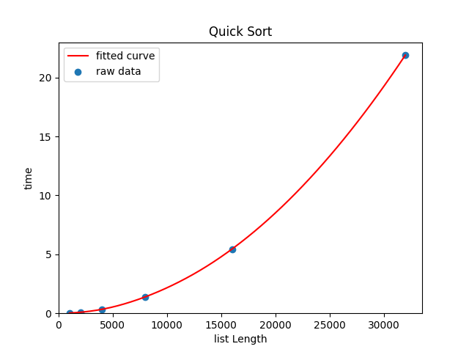
Question 4
The plot displays a quadratic function, inline with what we expect of O(n²).

